Slide 1
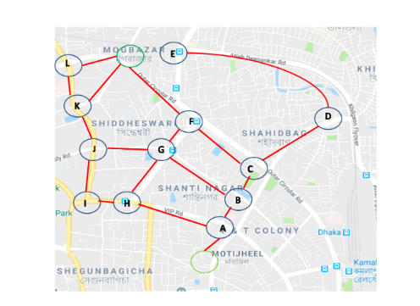

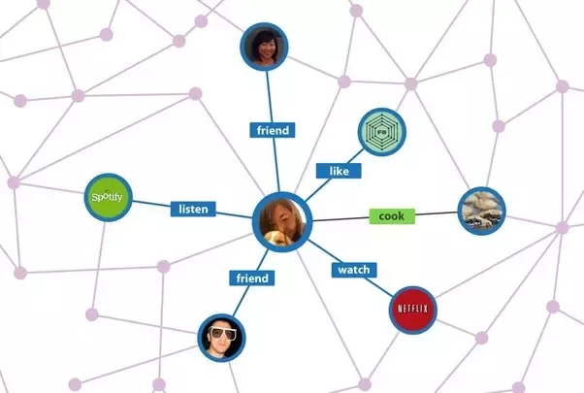

What is Graph Theory ?
Graph theory, as a subfield of computer science and mathematics, is used to model pairwise relations between objects.
Graph Theory has many real world applications:
Google maps
Internet
Social graph
A Graph is a collection of vertices (or nodes ) connected by edges.
B
O
I
II
P
R
G
III
V
This graph has
6 nodes
9 edges
and it divides the plane into
5 regions
IV
Y
Draw your own graph

Slide 2
Introduction to Graphs
Formally Definition of a Graph: G=(V,E) where
V is a set of nodes
E is a set of edges
Edges
Nodes
Undirected graph
directed graph
Path between A and C
is in both directions
Only path from A to D
A
A
D
B
B
C
C
D
V={A,B,C,D}
E={(A,D),(A,C),(B,A),(C,B),(D,C)}
V={A,B,C,D}
E={{A,B},{A,C},{B,C},{B,D},{C,D}}
adjacent Nodes:
Degree of a node: number of adjacent nodes
Share a common edge
C
„neighbors“
A
Degree of node A is 2
B

Slide 3
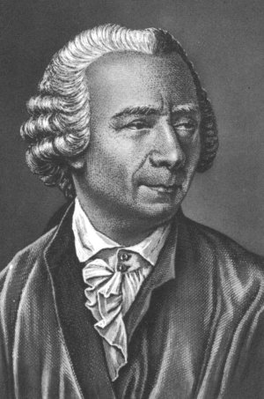
Planar Graphs
I
II
1
2
Without any edges crossing
1
2
III
3
4
IV
4
3
Euler Characteristic
The mathematician Leonard Euler noticed something very remarkable when he calculated:
Leonhard Euler
(1707-1783)
V
E
R
number of
vertices
-
number of
edges
+
number of
regions
Vertices: _______
Edges: _______
Regions: _______
B
P
V
E
R
G
-
+
=
___
This number is known as the Euler Characteristic

Slide 4






Social Graph
Nodes are the people, and edges represent friendships between them.
Carol
Bea
Elisa
E=
Bob
Lisa
Eric
V=
Draw the following social graph:
Bob is a friend of Carol and Sara
Sara is a friend of Paul and Darcy
Noah is a friend of Bob, Ben, and Carol
Darcy is a friend of Eric, Sara and Kate
Kate is a friend of Eric

Slide 5
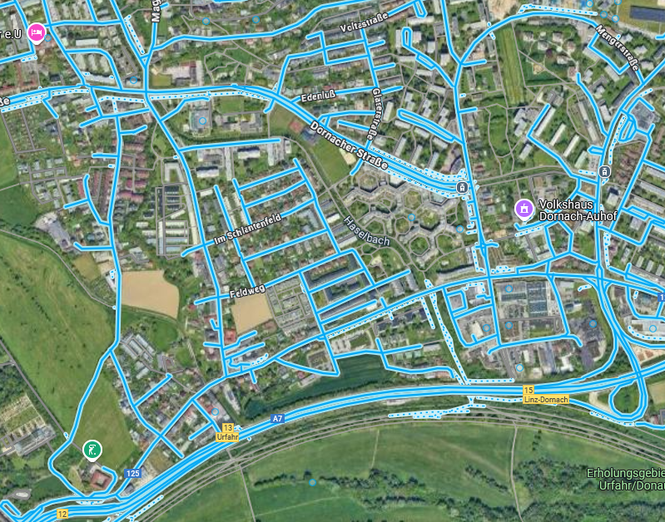
How does the Nav think?
Try it out for yourself
19
F
B
14
D
16
5
12
12
24
E
C
8
The Problem: What‘s the shortest way from point A to F.
A
How many ways are there from A to F?
Another example from point a to d?
6
b
2
 | current | processed | a | b | c | d
0
1
2
3
4
a
2
d
3
c
5

Slide 6
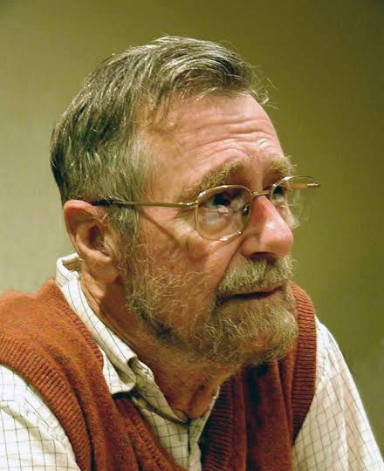
How does the Nav think?
The Dijkstra’s algorithm finds the shortest path by always moving to the closest unvisited node.
While nodes to process
Take node (=current node) that is nearest to starting node
From the current node check each of its neighbors (which are not processed):
Calculate distance for the neibghoring nodes (= distance to current node + distance to neighbor)
If new distance is less than known distance, update the shortest distance (= set to new distance) and previous node(= set to current node)
Mark current node as processed

Slide 7
s | p
6
b
2
 | current | processed | a | b | c | d
0 |  |  | 0 | ∞ | ∞ | ∞
1 | a | a | 0 | 6 | 3 | ∞
2 | c | a,c | 0 | 5 | 3 | 8
3 | b | a,c,b | 0 | 5 | 3 | 7
4 | d | a,c,b,d
a
2
d
s | p
s | p
0 | -
3
c
5
s | p
s | p
6 | a
6
b
2
a
2
d
s | p
s | p
0 | -
3
c
5
s | p
3 | a
s | p
5 | c
6
b
2
a
2
d
s | p
8 | c
s | p
0 | -
3
c
5
s | p
3 | a
s | p
5 | c
6
b
2
a
2
d
s | p
7 | b
s | p
0 | -
3
c
5
s | p
3 | a
6
b
2
a
2
d
3
c
5

Slide 8
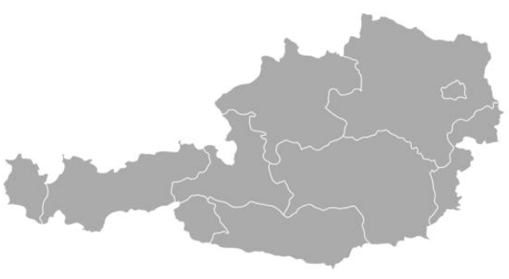
How does the Nav think?
Search the Internet for the current train connections in the federal states of Austria.
Draw a graph with at least all the federal capitals.
Determine the shortest route from Eisenstadt to Bregenz using Dijkstra's algorithm.

Slide 9
´Linz
99
66
Wien
107
St. Pölten
41
Salzburg
160
146
Bregenz
138
Eisenstadt
127
198
120
Innsbruck
146
85
35
98
Graz
Lienz
Villach
Klagenfurt

Slide 10
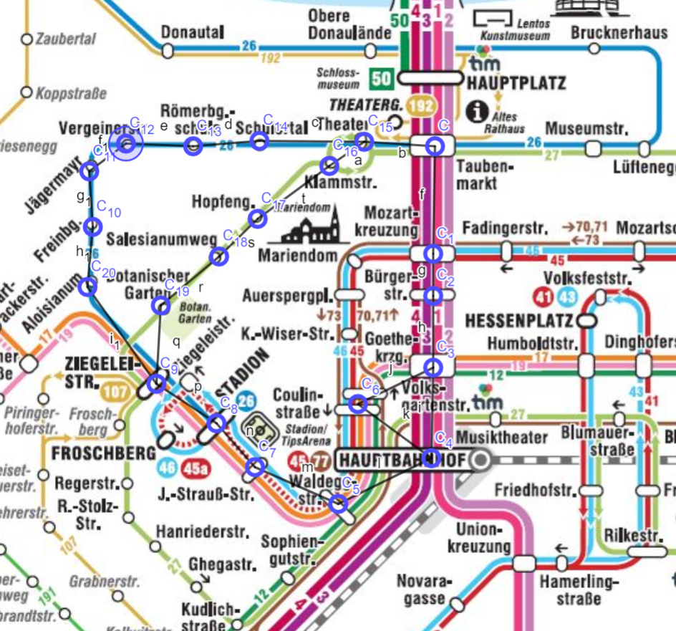
Linz

Slide 11
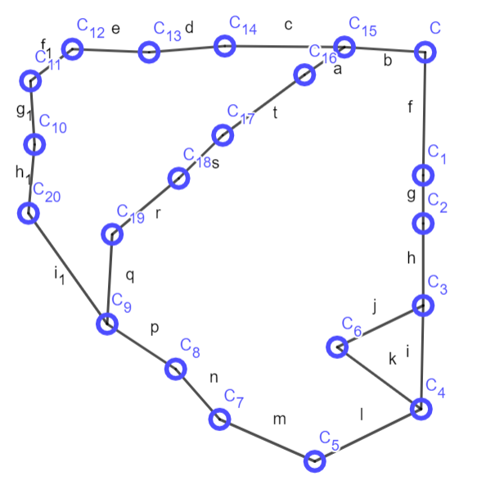
Find the shortest Path from Bürgerstr. To Ziegeleistr.

Slide 12



Edges
Nodes
A
A
A
B
D
A
C
E

Slide 13
Iter | Visited | un- visited | current | Not visited neighbors | A | B | C | D | E
0 | - | A,B,C,D,E | - |  | ∞ | ∞ | ∞ | ∞ | ∞
1 | A | B,C,D,E | A | B,C | 0
2
3
4
Iter | Visited | Not visited | current | Not visited neighbors | A | B | C | D | E
1 | -
2
3
4
5

Slide 14
While nodes to process
Take node (=current node) that is nearest to starting node
From the current node check each of its neighbors (which are not processed):
Calculate distance for the neibghoring nodes (= distance to current node + distance to neighbor)
If new distance is less than known distance, update the shortest distance (= set to new distance) and previous node(= set to current node)
Mark current node as processed

Slide 15
6
b
2
a
2
d
3
c
5
s | p
0 | -

Slide 16
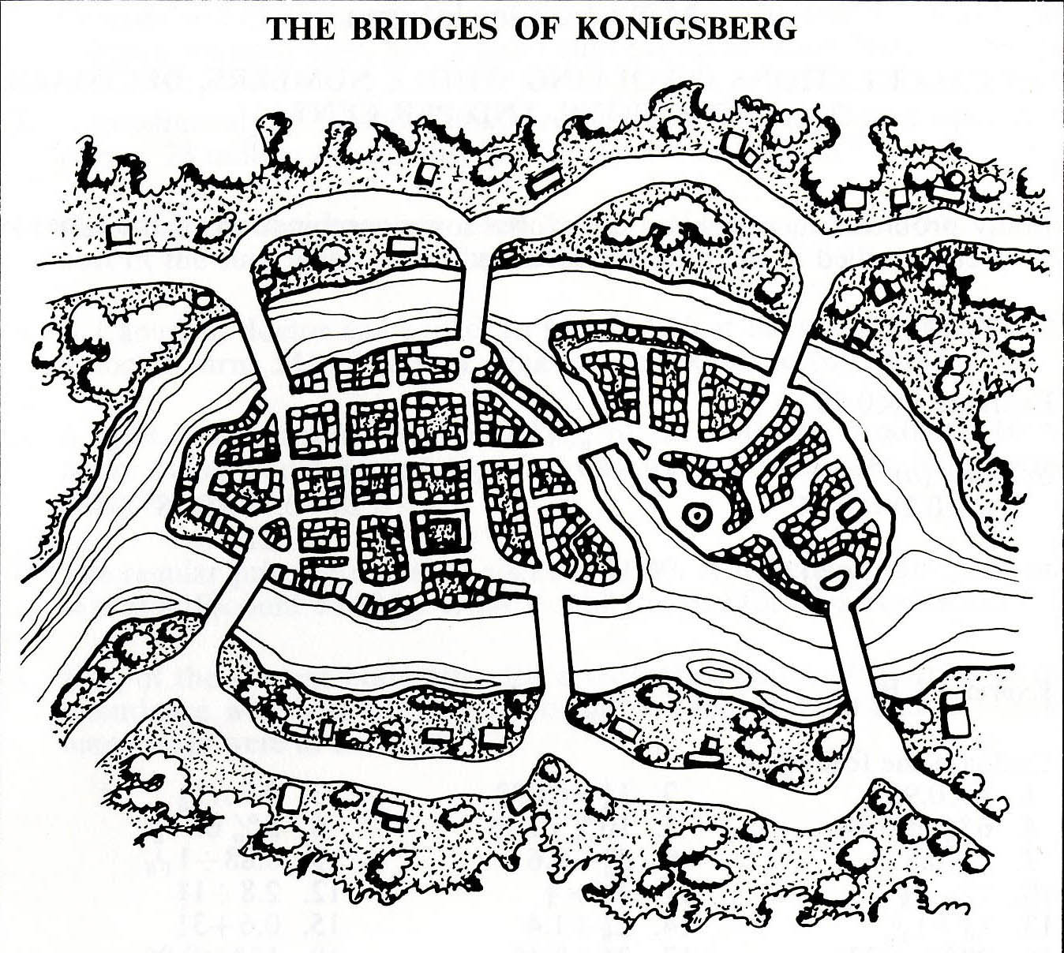

Slide 17
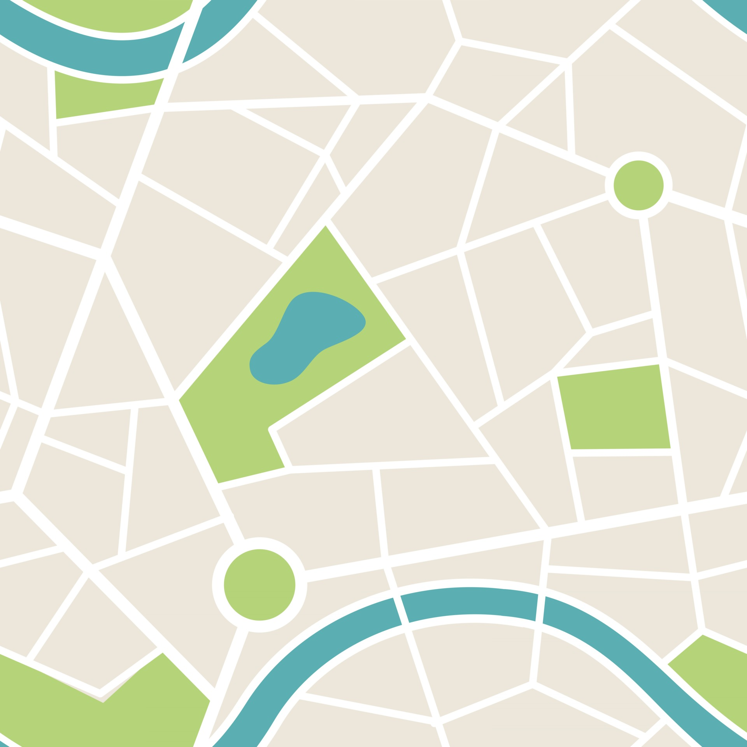
A
A
A
A
A
A

Slide 18
Graph | Nodes | Even Degree Node | Odd Degree Node | Possible
Iteration | Visited | un- visited | current | Not visited neighbors | A | B | C | D
0 | - | A,B,C,D,E | - |  | ∞ | ∞ | ∞ | ∞
1 | A | B,C,D,E | A | B,C | 0
2
3
4

