Slide 1
KNN
k=7

Slide 2


$$\frac{2}{\left\|w\right\|}$$
wx – b = -1
wx – b = 0
wx – b = 1
$$\frac{b}{\left\|w\right\|}$$

Slide 3
y
y
z
φ
x
x

Slide 4

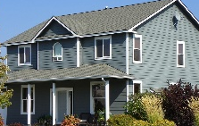


Slide 5
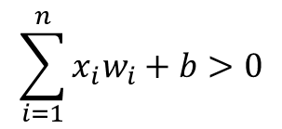
Visit a concert?
Artist is good x₁
w₁=3
w₂=5
1 Yes, 0 No
Weather is fine x₂
w₃=3
Friends come along x₃
b=-7
What is the output for x₁ = 1, x₂ = 1, x₃ = 0?
x₁
w₁
$$\sum_{i=1}^{n}{x_{i}w_{i}+b>0}$$
x₂
w₂
∑
f
w₃
x₃
w₄
x₂
b
x₄
x₁

Slide 6
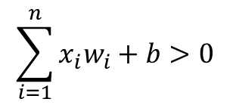
∑
f
Dendrite
x₁
w₁
$$\sum_{i=1}^{n}{x_{i}w_{i}+b>0}$$
x₂
w₂
Synaptic terminals
w₃
y
x₃
w₄
Nucleus
b
x₄
Axon

Slide 7
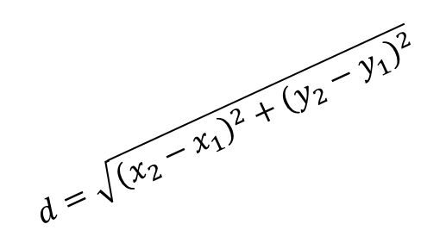
B(x₂,y₂)
$$d=\sqrt{{\left(x_{2}−x_{1}\right)}^{2}+{\left(y_{2}−y_{1}\right)}^{2}}$$
y₂-y₁
A(x₁,y₁)
x₂-x₁

Slide 8
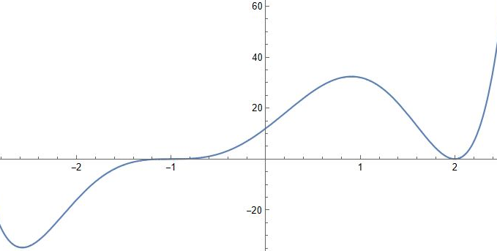

Startpoint
Minimum

Slide 9
δ_{k}
s_{i}
a_{i}
s_{k}
a_{k}
w_{ij}
s_{j}
a_{j}
s_{k}
a_{k}
w_{jk}
δ_{j}
δ_{K}
s_{k}
a_{K}

Slide 10
Which boolean function represents this perectron?
x₁
w₁=1
y
w₂=1
x₂
b=-1
Node 1
Node 3
1
a₁=1
w₁₃
Node 5
s₃
a₃
w₃₅
w₁₄
a₅=y
s₅
a₅
w₂₃
w₄₅
0.5
a₂=0.5
w₂₄
s₄
a₄
Node 2
Node 4

Slide 11
Input
Hidden
Output
∑
f
Input
Hidden
Output
x₁
w₁
w₂
∑
x₂
f
w_{n}
x_{n}

Slide 12
Initialization of the network with random weights
For each sample of the training set repeat the following steps:
Perform Forward Pass:
For each neuron, starting from input layer up to the output layer:
Compute preactivation a
Compute activation s
Perform Backward Pass:
Calculate Loss
Compute node error of output layer
Compute node error of output layer
Compute activation s

Slide 13
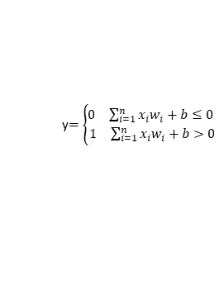
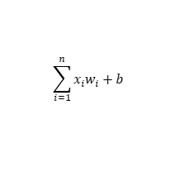
Inputs
x₁
Weights
w₁
x₂
Summation
Output
w₂
Activation
w₃
$$\sum_{i=1}^{n}{x_{i}w_{i}+b}$$
y$=\left\{\begin{aligned}\begin{matrix}0 & \sum_{i=1}^{n}{x_{i}w_{i}+b≤0}\end{matrix} \\ \begin{matrix}1 & \sum_{i=1}^{n}{x_{i}w_{i}+b>0}\end{matrix}\end{aligned}\right.$
y
x₃
…
w_{n}
b
x_{n}

Slide 14
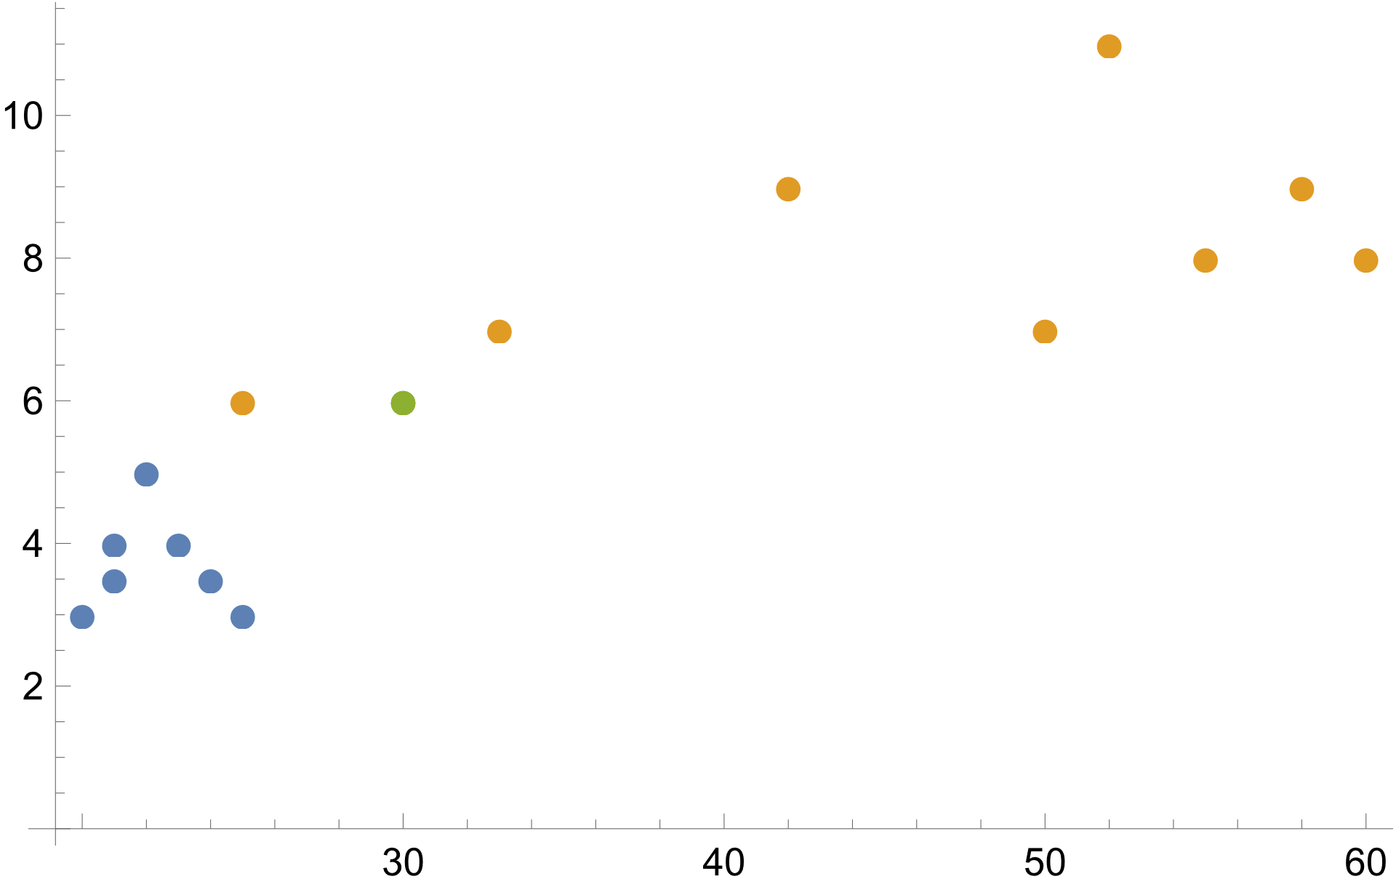

Slide 15
KNN
k=9

Slide 16
Unsupervised
Clustering
Outlier detection
Supervised
Classification
Regression
1

