Slide 1

Car Rental System

Slide 2
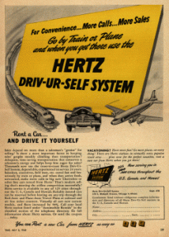
History
The rental car industry had its beginnings closely tied to Ford’s introduction of the economical Model T in 1908. In 1916, a Nebraskan named Joe Saunders was supposedly the first person to start a rent-a-car business when he lent out his Model T to traveling salesmen.

Slide 3
Table of Contents
Project Scope
Importance
ERD Diagram
Relational Schema
Data Warehouse Model.
Advantages of car rental system.
Disadvantages of car rental system.
Future Scope
Conclusion

Slide 4
Project Scope
The car rental company's web-based system is called Car Rental System "CRS".
The car rental system is specifically designed to meet the needs of car rental companies, travel agencies, and other travel-related businesses.
This system allows the company to track its services and make them publicly available online.

Slide 5
Why use Car Rental System
Car rental is one of the most reliable means of transportation in the world.
People prefer rental cars over all other modes of transportation.
Today's users can greatly benefit from car rental.
Customers can book a car after creating an account . The proposed solution is a fully integrated system.

Slide 6
Importance of Car Rentals
Most individuals these days prefer to go by automobile. We are happy when we are traveling by car with our friends or family.
Customers can view available cars, register, view profiles, and book a car via this system.
Compared to driving their own car, renting a car has several benefits.

Slide 7
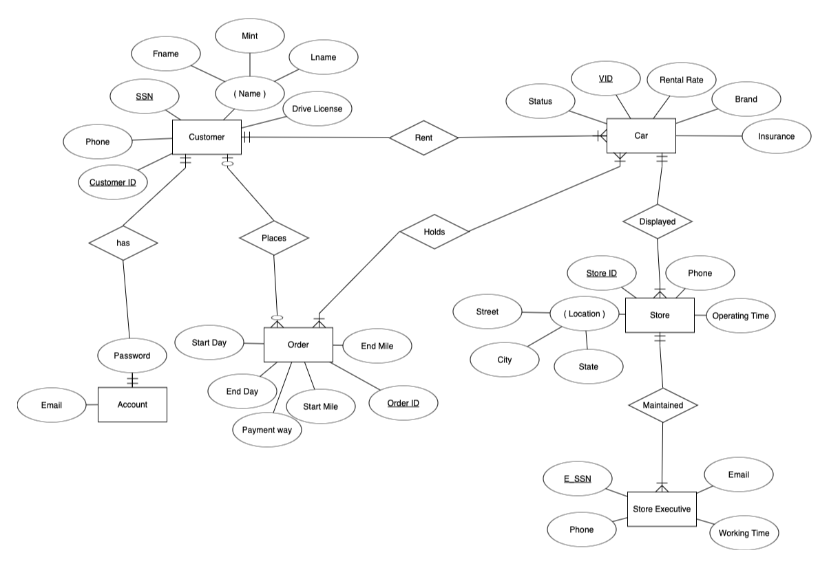
ER- DIAGRAM

Slide 8
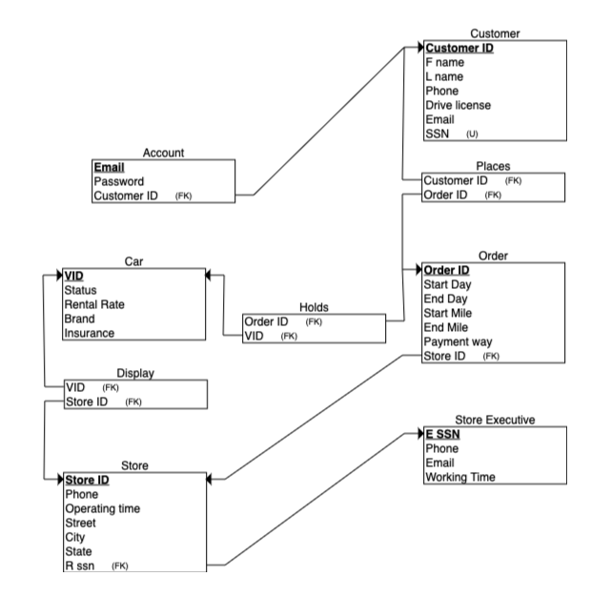
Relational Schema Diagram

Slide 9
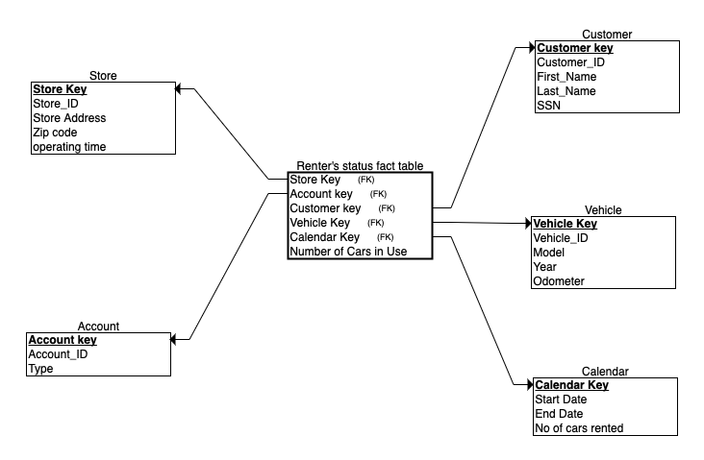
Data Warehouse Model

Slide 10
Advantages of car rental system.
Convenience & Comfort
Meets Your Need.
Flexibility & Automatic Fare Calculation
Easy to Customization and Security
Hassle-Free Reservation Management
A wide selection of vehicles.
Additional services & Round the Clock Availability

Slide 11
Disadvantages of car rental system.
Higher prices.
Strict terms.
Extra charges
Limitations

Slide 12
Future Scope
We would add an online feature to the database and an automated service.
Rental companies are now focusing on customer service, training, sales and marketing to differentiate themselves and improve customer communication. As a result, the number of customers and sales increase.

Slide 13
Conclusion
The main objective of the Car Rental System is to manage the details of Car,Payment,Customer,Supplier,Insurance. It manages all the information about Car, Booking, Insurance, Car. The project is totally built at administrative end and thus only the administrator is guaranteed the access.
The project is designed to help people utilize transport effectively. In recent times cars have become most convenient modes of transportation. Our Car rental system helps in making this an easier, hassle-free and enjoyable experience to acquire and use a car as per ones needs.

Slide 14


