Slide 1
C# Application with Entity Framework
- Nikkitha Ramesh
(based on a course on Udemy by Matt Turner, Mpire Training)

Slide 2
Goal of the application: Create an application that shows the details of a sale made by a sales person at a particular sales region.
SalesRegion: Name, Code (given for a region),Sales made in that region, SalesPerson, Active/Inactive state.
SalesPerson: Firstname, Lastname, Sales, SalesRegion, Active/Inactive state.
Sales: Amount, Date, SalesRegion, SalesPerson.

Slide 3
Entity Framework is first created. This is done by installing it from “Manage NuGet Packages” option.
Entity Framework is an open source object-relational mapping framework for ADO.NET.
ORM is defined as a technique for converting data between incompatible type systems using object-oriented programming languages. This creates, in effect, a "virtual object database" that can be used from within the programming language.

Slide 4
The models created are:
SalesRegion: Name, Code.
SalesPerson: Firstname, Lastname.
Sales: Amount, Date.
Base Model: Id, CreatedBy, CreatedDate,UpdatedBy, UpdatedDate.

Slide 5
Creating a folder named “Model” for the above mentioned 4 classes.
Apply the base model to all other models, so that all models will now have everything that is in base model.
Create interface, with ‘book Active’ in it.
-If true, item is active.
-Else, it is inactive.
SalesPerson and SalesRegion has to be active.

Slide 6
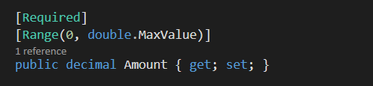
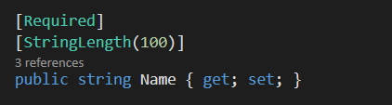
The properties are now translated to columns in database.
Data annotations are added to provide extra meaning to the properties.
Few of the types of Data annotations used in this application are:
1) Required - This attribute specifies that the value is mandatory and cannot be skipped.
2) StringLength() - Using this attribute we can specify maximum and minimum length of the property.
3) Range() - Using this attribute we can set a range between two numbers.

Slide 7
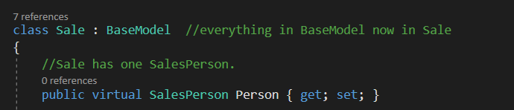
The relationship between models are defined.
The types of relationships -
One-to-One : A row in a table can have only one matching row in another table, and vice versa.
One-to-Many (or Many-to-One) : A row in a table can have many matching rows in another table, but a row in the second table can have only one matching row in first table.
Many-to-Many : A row in a table can have many matching rows in another table, and vice versa.
Ex – This Is an example of one-2-one relationship.

Slide 8
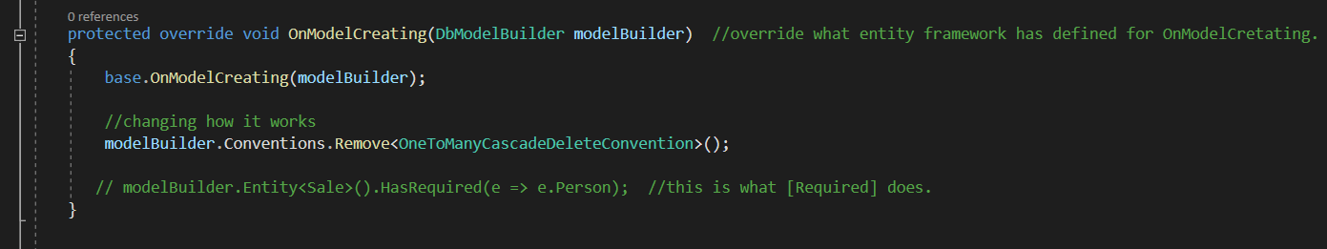
Data context are created to generate a database.
This data context is a primary class responsible for interacting with the database.
The gap between entity class/ domain and database are bridged.
The context class is used to query or save data to the database. It is also used to configure domain classes, database related mappings, change tracking settings, caching, transaction etc.
Overriding (if necessary) are done here.

Slide 9
Creating a database:
This is done by first adding SQL Server.
App.config file is generated, inside which the connection string is supposed to be entered, to establish the connection.

Slide 10
Creating a database:
This is done by first adding SQL Server.
App.config file is generated, inside which the connection string is supposed to be entered, to establish the connection.

Slide 11
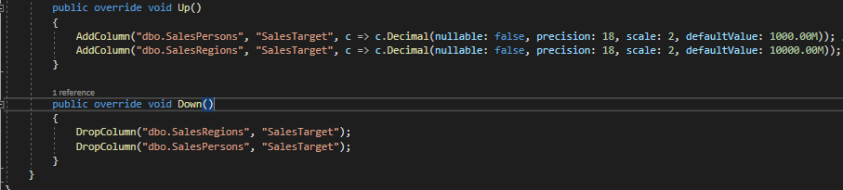
The migrations feature in Entity Framework provides a way to incrementally update the database schema to keep it in sync with the application's data model while preserving existing data in the database.
This feature enables you to change the data model and deploy your changes to production by updating the database schema without having to drop and re-create the database.
For the code based migration, the following commands are executed in Package Manager Console.
1) Enable-Migrations: Migration is enabled by creating a Configuration class.
2) Add-Migration: A new migration class is created as per specified name with the Up() and Down() methods. This creates database data based on existing class. The up method is a set of directions for running a migration, while the down method is a set of instructions for reverting a migration.
3) Update-Database: Executes the last migration file created by the Add-Migration command and applies changes to the database schema.

Slide 12
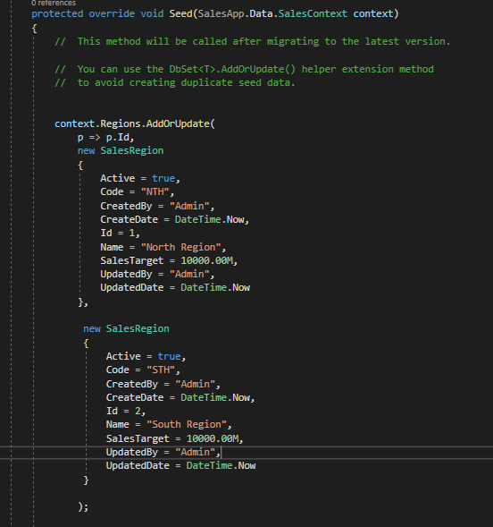
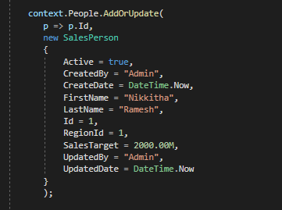
Seeding the database is where the data is populated while setting up the database.
In the configuration class file, the seed data values are entered.
A person’s data is also fed as seed data. It is usually an Admin's details.

Slide 13
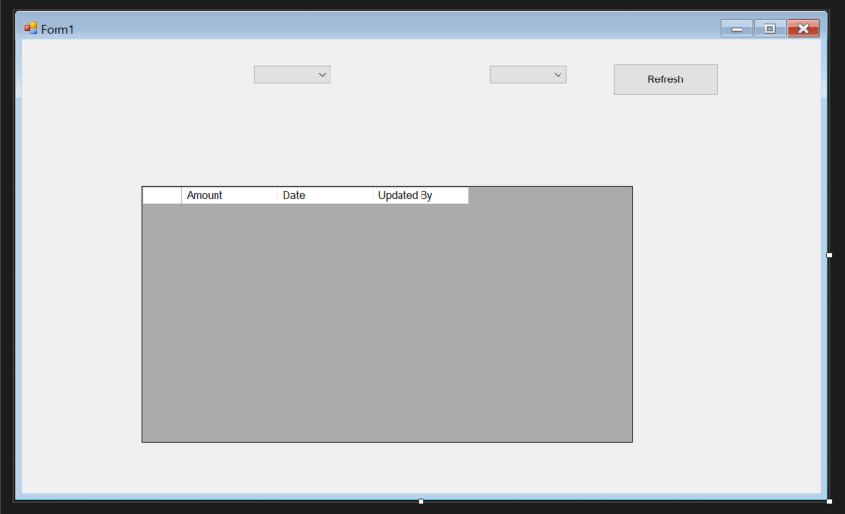
A form such as the following is created:

