Slide 1


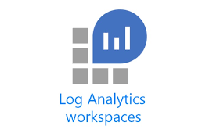







Resource Group
App Service Plan
REST
React JS App
SpringBoot App
Private Endpoint
Application Insights
Application Gateway can be used between React JS and SpringBoot App.
(SpringBoot App can be a backend of the App Gateway)

