Slide 1
Web services
RPC, SOAP and REST

Slide 2
Agenda
Internet (of things)
Need for web services
Web sites Vs Web services
Web services design models
The “dummy” way
XML RPC
SOAP
REST

Slide 3
Agenda
Modern app architecture
Web services decisions
Implementation of XML RPC
Implementation of SOAP
Implementation of REST
Questions

Slide 4
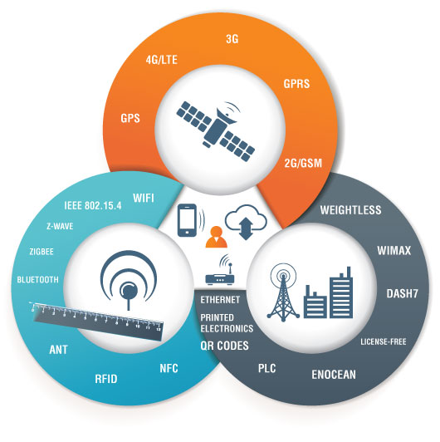
Internet (of things)

Slide 5
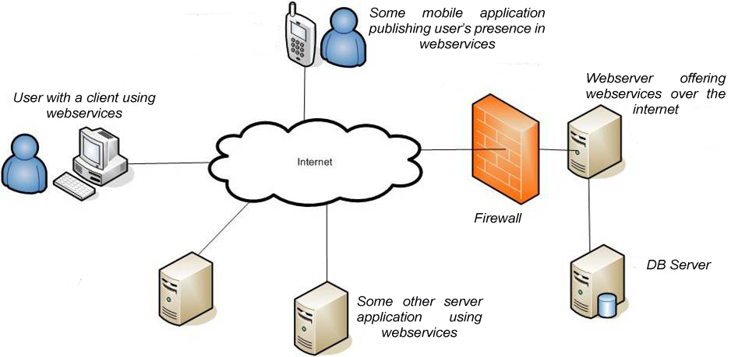
Need for web services

Slide 6
Need for web services
Abstract reusable interface
Hiding complexities
Supporting “Data anywhere” architecture
Services over internet
Services can be :
Infrastructure or Platform : Amazon S3
Reusable software component : Currency APIs
Data : Facebook, Twitter
and ….

Slide 7



Web site Vs Web services
Web site
Web services

Slide 8





Web services design models : The need

Slide 9
Web services in terms of it’s benifits
Easy to interoperate
It is Easy to use
It can be standardized
It allows using legacy
Language independence

Slide 10
Web services design models
The “dummy” way - A non standard hacky way and implications
XML RPC - XML – Remote Procedure Call Protocol
SOAP - Simple Object Access Protocol
REST - REpresentational State Transfer

Slide 11
The “dummy” way
HTTP GET or POST
CSV response in HTTP BODY

Slide 12
XML RPC
Protocol which uses XML to encode its calls and HTTP POST as a transport mechanism.
XML RPC standards : Link
Standards specify –
Data types : arrays, boolean, string etc
Structure of request and response
Transport specs

Slide 13
XML RPC : Sample Request
<?xml version="1.0"?>
<methodCall>
<methodName>examples.getStateName</methodName>
<params>
<param> <value><i4>40</i4></value> </param>
</params>
</methodCall>
Coded somewhere : String getStateName(int i4){
//fetch state name from some source
return stateName;
}

Slide 14
XML RPC : Sample Response
<?xml version="1.0"?>
<methodResponse>
<params>
<param>
<value><string>South Dakota</string></value>
</param>
</params>
</methodResponse>

Slide 15
XML RPC : How it works
Corresponding function to XML RPC Request executes and generates response
XML RPC Request
XML RPC Response

Slide 16
XML RPC : Critiques
Simple to use, develop and consume
Uses legacy XML
Light weight than SOAP
Doesn’t requires/support WSDL
No support for i18n
allows only one mode of method serialization

Slide 17
SOAP
Modified version of XML RPC
More powerful than XML RPC
Based on WSDL (Web Services Description Language) and UDDI (Universal Description Discovery and Integration)
SOAP Standards : Link
What standards : Data types, Structure and namespaces/attributes standards.

Slide 18
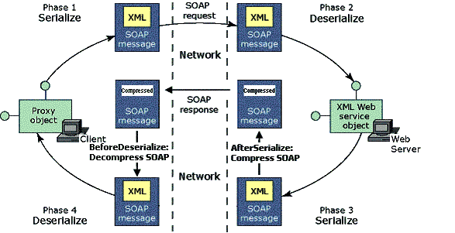
SOAP

Slide 19
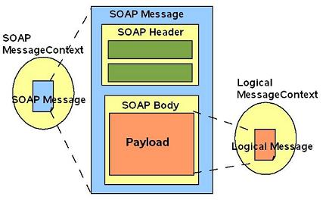
SOAP : Structure

Slide 20
SOAP Request : Structure
<?xml version="1.0"?> <soap:Envelope xmlns:soap="http://www.w3.org/2003/05/soap-envelope"> <soap:Header> </soap:Header> <soap:Body> <m:GetStockPrice xmlns:m="http://www.example.org/stock"> <m:StockName>IBM</m:StockName> </m:GetStockPrice> </soap:Body> </soap:Envelope>
Coded somewhere : float getStockPrice(String IBM){
// get stock price from some IS
return stockPrice;
}

Slide 21
SOAP Response : Structure
<?xml version="1.0"?> <soap:Envelope xmlns:soap="http://www.w3.org/2003/05/soap-envelope"> <soap:Header> </soap:Header> <soap:Body> <m:GetStockPriceResponse>
<m:Price>34.5</m:Price>
</m:GetStockPriceResponse> </soap:Body> </soap:Envelope>

Slide 22
SOAP : How it works
Corresponding function to SOAP Request executes and generates response
SOAP Request
SOAP Response

Slide 23
SOAP : Critiques
Versatile, can use different protocols : SMTP
More powerful
Automated tools exists
Uses XML
Supports WSDL
Too verbose

Slide 24
REST
It’s not a protocol, it’s an architectural approach.
Can be used with legacy XML or modern JSON information transfer format
Guidelines : HTTP methods and corresponding CRUD operation, recommendation about URI design.

Slide 25
REST : Principles
Be stateless
Use HTTP methods for CRUD operations
Directory like structure
Use proper MIME types

Slide 26
REST : HTTP Methods
SQL | REST
SELECT | GET
INSERT | POST
UPDATE | PUT
DELETE | DELETE
HEAD : get meta-data
OPTIONS : to get details about a resource TRACE : used to debug proxies CONNECT : Forward some other protocol through HTTP proxy

Slide 27
REST : URI Design
URI | HTTP METHOD | ACTION PERFORMED
/status/ | GET | Get all status
/status/3 | GET | Get status with id 3
/status/ | POST | Add a new status
/status/4 | PUT | Edit status with id 4
/status/4 | DELETE | Delete status with id 4

Slide 28
REST : HTTP Status
HTTP Status Codes | Informational
200 | OK
201 | Resource created
204 | No content
400 | Bad Request
401 | Unauthorised
404 | Not found
405 | Method Not allowed
500 | Internal Server Error

Slide 29
REST : Sample Request
URI | HTTP METHOD | ACTION PERFORMED
/status/ | POST | Add a new status
HTTP Method : POST HTTP BODY : {
“status”: “I am these days diving deeper in web services”
}

Slide 30
REST : Sample Response
HTTP Status : 201 HTTP BODY : {
“message”: “Status updated”
}

Slide 31
REST : How it works
1. Check HTTP Verb 2. Check path 3. Call Corresponding function 4. Send Response
HTTP Request
XML or JSON or *
HTTP Response

Slide 32
REST : Critiques
More open guidelines
Can use JSON or XML
Easy to develop and maintain
Depends on other security approaches like oAuth.
Confined to HTTP only

Slide 33




Modern apps architectures
REST API

Slide 34
Lets take a peek on the competition!
● Yahoo and all its services such as Flickr and
deli.ici.ous use REST
● Amazon and Ebay provide both though
Amazon's internal usage is nearly all REST.
● Google used to provide SOAP for all their
services, but in 2006 they deprecated in
favor of REST.

Slide 35
Soap | RESTful
Requires a toolkit to form requests and parse results! | Is easy to build - no toolkits required!
Requires specific knowledge of a new XML specification. | Just figure how to create and modify the URI to access different web resources!
requires an XML wrapper around every request and response | can be short!
once namespaces and typing are declared can take 10 times as many bytes as the same message in REST. | Lightweight
Needs to look into SOAP envelope! | easy to analyze the intent of each message by checking the HTTP command!
Authentication and authorization in the application layer. | Certificates and LDAP can delegate authentication and authorization to the network layer.
Best with SOA | Secure data should never be sent as parameters in the URI.

Slide 36
WSDL & Component
Types
Messages
Operations
Port
Bindings
Service

Slide 37
Compare JAVA with SOAP
JAVA | SOAP
Interfaces | Service
Beans or class level variables | Types
Input Output of methods | Messages
Information of sending details (use for schema/ style) | Binding
Collection of methods | port
Methods | operation
Exceptions | Fault
Package | TargetNameSpaces

Slide 38
Something about JAX-B

Slide 39
Modern apps architectures : The positive sides
Too many types of users
Too many types of devices
To be near your user
Data syncing
More user = more business
Ability to integrate with other apps

Slide 40
The web-services decisions
Client
Third party system
Legacy
Resources
Modern Moves
p.s: Take decisions smartly

