Slide 1
LDA on British Airway reviews
Nikshep A Kulli

Slide 2
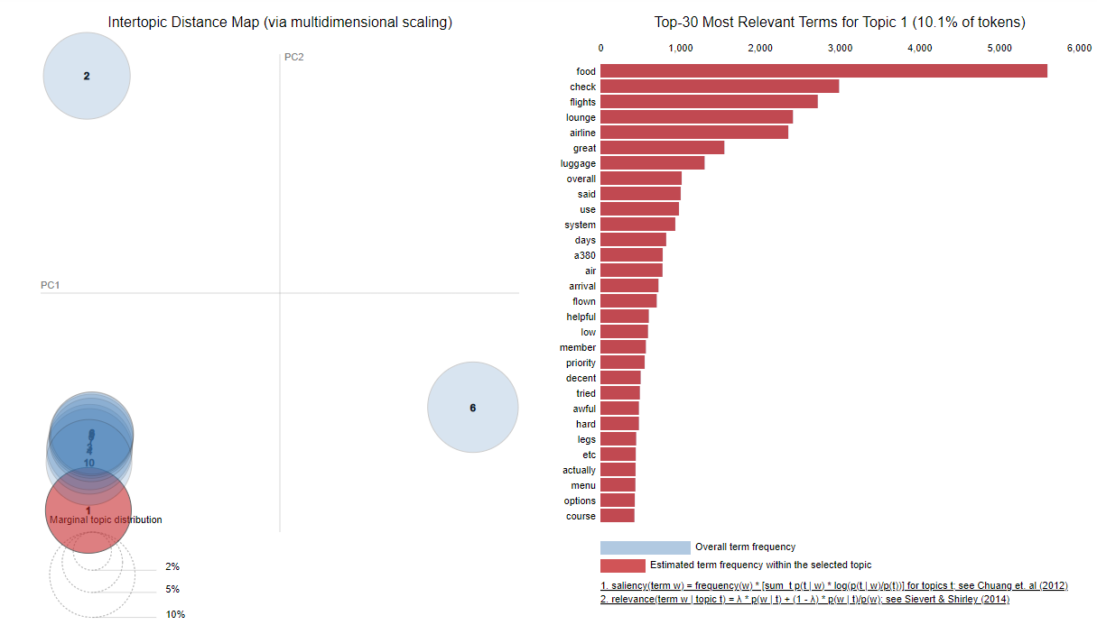
LDA analysis on reviews

Slide 3
Most Commonly occurred topics on LDA:
Food: The quality of the food served on British Airways flights.
Check-in: The efficiency and convenience of the check-in process.
Cabin crew: The performance and service provided by the cabin crew.
Class: The experience and amenities offered in different classes (e.g., economy, business, first).
Service: The overall level of service received during the flight.
Heathrow: Experiences related to the Heathrow Airport, likely in connection with British Airways flights.
Hours: Possibly refers to the duration or punctuality of the flights.
London: Experiences associated with flying to or from London.
Plane/Flight: General aspects related to the aircraft and the overall flight experience.
BA: Abbreviation for British Airways.
Seats: Comfort, legroom, and general satisfaction with the seating arrangements.
Good: Positive experiences or aspects mentioned in the reviews.
Time: Could refer to punctuality or overall time management during the journey.
British: Relating to the British Airways brand or services.
Aircraft: The quality and features of the aircraft used by British Airways
Meal: Thequality and satisfaction with the meals served on board.
Business/Club: Specifically refers to the business or club class experience.
Experience: Overall experiences and impressions of flying with British Airways.
Comfortable: Mention of comfort levels during the flight.
Poor: Negative aspects or dissatisfaction expressed in the reviews.
New: Possibly related to new aircraft, services, or features.
Verified: Indicates reviews from verified customers.
Storage: Availability and adequacy of storage space for luggage.
Lounge: Experiences in the airport lounge, possibly referring to British Airways lounges.
These were most commonly discussed topics in reviews by customes.

Slide 4
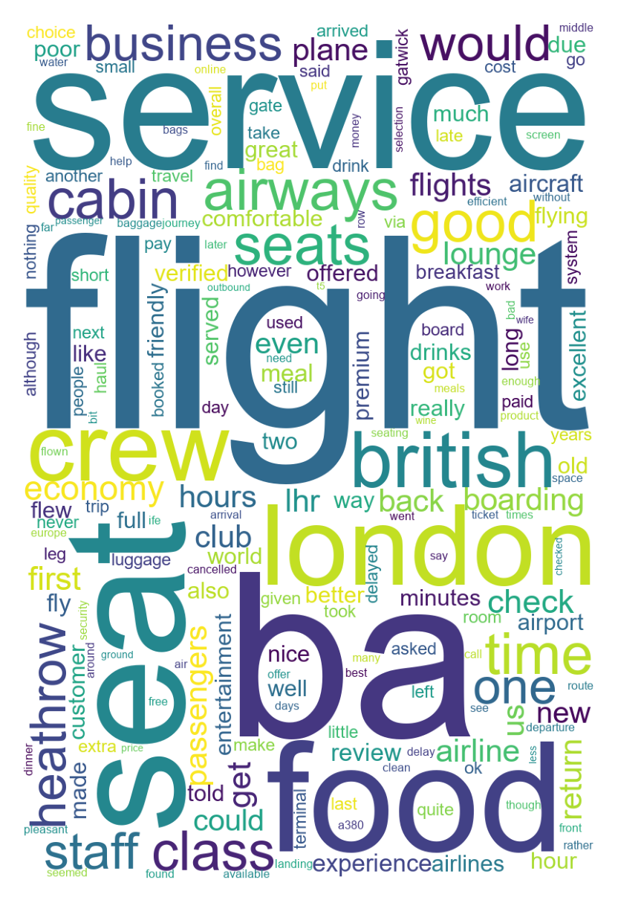
WordCloud for Word Frequency of reviews

Slide 5
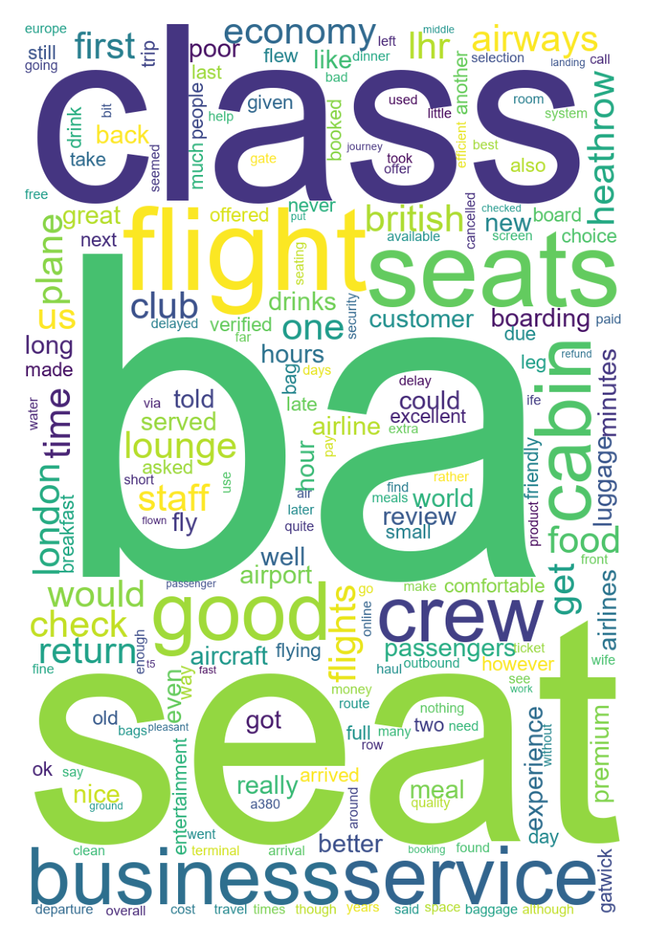
WordCloud for Word Frequency - TFIDF

Slide 6
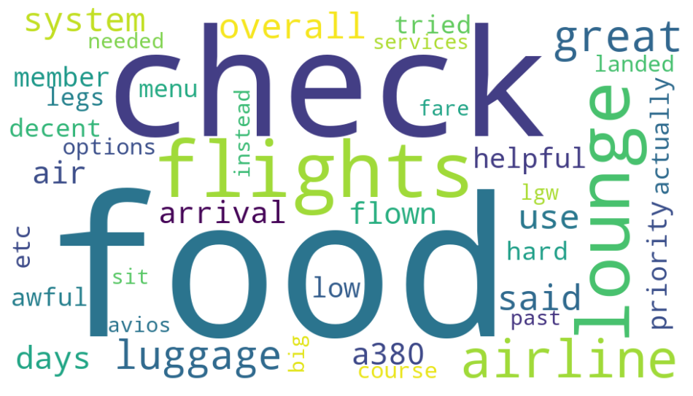
LDA Worcloud

Slide 7

NMF Wordcloud

