Slide 1
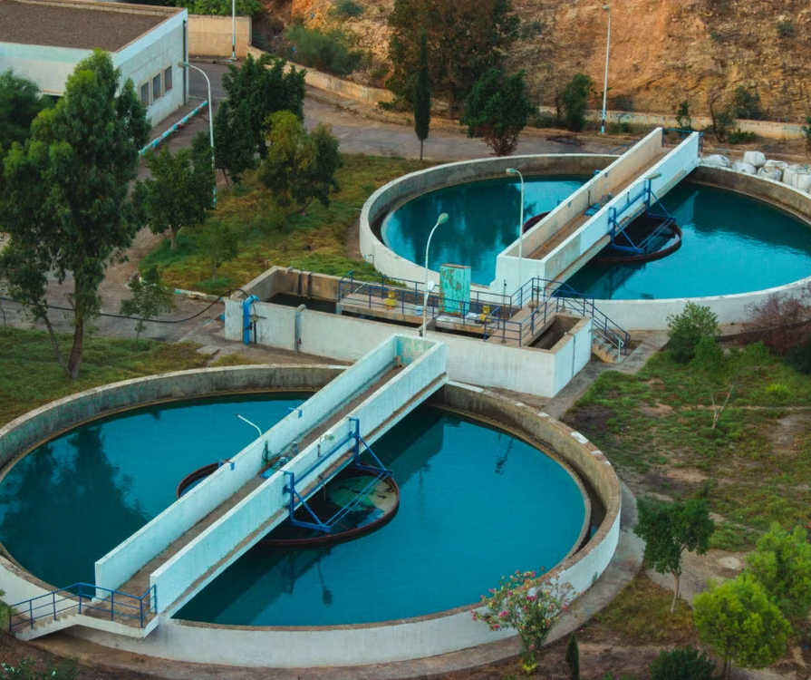
Health Benefits of Treated
Wastewater Reuse Projects
A presentation for Urban Water Team at WELL Labs
Image source: Pexels – Amine KM
1

Slide 2






WHAT'S AHEAD
Outline
01
02
Background
Research Objective
03
04
Methodology
Results
05
06
Limitations
References
2

Slide 3



BACKGROUND
Bengaluru's Wastewater Today
Potential Reuse Scenarios
Business-as-usual (BAU) Scenario
1,940 MLD of wastewater is generated by Bengaluru every day.
Of this, about 825 MLD of treated wastewater is redirected:
S2
Irrigating farms on the city's edges
S3
Watering public parks
S4
Supplying cooling water to an industrial estate
The city wants to know the monetary value of the increment in public health benefits under these potential scenarios.
Ahmad and Singhal, 2024; Kulranjan et al., 2024
3

Slide 4



RESEARCH OBJECTIVE
What This Assignment Sets Out to Do
To estimate the incremental value of public health benefits of the irrigation scenario (S2) over the business-as-usual scenario (BAU).
Public health is a science that aims to:
Protect and promote health
Prevent diseases and premature mortality
Reduce health disparities
Focus of this assignment: Diarrheal disease risk prevention
Jarvis et al., 2020
4

Slide 5



RESEARCH QUESTIONS AND METHODOLOGY
Four Research Questions
RQ1
RQ2
What is the pathway of treated wastewater in each scenario?
What is the diarrheal disease burden?
Flow Diagram (Ahmad and Singhal, 2024; Kulranjan et al., 2024)
DALY (George et al., 2015; WHO Guidelines, 2017)
RQ3
RQ4
What is the monetary value of this disease burden?
How does the monetary value vary across key variables?
Value of a DALY (Bergion et al., 2020; HM Treasury, 2026)
Sensitivity analysis
5

Slide 6
RESULTS — RQ1
What is the Pathway of Treated Wastewater in Each Scenario?
BAU
S2
Secondary
treatment
(2° STP)
Lakes / tanks
(recharge)
Aquifer
recharge
Bore / open
well
Water treatment
plant (WTP)
Sump
Secondary treatment
(2° STP)
Tertiary treatment
(3° TP)
Sump
Irrigation
Irrigation
84%
Domestic use
8%
Drinking water
8%
Ahmad and Singhal, 2024
Assumed
S3
S4
Secondary treatment
(2° STP)
Tertiary treatment
(3° TP)
Sump
Watering
public parks
Secondary treatment
(2° STP)
Tertiary treatment
(3° TP)
Sump
Industrial
cooling water
Assumed
Ahmad and Singhal, 2024
6

Slide 7





RESULTS — RQ 2A
Who Is Exposed to the Treated Wastewater?
Farm workers
Residents
Recreationists
BAU
S2
Farm workers
Consumers of produce
Secondary
treatment
(2° STP)
Lakes / tanks
(recharge)
Aquifer
recharge
Bore / open
well
Water treatment
plant (WTP)
Sump
Secondary treatment
(2° STP)
Tertiary treatment
(3° TP)
Sump
Irrigation
Irrigation
84%
Domestic use
8%
Drinking water
8%
Ahmad and Singhal, 2024
Assumed
S3
Recreationists
Park workers
S4
Industrial workers
Secondary treatment
(2° STP)
Tertiary treatment
(3° TP)
Sump
Watering
public parks
Secondary treatment
(2° STP)
Tertiary treatment
(3° TP)
Sump
Industrial
cooling water
Assumed
Ahmad and Singhal, 2024
6

Slide 8
RESULTS — RQ 2B & RQ2
What Is the Health Risk, and the Resulting Diarrheal Disease Burden?
BAU
S2
Diarrheal disease burden from | For Agricultural Population (DALY per year) | For Non-agricultural Population (DALY per year)
E. coli | 0.22 | 0.77
Rotavirus | 0.01 | 0.05
Campylobacter | 5.74 | 19.8
Diarrheal disease burden from | For Agricultural Population (DALY per year)
E. coli | 13
Rotavirus | 0.86
Campylobacter | 320
27 DALY per year
334 DALY per year
Ahmad and Singhal, 2024; WHO, 2017; George et al., 2015; Census India (n.d.)
8

Slide 9

RESULTS — RQ3
What is the monetary value of this disease burden?
Method: Human capital approach, using the GSDP per capita of Karnataka (Rs 4,77,003 in 2025-26)
BAU
S2
Value of DALYs
Value of DALYs
1.27 Crore Rupees
15.93 Crore Rupees
According to this assessment, direct reuse for irrigation (S2) is not recommended: the population faces Rs 14.66 crore higher damage in that scenario because of increased diarrheal disease burden.
Karnataka Budget Analysis 2026-27, n.d.; Bergion et al., 2020
9

Slide 10
RESULTS — RQ4
How Sensitive Is the Result to Key Variables?
Variant | Variation range | Value where net DALY value turns negative | Slope (Lakh Rs / unit change)
Total water supplied | 0 to 500,000 litres per day | NA | 830
Chance of ingestion of water during irrigation | 0.000076% to 0.01% | 0.000076% | 10E+08
Campylobacter concentration (in BAU) | 0.0007524 to 0.0099089 organisms per litre | 0.0099089 organisms per litre | −160,084
Campylobacter concentration (in S2) | 2.86 to 150.48 organisms per litre | 2.86 organisms per litre | 19,432
Among the variants chosen (based on uncertainty and potential influence), the net monetary value of public health benefits is most sensitive to the chance of ingestion of water during irrigation.
10

Slide 11
LIMITATIONS & ROOM FOR IMPROVEMENT
Internal Validity and Measurement Validity
Scenarios and exposure modelling
Water quality (organisms per L): primary data would improve accuracy
Disability weights are currently drawn from outside India
Internal Validity
Only diarrheal disease burden was estimated; Other health effects could be included (POPs, heavy metals, vector-borne diseases, mental health effects)
Only the ingestion pathway was modelled; Aerosol and food-borne pathways could be explored
Measurement Validity
(Public Health)
Measurement
Validity (Benefits)
By using GSDP, value of life is equated to value of livelihood, which is considered incorrect. HM Green Book recommends WTP approach (via revealed/stated preferences) but that would cost more time
Only public health benefits were measured; Could include other benefits/costs (agricultural productivity changes, opportunity cost of selling wastewater, implementation costs)
Could go beyond instrumental value framing: a plural value framework / broader well-being approach
11

Slide 12
LIMITATIONS & ROOM FOR IMPROVEMENT
External Validity and Reliability
External Validity
No conclusions are being drawn about other cities, so this is not a concern here
Reliability
Would matter more when collecting primary data; this assignment relied only on secondary data
11

Slide 13
Note on use of AI
This assignment used Claude for the following purposes:
Identifying relevant literature; For example – “Find peer reviewed papers on economic valuation of health benefits related to waste water reuse”
Understanding a concept / term / method; For example – “What is a QMRA? What are the steps involved?”
Retrieving already identified data sources for the excel sheet; For example – “Retrieve Table 4 from George et al 2015 and organize it in a format that I can directly copy onto excel”
Improving the visual style of this presentation; For example – “Improve the visuals in this presentation, keep it minimalistic. Don’t leave out any information because all of it is important”
Tasks done by human brain exclusively:
Mapping how to go about the assignment, how to structure the excel and the presentation
Reading about the context of wastewater reuse in Bengaluru, approaches to measuring its health effects and to valuing the health effects
Reasoning through decisions to choose, assume and derive the values used in the analyses
12

Slide 14
Thank You
Questions?
References →
13

Slide 15
REFERENCES
References
Adegoke, A. A., Amoah, I. D., Stenström, T. A., Verbyla, M. E., & Mihelcic, J. R. (2018). Epidemiological Evidence and Health Risks Associated With Agricultural Reuse of Partially Treated and Untreated Wastewater: A Review. Frontiers in Public Health, 6. https://doi.org/10.3389/fpubh.2018.00337
Ahmad, F., & Singhal, S. (2024). Waste to Worth: Managing India’s Urban Water Crisis through Wastewater Reuse. Centre for Science and Environment. https://www.cseindia.org/waste-to-worth-managing-india-s-urban-water-crisis-through-wastewater-reuse-12527
Bergion, V., Lindhe, A., Sokolova, E., & Rosén, L. (2020). Economic Valuation for Cost–Benefit Analysis of Health Risk Reduction in Drinking Water Systems. Exposure and Health, 12(1), 99–110. https://doi.org/10.1007/s12403-018-00291-8
Census India. (n.d.). India—Census of India 2011—Primary Census Abstract—Data Highlights—Karnataka—Series 30. Retrieved September 26, 2026, from https://censusindia.gov.in/nada/index.php/catalog/11311
George, J., An, W., Joshi, D., Zhang, D., Yang, M., & Suriyanarayanan, S. (2015). Quantitative Microbial Risk Assessment to Estimate the Health Risk in Urban Drinking Water Systems of Mysore, Karnataka, India. Water Quality, Exposure and Health, 7(3), 331–338. https://doi.org/10.1007/s12403-014-0152-4
Godfrey, S., Labhasetwar, P., & Wate, S. (2009). Greywater reuse in residential schools in Madhya Pradesh, India—A case study of cost–benefit analysis. Resources, Conservation and Recycling, 53(5), 287–293. https://doi.org/10.1016/j.resconrec.2009.01.001
Government of Karnataka. (n.d.). Labour Commissioner Office—Minimum-wages-final-notification. Retrieved September 26, 2026, from https://karmikaspandana.karnataka.gov.in/47/minimum-wages-final-notification/en
Guidelines for drinking-water quality, 4th edition, incorporating the 1st addendum. (2017). World Health Organization. https://www.who.int/publications/i/item/9789241549950
Hajare, R., Labhasetwar, P., & Nagarnaik, P. (2020). Evaluation of pathogen risks using QMRA to explore wastewater reuse options: A case study from New Delhi in India. Water Science and Technology, 83(3), 543–555. https://doi.org/10.2166/wst.2020.583
HM Treasury. (n.d.). The Green Book (2026). GOV.UK. Retrieved October 8, 2026, from https://www.gov.uk/government/publications/the-green-book--2/the-green-book-2026
Jarvis, T., Scott, F., El-Jardali, F., & Alvarez, E. (2020). Defining and classifying public health systems: A critical interpretive synthesis. Health Research Policy and Systems, 18(1), 68. https://doi.org/10.1186/s12961-020-00583-z
Kalita, M., Kalita, B. K., Patowary, A. N., Bora, R., & Kanungo, S. (2026). Trends and burden of diarrhoeal diseases across India, 1990 - 2023: A systematic analysis from the global burden of disease study 2023. New Microbes and New Infections, 71, 101764. https://doi.org/10.1016/j.nmni.2026.101764
Karnataka Budget Analysis 2026-27. (n.d.). PRS Legislative Research. Retrieved September 26, 2026, from https://prsindia.org/budgets/states/karnataka-budget-analysis-2026-27
Kulranjan, R., Palur, S., & Nesi, M. (2024). How Water Flows Through Bengaluru. https://welllabs.org/wp-content/uploads/2024/03/Jan-2024_WELL-Labs-Bengaluru-Urban-Water-Balance-Report.pdf
Macroeconomics and health: Investing in health for economic development. (n.d.). World Health Organization. Retrieved September 25, 2026, from https://www.who.int/publications/i/item/924154550X
Mara, D. D., Sleigh, P. A., Blumenthal, U. J., & Carr, R. M. (2006). Health risks in wastewater irrigation: Comparing estimates from quantitative microbial risk analyses and epidemiological studies. Journal of Water and Health, 5(1), 39–50. https://doi.org/10.2166/wh.2006.055
Murray, C. J. L., & Acharya, A. K. (1997). Understanding DALYs. Journal of Health Economics, 16(6), 703–730. https://doi.org/10.1016/S0167-6296(97)00004-0
Shi, K.-W., Wang, C.-W., & Jiang, S. C. (2018). Quantitative microbial risk assessment of Greywater on-site reuse. Science of The Total Environment, 635, 1507–1519. https://doi.org/10.1016/j.scitotenv.2018.04.197
Smarr, M. M., Grantz, K. L., Zhang, C., Sundaram, R., Maisog, J. M., Barr, D. B., & Louis, G. M. B. (2016). Persistent organic pollutants and pregnancy complications. Science of The Total Environment, 551–552, 285–291. https://doi.org/10.1016/j.scitotenv.2016.02.030
Zhiteneva, V., Carvajal, G., Shehata, O., Hübner, U., & Drewes, J. E. (2021). Quantitative microbial risk assessment of a non-membrane based indirect potable water reuse system using Bayesian networks. Science of The Total Environment, 780, 146462. https://doi.org/10.1016/j.scitotenv.2021.146462
14

