Slide 1
ACCIDENTS ANALYSIS
ALY 6110 - Final Project

Slide 2
PROJECT WORKFLOW
Project Definition
Data Cleaning
Data Exploration & Visualization
Model Development & Evaluation
Insights

Slide 3
REAL WORLD PROBLEM
US traffic accidents, with increasing fatalities, pose a significant and escalating problem.
Goal - Our analysis aims to identify patterns and provide actionable recommendations to enhance public safety and reduce accidents.

Slide 4
BUSINESS PROBLEMS
01
02
03
04
05
06
Severity
Location
How bad are accidents?
Where are the accident-prone areas?
Time
Road Features
Peak occurrence - year, week, day, and time?
How road conditions influence accidents
Other factors
Mitigation
Weather Impact?
Ways to reduce accidents?

Slide 5
UNDERSTANDING THE DATASET
Accident Records
Key Features
Timeframe
7.7M rows and 46 columns
Accident date, time, location, severity, other factors
Feb 2016 - Mar 2023
Coverage
Target Variable
Applications
49 states, countrywide
Severity (1 to 4)
Real-time accident prediction, hotspot analysis

Slide 6
BIG DATA PROCESS WORKFLOW
01
02
03
04
INPUT DATASET - 7.7M Records
APACHE SPARK
VISUALIZE USING PYSPARK
BUSINESS INSIGHTS

Slide 7
DATA CLEANING
Handling Missing values
Feature Engineering
Dropping Accident ID column
Renaming columns
01
02
03
04

Slide 8
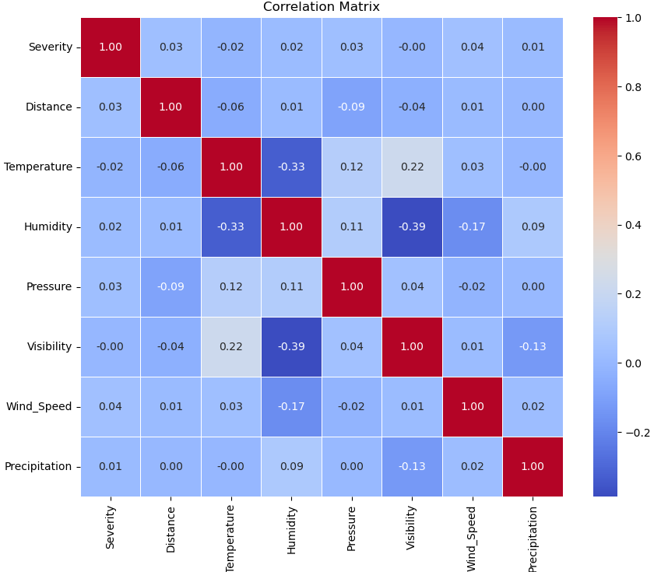
CORRELATION PLOT
Severity & Wind speed 0.040
Visibility & humidity -0.387
Mercúrio
Humidity & temperature -0.331

Slide 9
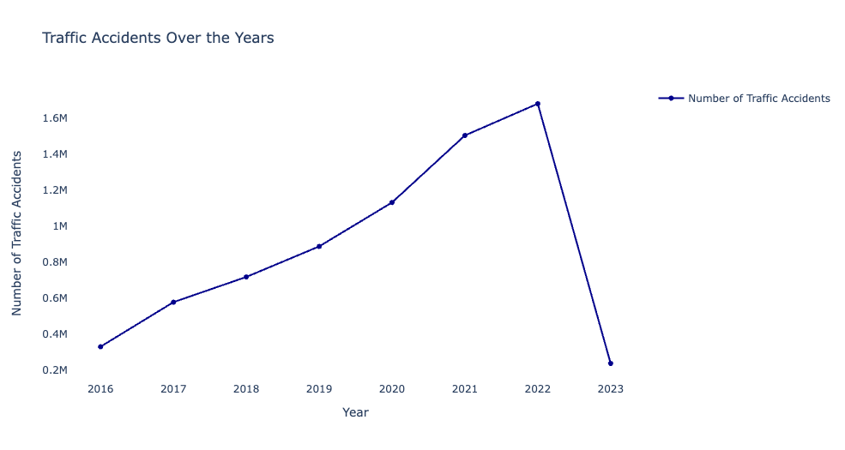
TIMELINE OF ACCIDENTS
Upward Trend of Accidents over the years
Highest Accidents recorded in the Year 2022
Sharp fall in accidents from 2022 to 2023

Slide 10
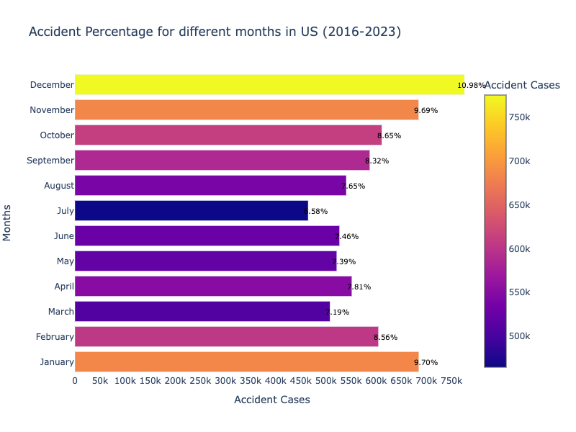
TIME ANALYSIS - MONTHLY
December
10.98%
January
9.70%
July
6.58%

Slide 11
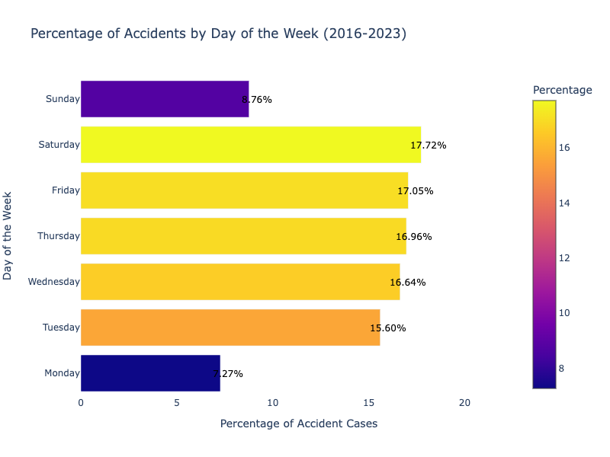
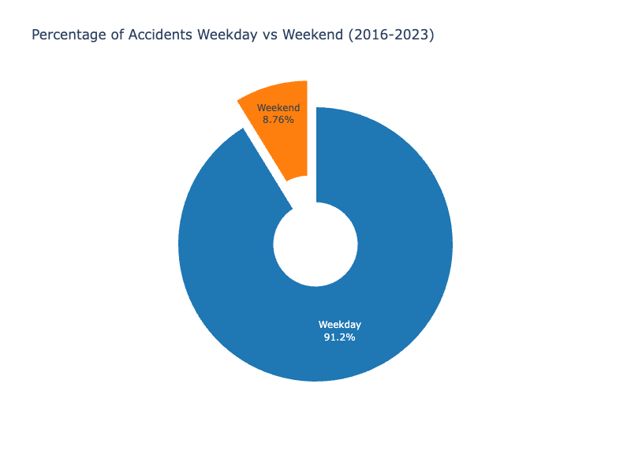
TIME ANALYSIS - WEEKLY
Highest Accidents on Saturday and lowest on Monday.
Overall fewer Accidents on Weekend vs combined Weekdays.

Slide 12
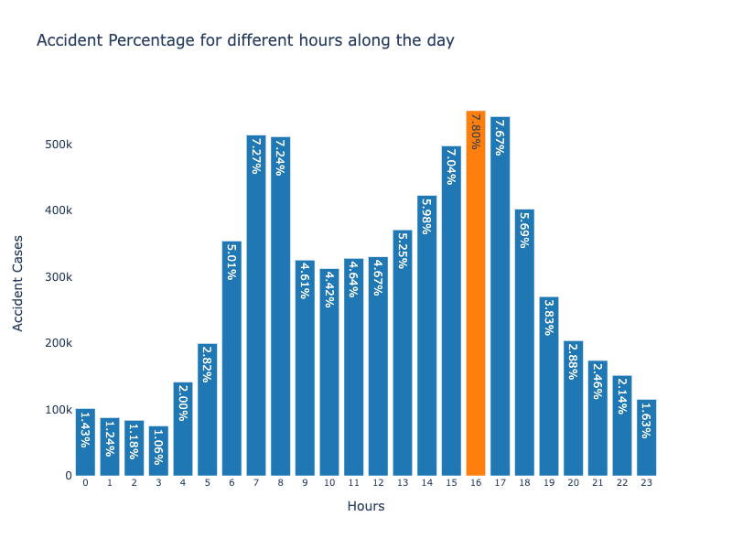
TIME ANALYSIS - HOURLY
Highest Accidents - 4 P.M
7.8%
6 AM to 9 AM
24 %
3 PM to 6 PM
28 %

Slide 13
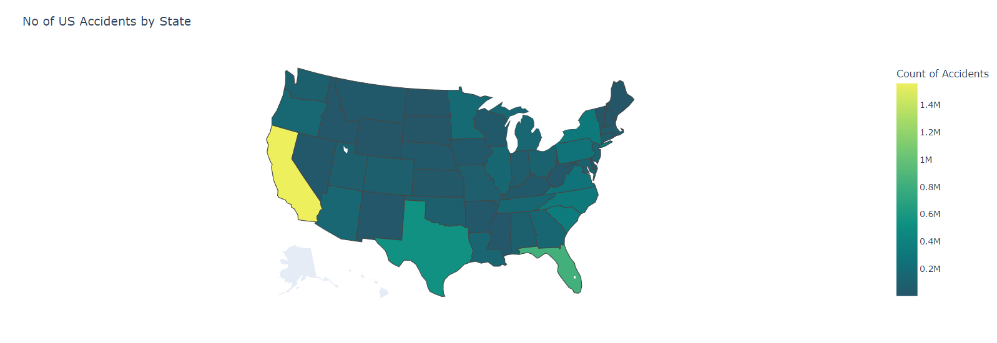
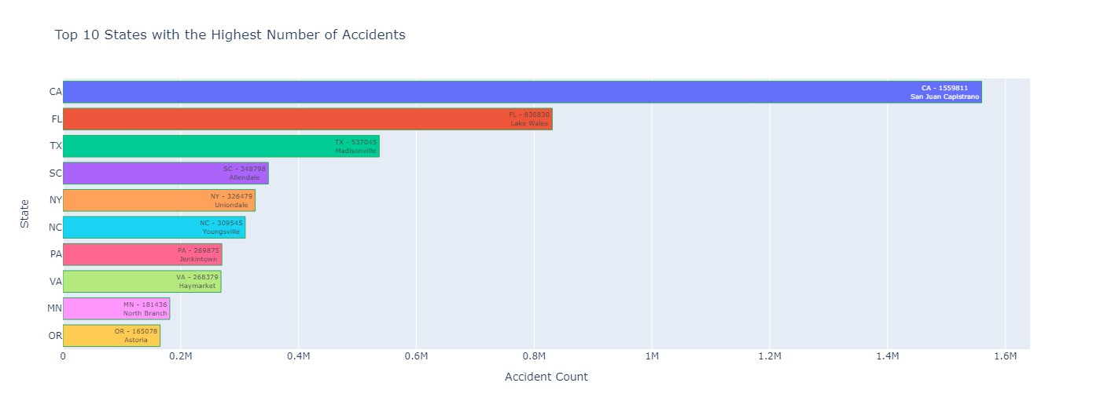
LOCATION ANALYSIS
CALIFORNIA
1.6M
FLORIDA
830K
TEXAS
537K

Slide 14
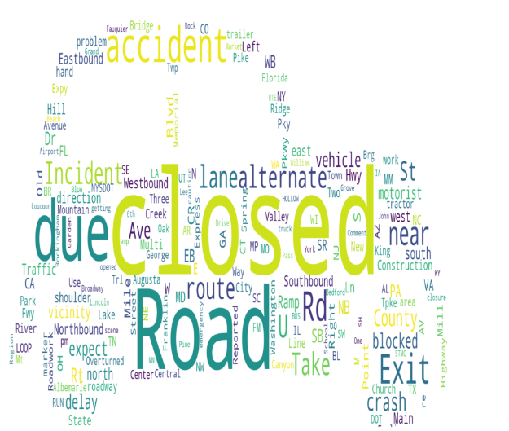
SEVERITY ANALYSIS
Key terms used in the accident descriptions for Severity 4 (Highest Severity)
Words - “Closed" , “Road” , “due” , “Accident”, ”Incident" , “blocked” , “crash” etc are the most frequently occuring.

Slide 15
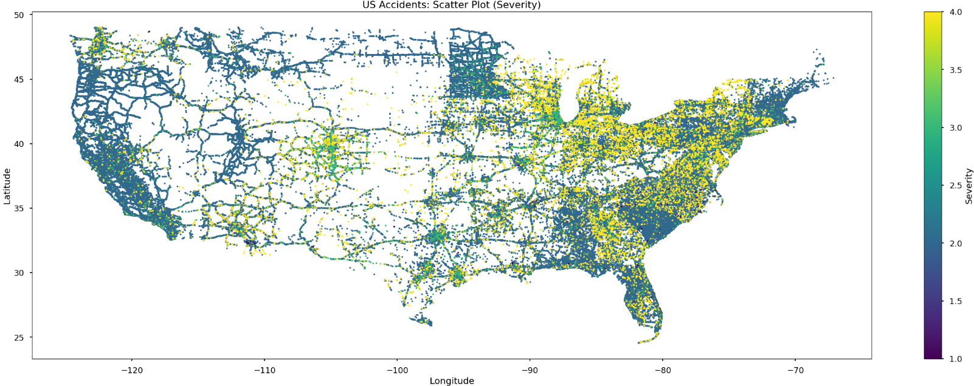
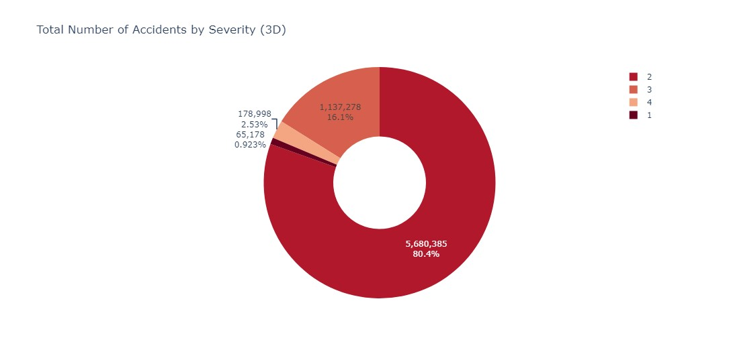
SEVERITY ANALYSIS
SEVERITY 2
80%
SEVERITY 3
16%
SEVERITY 4
2.5%

Slide 16
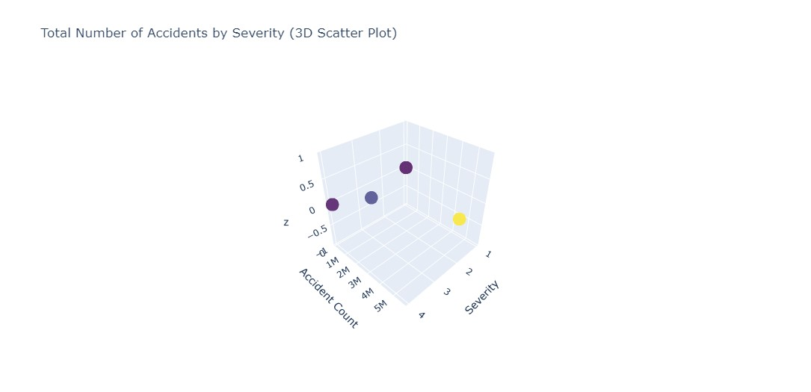
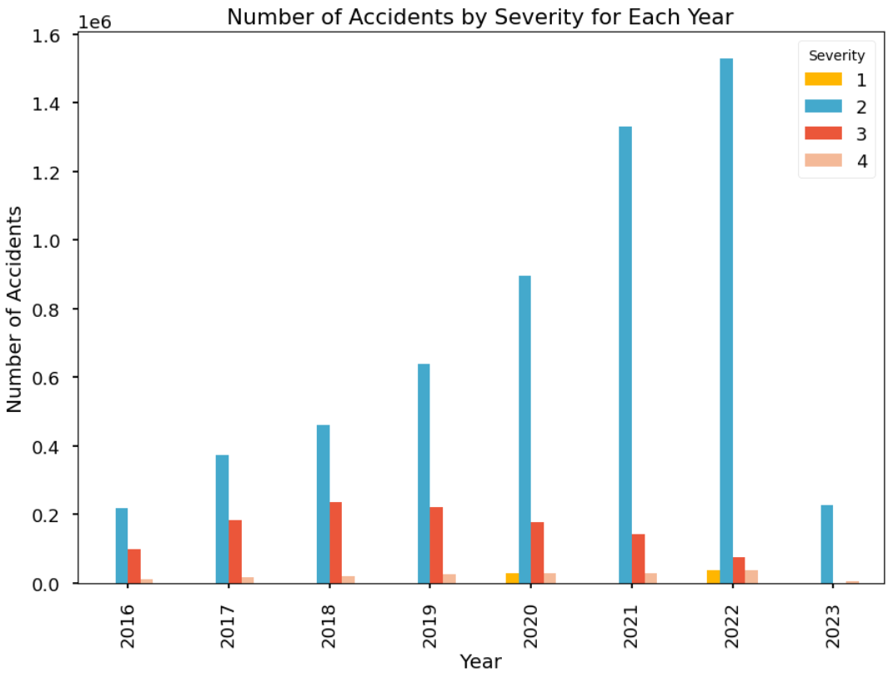
SEVERITY ANALYSIS
VARIATIONS ACROSS YEARS
~
SEVERITY 2 CONSISTENT
=
SEVERITY 1&4 LESS
<

Slide 17
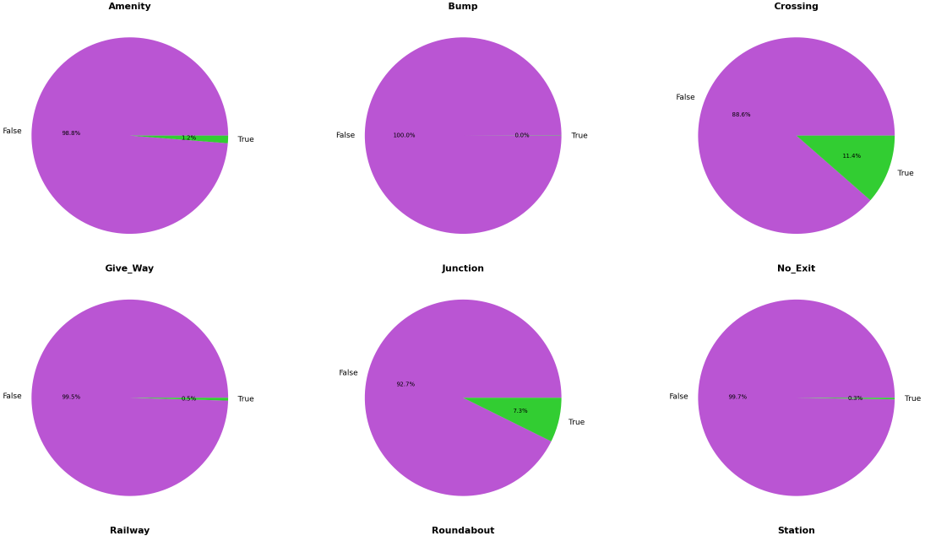
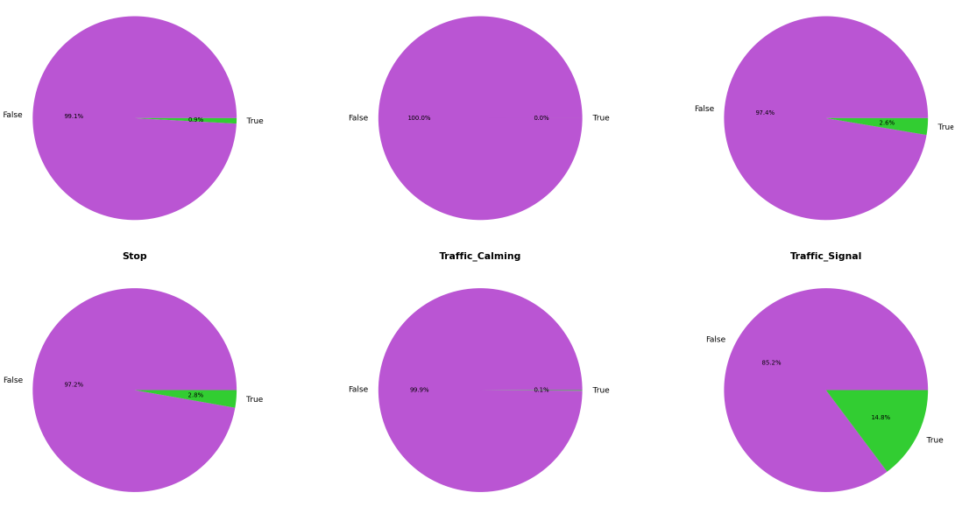
DRIVING FACTORS ANALYSIS
MAJORITY
FALSE
OCCURANCE
LOW
PRESENCE
RARE

Slide 18
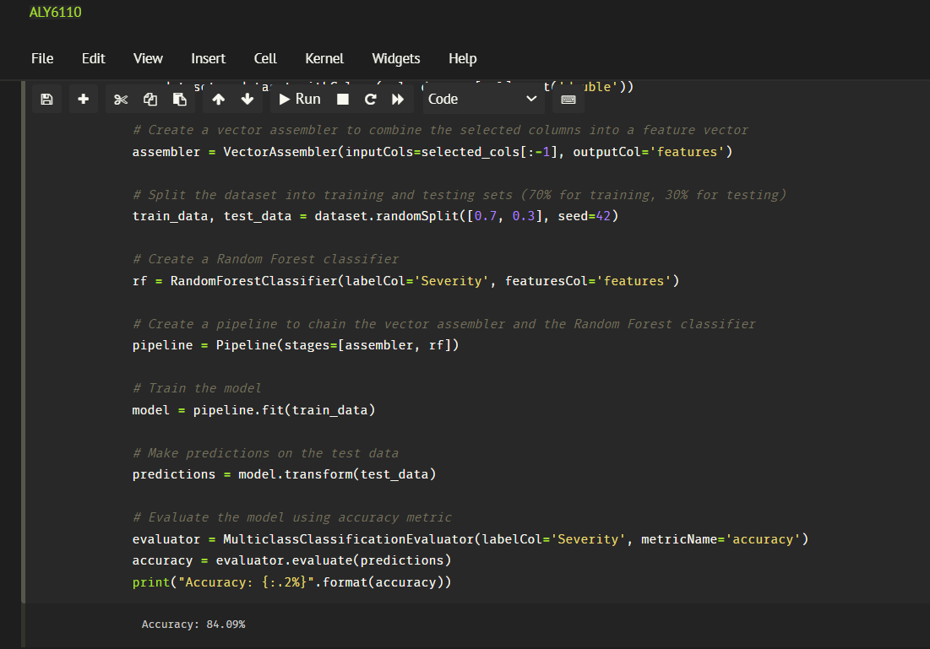
RANDOM FOREST MODEL
ACCURACY
84 %
Target Variable - Severity
Notes:
Selected columns - latitude, longitude, temperature, wind chill, humidity, pressure, visibility, wind speed. Target variable, severity.

Slide 19
CONCLUSION
Rising number of traffic accidents and fatalities in the US.
Analysis of US Accidents dataset to understand key factors and mitigate accidents.
Findings include trends over time, peak accident months, and high-accident states.
Analysis of severity, driving factors, and weather impact on accidents.
Random Forest model achieves 84.09% accuracy in predicting accident severity.

Slide 20
REFERENCES
US Accidents (2016 - 2023). (2023, May 28). Kaggle. https://www.kaggle.com/datasets/sobhanmoosavi/us-accidents
Shafique, A. (2021, December 9). Exploratory Data Analysis using Pyspark Dataframe in Python. Medium. https://medium.com/@aieeshashafique/exploratory-data-analysis-using-pyspark-dataframe-in-python-bd55c02a2852
Downloads | Apache Spark. (n.d.). https://spark.apache.org/downloads.html

Slide 21
Thank you

