Slide 1
GreenOps Weekly Report
2025-06-16 to 2025-06-23

Slide 2
Executive Summary
Total estimated monthly cost savings from optimization: Approximately $1163.84
Total estimated monthly carbon reductions from optimization: Approximately 1471.87 kgCO2e
Carbon emissions are projected to increase slightly over the next 7 days.
Regions Analyzed: 5

Slide 3
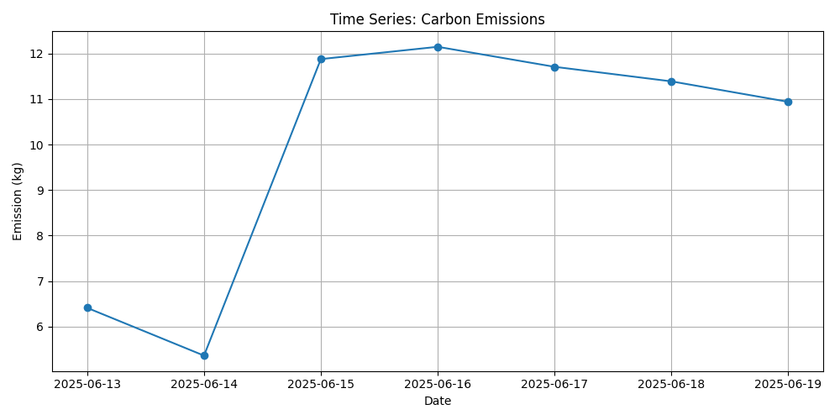
Forecast Overview
Projected total emission for next 7 days: 96.663 kg
Date with highest projected emission: 2025-06-27 (16.012 kg)
Top carbon-emitting instances: b6e68e26-65fb-4bf3-978a-3412b35b6b4a (8.311 kg), 704aa8df-20cd-4caf-be43-91deb403d437 (7.525 kg)

Slide 4
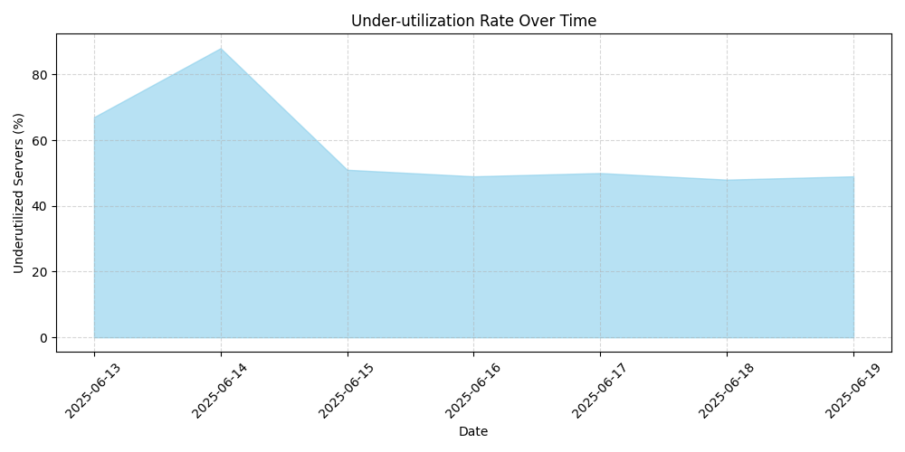
Regional Utilization
Asia South 1: 2 underutilized instances
Europe West 1: 2 underutilized instances
US Central 1: 2 underutilized instances
US East 1: 2 underutilized instances
US West 1: 2 underutilized instances

Slide 5
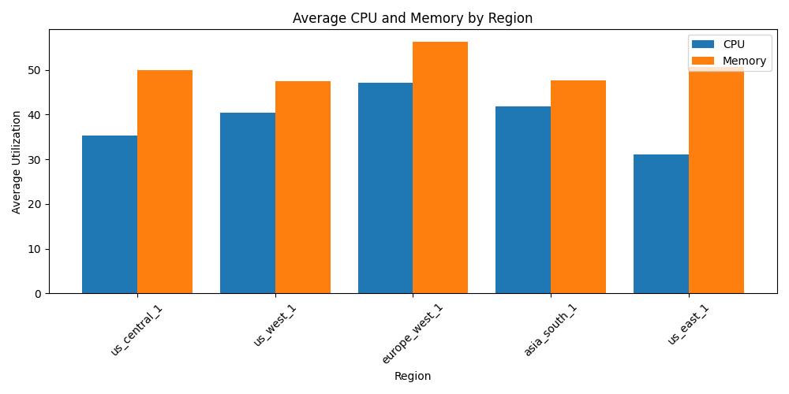
Top Recommendations
Asia South 1: Downgrade instance 30ab5043-5bf1-49ca-806d-fe6373abb1e3 (e2-standard-8 to e2-standard-4) for $115.89 cost and 300.24 kg carbon savings.
Europe West 1: Downsize instance a666158d-7dbf-497e-be47-a4cd69ad7ded (e2-standard-8 to e2-standard-4) for $106.15 cost and 143.71 kg carbon savings.
US West 1: Downgrade instance 641f7096-e9db-4c1d-a92e-fea3ea89f35d (a2-highgpu-1g to e2-medium) for $492.53 cost and 385.93 gCO2e carbon savings.

Slide 6
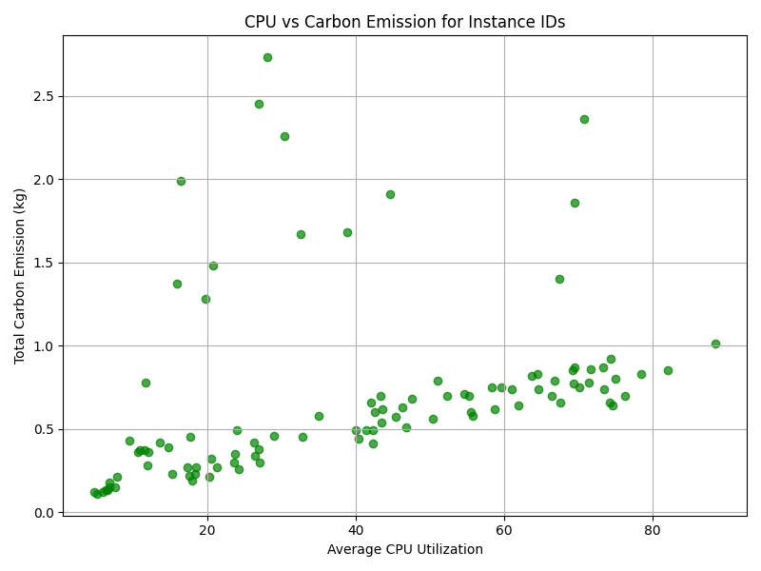
Instance Behaviour Insights
Instance types a2-highgpu-1g and a2-highgpu-4g generally emit higher carbon per CPU.
Instances with low CPU utilization but high carbon emissions were observed, indicating potential areas for optimization.
Several instances are underutilized in terms of CPU and memory, suggesting potential cost and carbon emission savings through downgrading to smaller instance types.

Slide 7
THANK YOU!

