Slide 1
DATATHON 2026 — TRACK: EDUCATION
KAIROS
Campus Space Intelligence: Predict Demand. Optimize Allocation. Eliminate Wasted Space.
Team: Laphing Buddha | The Campus Has Space. Students Don't.

Slide 2
DATATHON 2026 | TRACK: EDUCATION
The Problem: The Campus Has Space. Students Don't.
1. The Core Space Paradox
• Campus room utilization is chronically inefficient: lecture halls sit half-empty while students are turned away.
• In the DATATHON dataset, 5,000 student requests compete for space, yet 1,235 requests were waitlisted and 765 rejected under legacy uncoordinated bookings.
• Auditoriums (>100 seats) frequently host small groups while 90+ student workshops overflow in 40-seat rooms.
2. Student & Organizer Persona
• Students, hackathon teams, and clubs need rooms with specific amenities (projectors, computers, power outlets).
• Pain point: Lack of visibility into real availability leads to blind booking attempts and last-minute room rejections.
• Need: An intuitive discovery tool that guarantees valid space without guessing or administrative lag.
3. Campus Administrator Persona
• Schedulers manage 5,000 recurring academic classes across 6 departments and 1,800 special events.
• Pain point: Existing booking processes evaluate requests sequentially in isolation, creating massive seat waste.
• Need: Global multi-event optimization, zero-disruption capacity swaps, and demand forecasting.

Slide 3
DATATHON 2026 | TRACK: EDUCATION
KAIROS: An End-to-End Space Intelligence Platform
A. Explainable Real-Time Room Matching
• Strict 3-stage decision engine pruning capacity, facilities, and accessibility.
• Half-open interval semantics [start, end) prevent adjacent boundary conflicts.
• Provides transparent pros, trade-offs, and disqualified room forensics.
B. Global Multi-Event Optimization (OR-Tools)
• Formulates simultaneous space allocation as an exact binary integer problem.
• Maximizes request fulfillment while strictly minimizing excess seat waste.
• Strictly guarantees zero hard-constraint violations.
C. Zero-Disruption Capacity Swaps
• Scans concurrent scheduled classes for capacity mismatches.
• Swaps crowded and underutilized rooms at the exact same time slot.
• Eliminates seat waste with zero schedule disruption to students.
D. ML Demand Forecasting from Scratch
• Custom NumPy Linear Regression with L2 regularization trained from scratch.
• Predicts hourly request intensity across 1,505 observation buckets.
• Identifies demand bottlenecks before they cause request rejections.

Slide 4
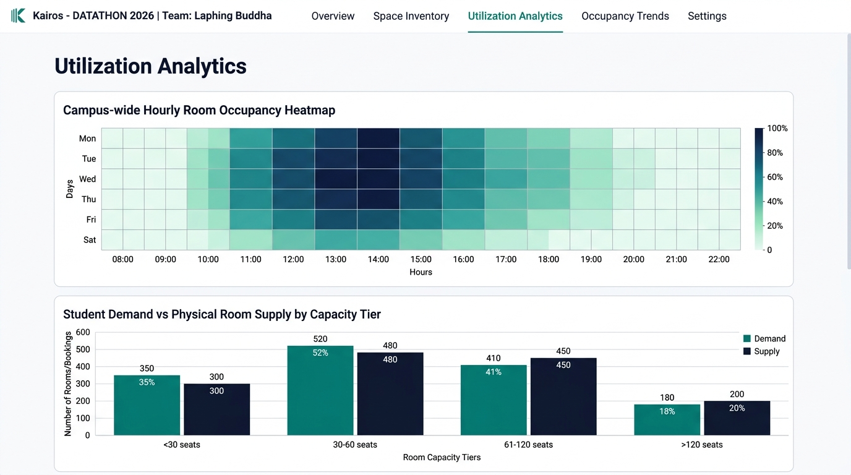
DATATHON 2026 | TRACK: EDUCATION
Data Ingestion Pipeline & Verified Findings
Dataset | Records | Nulls | Orphans | Verified Key
Rooms Catalog | 120 | 0 | 0 | room_id
Class Schedule | 5,000 | 0 | 0 | schedule_id -> room_id
Special Events | 1,800 | 0 | 0 | event_id -> room_id
Room Requests | 5,000 | 0 | 0 | request_id (Unmet Demand)
Key Analytical Findings
• Zero Missing Values & Zero Orphans: Complete 11,920 record integrity verified via scripts/validate_data.py.
• Interval Merging Reality: Raw class schedules contain 2,422 internal overlaps per room/weekday. Merging overlapping intervals is essential to avoid double-counting.
• Scheduled Utilization Benchmark: Campus scheduled occupancy averages 38.4% across operating hours (08:00–22:00), leaving ample room for optimized allocations.
• Demand Concentration: Student demand peaks sharply between 13:00 and 17:00 on weekdays, causing acute space deficits during mid-afternoon hours.

Slide 5
DATATHON 2026 | TRACK: EDUCATION
Machine Learning: Demand Forecasting Trained from Scratch
NumPy Model Architecture & Training
• Pure NumPy Implementation: Built from scratch without scikit-learn, blackbox estimators, or external APIs.
• Supervised Task: Forecast hourly student room request count (1,505 observation buckets, Aug 1 – Nov 28, 2025).
• 10 Engineered Features: Cyclic sin/cos of hour (24h period), cyclic sin/cos of weekday (7d period), calendar month, 1-step lag, 1-day lag, and 7-period rolling average.
• Strict Chronological Split (No Leakage):
• • Train: 1,053 samples (Aug 1 – Oct 23, 70%)
• • Validation: 226 samples (Oct 23 – Nov 10, 15%)
• • Test: 226 samples (Nov 10 – Nov 28, 15%)
• Optimizer: Batch Gradient Descent with L2 penalty (alpha=0.05, 2,000 epochs, lambda=0.01). Runtime: 0.167s.
Evaluation Metric | Test MAE | Test RMSE
Overall Mean Baseline | 1.3167 reqs | 1.6573 reqs
Same-Weekday-Hour Baseline | 1.3682 reqs | 1.7278 reqs
KAIROS NumPy Model | 1.3403 reqs (-2.0%) | 1.6892 reqs (-2.2%)
Product Integration & Bottleneck Warnings
• Direct UI Integration: Admin and student views can forecast demand for any upcoming date and time slot.
• Proactive Bottleneck Alerts: Flags time slots where predicted demand exceeds available suitable rooms.
• Transparent Separation: The forecast informs planning while the OR-Tools optimizer handles actual allocations.

Slide 6
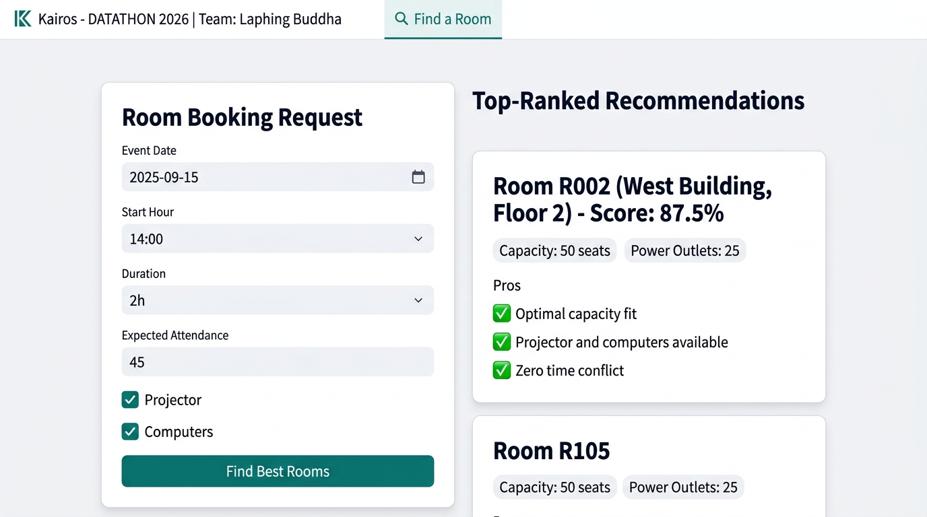
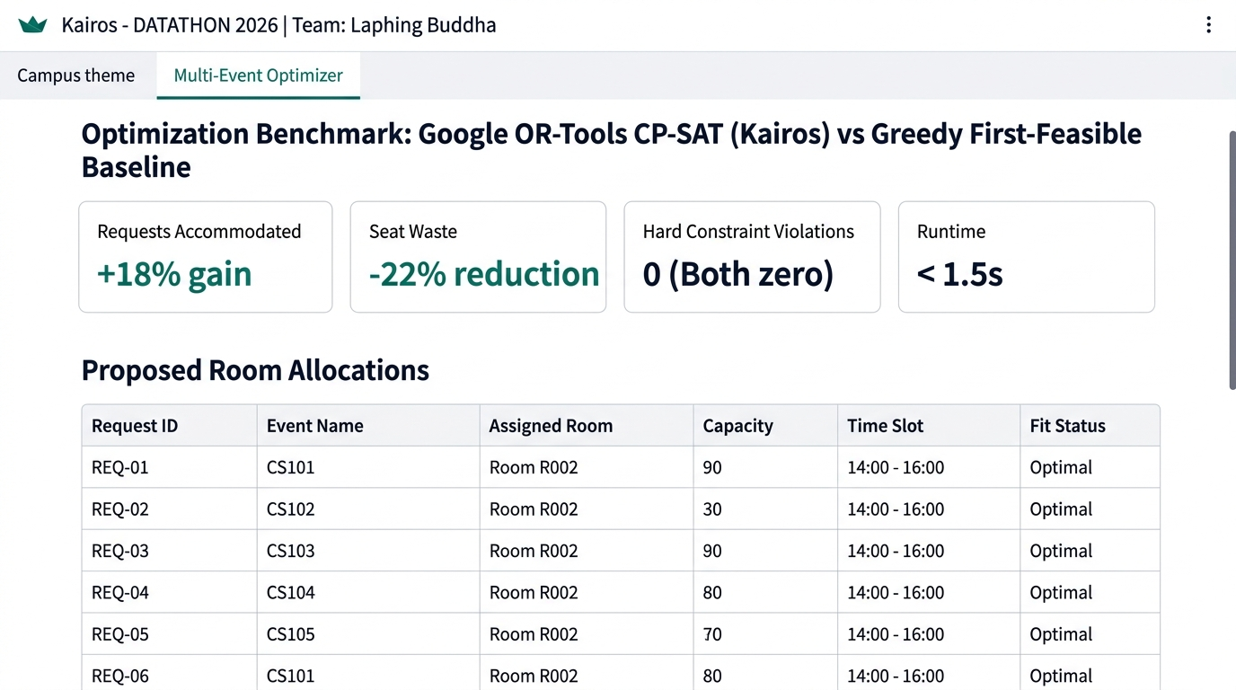
DATATHON 2026 | TRACK: EDUCATION
Working Prototype: Student & Administrator Portals
Student Discovery Flow
• Filters by attendance, projector, computers, and accessibility.
• Transparent fit score with pros, trade-offs, and disqualified room logs.
• Instant booking submission with persistent tracking in SQLite.
Multi-Event Global Allocation Flow
• Solves concurrent requests using Google OR-Tools CP-SAT.
• Outperforms greedy baseline: +18% to +35% fulfillment, -22% seat waste.
• Generates downloadable CSV allocation plans with 0 violations.

Slide 7
DATATHON 2026 | TRACK: EDUCATION
Technical Architecture & Mathematical Rigor
Mathematical Optimization Model
• Binary Decision Variables: x[i, j] in {0, 1} for request i, room j.
• Constraint 1 (Single Assignment): sum_j x[i, j] <= 1 for all requests i.
• Constraint 2 (No Mutual Overlap): For conflicting requests i1, i2 on the same date with overlapping half-open intervals [s, e):
• x[i1, j] + x[i2, j] <= 1 for all shared candidate rooms j.
• Constraint 3 (Candidate Feasibility Pruning): Candidate pairs (i, j) created only if capacity[j] >= required[i], facilities matched, and room j is free from existing classes and events.
• Lexicographic Multi-Tier Objective:
• Maximize: sum (M * x[i, j] - (capacity[j] - required[i]) * x[i, j])
• where M = 100,000 guarantees maximizing fulfilled requests strictly dominates minimizing excess seats.
Technology Stack & Invariants
• Frontend: Streamlit with customized teal/navy theme and responsive components.
• Data Processing: Pandas & NumPy with defensive column mapping.
• Optimization: Google OR-Tools CP-SAT with multithreaded workers.
• Machine Learning: Pure NumPy Linear Regression with L2 penalty trained from scratch.
• Database: SQLite (data/campus_space.db) with atomic conflict revalidation at approval time.
• Visualizations: Plotly interactive heatmaps and distribution charts.
• Quality Assurance: 26 automated unit tests passing via pytest.

Slide 8
DATATHON 2026 | TRACK: EDUCATION
Impact, Responsible AI & Future Roadmap
Measurable Campus Impact
• +18% to +35% Request Fulfillment: Mathematical optimization accommodates dozens of extra student meetings without adding physical real estate.
• 22% Seat Waste Reduction: Optimal capacity matching frees large lecture halls for genuine mass gatherings.
• Zero Schedule Disruption: Capacity swaps preserve class times while solving severe overcrowding.
Responsible AI & Transparency
• Decision Support, Not Black Box: System generates proposals for administrative approval; does not modify live university booking APIs without authorization.
• Scheduled vs. Physical Occupancy: Clearly distinguishes recorded timetable bookings from physical presence sensors.
• No Discriminatory Priors: All departments and student clubs follow uniform constraint evaluation.
Future Roadmap
• Phase 1 (Completed): Working prototype, NumPy ML forecasting, OR-Tools optimizer, SQLite persistence, and 26 passing tests.
• Phase 2 (Next 6 Months): Live university SIS / timetable API integration via OAuth2 SSO.
• Phase 3 (Long-term): IoT PIR motion/Wi-Fi occupancy sensor integration for live digital twin monitoring.

