Slide 1

MITM Operator Console
LAN Host Discovery, ARP Monitoring &
Packet Capture in an Isolated Lab

Slide 2
Objective
Building a professional-grade lab security console to demonstrate a full network security workflow — all within an isolated, private virtual environment.
→
Discover active LAN hosts and build an IP/MAC inventory
→
Capture network packets into PCAP files for Wireshark validation
→
Capture normal ARP baseline mappings (before/after reference)
→
Analyze traffic with flow-statistics and protocol breakdown plugins
→
Monitor ARP replies in real time and detect mapping changes
→
Present all results in a Flask-powered web operator dashboard
→
Log ARP events to a database with timestamps and severity

Slide 3
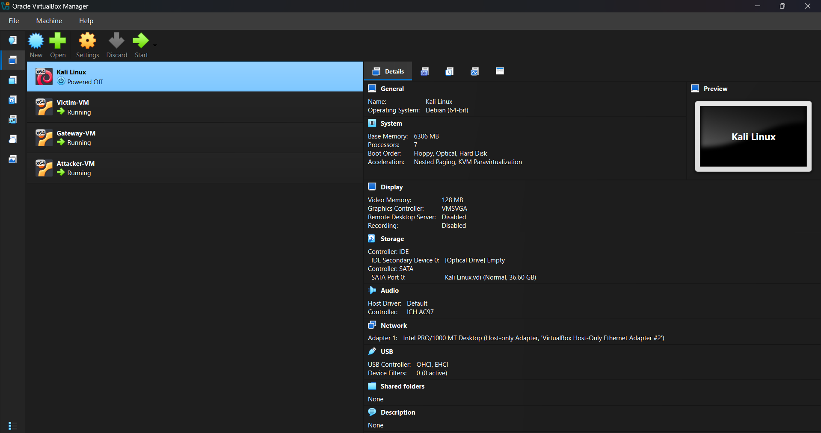
Lab Topology & Environment
Gateway VM
192.168.255.1
Default gateway, routing relay
Victim VM
192.168.255.10
Target host for demo traffic
Attacker VM
192.168.255.20
Fig 1. VirtualBox Manager — 3 VMs on isolated host-only network
Operator console, Scapy engine
All VMs use a VirtualBox host-only adapter — no external traffic escapes the lab.

Slide 4
Tools & Technologies
Python 3
Scapy
Flask
SQLAlchemy
Core implementation language for all modules
Packet sniffing, ARP probing, and PCAP parsing
Web backend serving the operator dashboard
ORM layer for hosts and ARP events storage
SQLite
VirtualBox
Wireshark
Kali Linux
Lightweight embedded database for all session data
Isolated lab hypervisor — 3-VM private network
PCAP verification and traffic validation tool
Attacker/console VM OS with pre-installed tools

Slide 5
System Workflow
1
2
3
4
5
6
7
Lab Setup
Host Discovery
ARP Baseline
ARP Monitoring
Packet Capture
Traffic Analysis
Dashboard
Deploy 3 VMs on host-only LAN; configure IPs
ARP broadcast scan → IP/MAC inventory
Record normal IP→MAC mappings for reference
Live monitor of ARP replies + event logging
Save PCAP session artifacts to disk
Plugin: flow stats, protocol breakdown
Flask web UI — hosts, events, flow stats
▶
▶
▶
▶
▶
▶

Slide 6
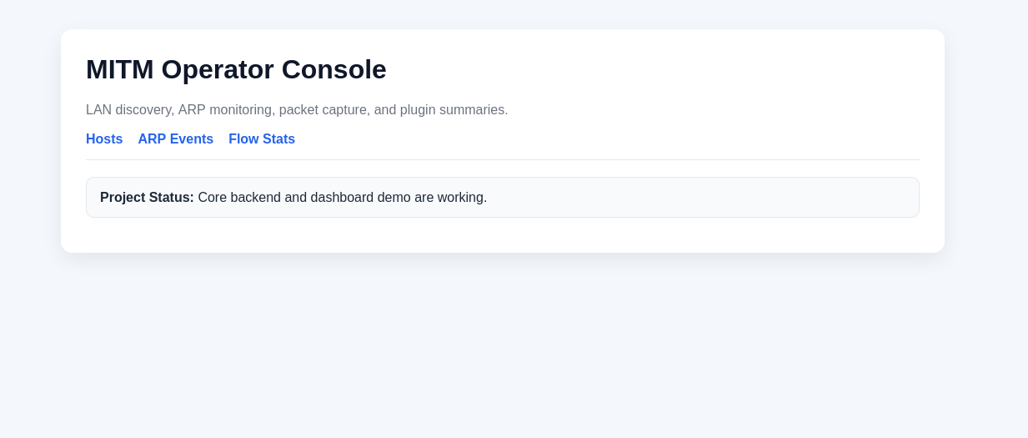
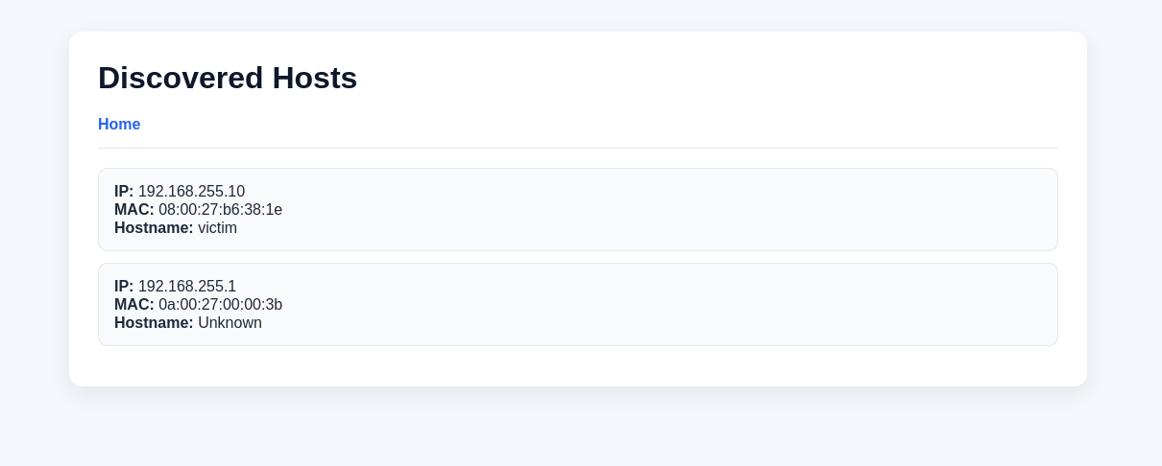
Host Discovery
How it works
Sends ARP broadcast (who-has) packets to all /24 addresses
Collects ARP replies: IP address + MAC address pairs
Hostnames resolved where available
Results stored directly in SQLite via SQLAlchemy ORM
Dashboard /hosts page reflects live database content
Fig 6. Host discovery terminal output with DB save confirmation
Discovered: Gateway (192.168.255.1) + Victim (192.168.255.10)
Both stored in SQLite hosts table ✓
Fig 8. /hosts dashboard — IP, MAC, hostname from live database

Slide 7
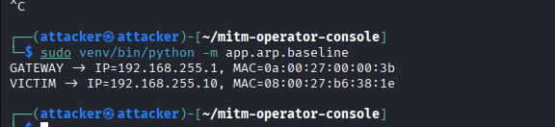
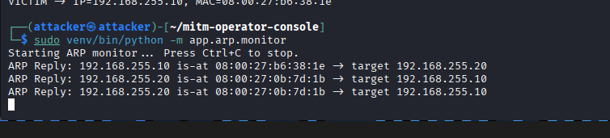
ARP Baseline Capture & Live Monitoring
ARP Baseline Module
Captures current gateway and victim IP→MAC mappings
Stores as the "normal" reference state
Enables before/after comparison for change detection
Fig 9. ARP baseline — normal IP→MAC mappings recorded
Fig 11. Live ARP monitor — real-time observed ARP reply stream from Scapy sniffer
ARP monitor sniffs all replies on the interface using Scapy
Compares observed IP→MAC mappings against baseline for anomaly detection

Slide 8
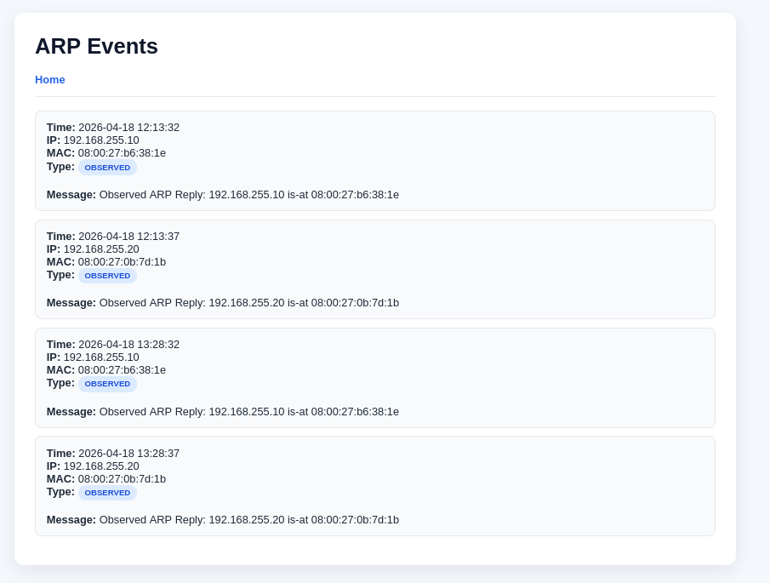
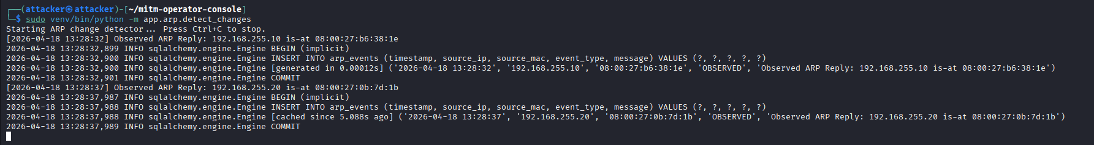
ARP Event Logging & Database Persistence
Each ARP event stores:
Timestamp (UTC)
Source IP address
Source MAC address
Event type / severity
Human-readable message
Live output → Log file (.json) → SQLite DB
All three storage targets written simultaneously
Fig 12/13. /arp-events dashboard — timestamped events from SQLite

Slide 9


Packet Capture & PCAP Management
1. Start Capture
2. Save PCAP
3. Read & Validate
→
→
Scapy sniffer activated, session timer begins
Packets written to data/pcaps/test_capture.pcap
PCAP loaded back, packet count confirmed (20 pkts)
Fig 16. Capture start — 20 packets captured, PCAP path confirmed
Fig 18. PCAP readback: 20 packets loaded from data/pcaps/test_capture.pcap
PCAP Artifacts & Verification
Each session stores a uniquely-named PCAP file plus metadata in SQLite
PCAP files are downloadable directly from the dashboard for Wireshark validation
File system path: data/pcaps/test_capture.pcap — confirmed 20 packets in demo

Slide 10
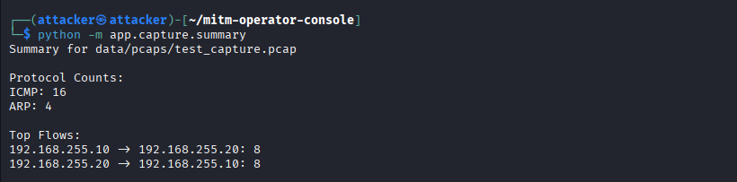
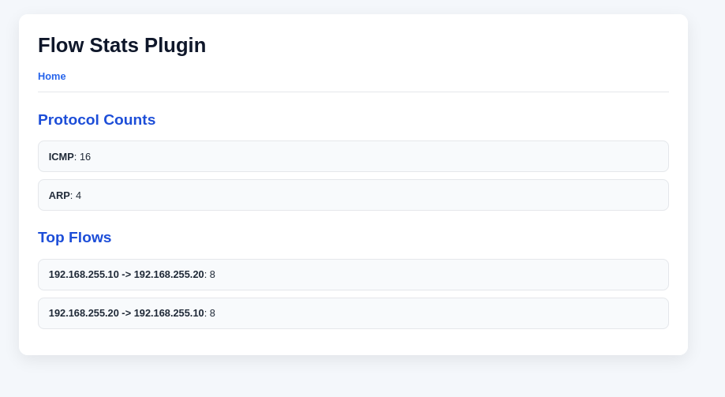
Traffic Analysis — Flow Statistics Plugin
Plugin Framework
Plugins accept PCAP/session metadata as input
Output a structured JSON summary to the dashboard
Implemented: Flow Statistics plugin (demo)
Demo Results
ICMP — 10 pkts
ICMP ping testing between VMs
ARP — 10 pkts
Fig 19. Terminal: protocol counts and top IP-to-IP flow summary from saved PCAP
Address resolution traffic

Slide 11
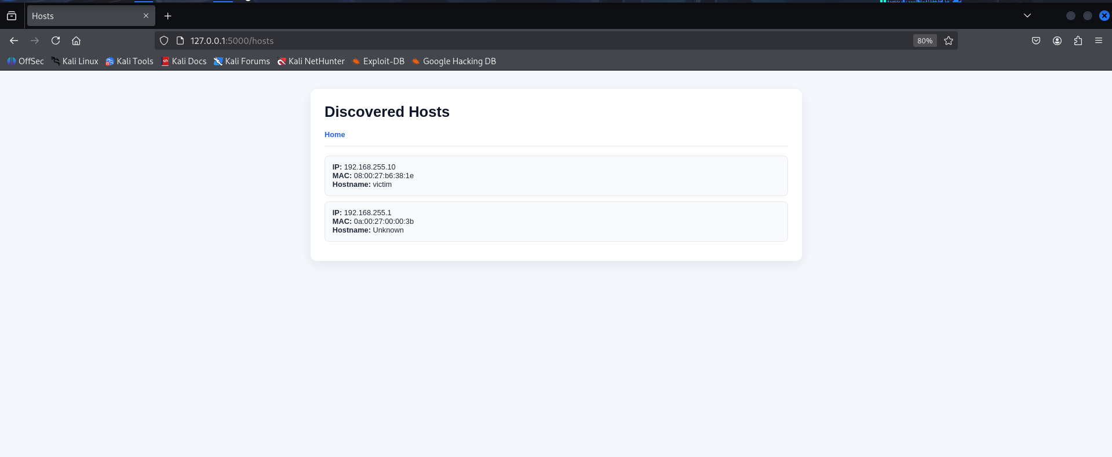
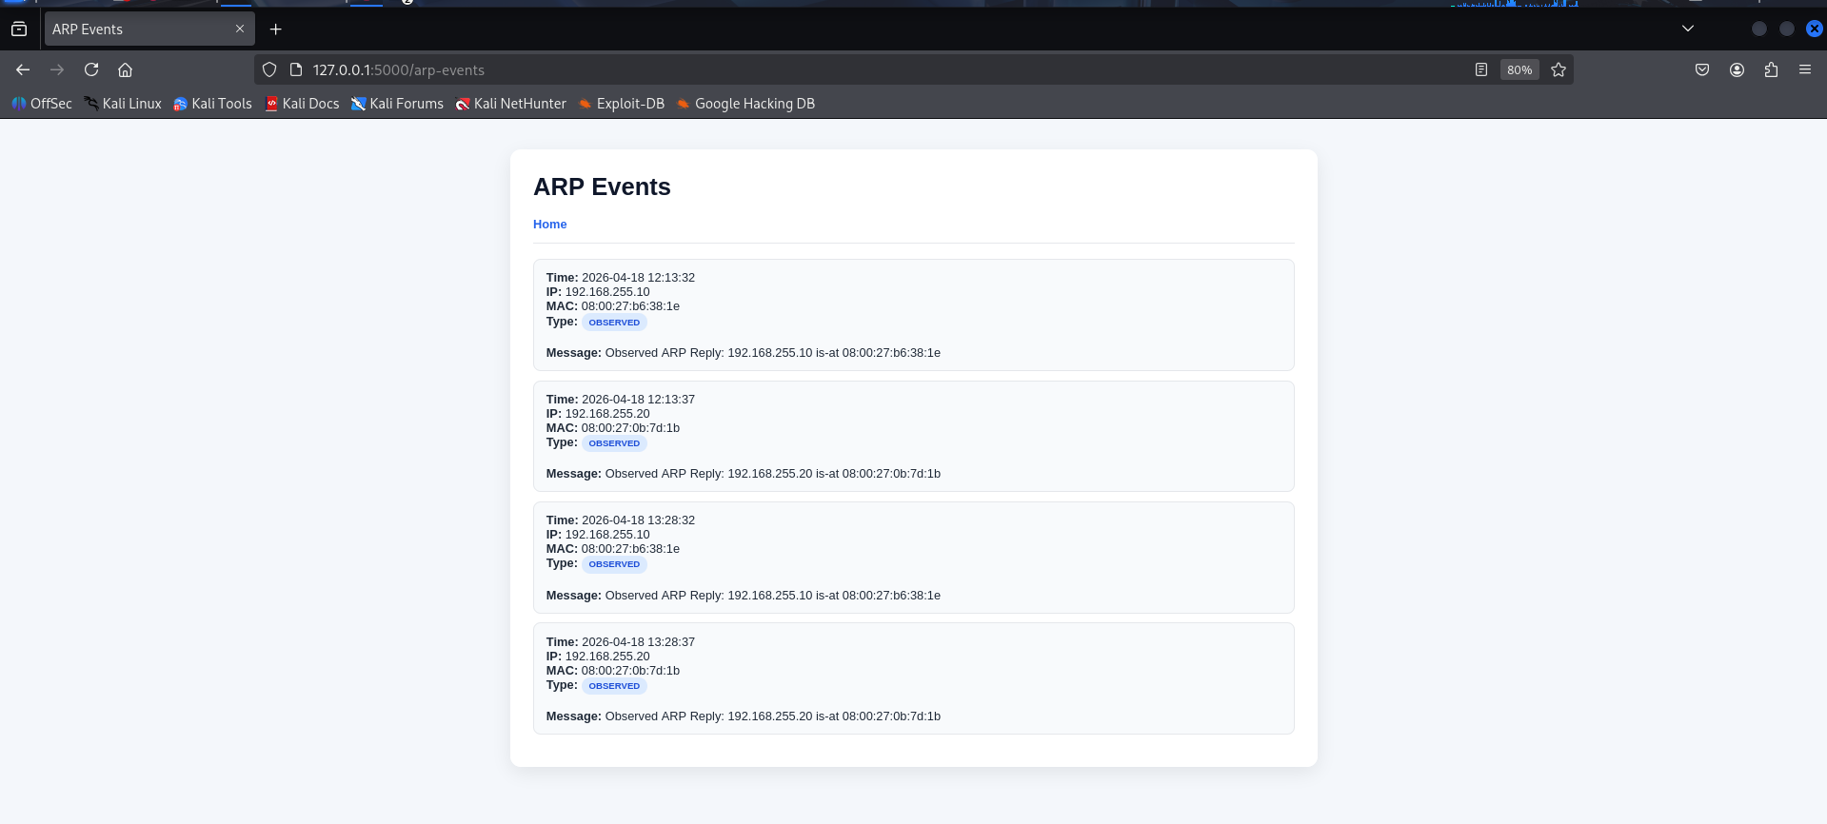
Web Operator Dashboard (Flask)
Fig 23. Styled ARP Events dashboard
Dashboard Pages
/ Home overview
Fig 22. Styled Discovered Hosts dashboard
/hosts Network map
/arp-events ARP timeline
/plugins/flow-stats Flow stats
Organizes all results clearly — every module's output accessible in one place
Fully database-backed: real SQLite data rendered live, not hardcoded HTML
Dramatically improves demo readability and project professionalism

Slide 12
Conclusion & Future Work
Project Achievements
Future Improvements
✓ LAN host discovery with database persistence
→ Additional plugins: DNS, TLS/SNI, anomaly score
✓ ARP baseline capture for before/after comparison
→ Full session create/stop controls via dashboard
✓ Real-time ARP monitoring and event logging
→ HTML/PDF report export with Wireshark screenshots
✓ Packet capture to PCAP with readback validation
→ Enhanced UI styling and responsive layout
✓ Flow statistics plugin (protocol + flow summary)
→ ARP event severity scoring & alert threshold
✓ Flask operator dashboard with live DB data
→ Timeline visualization for ARP events page
All testing conducted strictly in an isolated VirtualBox lab network for security research.

Slide 13

THANK YOU

