Slide 1
BDD
Author: Nikunj Kumar

Slide 2
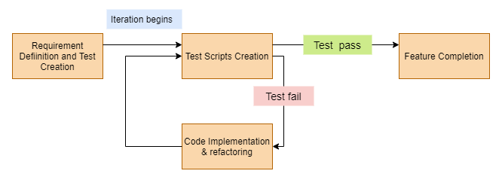
TDD (Test Driven Development)
Is an iterative approach, starts with writing the test scripts first which supposed to fail in first iteration as there will be no application code.
In the next phases of iteration, application code is written with an intention to pass all the tests written earlier.

Slide 3
TDD (Test Driven Development)
Benefits:
The programmers productivity is increased.
Receives fast feedback.
Creates solid code.
Improves code quality.
Drawbacks:
Re-write the test when requirements change.
Tests become part of maintenance overhead of a project.
Targets verification of classes and methods and not on what it is supposed to do.
Can be considered as a waste of time.

Slide 4
BDD (Behavior-Driven Development)
Extension of TDD, We write tests first and add application code.
Tests are written in plain descriptive English type grammar.
Test scenarios are written separately in a separate file, named as feature file.
Tests are more user focussed.
Code is written differently in step definitions file i.e. Java, Python.
Using examples to clarify requirements.
It is an Agile software development process that encourages collaboration among developers, QA and non-technical or business stakeholders. Bridges the gaps between technical and the non-technical teams.
There are various BDD framework like Cucumber, Jbehave, Specflow and many more.

Slide 5
Cucumber (BDD tool)
Cucumber is a testing framework which supports Behavior Driven Development (BDD). It lets us define application behavior in plain meaningful English text using a simple grammar defined by a language called Gherkin. Cucumber itself is written in Ruby, but it can be used to “test” code written in Ruby or other languages including but not limited to Java, C# and Python.
Gherkin: It's a BDD language or DSL (Domain specific language) which helps to describe business behaviour.
This language exists in more than 37 languages like, English, French etc…
Gherkin Syntax:
Feature: Title of the Scenario
Given [Preconditions or Initial Context]
When [Event or Trigger]
Then [Expected output]

Slide 6
Gherkin (Example)
Suppose, I want to login to facebook then the gherkin example would be as below:
Feature: Login to Facebook.
Given: I am a registered facebook user.
When: I enter username as username.
And I enter the password as the password.
Then I should be redirected to the home page of facebook.
Important terms in Gherkin:
Feature
Background
Scenario
Given
When
Then
And
But
Scenario Outline Examples

Slide 7
Gherkin (Example)
Secondary keywords:
""" (Doc Strings)
| (Data Tables)
@ (Tags)
# (Comments)

Slide 8
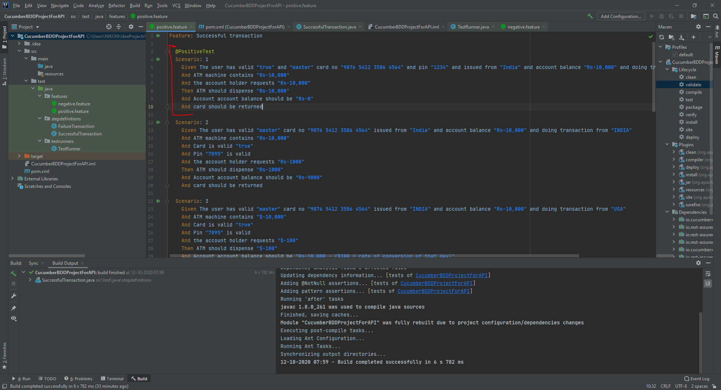
Card transaction feature file

Slide 9
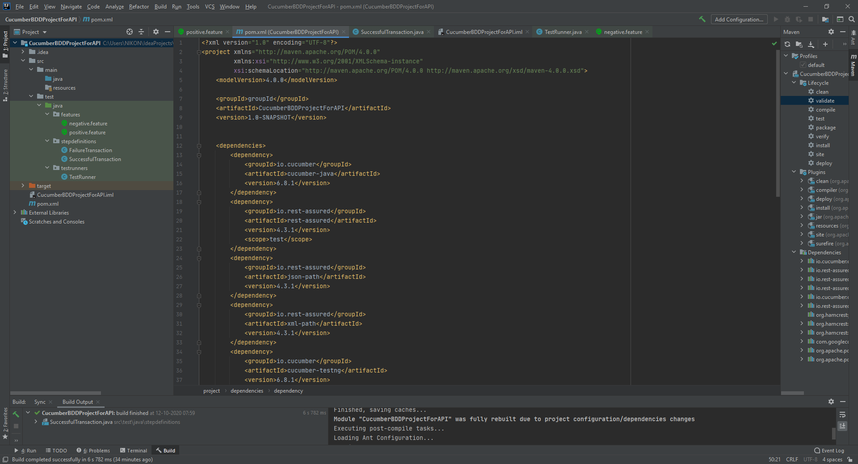
Jars Used

Slide 10
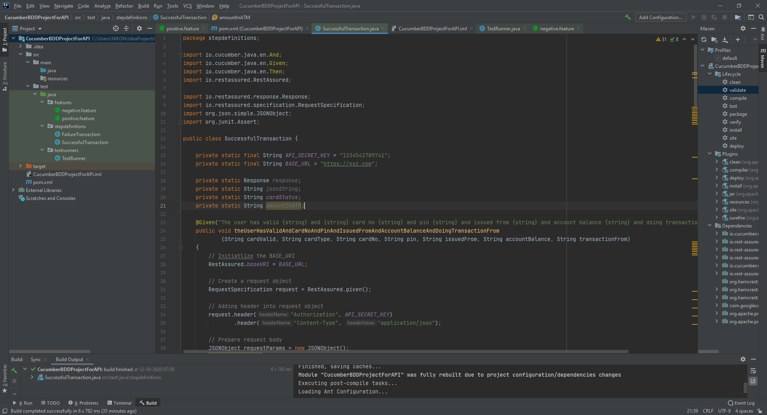

Slide 11
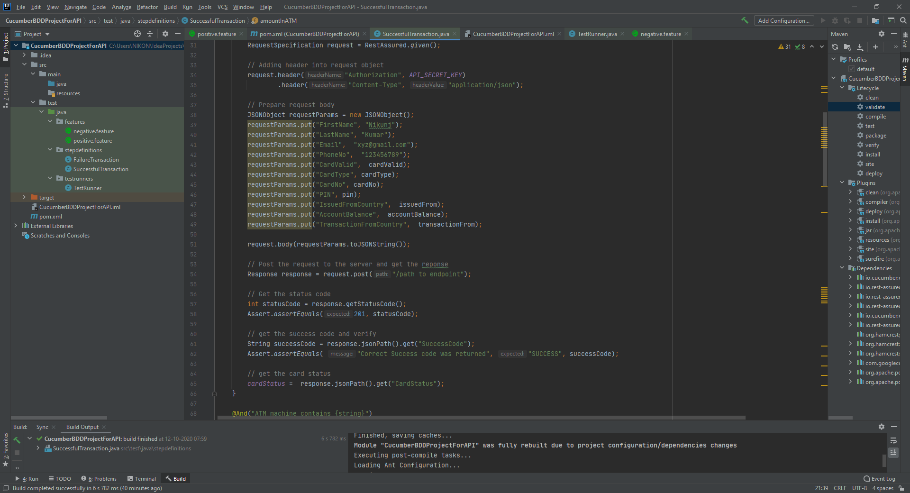

Slide 12
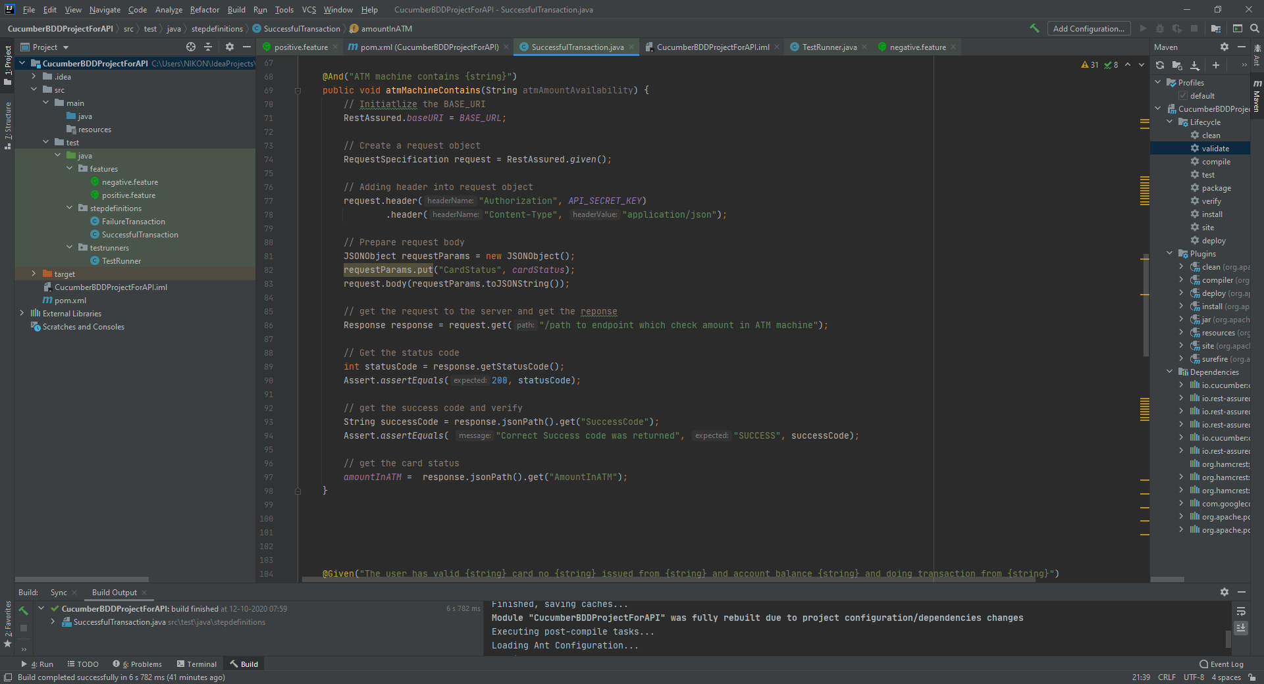

Slide 13
Project files

