Slide 1
◎
SENTINEL
Unified CCTV Intelligence for Gujarat Police
Turning the 80,000 cameras Gujarat already owns into one real-time public-safety network
Team: Nikunj Maheshwari · Dhurvi Thakkar
Primary Model: Hybrid (Model 1 + 3 + 4) · Gujarat Police Innovation Hackathon 2026

Slide 2
THE PROBLEM
80,000 cameras. 5 departments. Zero coordination.
📷 📷 📷
📷 📷 📷
📷 📷 📷
📷 📷 📷
📷 📷 📷
📷 📷 📷
📷 📷 📷
📷 📷 📷
📷 📷 📷
📷 📷 📷
Health
Police
GSRTC
Panchayat
Municipal
Isolated silos. No unified view. No automatic alerts.
A stolen vehicle or a wanted person passes a camera — and we find out only later, after manually reviewing footage.
SENTINEL · Gujarat Police Innovation Hackathon 2026
2

Slide 3
BEYOND POINT-ANPR
Not another plate-reader — a city-wide platform
EXISTING BORDER ANPR
SENTINEL
• Dedicated ANPR cameras only
• Fixed chokepoints
• Reads number plates only
• Isolated, single-point logs
• Hardware-locked, expensive
• Works on ANY existing camera
• Whole network, all departments
• Plates + faces + any scene
• Cross-camera route tracking
• Natural-language video search
SENTINEL · Gujarat Police Innovation Hackathon 2026
3

Slide 4
SOLUTION OVERVIEW
One platform. Three layers. Edge-first.
MODEL 1
Mandatory foundation — unified camera inventory on a live map
CCTV Registry + GIS
MODEL 3
Connect any existing camera without disrupting departments
VMS Federation + Middleware
MODEL 4
Analytics, alerts, cross-camera tracking, language search
Central AI Platform
★ Core principle: Process at the edge — centralise only intelligence, never bulk video.
SENTINEL · Gujarat Police Innovation Hackathon 2026
4

Slide 5
ARCHITECTURE
How it works — from camera to command centre
📹
⚡
📡
🧠
🗺️
Existing CCTV
Edge AI
MQTT
Central AI
Dashboard
multi-vendor
OpenVINO / iGPU
metadata only
correlate + DBs
GIS + alerts
Only lightweight alerts + metadata reach the centre — NEVER bulk video
Correlated in real time with VAHAN · SARTHI · eGujCop / CCTNS
SENTINEL · Gujarat Police Innovation Hackathon 2026
5

Slide 6
KEY FEATURES · BUILT & LIVE
A complete, multi-modal policing platform
🚗
🧑
🗺️
🔍
ANPR + Stolen-vehicle alerts
Face recognition
Cross-camera route tracking
Natural-language search
OCR-tolerant fuzzy matching
Wanted / missing persons (eGujCop)
Reconstruct a target's path
"red SUV near Sector 18"
📡
📋
🛡️
⚡
Real-time alerts
Camera registry + health
RBAC + audit trail
Edge AI, no GPU
Lightweight MQTT backbone
Live status, CSV onboarding
DPDP-aligned governance
Runs on commodity hardware
SENTINEL · Gujarat Police Innovation Hackathon 2026
6

Slide 7
LIVE DEMONSTRATION
See it working — camera to alert in seconds
7
7
7
7
Vehicle passes camera
Matched to database
Instant RED alert
Route reconstructed
Plate detected & read on the live stream
Checked against stolen-vehicle watchlist
Raised on the live GIS map in real time
Vehicle's path drawn across all cameras
Plus: face recognition alerts · natural-language video search · predictive next-camera + drone dispatch
All validated live on a standard laptop with an Intel integrated GPU — no dedicated GPU required.
SENTINEL · Gujarat Police Innovation Hackathon 2026
7

Slide 8
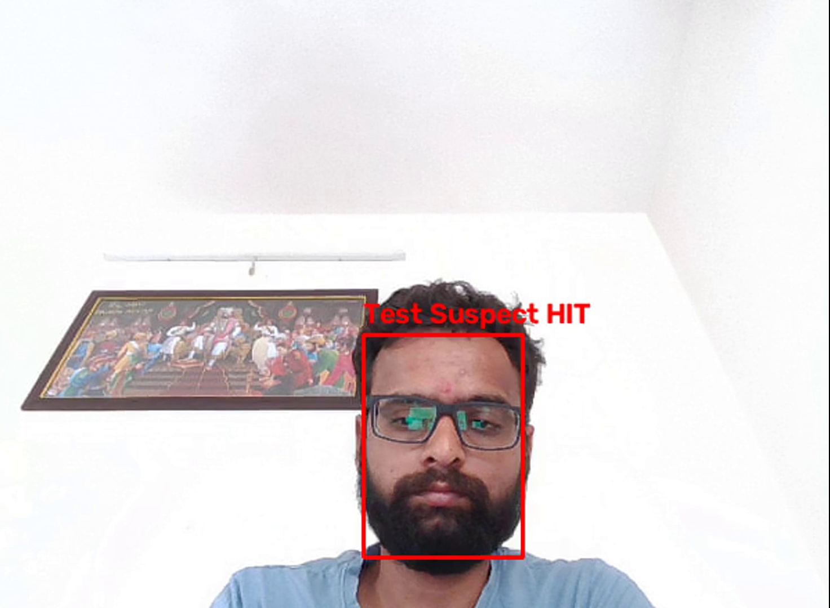
WANTED PERSON RECOGNITION
Every face on camera, checked against the wanted & missing list
FACE WATCHLIST MATCH
• Every detected face is embedded and matched in real time against eGujCop wanted / missing-persons records
• Works on angled, partial or low-light faces using InsightFace embeddings + vector similarity search
• Configurable match threshold balances recall against false positives for field use
• Instant alert with match confidence, camera ID and timestamp — same MQTT alert backbone as ANPR
Live capture: webcam feed → instant “HIT” on a registered profile
★ Demonstrated live on an ordinary webcam — deployable on any existing camera the same way.
SENTINEL · Gujarat Police Innovation Hackathon 2026
8

Slide 9
PREDICTIVE POLICING & AUTONOMOUS RESPONSE
From last-seen to intercepted — before it arrives
PREDICTIVE NEXT-CAMERA
AUTONOMOUS DRONE DISPATCH
• Scores every camera in range by direction + distance from the vehicle's last sighting
• score = 0.6 × bearing alignment + 0.4 × proximity (haversine distance + compass bearing)
• Predicted camera and ETA appear instantly on the live map — an amber marker + dotted path
• No manual guesswork: patrol units know exactly where to look next
• One click on any alert dispatches a drone toward the interception point
• Simulated flight path animates in real time, with a live trailing route on the map
• Status panel shows next waypoint, live ETA and a one-click recall
• Integration-ready for real hardware via MAVLink / DJI SDK
★ Sentinel doesn't just alert — it predicts where the target is going, and can act on it.
SENTINEL · Gujarat Police Innovation Hackathon 2026
9

Slide 10
AUTONOMOUS DRONE DISPATCH
From alert to interception — a drone in the loop, not just a camera
🚨
🧭
🚁
📡
🎯
Alert Triggered
Next Camera Predicted
Drone Dispatched
Live Telemetry
Interception Point
Stolen vehicle / wanted person
Bearing + distance scoring
One click from the alert
ETA, waypoint, trailing route
Ground units guided in
• Animated flight path with a live trailing route and a status panel (next waypoint, ETA, one-click recall)
• Fully simulated today on the same map used for ANPR and face alerts — integration-ready for real hardware via MAVLink / DJI SDK
★ Same pipeline, faster response: detect → predict → dispatch → intercept, in seconds.
SENTINEL · Gujarat Police Innovation Hackathon 2026
10

Slide 11
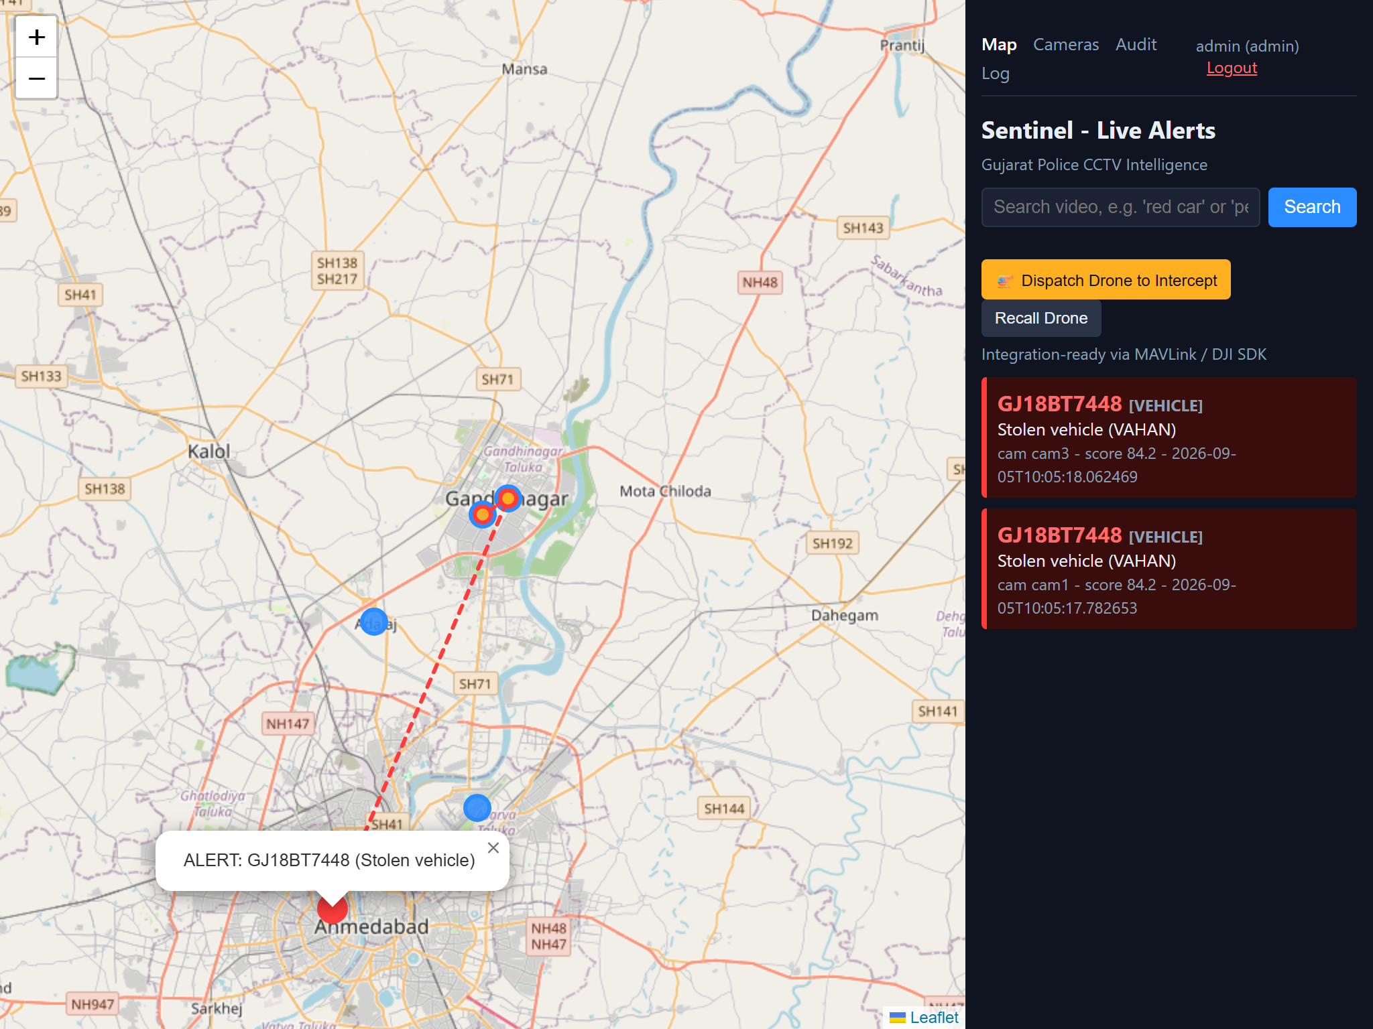
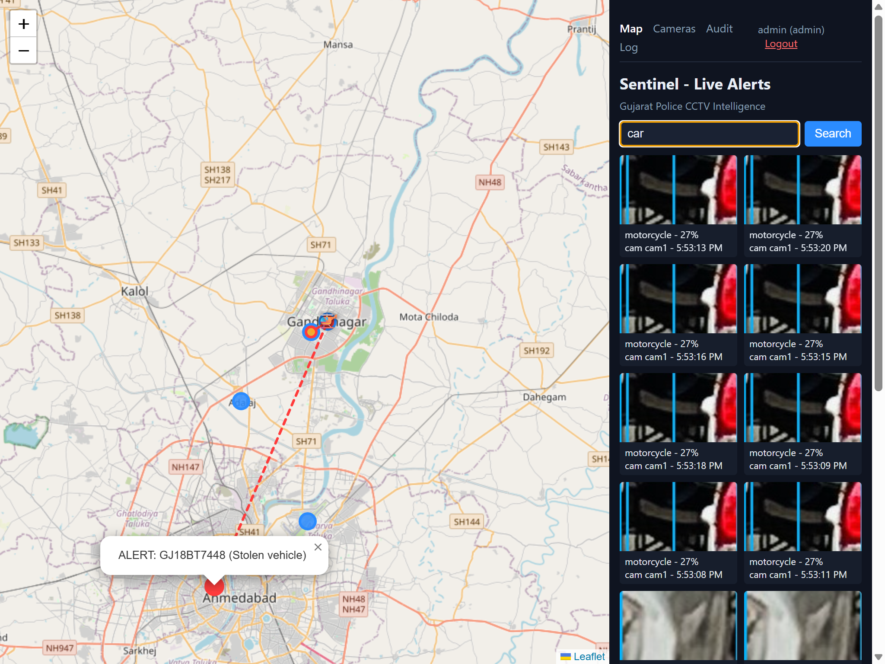
PRODUCT IN ACTION
Real screens, real detections — captured from the running system
Cross-camera alert + automatic route reconstruction
Predictive next-camera + one-click drone dispatch
Also live on the same dashboard: natural-language video search across every camera, and a full camera registry with live health status.
SENTINEL · Gujarat Police Innovation Hackathon 2026
11

Slide 12
THE SCALE BREAKTHROUGH
Why Sentinel reaches 80,000 cameras
160 Gbps
≈ 10 Gbps
Centralising all video — impossible
Edge processing — 15× less, feasible
Process at the edge · send only metadata · run on ordinary Intel hardware
15–50× lower bandwidth · central storage cut from petabytes to a fraction · no GPU required
SENTINEL · Gujarat Police Innovation Hackathon 2026
12

Slide 13
COST & IMPACT
Measurable benefits at state scale
₹120 Cr / yr
₹0
Commercial per-camera licensing (indicative)
Sentinel licensing — open-source
~1–2 sec
80,000
Zero
detection-to-alert
(vs hours of manual review)
existing cameras activated
as intelligent sensors
new hardware —
reuses existing cameras
SENTINEL · Gujarat Police Innovation Hackathon 2026
13

Slide 14
SECURITY & COMPLIANCE
Government-grade by design
🔐
📜
⚖️
🛰️
Role-Based Access
Full Audit Trail
DPDP Act 2023
Secure & Isolated
Admin / operator roles; every route and API gated
Every login, action and dispatch logged
Purpose-limited, retention-bound, access-controlled PII
TLS transport, tamper detection, department isolation
Cameras stay in their department networks — Sentinel federates with least-privilege, read-only access.
SENTINEL · Gujarat Police Innovation Hackathon 2026
14

Slide 15
TECHNOLOGY & INTEGRATION
Production-credible stack — easy camera integration
TECHNOLOGY STACK
CAMERA INTEGRATION
AI/Edge: Intel OpenVINO · YOLOv8 · fast-plate-ocr · InsightFace · CLIP
Data: PostgreSQL + PostGIS · Qdrant (vector DB)
Backbone: MQTT (Mosquitto) · MediaMTX · FFmpeg
App: FastAPI · Leaflet GIS · Docker
IP cameras — Easy:
Drop-in via RTSP / ONVIF. Point the gateway at the URL.
Analog cameras — via DVR:
Use the DVR/NVR RTSP output, or an analog-to-IP encoder.
Everything normalises to one RTSP URL per camera — exactly the hackathon feed model.
SENTINEL · Gujarat Police Innovation Hackathon 2026
15

Slide 16
ROADMAP & VISION
From working prototype to statewide deployment
PILOT
REGIONAL
STATEWIDE
1 district
1 zone
~80,000 cams
Registry + GIS, ANPR + face, validate on real cameras
HA/DR, live VAHAN & eGujCop, production SSO + audit
Edge fleet, language search, IoT sensor fusion, SOC
Protect What Matters.
Sentinel — built on the cameras Gujarat already owns.
Team: Nikunj Maheshwari · Dhurvi Thakkar

