Slide 1
ESW Project
TEAM 1 : Silent Storm
Nikunj Garg
Manuj Garg
Ishit Bansal
Pranav Gupta

Slide 2
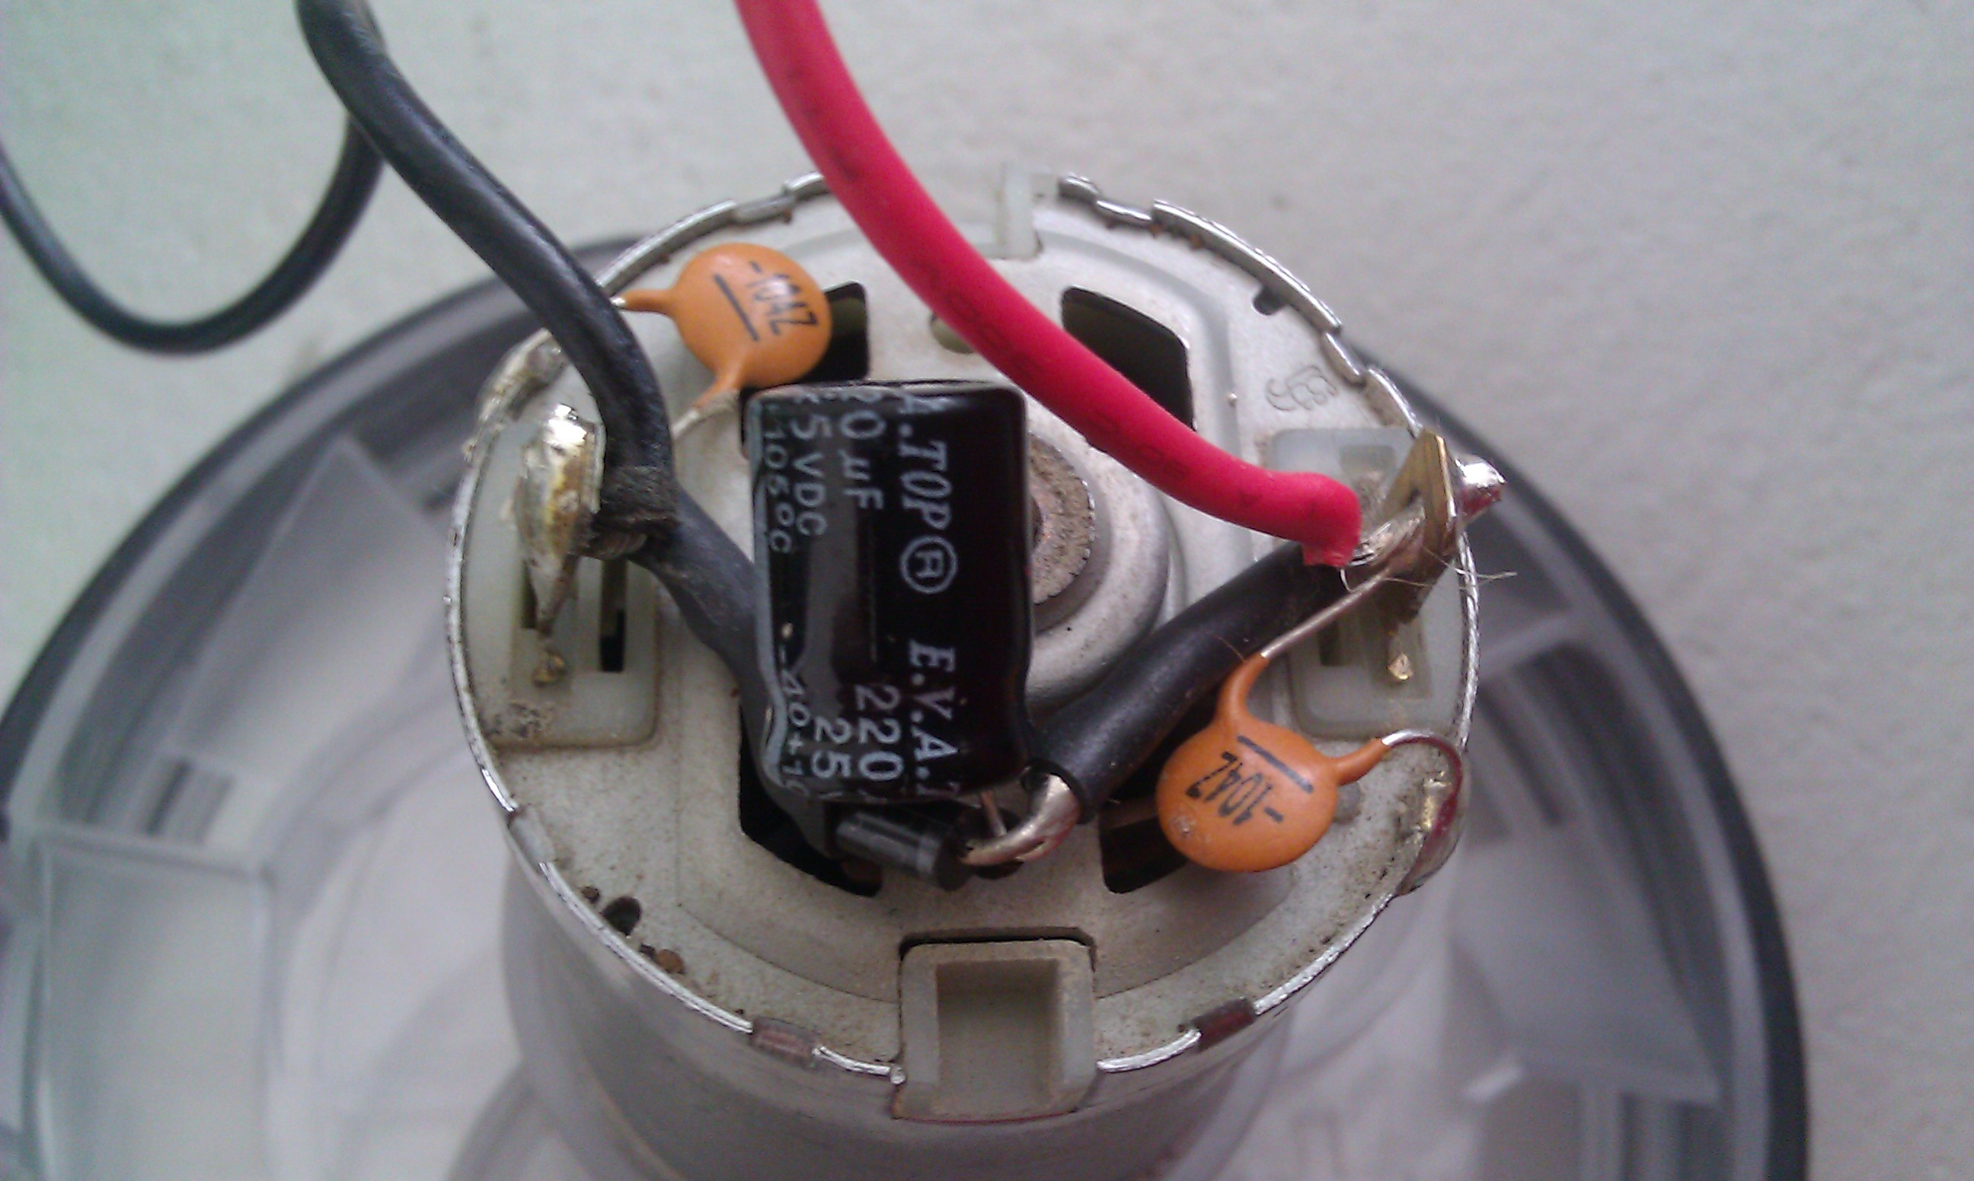
Motivation
In developing countries like India there are lakhs of students who are deprived of the opportunity of performing electronic experiments. Hence our objective is to create remote project which can be accessed from any part of the world in the minimal cost the remote DC Motor where user varies the voltage and volts vs rpm characteristics are recorded in dashboard.
This Photo by Unknown author is licensed under CC BY-SA.

Slide 3
Setting up of Hardware
In this project we are assembling DC motor, Motor Driver to scale voltage, RPM sensor, opto-interrupt sensor MOC7811, ESP-32, ESP cam module, PWM module to vary voltage in the actual setup of the hardware to track the measurement of the Input Current, Input Voltage, input power and output RPM of the motor.

Slide 4
Dashboard/Command Centre
We are developing an interface that will give commands , receive and monitor data related to Voltage/Power vs RPM of DC Motor.
Data communication is achieved with OM2M and THINGSPEAK platforms for exchanging data online with the actual setup.
A student can remotely control Voltage/power of motor and corresponding rpm reading will be published and a characteristic graph is also formed in the dashboard.
The rpm, voltage and current readings are collected at the remote level analyzed in the cloud, characteristic graph plotted.

Slide 5
Streaming Setup
Live setup of the actual hardware will be streamed online and on the dashboard to understand the experiment properly. It is achieved through ESP cam module and global server is hosted on the NGROK platform.
Data is uploaded in the OM2M global server, THINGSPEAK platform and can be accessed from anywhere.

Slide 6
Data Analysis
Variation in the characteristics is monitored and conclusions about the voltage/power Vs RPM of the motor are obtained.
Using cloud Data analysis, various patterns about the dependencies of Voltage/Power vs RPM are derived using graphs and nearest fit curve of the graph.

Slide 7
Summary
With the help of this project, we can optimize the costs of installation and interpretation of the experimental data so that its analysis becomes an easy task and can be performed from anywhere.
This project is helpful from student's point of view, because they can interpret the readings and use these in their experiments to enhance the learning process.
We are controlling the power, voltage or current inputs online to the dc motor and reading the rpm reading from the sensor and drawing relationship via graphs and best fit curve.
Data is well-organized in the form of line graphs and histograms to draw inferences from data and video is streamed on the website.

