Slide 1
Restaurant@Bangalore, INDIA
A Data Science Capstone Project by NikunjaBihari

Slide 2
Introduction / Business Problem
We have a friend who wish to setup a new restaurant in the city of Bangalore, India which is considered as the IT city of the country. Although he has some moderate level of knowledge about the city’s neighborhoods/areas and it’s famous venues, but not quite sure in details of each and every neighborhoods & cant really compare every neighborhoods and venues manually like visiting every places personally and exploring to figure out which neighborhood would be most suitable to open up a restaurant and what type of restaurant would be best which is popular amongst Bangalorians and will easily fetch customers as well good profit.
So, the 2 main business problem here with us are as follows:
Which neighborhood/area would be best to open a new restaurant in Bangalore.
What type of restaurant is most popular & best in Bangalore to easily get customer & earn profit.

Slide 3
Data Insight
City – Bangalore, Karnataka, INDIA
Total individual neighborhoods – 294
Neighborhoods mapped into no. of Pincode location – 96
No. of venues wrangled across the Bangalore city – 2366
No. of unique category venues traversed – 207
Short listed locations for a new restaurant - 2
Short listed Type of Restaurant - 1

Slide 4
Data Science Applications
Data science methodologies used to collect data, prepare & clean the data using various techniques like Data visualization, sorting & filtering to make it ready for the processing.
Used the one hot encoding to normalize the data.
K-means clustering has been used to segment the neighborhoods into different clusters to focus on a target potential no. of areas further further analysis.
Used Frequency matrix and venue density to find out target neighborhoods with less restaurants.

Slide 5
Four Clusters of Neighborhood
Cluster 0 - 44 neighborhoods Place of restaurants and eateries
Cluster 1 - 1 neighborhood Less restaurants and eateries, outskirt neighborhood
Cluster 2 - 50 neighborhood Mix-N-Match of all types of venue categories
Cluster 3 - 1 neighborhood Less restaurants and eateries, outskirt neighborhood

Slide 6
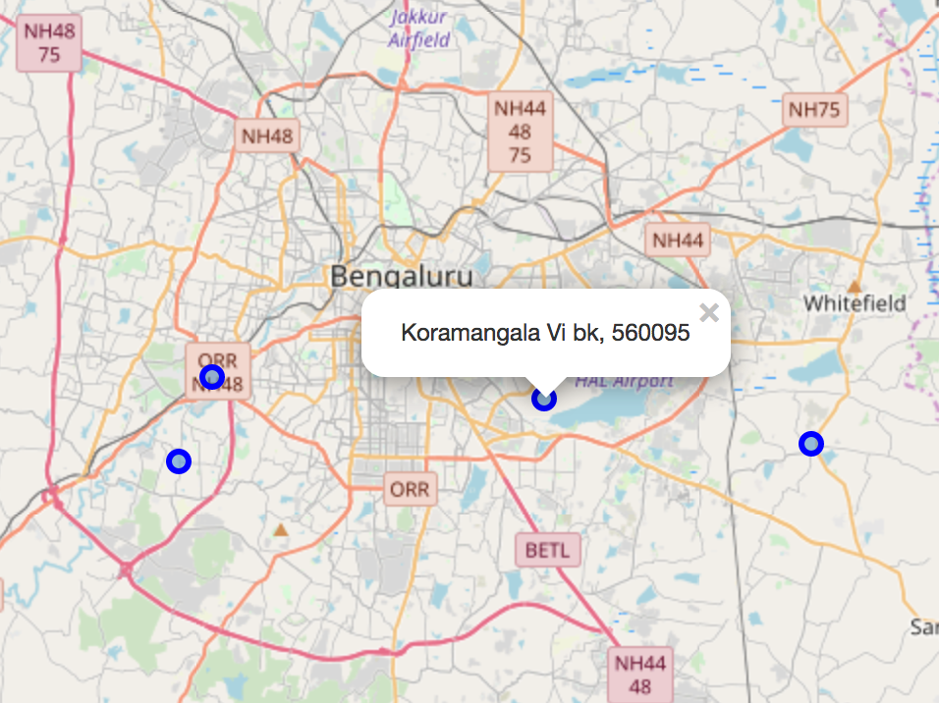
The Final Four
Neighborhoods with ZERO restaurant density in 10 most common venue categories as extracted from Foursquare.
Koramangala Vi bk -> 1st Preference since its in the core of the city limits
Nayandahalli -> 2nd Preference as its just at the border line of city limit.
Gunjur, Muthusandra, Panathur, Vartur
Kenchanahalli, Rajarajeshwarinagar

Slide 7
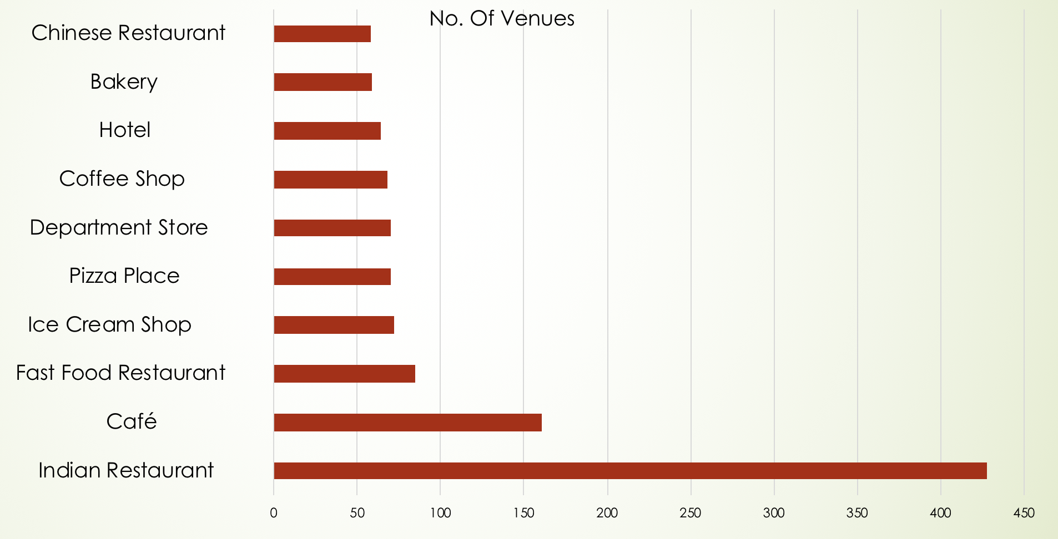
Top 10 venue categories across all the neighborhoods

Slide 8
The Final Recommendation for Location & Restaurant Type
Restaurant Type –
Indian Restaurant
Location –
1. Koramangala Vi bk - 560095
2. Nayandahalli - 560039

Slide 9


