Slide 1

Assignment2
Nikunj Lad
001422467

Slide 2
Loan Approval Analysis
Performed EDA which includes filtering Null values, correlation analysis, Covariance analysis
One hot encoded categorical values and feature hashed higher order categorical values using Murmurhash3 function
Used Keras Sequential API for model architecture of feed forward network
Train-Validation loss and accuracy curves vs the epochs, Confusion matrix and accuracies as metrics for evaluation.

Slide 3
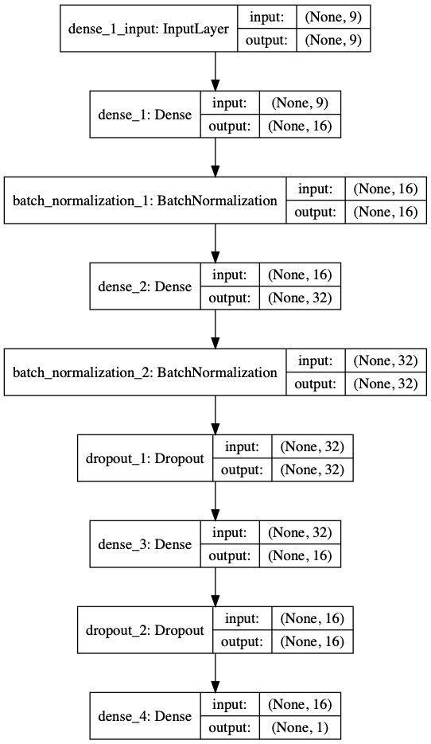
Model Architecture
Kernel Initializer : Random Uniform
Optimizer: Stochastic Gradient Descent
Dropout factor: 0.25 and 0.10
Learning rate : 0.15
Batch Size : 32
Activation: ReLU and Sigmoid

Slide 4
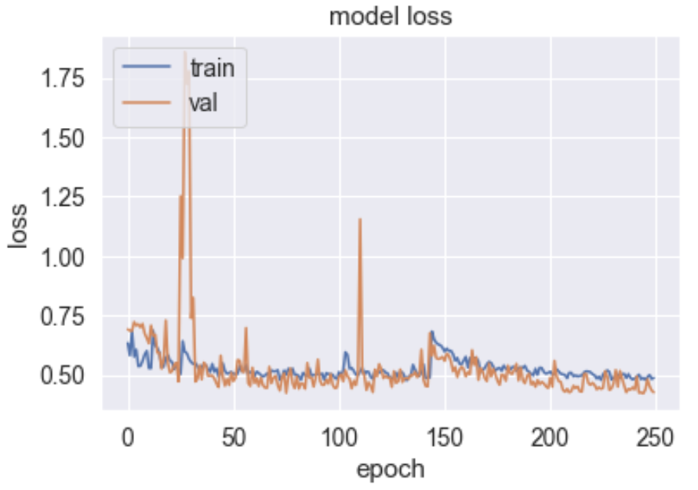
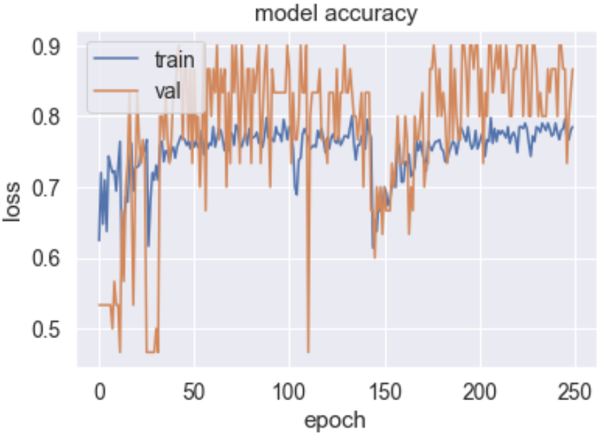
Training-Validation Loss and Accuracy Curves
Training Loss : 0.4869
Training Accuracy : 78.50%
Validation Loss : 0.4257
Validation Accuracy : 86.67%
MSE : 0.1291

Slide 5
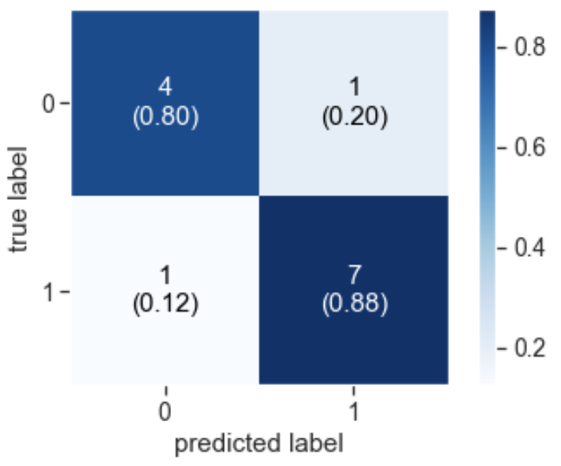
Confusion Matrix
Test Accuracy : 84.65%
True positives are 7 (88%), True negatives are 4 (80%).
~85% accurate predictions on unknown data.
~15% mispredictions.

Slide 6
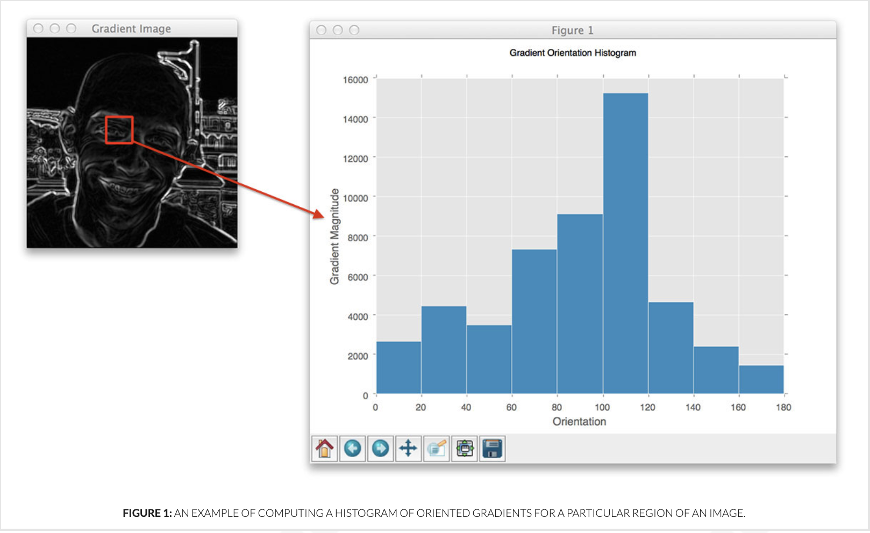
Histogram of Oriented Gradients
Mainly used for Object detection but can be used for classification as well
Used for quantifying and representing both texture and shape attributes
Local object appearance and shape can be characterized by intensity gradients

Slide 7
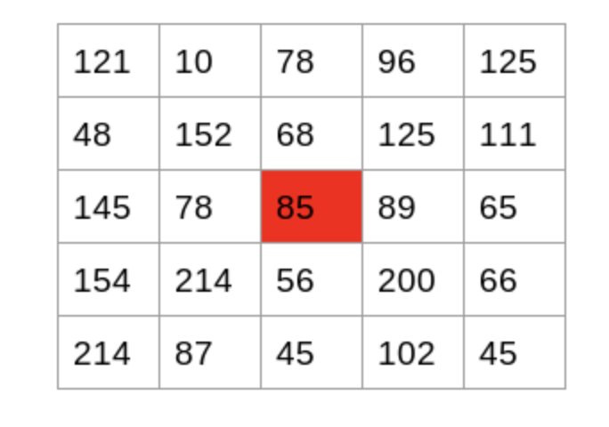
Gradient Computation
X direction: 89 – 78 = 11
Y direction: 68 – 56 = 8
Magnitude higher for sharp change in intensity, like edges

Slide 8
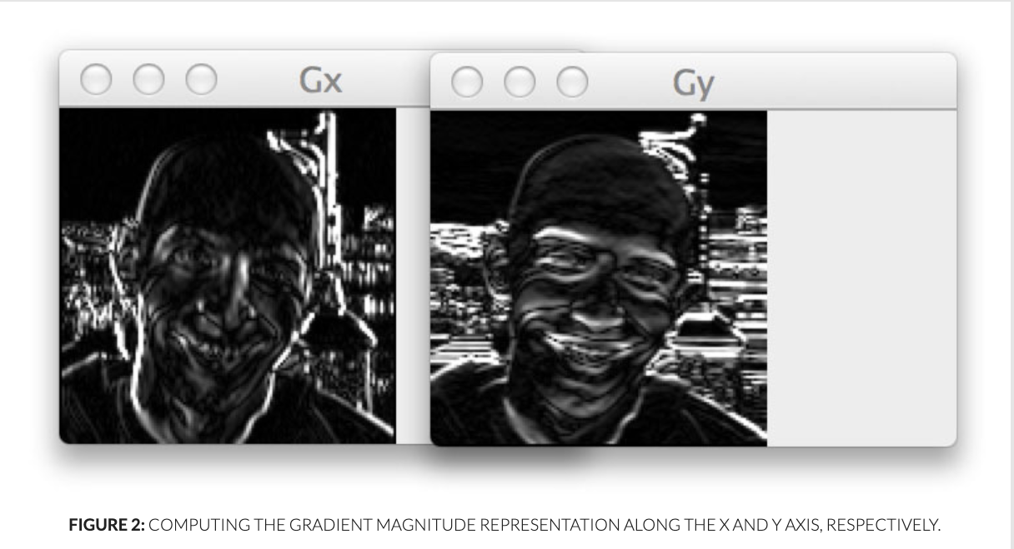
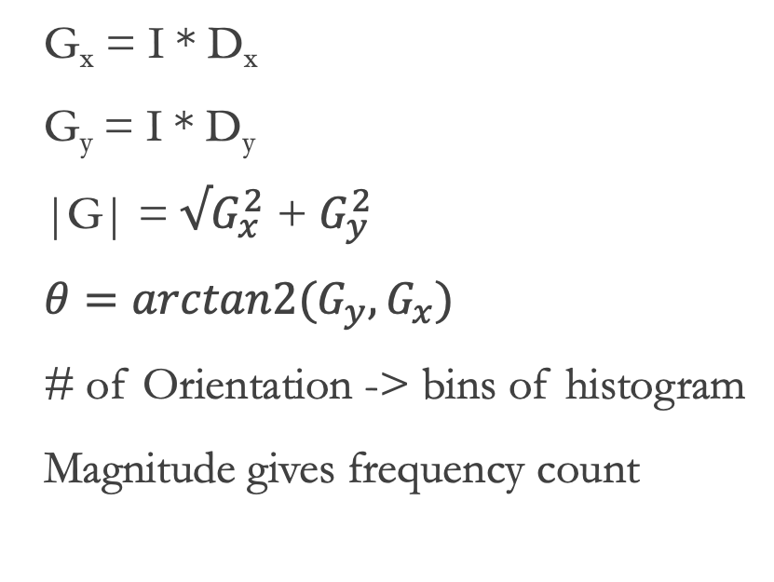
X-Y Gradients
G_{x} = I * D_{x}
G_{y} = I * D_{y}
|G| = $√G_{x}^{2}$ + $G_{y}^{2}$
$θ=arctan2(G_{y},G_{x})$
# of Orientation -> bins of histogram
Magnitude gives frequency count

Slide 9
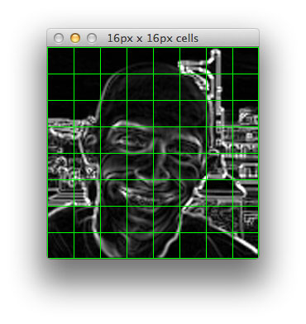
Voting
Histograms generated for each cell in the image.
Weighted vote of gradients corresponding to a pixel in image is considered.

Slide 10
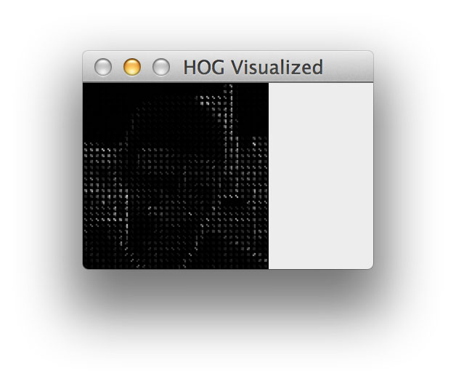
Blocks
Image divided into grid of cells.
Cells : group of image pixels
Blocks : group of cells
Finally Normalization leads to texture detection

Slide 11
HOG with SVM and KNN Classifier
SVM is used for classification after using HOG.
KNN is another algorithm which can be considered for classification
Very large feature vectors may be developed leading to storage costs
Very accurate for object classification.
Extremely useful for representing structural objects that do not demonstrate substantial variation in form (i.e. buildings, people walking the street, bicycles leaning against a wall).

Slide 12
Citations
https://gurus.pyimagesearch.com/lesson-sample-histogram-of-oriented-gradients-and-car-logo-recognition/#https://www.youtube.com/channel/UClKKWBe2SCAEyv7ZNGhIe4g
https://towardsdatascience.com/hyper-parameters-in-action-part-ii-weight-initializers-35aee1a28404

Slide 13
THANK YOU

