Slide 1

Assignment 4
Nikunj Lad
001422467

Slide 2
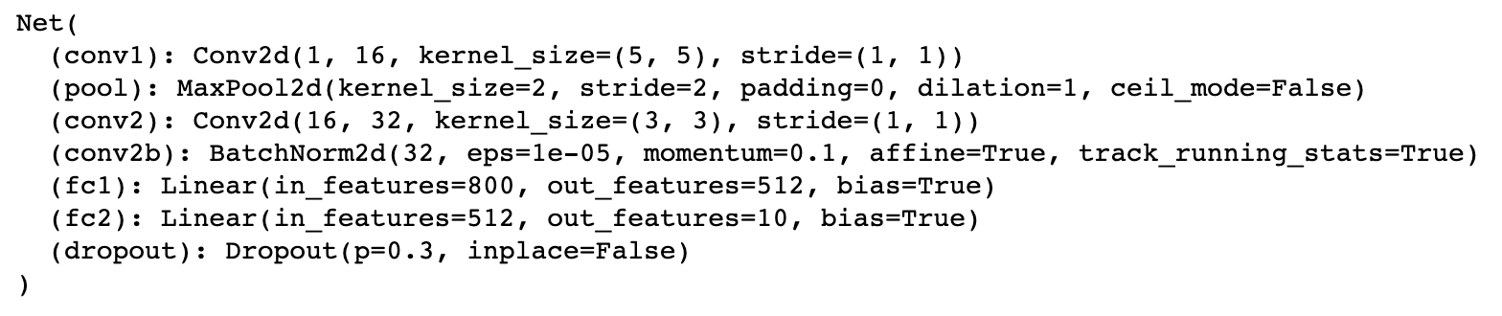
CIFAR-10 Classifier
18 Convolutional Layers, with 64, 128, 256 and 512 filters, alternating with strides 2 and 1, 3x3 kernel
2x2 Max-Pooling with stride of 2
2 Fully connected layers one with 512 neurons and another with 10 neurons.
1 Dropout layer with a factor of 0.3

Slide 3
Hyperparameters for MNIST
1. GPU: Nvidia Tesla T4 – Device 0 (Google Cloud)
2. Batch Size: 64
3. Epochs: 100
4. Learning Rate (alpha): 0.005
5. Momentum: 0.9
6. Optimizer: Stochastic Gradient Descent (SGD)

Slide 4
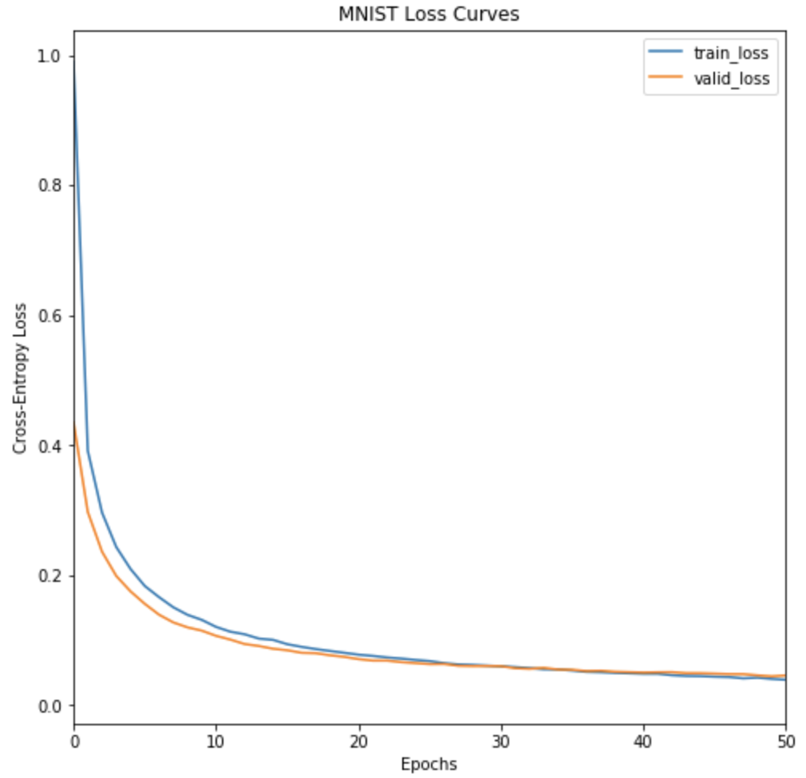
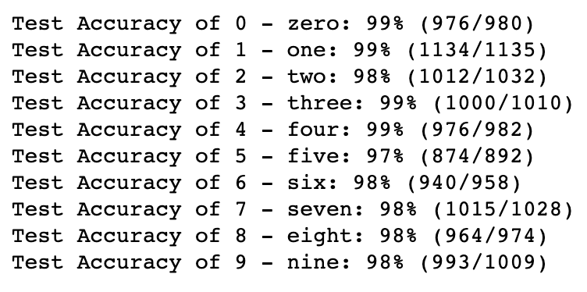
Loss Curves and Prediction Results
Training Loss : 0.028
Validation Loss : 0.0371
Test Loss: 0.036092
Test Accuracy: 98%

Slide 5
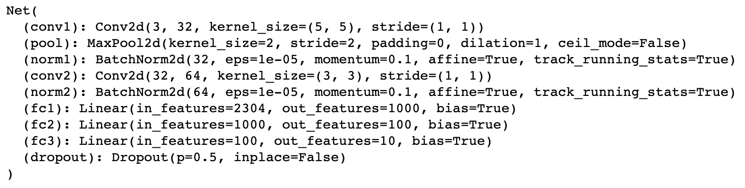
CIFAR-10 Classifier
2 Convolutional Layers, one with 32 filters (5x5 kernel size) and another with 64 filters (3x3 kernel size)
each with stride 1
2x2 Max-Pooling with stride of 2 along with Batch Normalization after each convolutional layer
3 Fully connected layers, with 1000, 100 and 10 neurons
1 Dropout layer with a factor of 0.5

Slide 6
Hyperparameters for CIFAR-10
1. GPU: Nvidia Tesla T4 – Device 1 (Google Cloud)
2. Batch Size: 64
3. Epochs: 150
4. Learning Rate (alpha): 0.005
5. Momentum: 0.9
6. Optimizer: Stochastic Gradient Descent (SGD)

Slide 7
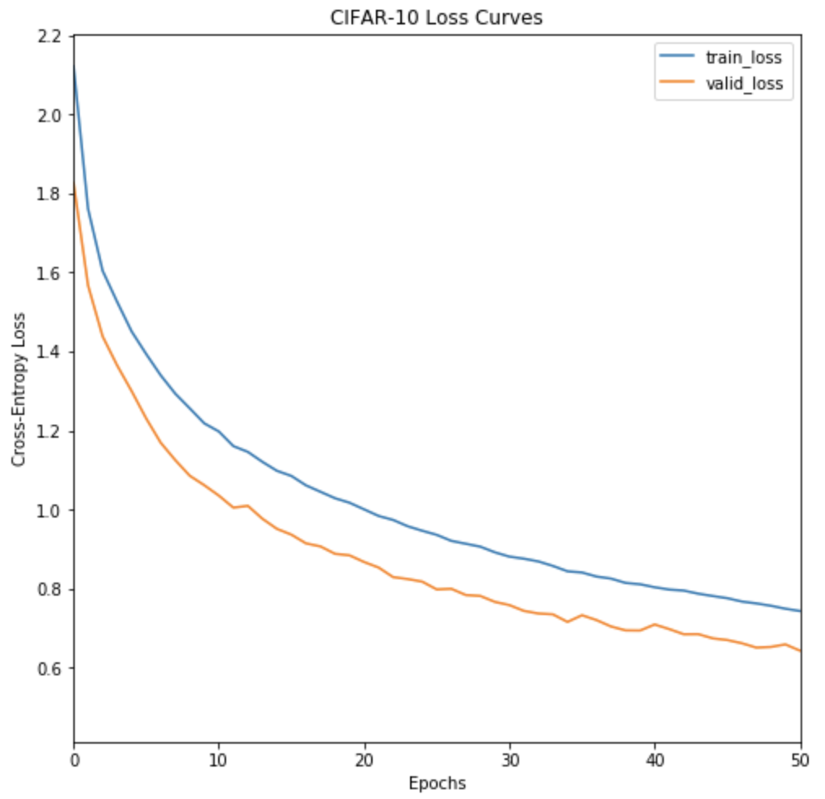
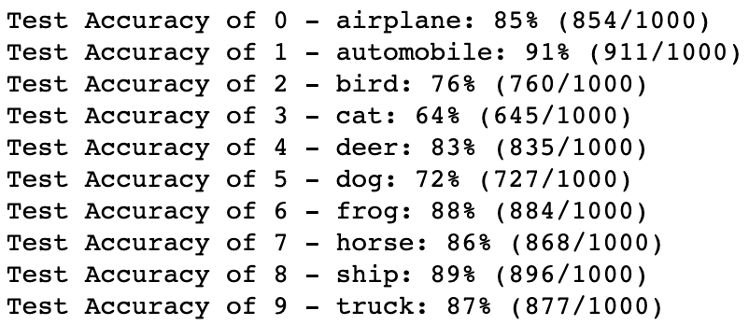
Loss Curves and Prediction Results
Training Loss : 0.4946
Validation Loss : 0.5074
Test Loss: 0.505813
Test Accuracy: 82%

Slide 8
Citations
https://pytorch.org/tutorials/beginner/blitz/cifar10_tutorial.html
https://jdhao.github.io/2018/04/02/pytorch-gpu-usage/
https://github.com/pytorch/examples/blob/master/mnist/main.py
Eswar Jalaparthi

Slide 9
THANK YOU

