Slide 1

Assignment1
Nikunj Lad
001422467

Slide 2
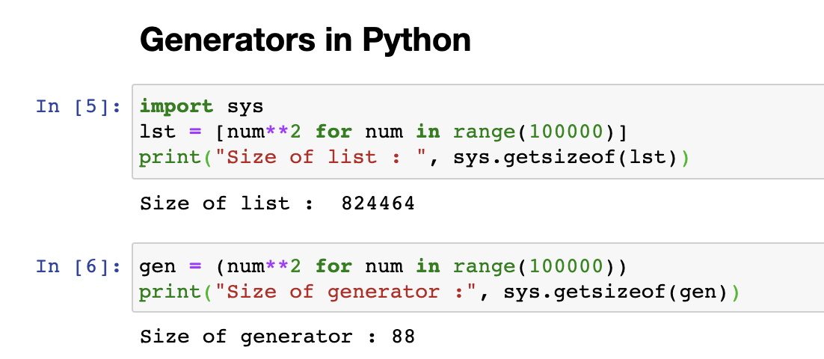
Distinguishing Python Features
Python has many extraordinary features and here are some which I would like to share:
1. Generators

Slide 3
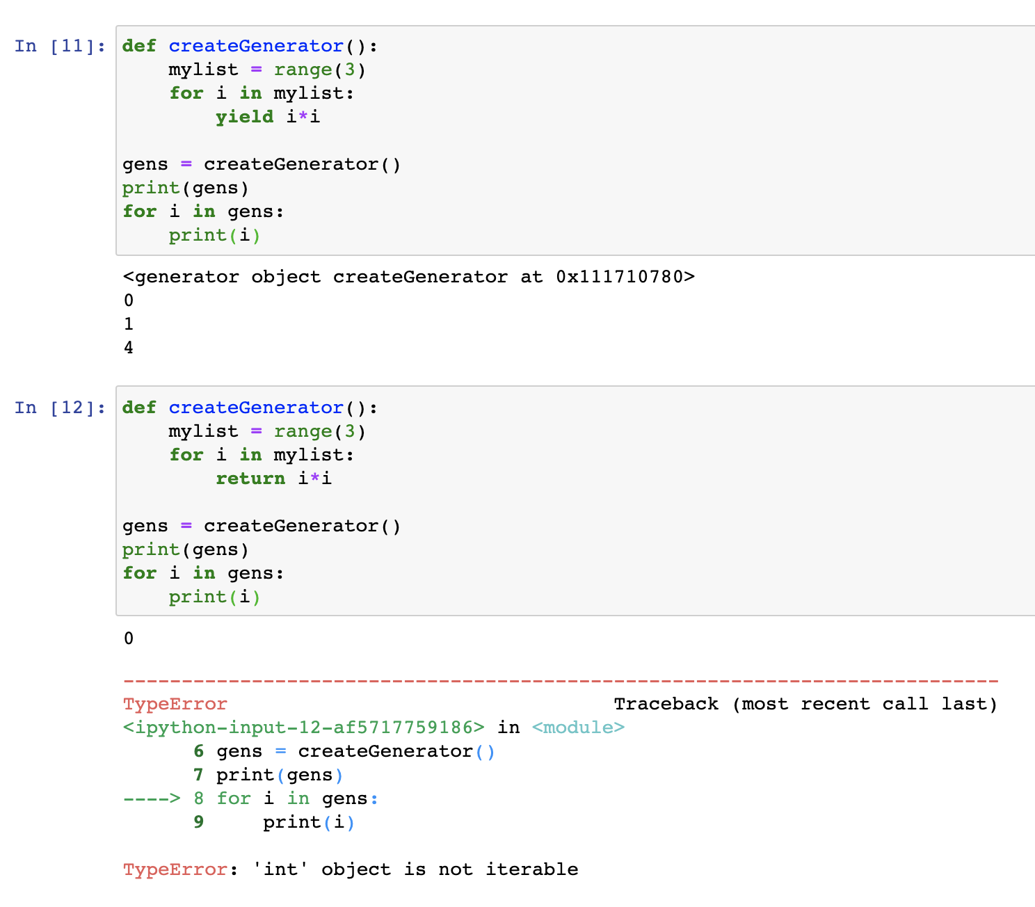
Saves memory and suspends function execution unlike stopping the function entirely.
Makes use of yield instead of return statement.
Beneficial for loading large datasets which would primarily eat up a lot of disk space or even to load datasets greater than the disk space.

Slide 4
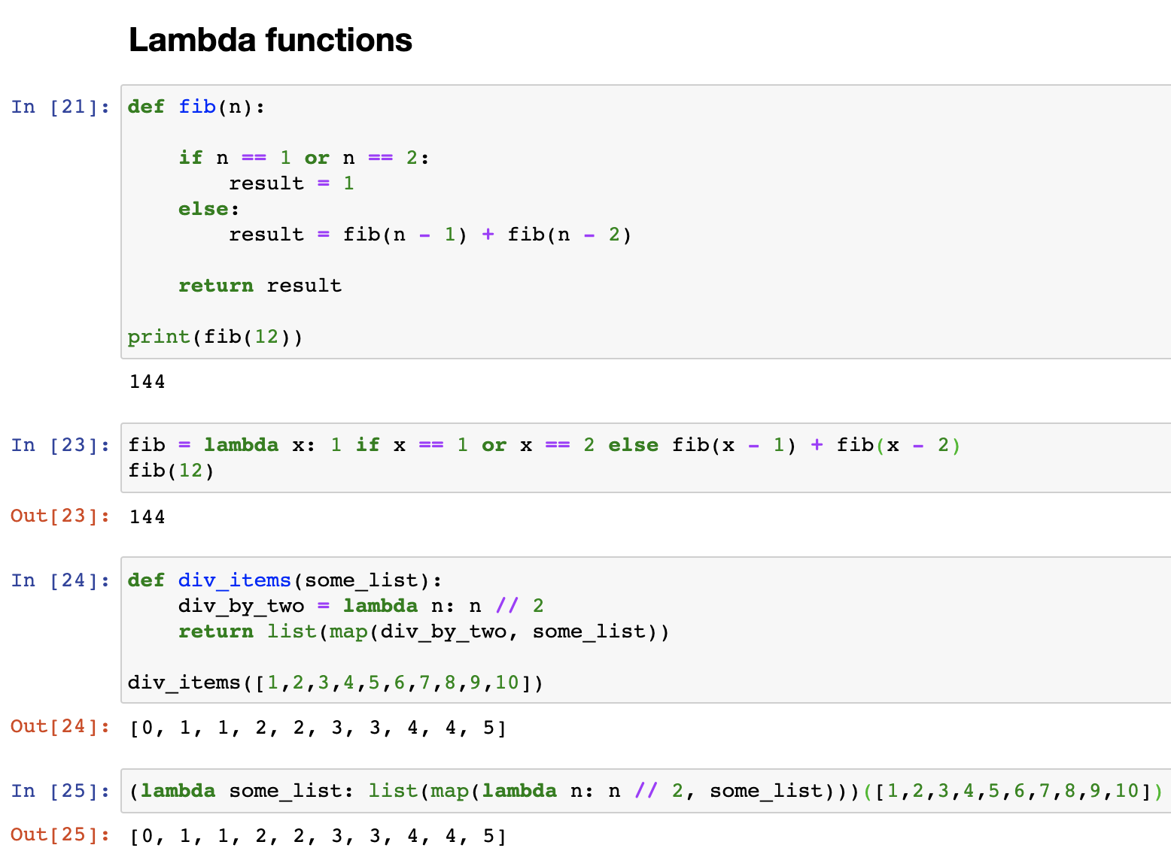
2. Lambda functions
Single line functions which can be invoked repeatedly like normal functions.
Non readable unlike traditional functions
Gives a functional programming flavor to Python language.

Slide 5
Orange for Machine Learning
Used Iris Dataset to explore classification problem.
Performed Descriptive statistics to understand relationships between models.
Applied 6 different models for predictions.
Evaluated our training models.
Observed the ROC curves and confusion matrices.

Slide 6
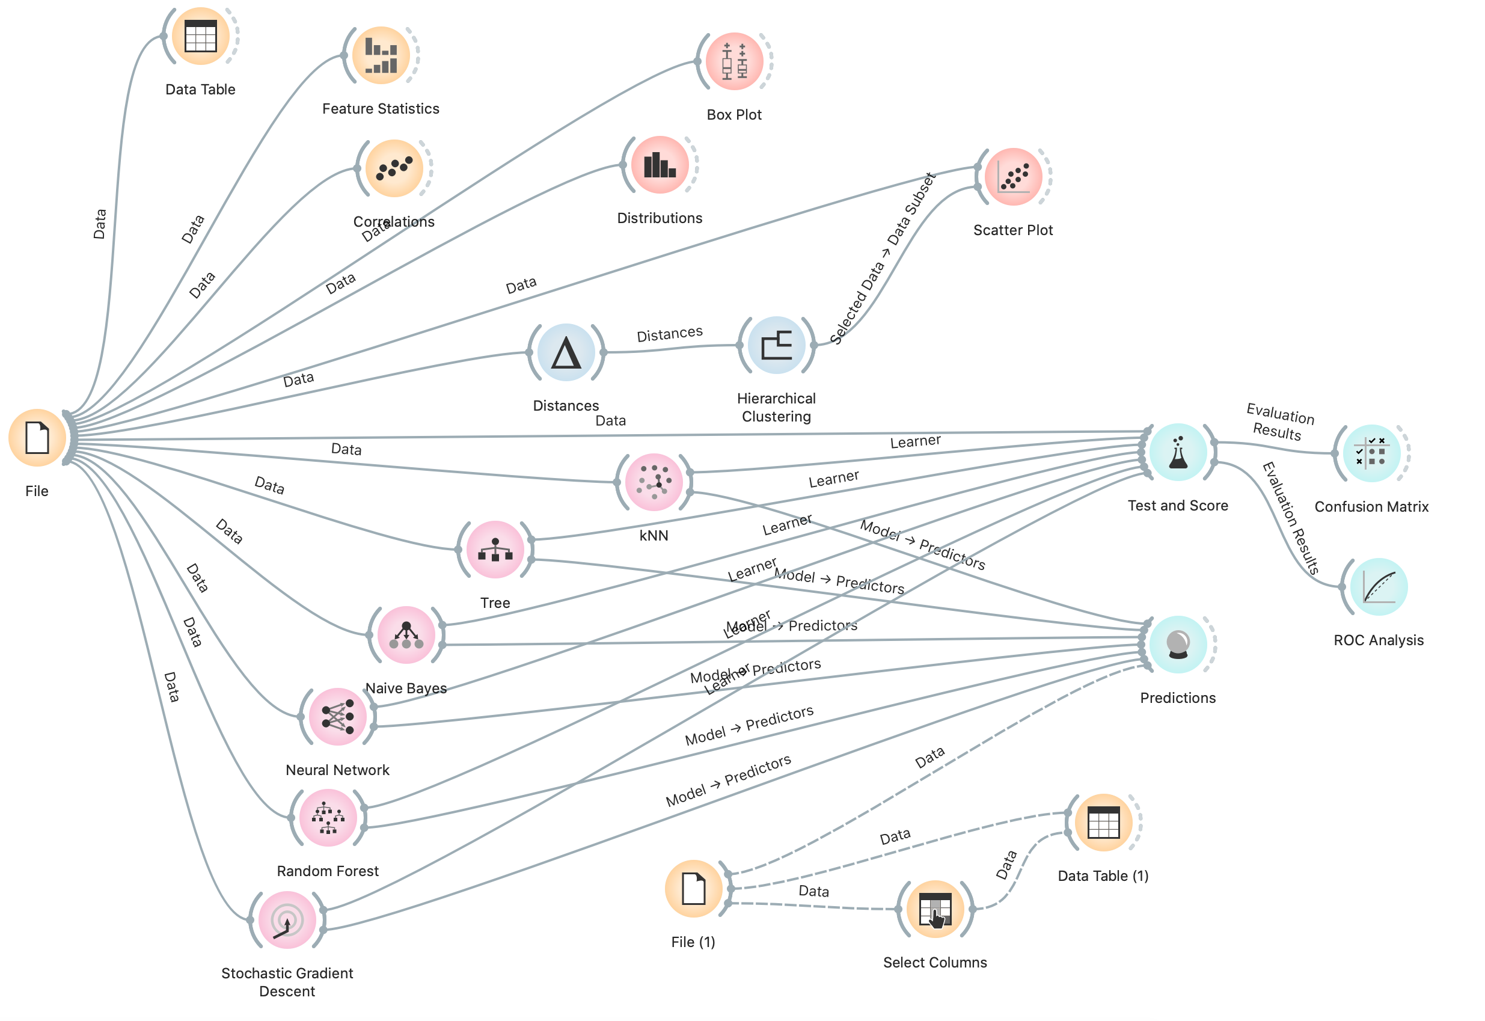
Computational Graph in Orange on Iris dataset.

Slide 7
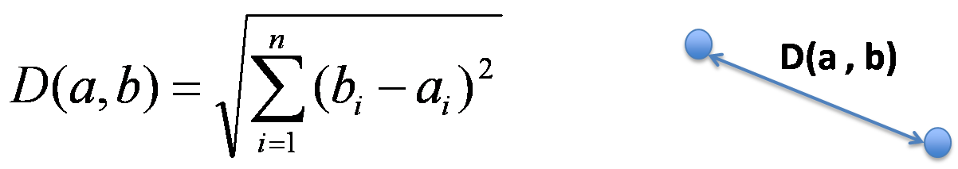
K-Nearest Neighbor Algorithm
Supervised machine learning algorithm which can be used for both classification and regression problems.
Algorithm assumes that similar things exist in close proximity, i.e similar things are close to each other.
Captures idea of similarity using some distance metric - Euclidean distance, Manhattan distance, etc.

Slide 8
Involves hyperparameter K, which indicates how many samples to compare in order to make a prediction.
K taken as odd number to act as a tie breaker during decision making, smaller K will lead to less stable results, while larger K will lead to more stable results.
Implementation is simple since K is the only hyperparameter to be tuned and the mathematics involved is just the distance function.

Slide 9
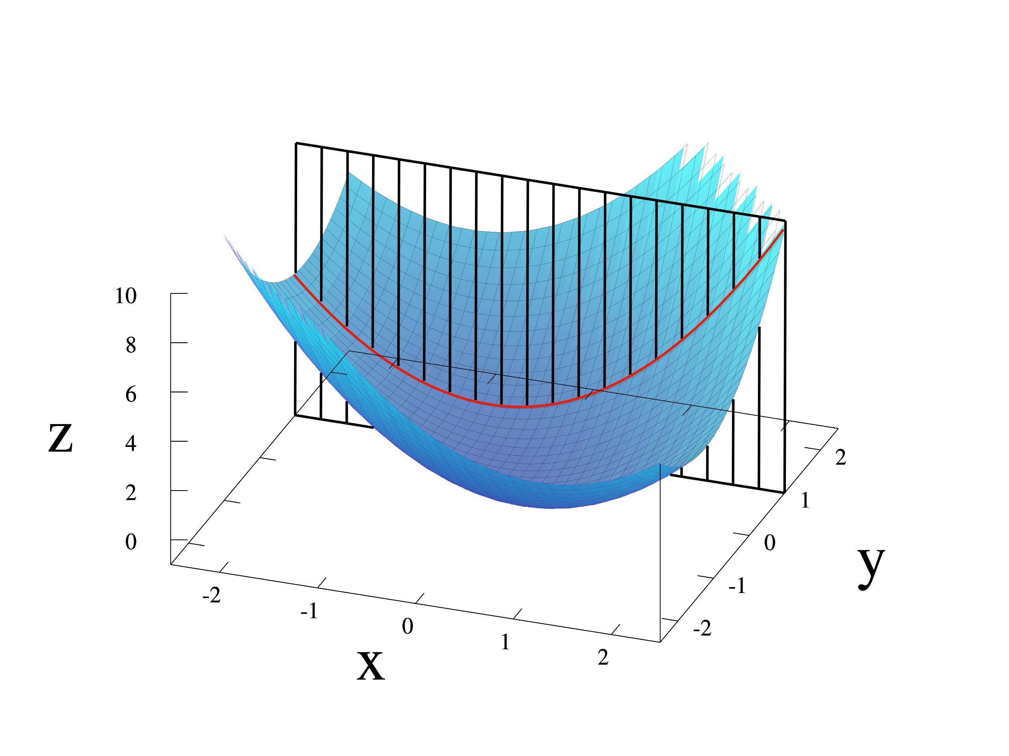
Partial Derivative and its relation to Gradient
Z = f(x,y) = x² + xy + y². Infinite tangent lines to this. Partial differentiation is choosing one of these lines.
Given is slope of function at f(1,1) with y constant and plane parallel to XZ plane.

Slide 10
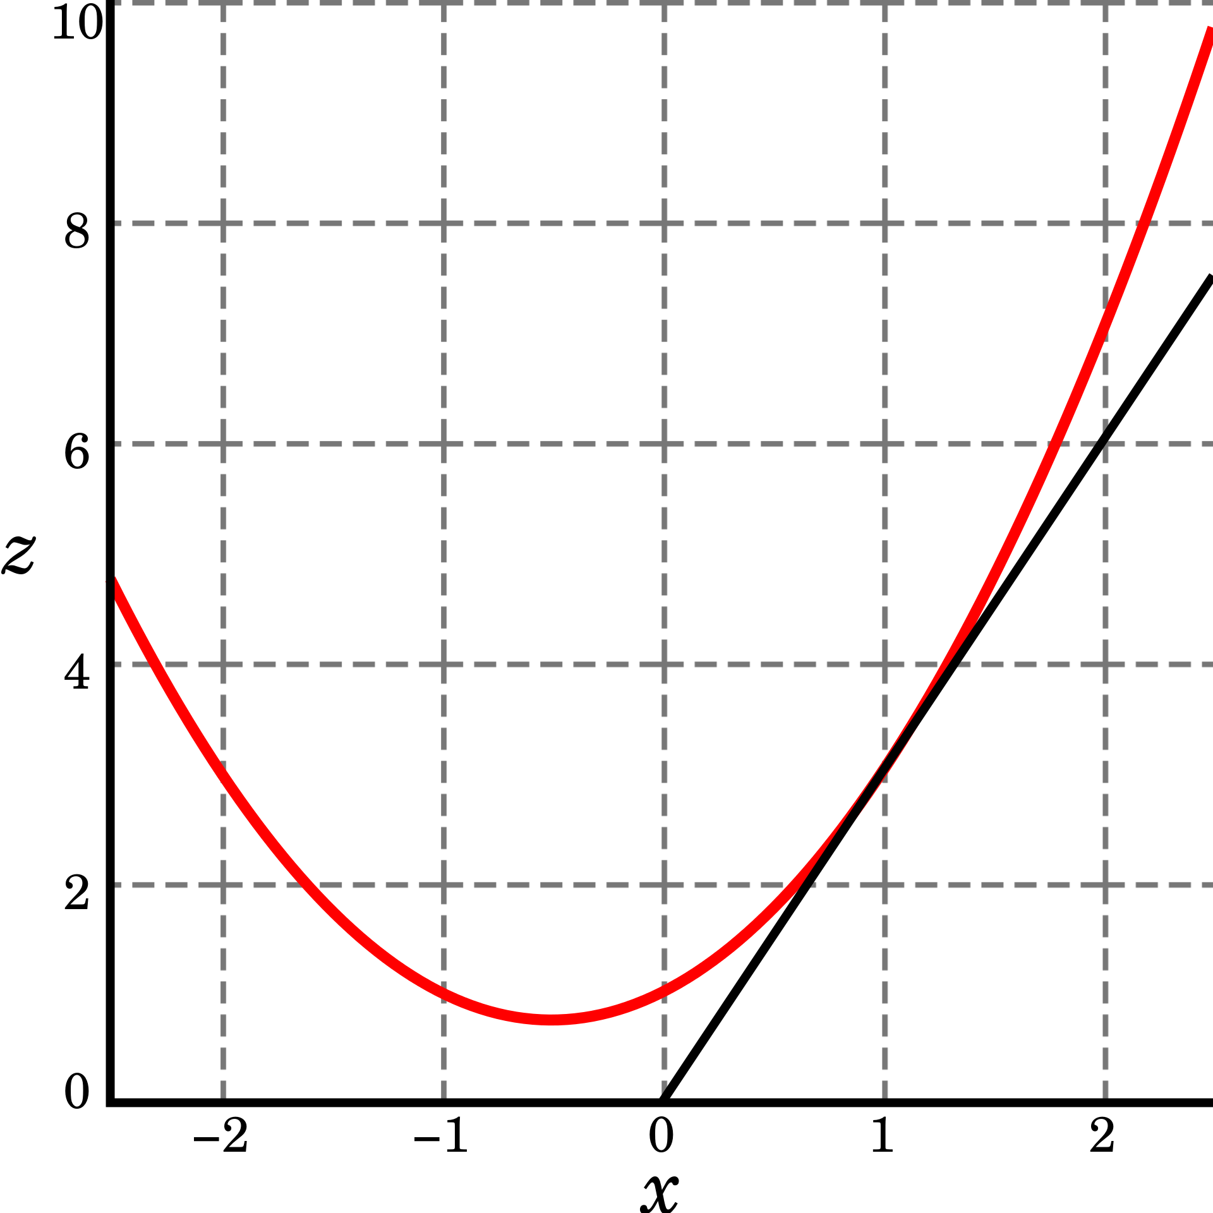
Derivative is 2x + y. Gives value of z = 3
For multiple variables, we hold one variable constant while calculating the derivative of another. This is maximally used in minimization functions especially during gradient descent.

Slide 11
Citations
https://towardsdatascience.com/machine-learning-basics-with-the-k-nearest-neighbors-algorithm-6a6e71d01761
https://www.youtube.com/channel/UClKKWBe2SCAEyv7ZNGhIe4g
https://realpython.com/python-lambda/#appropriate-uses-of-lambda-expressions

Slide 12
THANK YOU

