Slide 1

Sequential Decision making in Autonomous driving using Deep RL
Mini Project Presentation
Group 6
Kushal R (190030023)
Neville Thomas Sebastian (190020028)
Nikunj Pansari (211012001)
Course Instructor
Prof. Prabuchandran K J

Slide 2
Outline
Problem Statement
Overview
State & action space
Implementation
Results
Conclusion

Slide 3
Problem Statement
Employing DeepCars highway simulation environment using Deep Reinforcement learning agents to minimize the collisions with other vehicles on the highway due to the lane change commands.

Slide 4
Overview
Illustrating a type of multi-modal architecture consisting of environmental modeling of the ego surroundings (highway scenario) using deep reinforcement learning agent (DRL) which would be helpful in inferring consistent performance for stochastic highway driving scenarios.*
Used DeepCars simulation environment made using pygame,for simulating the highway scenario.

Slide 5
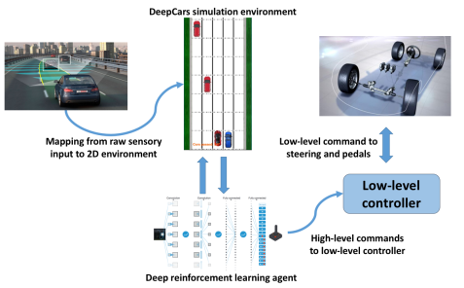

Slide 6


State & Action Space
States & actions are discrete.
State representation contains occupancy grid of the environment.
Deepcars the simulation environment receives the high-level control commands as the input vector and provides the state and reward as output.

Slide 7

The prime aim is to train the DeepCars agent such that it can avoid the collisions in the highway driving scenario with other vehicles.
The reward function is defined as follows -
Where ‘sT‘ indicates the terminal state that the agent makes
a collision.

Slide 8
RL Algorithms Implementation*
For large state space,preferred to evaluate using DQN & DDQN deep reinforcement learning algorithms since tabular Q-learning was computationally intensive & time consuming,and at the same time lead to more no of collisions for the test set.
Illustrated that DDQN will demonstrate better results in terms of the performance-training speed trade-off.

Slide 9
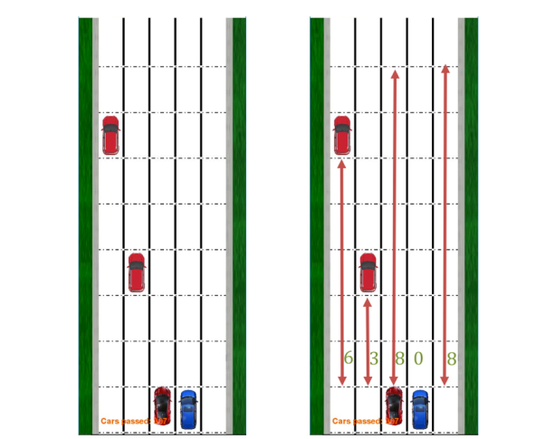
DeepCars simulation environment

Slide 10
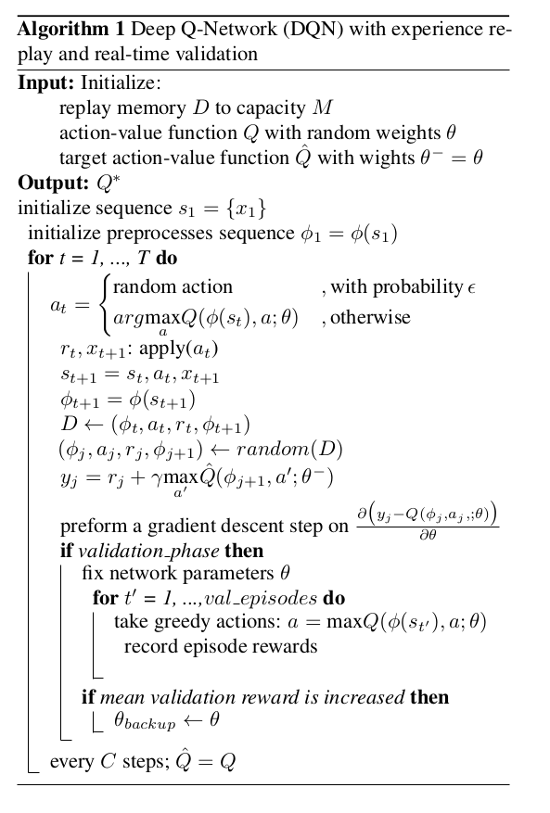

Slide 11
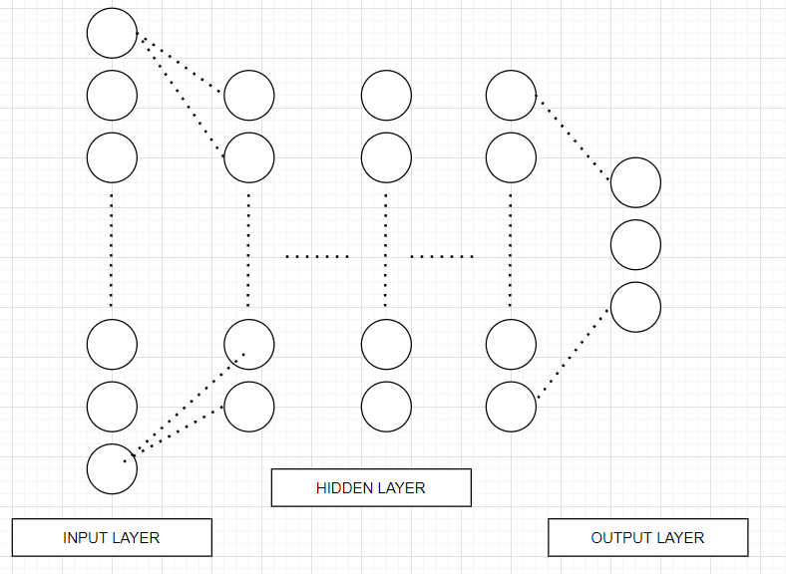
Neural Network Architecture
INPUT-DIMENSION = 50,
OUTPUT-DIMENSION = 3

Slide 12
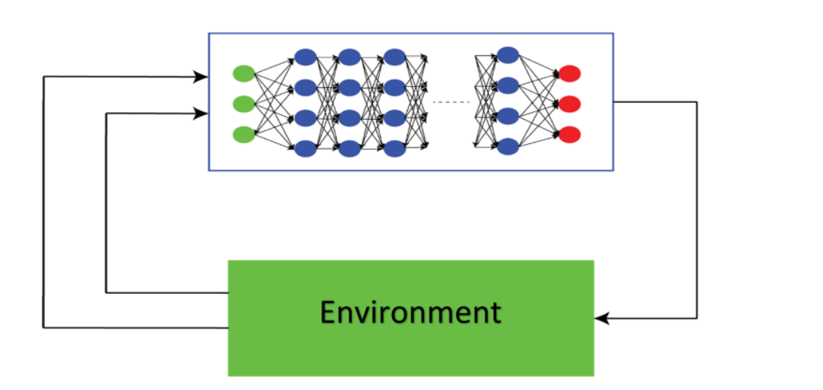

Slide 13
Hyperparameters
For hyperparameters tuning ,optimal settings obtained are defined below :
Learning rate (ɑ) : 0.1
Discount factor (ℽ) : 0.9
Exploration (𝝐) : 0.2
Exploitation (1 - 𝝐) : 0.8

Slide 14
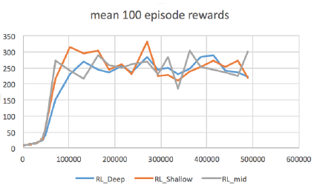
DQN Performance

Slide 15

Performance Metric
Important parameters:
Accuracy
100 eps reward time
reward

Slide 16
Experimental Setup
Trained for 500000 steps and considered for evaluation for 100000 steps using 3 different types of neural network architectures : shallow {16} , medium {16,32} & deep {16,32,16} neural network architectures .
To get a smooth plot for the reward values,use mean cumulative reward every 100 episodes as the performance metric.

Slide 17
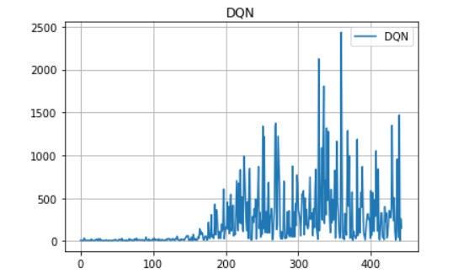
DQN:episode reward
Accuracy=99.48%

Slide 18
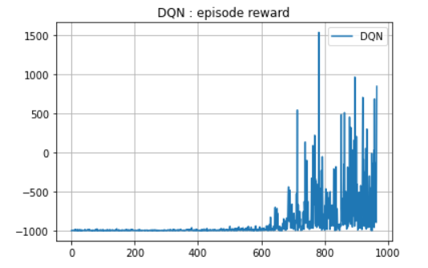
DQN
Accuracy=99.04%

Slide 19
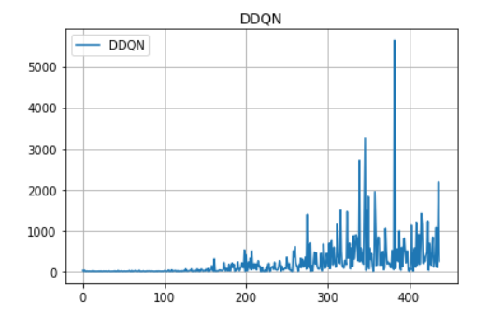
DDQN : episode reward
Accuracy=99.54%
Notes:
Reward is -1 for collision

Slide 20
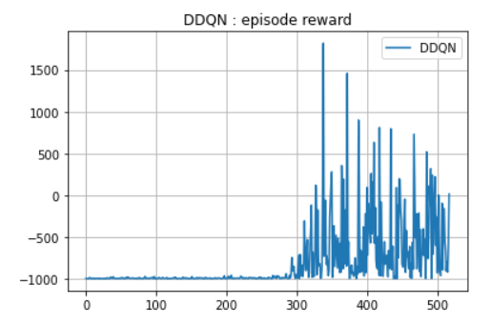
DDQN
Accuracy=99.4%

Slide 21
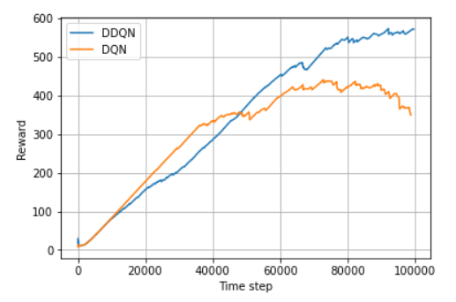
DQN Vs DDQN: 100 eps mean

Slide 22
Conclusion
References
Focused on the autonomous driving in the highway scenario.
Focused on hierarchical architecture of decision making systems where the sequential high level decision are made using deep reinforcement learning algorithm.
We have shown that its possible to leverage the provided multi layer architecture to generate high level commands using DRL with acceptable reliability score.
Moghadam, Majid, and Gabriel Hugh Elkaim. "A hierarchical architecture for sequential decision-making in autonomous driving using deep reinforcement learning." arXiv preprint arXiv:1906.08464 (2019).*

Slide 23
THANK YOU!!
Any Questions?

