Slide 1
PaaS

Slide 2
Platform
As a
service

Slide 3
PaaS
Platform as a service (PaaS) is a cloud computing offering that provides users a cloud environment in which they can develop, manage, and deliver applications. In addition to storage and other computing resources, users are able to use a suite of prebuilt tools to develop, customize and test their own applicPaaS can be delivered in two ways: as a public cloud service from a provider, where the consumer controls software deployment with minimal configuration options, and the provider provides the networks, servers, storage, OS, 'middleware' (i.e.; java runtime, .net runtime, integration, etc.), database and other services to host the consumer's application; or as a private service (software or appliance) inside the firewall, or as software deployed on a public infrastructure as a service.

Slide 4
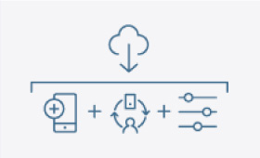
Platform as a service (PaaS)
A service provider offers access to a cloud-based environment in which users can build and deliver applications. The provider supplies underlying infrastructure.

Slide 5
KEY FEATURES
Facilitates collaborative work even if teams work remotely.
PaaS provides a platform with tools to test, develop, and host applications in the same environment.
Enables organizations to focus on development without having to worry about underlying infrastructure.
Providers manage security, operating systems, server software, and backups.

Slide 6
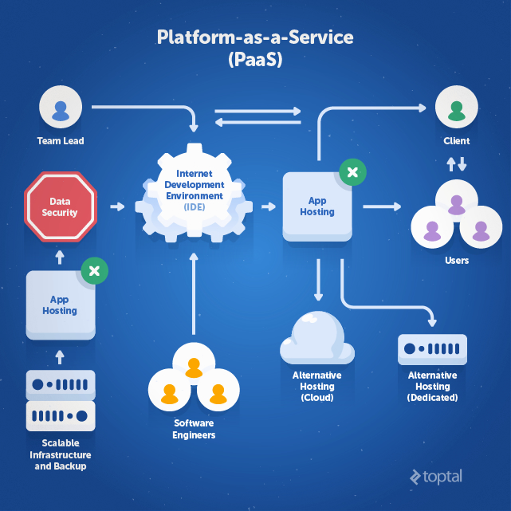

Slide 7
ADVANTAGES
The advantages of PaaS are primarily that it allows for higher-level programming with dramatically reduced complexity; the overall development of the application can be more effective, as it has built-in infrastructure; and maintenance and enhancement of the application is easier. It can also be useful in situations where multiple developers are working on a single project involving parties who are not located nearby.

Slide 8
DISADVANTAGES
One disadvantage of PaaS offerings is that developers may not be able to use a full range of conventional tools (e.g. relational databases, with unrestricted joins). Another possible disadvantage is being locked in to a certain platform. However, most PaaSes are relatively lock-in free.

Slide 9
TYPES OF PaaS
Public PaaS.
Private PaaS.
Open PaaS.
Hybrid PaaS.
Mobile PaaS.

Slide 10
PUBLIC PaaS
Public PaaS is derived from software as a service (SaaS),and is situated in cloud computing between SaaS and infrastructure as a service (IaaS).SaaS is software that is hosted in the cloud, so that it doesn't take up hard drive from the computer of the user or the servers of a company. IaaS provides virtual hardware from a provider with adjustable scalability. With IaaS, the user still has to manage the server, whereas with PaaS the server management is done by the provider.IBM Bluemix (also private and hybrid), Amazon AWS and Heroku are some of the commercial public cloud PaaS providers.

Slide 11
PRIVATE PaaS
A private PaaS can typically be downloaded and installed either on a company's on-premises infrastructure, or in a public cloud. Once the software is installed on one or more machines, the private PaaS arranges the application and database components into a single hosting platform. Private PaaS vendors include Apprenda, which started out on the Microsoft .NET platform before rolling out a Java PaaS; Red Hat's OpenShift and Pivotal Cloud Foundry.Apprenda and Microsoft once considered to be two of the only PaaSes that provide superior .NET support. Now joined by the publicly announced Microsoft and IBM Partnership programme.

Slide 12
Case Study: Menumate Uses PaaS to Serve Tasty Applications
Menumate is a provider of point of sale hardware and software for the hospitality industry across Australasia. Menumate has taken advantage of the Force.com PaaS to migrate over time a series of legacy applications used in the business. Daniel Fowlie and Abhinav Keswani are Directors of development house Trineo the company responsible for boutique development for Menumate. Fowlie explains that the use of the Force.com platform has allowed Menumate to centralise, modernise and integrate an otherwise disparate in-house software toolkit. Keswani feels that a more conventional development approach would require significant infrastructure, connectivity, security and would introduce uptime considerations - whereas the Force.com platform inherently provides these non-functional requirements - allowing Menumate and Trineo to focus purely on developing the needed functionality. Additionally, utilizing a PaaS approach has meant Trineo could take advantage of both existing integrations and automated deployment tools - another example of PaaS easing the development process.

Slide 13
Using PaaS, Trineo have been able to migrate over time a series of legacy applications used in the business. Some of these applications are:
License Key Generation - The Menumate software uses license keys to activate the features that the customer has paid for. The power of the PaaS programming language allowed Menumate to quickly port this code to Force.com where the license keys are linked to the customer record in the Salesforce.com CRM. This allows Sales and Support staff to quickly see the status of licenses.
Enhanced Case Management - A lot of the support cases Menumate were dealing with were orders for consumables. To handle this they had a separate DOS based application that would allow the user to build up an order and create an invoice. Menumate now can add products to a support case and automatically send an invoice to their accounting software using an existing integration product.

Slide 14
Label Printing - Another legacy application was for creating freight labels for sending consumables and hardware to customers. Utilising the PaaS technology, these can now be printed directly from the customer record.
Utilizing a PaaS development environment has resulted in the creation of these applications being significantly faster than would otherwise be the case. In some examples, in the absence of PaaS, the cost of developing the application would have been prohibitive.
PaaS is undoubtedly an exciting and powerful form of Cloud Computing however in terms of market awareness it’s hard to look past Infrastructure as a Service and the rapid growth it’s seeing in the marketplace.

Slide 15
Database Middleware Solutions with PaaS
Database middleware is one of the best things that a company can employ to help their company. Database middleware offers companies an additional layer of performance management, and security for their database administrators. There are two basic kinds of the database middleware – native database and database-generic. The native database middleware is known as a proprietary access mechanism that’s used for a certain database server.
The database middleware that’s database-generic enables packages and applications to communicate across various network protocols, native APIs and SQL dialects, using the common interfaces.

Slide 16
Even though database access is being standardized by the database industry, there’s still a hodgepodge of the proprietary access mechanisms. So it makes sense to hide an access to a native database behind Middleware layers. If you are looking for a searching for a provider of database middleware, there are a few things that can use in order to find the right provider. Here are three ways that you can find the right provider:
Research – The first thing that you can do in order to find the right provider of database middleware is to do some research to find out what companies there are to find the one that is right for you. Make a list of the companies that offer database middleware and then move onto the next step.
Review – The second thing that you can do in order to find a good provider of database middleware is to review the companies that you have listed. Look what other people have said about them and find out what they liked about the companies.
Choose – The third thing that you want to do is to decide which of the companies that found that you want to choose. Think about the reviews that you have found about the companies that you read and use them to make a choice about the right company.
There are a lot of companies that offer database middleware that you can choose from but there is one company that has been in business a long time and has a long standard of excellence. This company is known as Apprenda. Along with database middleware, they have a lot of other business solutions to make your business run in a way that is cost effective that will offer you a company that runs much more smoothly. Apprenda can help your company with just about anything that you need for your business.

Slide 17
10 most powerful PaaS companies
Amazon web services.
Salesforce.com
Long jump .
Microsoft
IBM
Redhat
Cloud foundry.
Google
Cloudbees.
Engine yard.

