Slide 1



Machine Learning on HPC systems
16 May 2023
Trainers: Robert Jan Schlimbach, Yue Zhao, Caspar van Leeuwen

Slide 2
About EuroCC & EuroHPC JU
EuroHPC JU:
joint initiative between EU, EU member states, and private partners to develop a World Class Supercomputing Ecosystem in Europe
https://eurohpc-ju.europa.eu/
EuroCC
A key program in EuroHPC JU
EuroCC acts as gateway for industry and academia to find providers with suitable HPC expertise
EuroCC facilitates HPC-skill oriented trainings

Slide 3
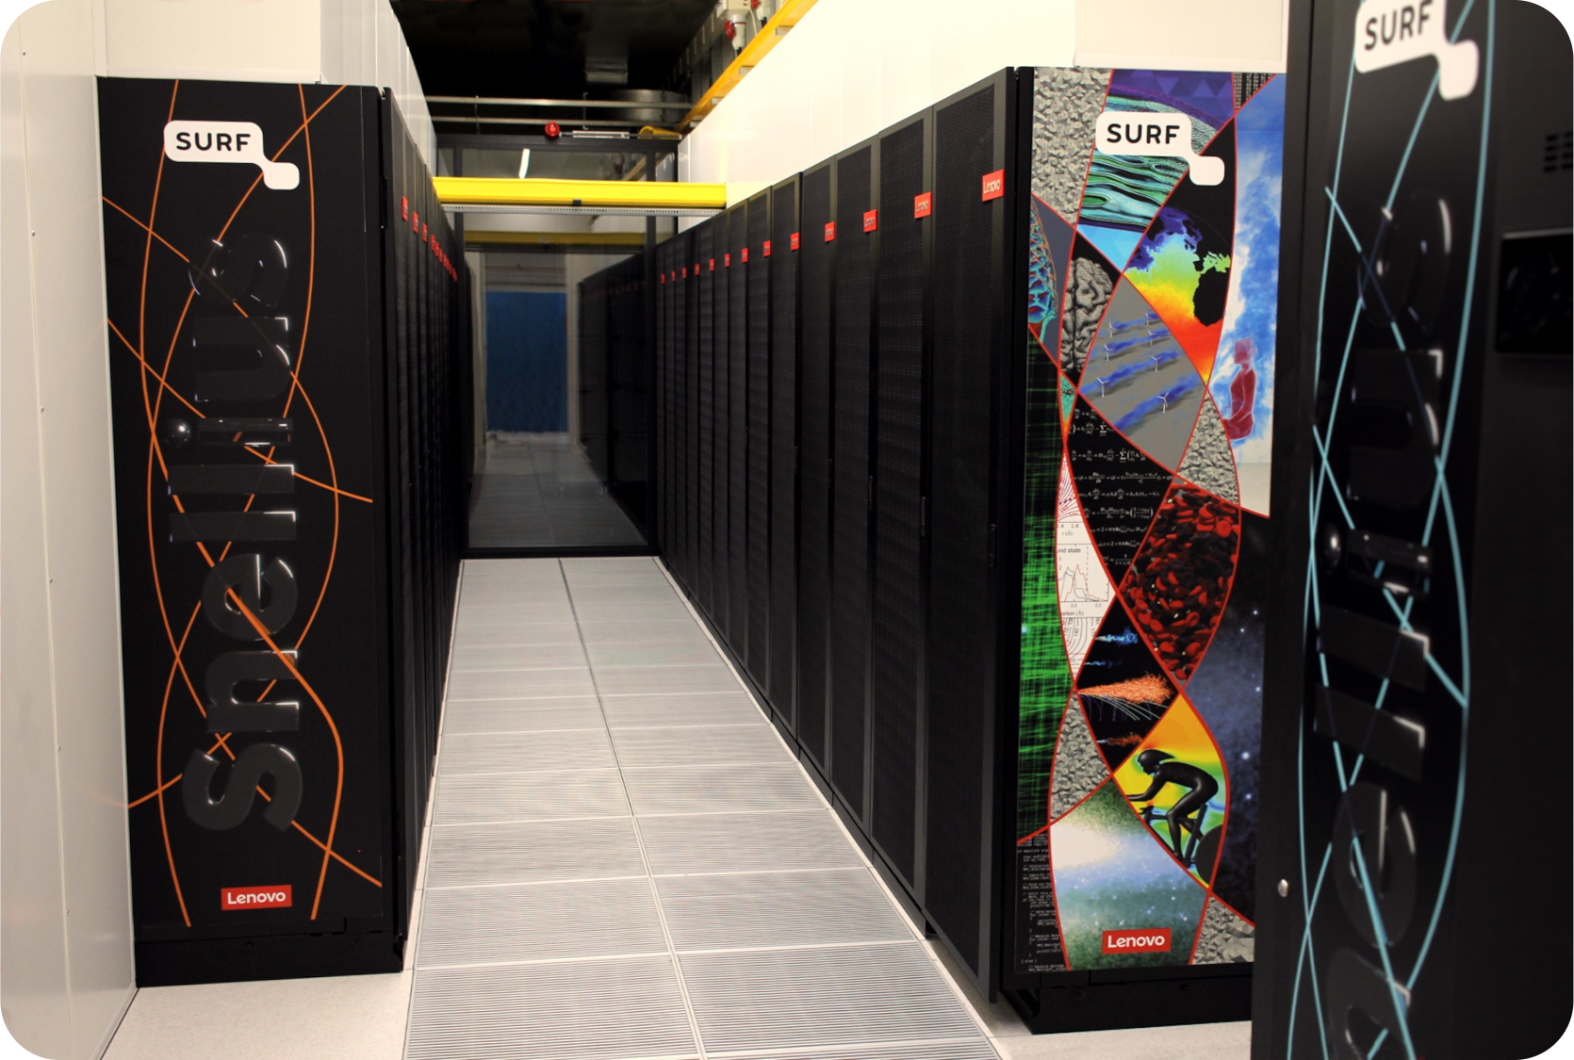
About SURF
Collaborative organization for ICT in Dutch education and research
National Competence Center in EuroCC for The Netherlands
Offers HPC services (and many others, data storage, cloud, networking, etc)

Slide 4
Course plan
9:30 – 9:45 Welcome and course overview (Caspar van Leeuwen)
9:45 – 11:00 Software installations on HPC systems (Caspar van Leeuwen)
11:00 – 11:15 Coffee break
11:15 – 12:30 Packed file formats (Caspar van Leeuwen)
12:30 – 13:30 Lunch Break
13:30 – 15:00 Parallel Computing for Deep Learning (Caspar van Leeuwen & Yue Zhao)
15:00 – 15:15 Coffee Break
15:15 – 16:00 Hardware and software features to accelerate deep learning (Robert Jan Schlimbach)
16:00 – 16:50 Profiling to understand your neural network’s performance (Robert Jan Schlimbach)
16:50 – 17:00 Questions, wrap up

Slide 5
https://github.com/sara-nl/MLonHPC_May2023

Slide 6
Introductions!
In 3 sentences, tell us
Your name
Your job
Why you’re attending this course

Slide 7
Logins
Access to two systems for this course
Lisa Cluster (GPU-based Jupyter Notebook environment)
Did you get an initiation for SRAM? And after registering, did you get another login ‘jhlsrf024-XXX’?
Try to login at https://jupyter.lisa.surfsara.nl/jhlsrf024
Snellius Supercomputer (CPU-based Jupyter Notebook environment, GPU batch jobs)
Did you get a login ‘scurXXX’?
Try to login at https://jupyter.snellius.surf.nl/jhssrf001
If not, let me know!

