Slide 1
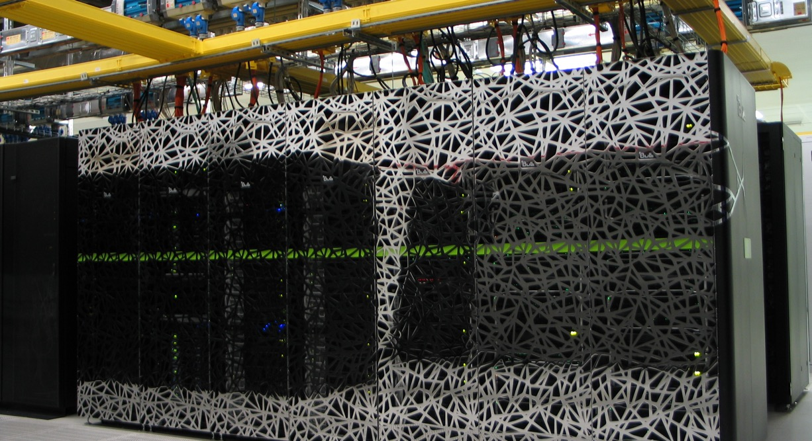
High Performance machine learning
Caspar van Leeuwen
High Performance ML consultant
SURF

Slide 2
https://github.com/sara-nl/MLonHPC_May2023

Slide 3
Program
9:30 – 9:45 Welcome and course overview (Caspar van Leeuwen)
9:45 – 11:00 Software installations on HPC systems (Caspar van Leeuwen)
11:00 – 11:15 Coffee break
11:15 – 12:30 Packed file formats (Caspar van Leeuwen)
12:30 – 13:30 Lunch Break
13:30 – 15:00 Parallel Computing for Deep Learning (Caspar van Leeuwen & Yue Zhao)
15:00 – 15:15 Coffee Break
15:15 – 16:00 Hardware and software features to accelerate deep learning (Robert Jan Schlimbach)
16:00 – 16:50 Profiling to understand your neural network’s performance (Robert Jan Schlimbach)
16:50 – 17:00 Questions, wrap up

Slide 4
Parallel computing for Deep Learning
Content
benefits of parallellization
parallellization strategies
Hands-on: hyperparameter grid search on an HPC system
parallel stochastic gradient descent (SGD)
synchronous and asynchronous parallel SGD
communication backends
frameworks for distributed deep learning
documentation of distributed DL frameworks

Slide 5
Parallel computing for Deep Learning
Goal: understand the documentation of distributed DL frameworks.
From TensorFlow docs on “distribution strategy”:
“tf.distribute.Strategy intends to cover a number of use cases along different axes… Synchronous vs asynchronous training: These are two common ways of distributing training with data parallelism. In sync training, all workers train over different slices of input data in sync, and aggregating gradients at each step. In async training, all workers are independently training over the input data and updating variables asynchronously. Typically sync training is supported via all-reduce and async through parameter server architecture.”
“MultiWorkerMirroredStrategy currently allows you to choose between two different implementations of collective ops. CollectiveCommunication.RING implements ring-based collectives using gRPC as the communication layer. CollectiveCommunication.NCCL uses Nvidia's NCCL to implement collectives.”

Slide 6
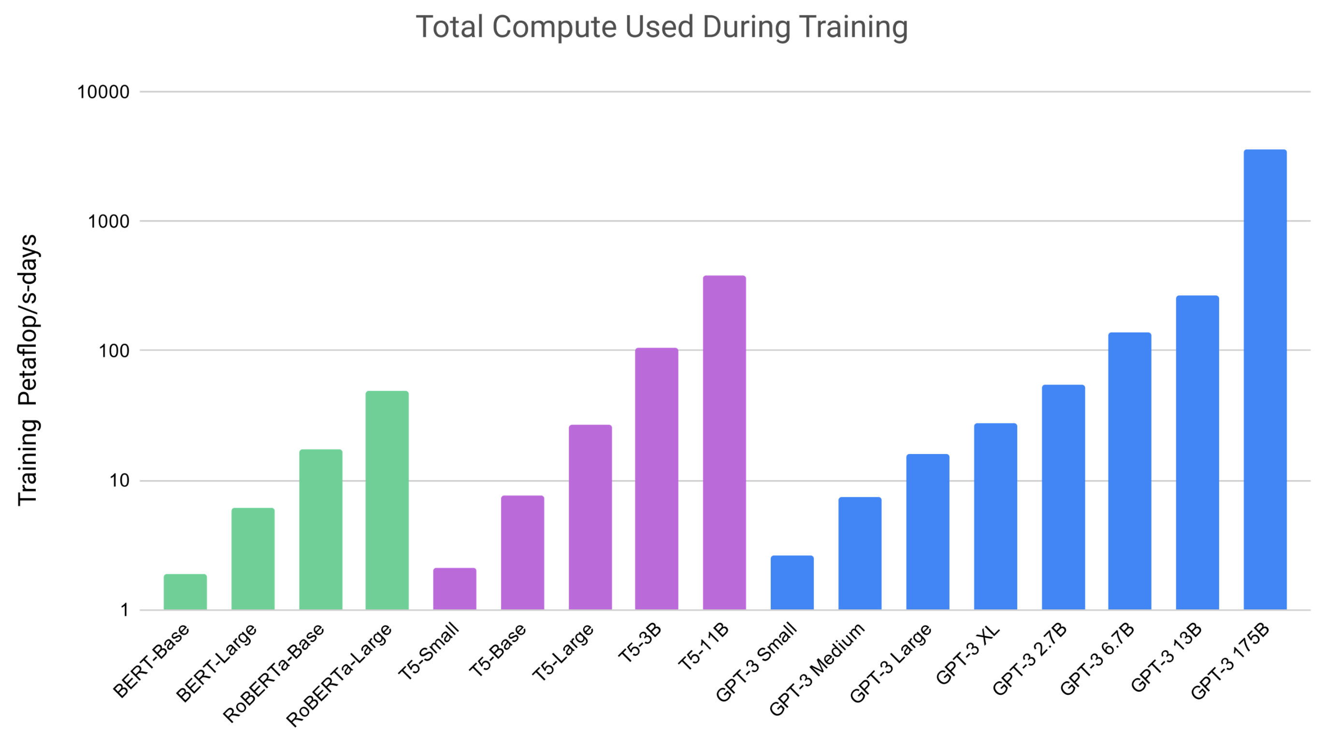
Parallelization: why?
5 years @ 1 A100 GPU

Slide 7
Parallelization: why?
Faster trainings …
Enables learning on larger datasets
Enables improved accuracy through better hyperparemeter tuning
Enables larger, more complex models
…
Bigger models (high memory requirement) …
Enables larger, more complex models

Slide 8
Parallelization: when?
Large
Radboud UMC
Histopathology
100Kx200K
100GB
Oil-Gas
Seismic Images (>4K^3)
10GB
MaxPlanck
MS-D CNN (BS=1), Inference, 2304x1280x1024)
Input Size
1GB
Netherlands Kancer Inst (NKI): P-GANS, (BS=1)
500x500x500
100MB
DellEMC, AI Radiologist: ResNet-59, (BS=64)
896x896
Novartis:
M-CNN, (BS=8), 1280x1024
DellEMC, AI Radiologist: AmoebaNet(2,512), (BS=64),
480x480
10MB
Model + Activations Memory
Small
10GB
Large
100MB
1GB
CERN: 3D-GANs, (BS=128), 25x25x25
100GB
1000GB
10TB
BENCHMARKS
MLPerf, others
RNet-50
DellEMC:
Transformer-LT Big (Eng-Ger),(BS=64)
BS=6
1MB
Benchmark
ImageNet: 224x224
VGG-16
GoogleNet
GENCI/CINES:
Pl@ntNet, (BS=16),
224x224
Google: Transformer-LT
Eng-French, (BS-64)
5.9B Parameters; Mem-Est
RNet-101
0.1MB
Inception-v3
Source: Kushal Datta & Vikram Saletore, AIPG, Intel
Small

Slide 9
Parallelization: the basics
What is parallel computing?
Multiple processors or computers working on a single computational problem

Slide 10
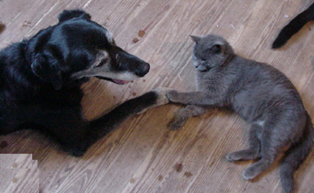

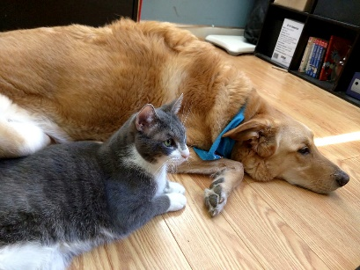





Parallelization: the basics
Serial computing
Data
Output
Apply filter()
Processor

Slide 11




Parallelization: the basics
Parallel computing
Data
Output
Apply filter()
Processor
Apply filter()
Processor
Apply filter()
Processor
Apply filter()
Processor

Slide 12
Parallelization: the basics
Benefits:
Solve computationally intensive problems (speedup)
Solve problems that don’t fit a single memory (multiple computers)
Requirements:
Problem should be divisible in smaller tasks

Slide 13
Types of parallelization
What types of parallelization exist?
Instruction level parallelism
Embarrassingly parallel
Data parallel
Model parallel
Hybrid data/model parallelism
Pipeline parallelism
Increasing complexity

Slide 14
Types of parallelization
Instruction level parallelism
Executing multiple instructions (e.g. additions) in parallel
Examples: vector instructions (CPU), Tensor Cores (GPU)
https://en.wikipedia.org/wiki/Instruction-level_parallelism
More this afternoon!
X =
1.1 | 3.7 | -1.6 | 2.3
+
=
-2.3 | 5.4 | -1.8 | 7.5
Y =
-3.4 | 1.7 | -0.2 | 5.2

Slide 15
Types of parallelization
Embarrassingly parallel
A workload or problem where little or no effort is needed to separate into number of parallel tasks
Examples: hyperparameter grid search, training multiple model architectures
https://en.wikipedia.org/wiki/Embarrassingly_parallel

Slide 16
Data Parallelism
Train a single model, single set of hyperparameters, but faster
Split the batch over multiple processors (CPUs/GPUs)
Each processor holds a copy of the model
Forward pass: calculated by each of the workers
Backward pass: gradients computed (per worker), communicated and aggregated
Processor 1
Processor 2

Slide 17
Model parallelism
Train a single very big model, single set of hyperparameters
Split the model over multiple processors (CPUs/GPUs)
Each processor sees all the data
Communication needed both during forward and backward pass!
Processor 1
Processor 2

Slide 18
Hybrid model/data parallelism
Processor 1
Processor 2
Processor 3
Processor 4

Slide 19
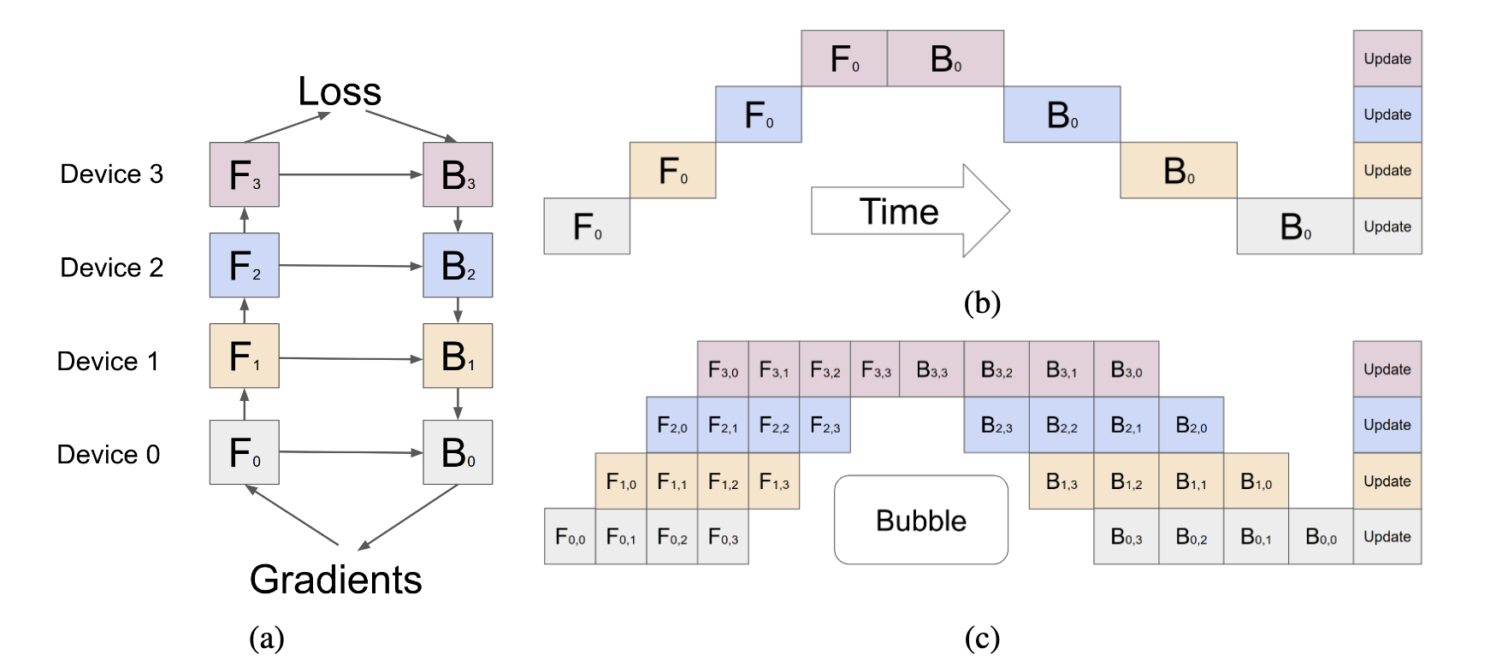
Pipeline parallelism
Model parallelism, executed in a pipelined fashion over multiple micro-batches.
More efficient than model parallelism: hides communication with computation
E.g. Gpipe (for PyTorch / TensorFlow), PipeDream (PyTorch)
See https://pytorch.org/docs/stable/pipeline.html
Huang et al. (2019, arXiv:1811.06965)
Notes:
Pipeline parallelism combines both data and model parallelism. At the top, you see a model parallel training. Each color indicates a part of the model. However, since device 1 has to wait for the output of device zero, there is a lot of wait-time in model parallel training. Essenitally, all of the white space in this top figure represents devices that are idling. We can do this in a more efficient way using pipeline parallelism. In pipeline parallelism, we also shard the model over various devices, as indicated by the different colors. However, instead of computing the forward pass on the full batch, we cut the batch into 4 smaller pieces. Once the forward pass is done on the first piece, device number 1 can start _its_ forward pass. (F0,X means: this device holds part ‘0’ of the model, and processes mini-batch X)

Slide 20
What type of parallelism is applicable?
Multiple (independent) training runs => Embarrassingly parallel
Single model takes too long too train => Data parallel
Single model is too big for memory => Model parallel / Pipeline parallelism
Single model is too big for memory and takes too long to train => Hybrid parallelism
All of the well-known, big models (GPT-X) are trained this way

Slide 21
What type of parallelism is applicable?
Multiple (independent) training runs => Embarrassingly parallel
Single model takes too long too train => Data parallel
Single model is too big for memory => Model parallel / Pipeline parallelism
Single model is too big for memory and takes too long to train => Hybrid parallelism
All of the well-known, big models (GPT-X) are trained this way
Any cluster will do, no fast network needed

Slide 22
What type of parallelism is applicable?
Multiple (independent) training runs => Embarrassingly parallel
Single model takes too long too train => Data parallel
Single model is too big for memory => Model parallel / Pipeline parallelism
Single model is too big for memory and takes too long to train => Hybrid parallelism
All of the well-known, big models (GPT-X) are trained this way
HPC cluster needed, i.e. with fast network and fast connections between e.g. GPUs in a single node

Slide 23
What type of parallelism is applicable?
Multiple (independent) training runs => Embarrassingly parallel
Single model takes too long too train => Data parallel
Single model is too big for memory => Model parallel / Pipeline parallelism
Single model is too big for memory and takes too long to train => Hybrid parallelism
All of the well-known, big models (GPT-X) are trained this way
Note: use data parallel whenever you can. Use model / Pipeline parallel if you really need to. Even then, consider alternatives:
Model pruning
Use different hardware architecture (e.g. data parallel @ CPU)
Reduced precision datatypes (discussed later today)

Slide 24
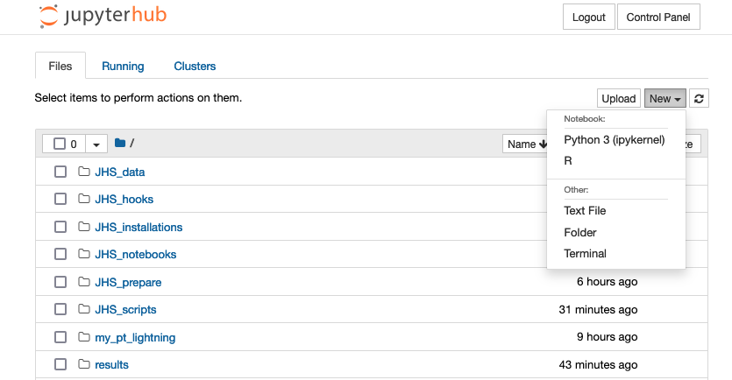
Hands-on: hyperparameter grid search on an HPC system
What this hands-on is about
An example of embarrassingly parallel training
We train a simple CNN that classifies handwritten digits based on the MNIST dataset
Test a range of various hyperparameters => an array job
What to do
New -> Terminal
cd hyperparameter_array
Have a look around, especially array.batch
Exercise: add a third hyperparameter gamma

Slide 25
Data parallel stochastic gradient descent
Most networks are trained using stochastic gradient descent (SGD)
Distributed stochastic gradient can be done in two ways
Synchronous SGD
Asynchronous SGD

Slide 26
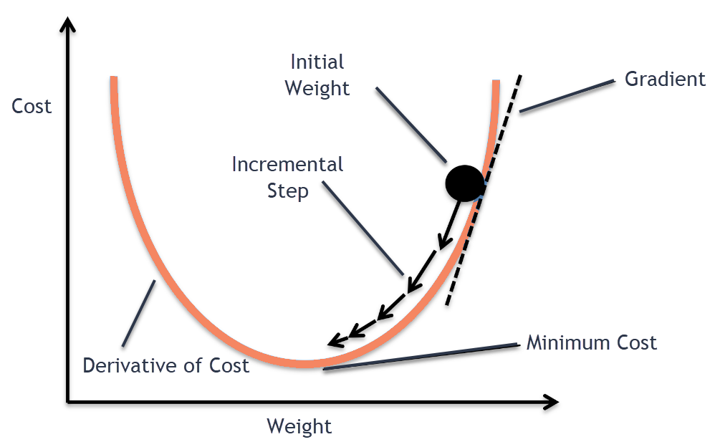

Stochastic gradient descent (SGD)
SGD: find optimum by following the slope
$$w=w−η∇Q(w)$$
w = weights, $η$ = learning rate,$∇Q(w)$ = gradient for current batch.
$$W_{1}$$
$$W_{2}$$
$$W_{3}$$

Slide 27







Data parallel synchronous SGD
Each device (j) computes the gradients ($∇Qj\left(w\right)$) based on its own batch!
Needs to be aggregated before updating weights
Device 1
$$g_{1}=∇Q_{1}(w)$$
Device 2
$$g_{2}=∇Q_{2}(w)$$
Device 3
$$g_{1}=∇Q_{3}(w)$$
Device 4
$$g_{1}=∇Q_{4}(w)$$
$$∇Q\left(w\right)=\sum_{j}{∇Qj\left(w\right)}$$
$$w=w−η∇Q(w)$$

Slide 28
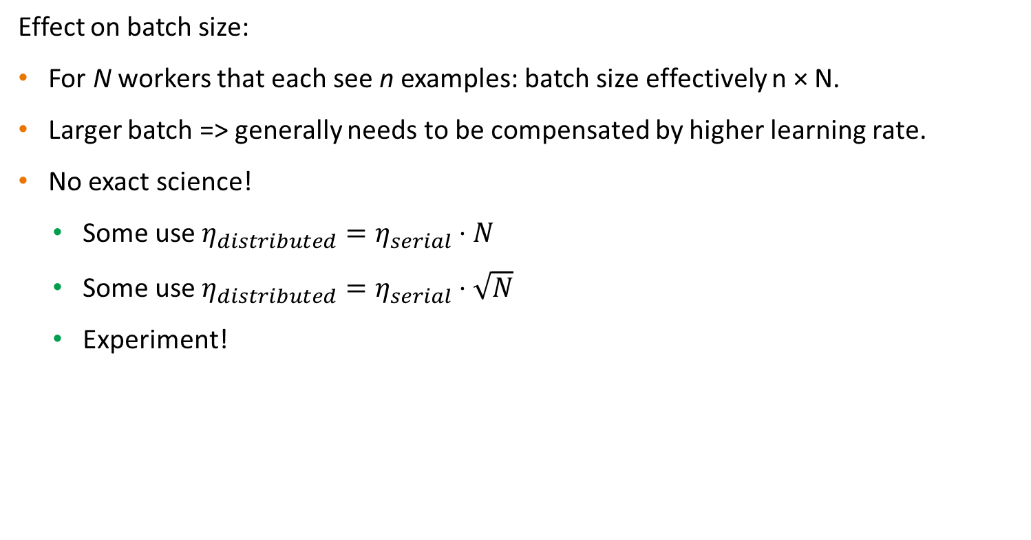
Data parallel synchronous SGD
Effect on batch size:
For N workers that each see n examples: batch size effectively n × N.
Larger batch => generally needs to be compensated by higher learning rate.
No exact science!
Some use $η_{distributed}=η_{serial}⋅N$
Some use $η_{distributed}=η_{serial}⋅\sqrt{N}$
Experiment!

Slide 29
Data parallel synchronous SGD
Pro tip:
- Overlap communication and computation (don’t waste compute cycles waiting for communication!)
- Most (distributed) DL frameworks already take care of this for you ☺
A different view…
Time
Synchronization
barrier
Pro tip 2:
Penalty for synchronous SGD: you have to wait for the slowest worker, before next iteration.
Make sure all workers are equally fast!
Worker 1
N
N-1
…
1
N
N-1
…
1
N
N-1
…
1
Forward pass
Worker 2
N
N-1
…
1
N
Backward pass,
compute gradient of layer N
N
Backward pass,
communicate gradient N
Wait

Slide 30









Decentralized data parallel synchronous SGD
Gradients are communicated and aggregated by all workers
$$∇Q1+∇Q2+∇Q3$$
$$∇Q1+∇Q2+∇Q3$$
$$∇Q1$$
Worker 1
Worker 2
$$∇Q2$$
$$∇Q3$$
$$∇Q3$$
$$∇Q1$$
$$∇Q2$$
Worker 3
$$∇Q1+∇Q2+∇Q3$$

Slide 31







Centralized data parallel synchronous SGD
There is also an alternative, where a parameter server is used to aggregate the gradients, and distribute the updated model:
Worker 1
Worker 2
$$w$$
$$w$$
$$∇Q1$$
$$∇Q2$$
Parameter server
$$∇Q1+∇Q2+∇Q3$$
$$w$$
$$∇Q3$$
Worker 3

Slide 32
Centralized vs decentralized
Centralized approach does not scale well: parameter servers create a communication bottleneck
More info, see e.g. https://arxiv.org/pdf/1705.09056.pdf

Slide 33
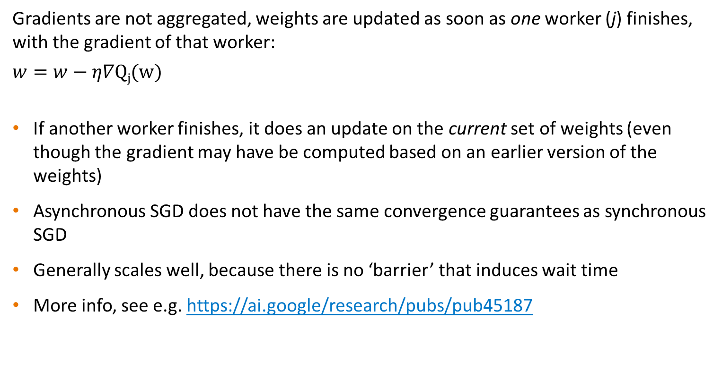
Data parallel asynchronous SGD
Gradients are not aggregated, weights are updated as soon as one worker (j) finishes, with the gradient of that worker:
$$w=w−η∇Qj(w)$$
If another worker finishes, it does an update on the current set of weights (even though the gradient may have be computed based on an earlier version of the weights)
Asynchronous SGD does not have the same convergence guarantees as synchronous SGD
Generally scales well, because there is no ‘barrier’ that induces wait time
More info, see e.g. https://ai.google/research/pubs/pub45187

Slide 34
Data parallel asynchronous SGD
Time
Worker 1
1
N
N-1
…
1
2
N
N-1
…
1
N
N-1
…
1
N
N-1
…
1
Parameter server
M₁
M₂
M₃
M₄
N
N-1
…
1
N
N-1
…
1
Worker 2
1
N
N-1
…
1
2
N
N-1
…
1
i
Forward pass, iteration i
M_{j}
Model state, update j
N
Backward pass, compute gradient of layer N
N
Backward pass, communicate gradient N

Slide 35
Data parallel SGD
Word of warning:
Data parallel asynchronous SGD is an active area of research
Data parallel synchronous SGD is well understood and is currently the accepted and advised approach

Slide 36
Communicating gradients…
Ok, so the most widely accepted approach is
distributed…
data parallel…
synchronous…
SGD…
… but how do distributed deep learning frameworks aggregate their gradients in such a setup?

Slide 37
A bit of history
‘Traditionally’ a lot of machine learning was not done in an HPC context. As a result:
Most frameworks had little focus on distributed learning
Most frameworks that offered distributed learning were based on parameter servers
Most AI experts probably never heard of MPI...

Slide 38
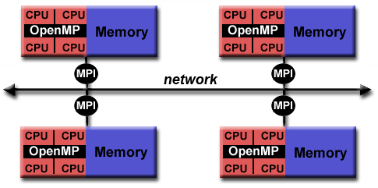
The Message Passing Interface (MPI)
MPI is a standard for parallelization on a distributed memory system
Distributed memory system: processors can’t access each other’s memory
Explicit communication (over a network) is required between one memory and another to work on the same task
MPI is the ‘language’ of this communication
MPI is the de facto standard for traditional HPC applications

Slide 39
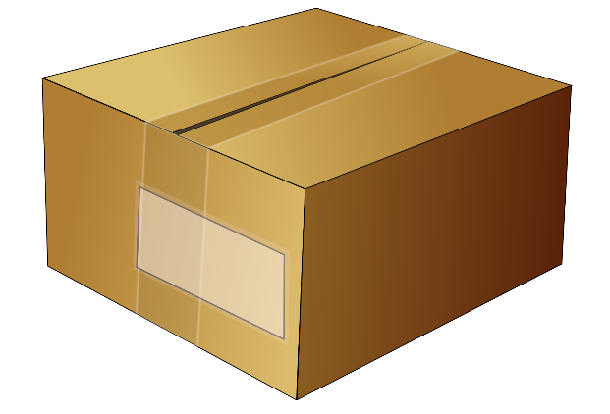
The Message Passing Interface (MPI)
MPI has routines to send data between individual workers…
From: Node 0
To: Node 1

Slide 40
The Message Passing Interface (MPI)
But also to broadcast data to other workers…
From: Node 0
To: everyone

Slide 41
The Message Passing Interface (MPI)
And most importantly (for deep learning): apply collective operations, such as ‘allreduce’. This operation is widely used in distributed deep learning to aggregate gradients!
P0
A
B
C
D
P0
A+B+C+D
A+B+C+D
A+B+C+D
A+B+C+D
P1
AllReduce
P1
P2
P2
P3
P3

Slide 42
The Message Passing Interface (MPI)
MPI is a standard: it defines what AllReduce should do, not how it should be done.
MPI libraries implement MPI functions. These libraries decide how it should be done.
Example: an inefficient allreduce operation could implemented like this:
P0
A
B
C
D
P0
A+B+C+D
A+B+C+D
A+B+C+D
A+B+C+D
A+B+C+D
P0
P1
P1
P2
P2
P3
P3

Slide 43
Relevance of MPI for distributed deep learning
Why is this relevant?
Distributed DL frameworks often support multiple communication backends for their collective allreduce operations
These backends often either implement (part of) the MPI API or something similar
It is important to pick a communication backend with an efficient implementation.
The most efficient implementation may vary per hardware.
Example: Nvidia’s NCCL library implements a subset of MPI collective operations. These implementations are highly optimized for Nvidia GPUs.

Slide 44

MPI / NCCL
MPI often used to communicate gradients
MPI_AllReduce aggregates and sums gradients (remember: $∇Q\left(w\right)=\sum_{j}{∇Qj\left(w\right)}$)
NVIDIA’s NCCL library contains an implementation of MPI routines optimized for GPU ⬄ GPU communication
P0
A
B
C
D
P0
A+B+C+D
A+B+C+D
A+B+C+D
A+B+C+D
P1
MPI_AllReduce
P1
P2
P2
P3
P3
Notes:
This is slide is for “the short version”, we can use the other slides explaining MPI for the long version.

Slide 45
Frameworks for distributed learning
TensorFlow’s tf.distribute: quite tricky to program. Lot’s of code changes needed from serial to distributed (https://www.tensorflow.org/guide/distributed_training)
TensorFlow + Horovod: serial => distributed with minimal code changes (https://horovod.readthedocs.io/en/stable/tensorflow.html)
PyTorch’s torch.distributed (https://pytorch.org/tutorials/intermediate/dist_tuto.html)
PyTorch + Horovod: serial => distributed with minimal code changes (https://horovod.readthedocs.io/en/stable/pytorch.html)
PyTorch Lightning: hides a lot of boiler plate code (also nice for serial training). Very little changes needed between serial & parallel execution, especially on a SLURM cluster (https://pytorch-lightning.readthedocs.io/en/latest/clouds/cluster.html#slurm-managed-cluster)

Slide 46
Hands-on: data parallel with torch.distributed and PyTorch Lightning
What this hands-on is about
Experience data parallelism using PyTorch
See the same model implemented with PyTorch Lightning
We use the same MNIST example again, but this time run it on GPUs!

Slide 47
Hands-on: data parallel with torch.distributed and PyTorch Lightning
What to do: load modules
New -> Terminal
cd ddp
salloc -p gpu_course -n 1 -c 18 --gpus 1 -t 20:00
module purge
module load 2022
module load PyTorch/1.12.0-foss-2022a-CUDA-11.7.0
module load torchvision/0.13.1-foss-2022a-CUDA-11.7.0
…

Slide 48
Hands-on: data parallel with torch.distributed and PyTorch Lightning
What to do: set up environment variables and run PyTorch training
export MASTER_PORT=$(expr 10000 + $(echo -n $SLURM_JOBID | tail -c 4))
master_addr=$(scontrol show hostnames "$SLURM_JOB_NODELIST" | head -n 1)
export MASTER_ADDR=$master_addr
echo "MASTER_PORT="$MASTER_PORT
echo "MASTER_ADDR="$MASTER_ADDR
python mnist_classify_ddp.py --save-model

Slide 49
Hands-on: data parallel with torch.distributed and PyTorch Lightning
What to do: load PyTorch Lightning from the virtual environment we set up earlier, and train the model using Lightning
…
source ~/my_pt_lightning/bin/activate
python mnist_classify_ddp_lightning.py

Slide 50
Hands-on: data parallel with torch.distributed and PyTorch Lightning
What to do: exit the current gpu allocation and start a new allocation of a full node
…
exit
salloc -p gpu_course -N 1 -c 18 --gpus 4 -t 20:00

Slide 52
Recap of goal: understand docs of DL frameworks
From TensorFlow docs on “distribution strategy”:
“tf.distribute.Strategy intends to cover a number of use cases along different axes… Synchronous vs asynchronous training: These are two common ways of distributing training with data parallelism. In sync training, all workers train over different slices of input data in sync, and aggregating gradients at each step. In async training, all workers are independently training over the input data and updating variables asynchronously. Typically sync training is supported via all-reduce and async through parameter server architecture.”
“MultiWorkerMirroredStrategy currently allows you to choose between two different implementations of collective ops. CollectiveCommunication.RING implements ring-based collectives using gRPC as the communication layer. CollectiveCommunication.NCCL uses Nvidia's NCCL to implement collectives.”

Slide 53
Practical tips & take home messages
If increased throughput is the goal, use data parallelism
If a large model is the goal, use model (or hybrid or pipeline) parallelism, but consider the consequences (slower training) and alternatives (model pruning, CPU-based training, etc)
Account for the difference in convergence behavior of data parallel SGD, e.g. by adjusting & experimenting with the learning rate.
Synchronous parallel SGD is the most common approach for distributed learning, because it is well understood. Asynchronous parallel SGD can scale very well, but convergence behavior is less clear.
Use an efficient backend for collective communications (e.g. NCCL)

Slide 54
Further reading
Distributed TensorFlow using Horovod: https://towardsdatascience.com/distributed-tensorflow-using-horovod-6d572f8790c4
Demystifying Parallel and Distributed Deep Learning: An In-Depth Concurrency Analysis: https://arxiv.org/pdf/1802.09941.pdf
Prace best practice guide for Deep Learning: http://www.prace-ri.eu/IMG/pdf/Best-Practice-Guide-Deep-Learning.pdf
Technologies behind Distributed Deep Learning: https://preferredresearch.jp/2018/07/10/technologies-behind-distributed-deep-learning-allreduce/
PyTorch Distributed: https://pytorch.org/tutorials/beginner/dist_overview.html and https://pytorch.org/docs/stable/distributed.html

