Slide 1

Magna Cum Laude Thesis Defense:
An Open-Source Remote Monitoring System
Nikolas Wolfe
Dept of Computer and Information
Sciences and Engineering
December 8, 2009

Slide 2
Summary
Motivation
To lower the cost and improve the quality of remote monitoring and the sustainability of renewable energy systems
Problem
Existing monitoring technologies are expensive, limited, and proprietary
Solution
To develop an open-source monitoring system for remote power systems that minimizes after-installation costs

Slide 3
High Level Design
An open-source monitoring system for remote solar power systems
Two Parts:
1.) Hardware Component: Interfaces with charge controller, transmits data
2.) Software Component: Stores and analyzes data

Slide 4
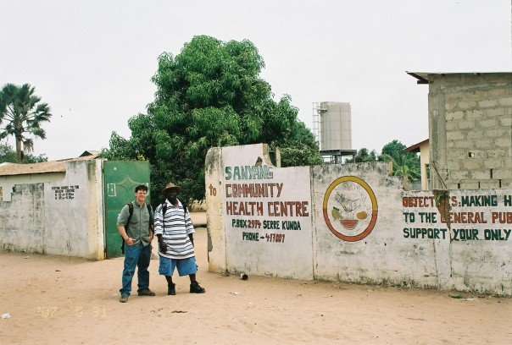
Inspiration?
Why doesn’t this work?
Sanyang, The Gambia, Summer 2007

Slide 5
Premises
1.) Solar is common
2.) Projects using solar routinely fail
3.) Maintenance requires trained personnel, but also information
4.) Remote Monitoring can provide essential information
5.) Existing systems are limited and proprietary
6.) This technology should be open source

Slide 6
Premise 1: Background and Case Studies
UNDP-GEF Project, Zimbabwe
Nyimba ESCO Project, Zambia
Home Power! Namibia

Slide 7
Premise 3, 4: Maintenance and RM
Essential task: cycling of batteries
Remote Monitoring assists owners and local technicians in their jobs

