Slide 1
🏡
Site Visit Analyzer
AI-powered sales coaching & Voice-of-Customer intelligence for real estate
📍 Pilot: Sunrise Residences · Whitefield, Bangalore
Prototype · Team BYTEBattle

Slide 2
⚠️
Every site visit is a goldmine of data — and today it's all lost
The Problem
🎙️
🧑‍🏫
📊
Conversations vanish
No objective coaching
No aggregated signal
Agent pitches, customer objections, and on-the-spot feedback are never captured after the visit ends.
Sales managers can't tell why a deal was won or lost, or which agents need help with which skills.
Developers have no structured view of why leads hesitate — price, timelines, trust, or location.
The result: decisions about coaching, pricing, and product positioning are made on gut feel instead of evidence.
Site Visit Analyzer · BYTEBattle
2

Slide 3
✨
From a 2-minute voice note to coaching + market intelligence
How It Works
1
2
3
4
🎙️
🤖
📈
🗣️
Record
›
AI Analysis
›
Instant Coaching
›
Aggregated VoC
Agent records a short voice summary right after the site visit, in-browser.
Gemini 2.5 listens to the raw audio — tone, content, and objections — not just a transcript.
Agent gets a 5-pillar scorecard, transcript, and one actionable coaching tip.
Developers see synthesized customer themes across every visit, ranked by priority.
Site Visit Analyzer · BYTEBattle
3

Slide 4
🎯
Built for two audiences, in one product
Who It's For
🧑‍💼
Sales Agent
🏗️
Developer / Sales Manager
“How did I perform? What should I do differently with this lead?”
“Across all visits, why are customers hesitating — price, location, or agent knowledge?”
Instant, judgment-free scorecard after every visit
One concrete coaching tip to apply on the next call
Tracks personal performance over time on the leaderboard
Team-wide KPIs and pillar performance at a glance
Agent leaderboard to identify coaching priorities
AI-synthesized Voice-of-Customer themes for product decisions
Site Visit Analyzer · BYTEBattle
4

Slide 5
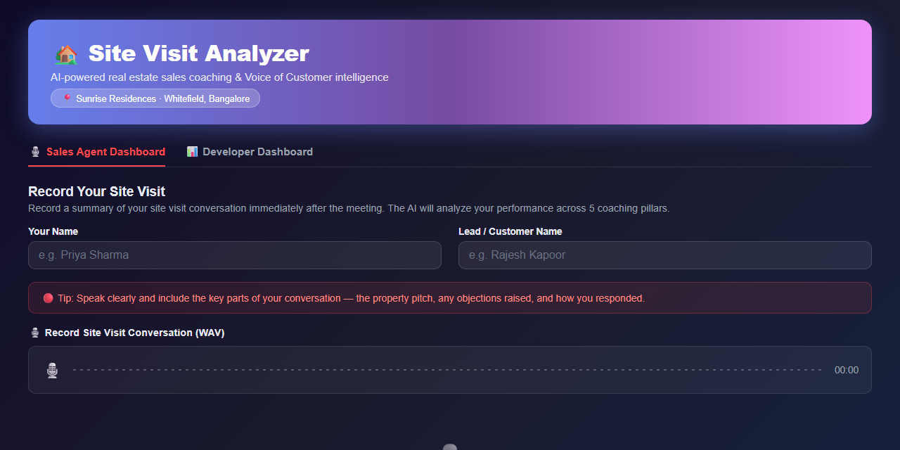
🎙️
One-click audio capture, right in the browser
Feature 1 / 5
Agent records a short spoken summary immediately after the visit — no app install, no extra hardware.
Captures agent name and lead name alongside the recording for clean tracking.
Built-in guidance prompts the agent to mention the pitch, objections raised, and how they were handled.
Site Visit Analyzer · BYTEBattle
5

Slide 6
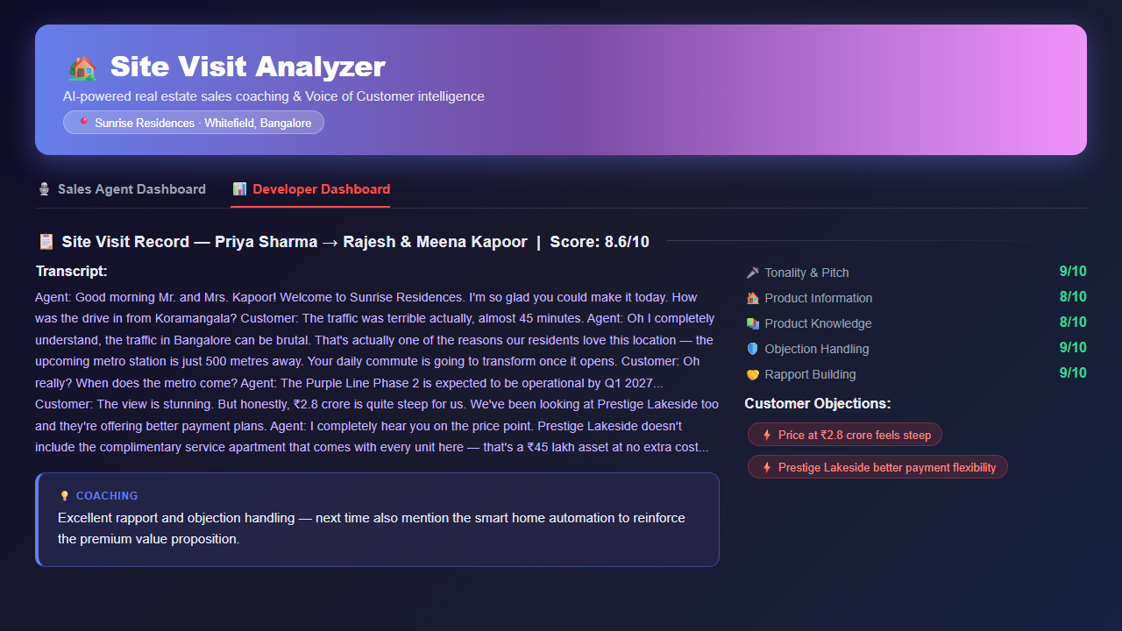
📈
Multimodal AI scoring across 5 coaching pillars
Feature 2 / 5
Google Gemini listens to the raw audio — tone, pacing, and confidence — not just a text transcript.
Scores every visit on Tonality & Pitch, Product Information, Product Knowledge, Objection Handling, and Rapport Building.
Returns a full transcript, an overall score, and one specific, actionable coaching tip.
Automatically extracts customer objections and positive signals from the conversation.
Site Visit Analyzer · BYTEBattle
6

Slide 7
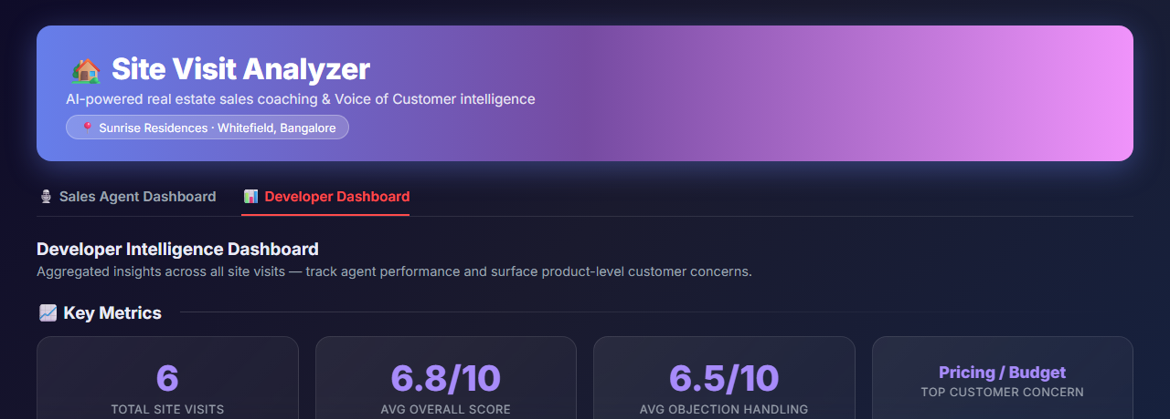
📊
Developer dashboard with real-time team KPIs
Feature 3 / 5
Aggregates every recorded visit into a single live view for sales managers and developers.
Tracks total site visits, average overall score, and average objection-handling performance.
Surfaces the single biggest customer concern across the whole pipeline — automatically.
Site Visit Analyzer · BYTEBattle
7

Slide 8
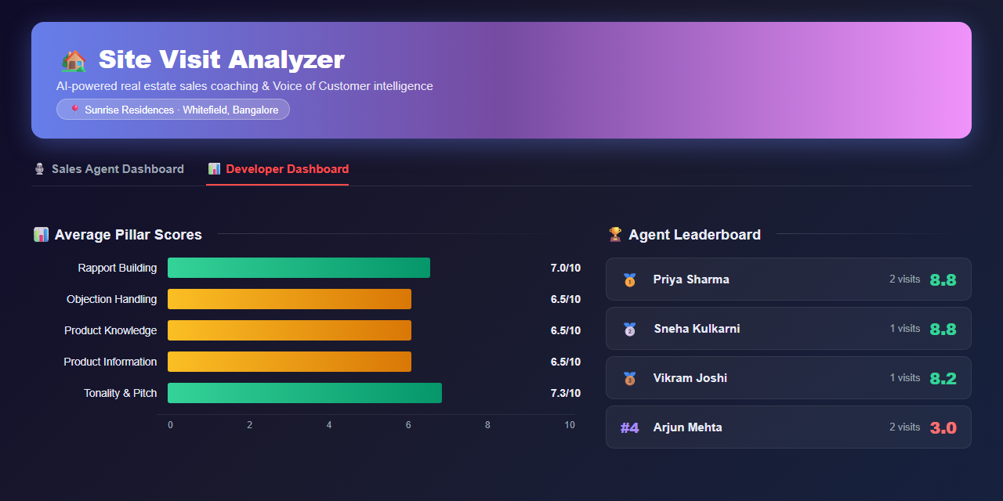
🏆
Pillar performance breakdown & agent leaderboard
Feature 4 / 5
Visualizes the team's average score on each of the 5 coaching pillars to spot systemic strengths and gaps.
Ranks agents by overall score, turning every recording into a friendly performance leaderboard.
Helps managers target coaching where it matters most — e.g. objection handling vs. rapport.
Site Visit Analyzer · BYTEBattle
8

Slide 9
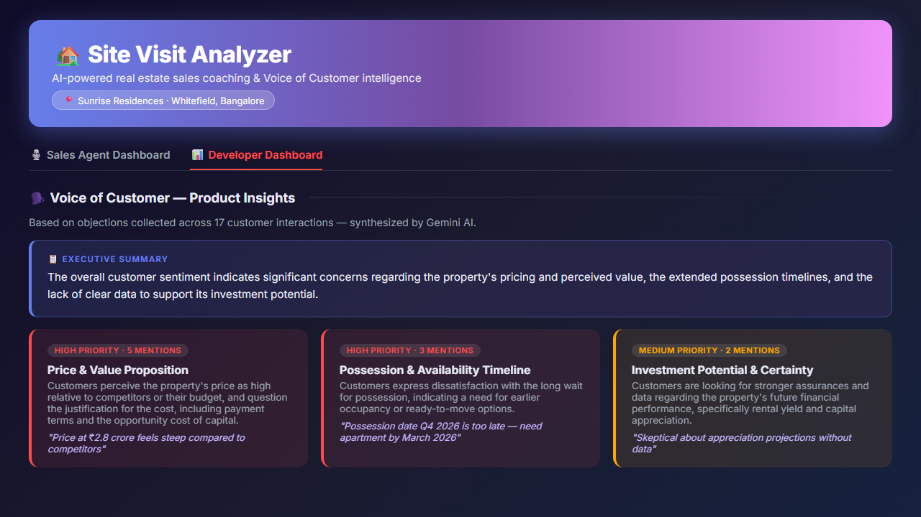
🗣️
AI-synthesized Voice of Customer, ranked by priority
Feature 5 / 5
Gemini reads every customer objection collected across all visits and groups them into recurring themes.
Each theme gets a priority level, a mention count, a description, and a real supporting quote.
An executive summary gives product and leadership teams a one-paragraph read on customer sentiment.
Site Visit Analyzer · BYTEBattle
9

Slide 10
🛠️
A lean stack, built to move from prototype to pilot fast
Tech Stack
🖥️
🤖
💾
Frontend
AI Engine
Storage
Streamlit — a fast, Python-native UI for both the Agent and Developer dashboards.
Google Gemini 2.5 Flash — multimodal model that analyzes audio directly for transcript + scoring.
Local JSON files for live and mock data — simple, transparent, and easy to swap for a real database.
Why it matters: every layer is replaceable without a rewrite — swap JSON for Postgres, or add a CRM integration, without touching the AI pipeline.
Site Visit Analyzer · BYTEBattle
10

Slide 11
🚀
Measuring impact, and what comes next
What's Next
📏 Success Metrics
🗺️ Roadmap
% of site visits with a recorded analysis
Agent score improvement over time — does the coaching loop close?
Reduction in the top VoC objection category, quarter over quarter
Move from local JSON to a shared database for multi-agent, multi-property use
Multi-property / multi-project support for developers with several launches
CRM integration to push coaching scores and VoC themes into existing workflows
Mobile-friendly recording flow for agents in the field
Site Visit Analyzer · BYTEBattle
11

Slide 12
Let's turn every site visit
into a coaching + insight engine
Site Visit Analyzer · Prototype · Team BYTEBattle
📍 Pilot: Sunrise Residences · Whitefield, Bangalore

