Slide 1


Slide 2
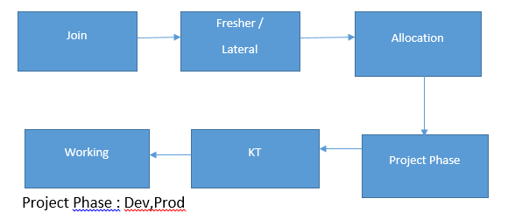
Project Phases

Slide 3
Various Domains
Telecom
Banking
Automobile
Pharma
Security
Ecom
Transport
Etc

Slide 4
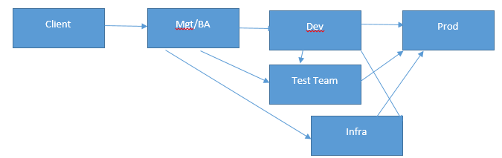
Project Working

Slide 5
Team Size
Total 9
Mgr-1
TL/ Scrum Master – 1
HE/Dev – 2
MidE/Dev-4
Infra-1

Slide 6
Cluster Details
Total Number of nodes : 9
Masters : 3 (ANN,PNN,RM)
Slaves : 6
Total RAM : 256 GB * 6 ~ = 1.35 TB
HDFS Size ~ = 120 TB (100 TB Process)
Total Cores = 64 * 6 = 350 cores
Cluster retention: 1 year
Replication Factor: 3
Block Size: 128 MB

Slide 7
Continue…
Data in Depth :
Daily Data Size : ~200 GB
Input File Type : .csv
Delimiter : |
Daily 1 file for each transactional Table.
Total Number of tables :
~300 : (220 TX , 60 REF , 20 Hist.)
Total Number of Jobs : Around 340 jobs

Slide 8
Project Duration
Development : 1.5-2 year
Support – 6 months
Bigdata Analysis in Telecom Industry
Refer. Doc : 00.EDWA.docx
Version of tools

Slide 9









Project Flow

Slide 10
Reconciliation
Count
Null
Duplicate
RI
Detailed Validation

Slide 11
Project Description
Refer : 00.EDWA.docx
Refer : EDWA_User_Guide.docx

Slide 12
Something More…
Job debug and Errors
Monitoring
Optimization
Error and resolution
Scheduling
Reconcilation
Refer : 14.Something_Extra.docx

Slide 13
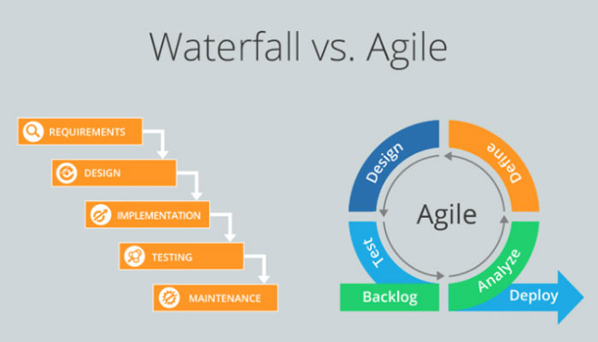
Agile
What is Agile
Benefit
Scrum
Project Flow
Artifact :
1.Product Backlog
2.Sprint Backlog
3.Product Increment

Slide 14
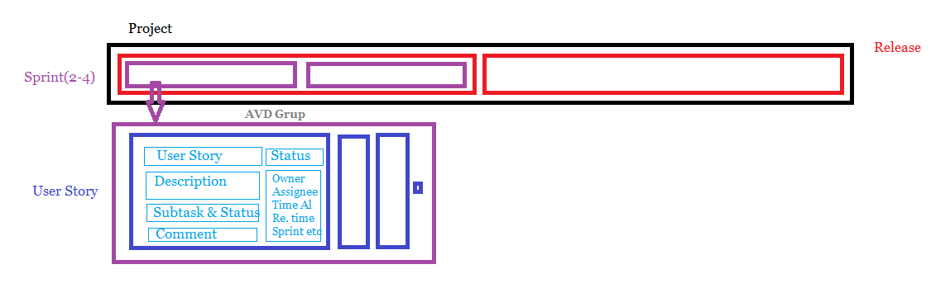
Project Flow

Slide 15
Continue…
Meeting :
1.Sprint Planning
2.Daily Standup
3.Sprint Review
4.Sprint Retrospective
Roles :
1.Product Owner
2.Scrum master
3.Scrum Team

Slide 16
Continue…
User Story
Release backlog
Burn down chart
Issue or Bug
Deployment

Slide 17



Some additional Concepts
Jira Tool
Confluence
Trello

Slide 18


