Slide 1

OLIST E-COMMERCE ANALYSIS
Presenting by
Group 3
MENTOR
Ms. Dipti Sinha
Ms. Smitha Bantwal

Slide 2




OUR TEAM
Nilavu .E.D
Jayavedhan. A
Dinesh .J
Teenu Rajendra Awachat
Neelakandan .G
Deepak Kharvi

Slide 3
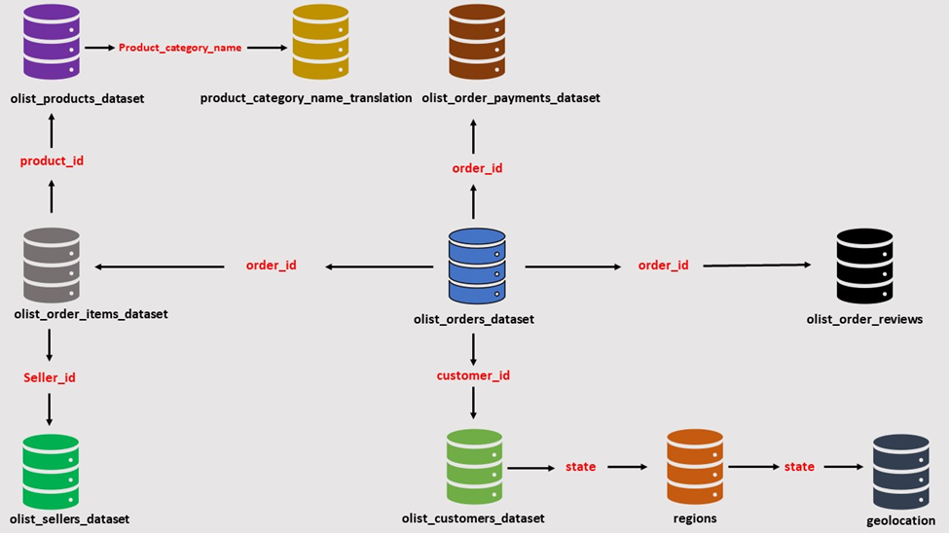

Slide 4
Agenda
Introduction
Over view
Summary
Insights & Recommendations
KPI’s

Slide 5
INTRODUCTION
Data for this analysis comes from Olist, a major Brazilian e-commerce platform. Olist seamlessly connects small businesses across Brazil to various sales channels through a single contract. These merchants can sell their products through the Olist Store and fulfill orders using Olist's logistics partners. Upon order completion, customers receive a satisfaction survey via email, allowing them to rate their purchase experience and provide feedback

Slide 6
OVER VIEW
The Olist Store Analysis project aims to analyze customer purchasing patterns and payment statistics on an Ecommerce platform, Olist. This project covers several key performance indicators (KPIs) such as weekday vs weekend sales, payment statistics, delivery time, and customer behavior. The analysis is based on nine CSV files, which are cleaned and manipulated to extract valuable insights

Slide 7
INFORMATION CONTAIN BY DATASETS
Olist Order Customers - The customer's location and other details are included in the dataset. Utilize it to determine the order delivery location and to identify unique consumers within the orders dataset.
Olist geolocation dataset - This dataset contains the latitude and longitude of Brazilian zip codes.
Olist Order Items dataset contains information about the products that are bought in each order.
Olist Order Payments dataset comprises information regarding the payment alternatives available for orders.
Olist order reviews dataset - This dataset contains information on customer reviews.
Olist orders dataset: This is the main dataset. Each order in this has all the relevant information mapped to it.
Olist products dataset: This dataset contains information about the goods that Olist sells.
Olist sellers dataset: This dataset contains information about Seller details.
Olist product category name dataset: These are used to organize products into specific groups based on their characteristics and usage.

Slide 8
KPI’s
Weekdays and weekend payment statistics
Payment Type with review score 5
Average numbers of delivery days taken for pet shop
Average price and payment value of Sao Paulo city
Average shipping days vs review scores

Slide 9
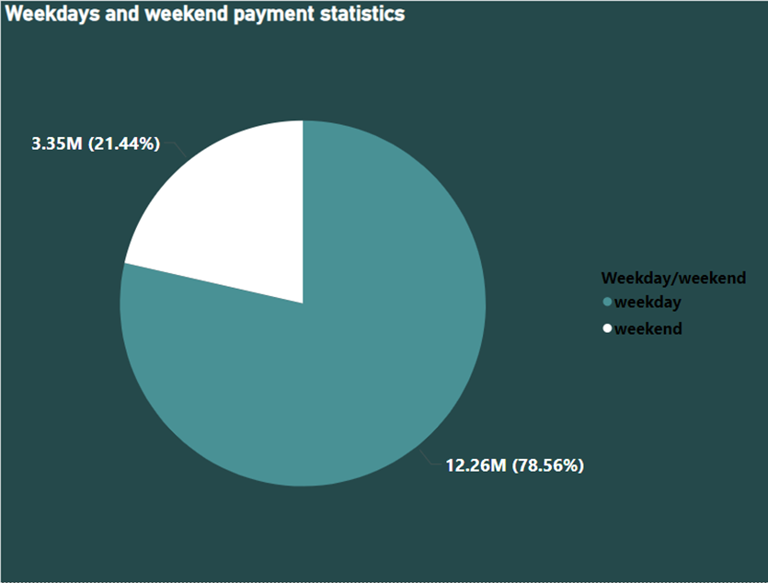
Weekdays and weekend payment statistics
OBSERVATION
As we can see weekday vs weekend payment statistics we observe that weekend payment value is $3.35M, accounting for 21.44% of total payment.
Similarly in weekday we observe that payment value is $12.26M,accounting for 78.56% of total payment.
We can observe that there is a higher percentage of payments on weekdays, it indicates that customers are more active and prefer shopping on weekdays.
CONCLUSION
Marketing and promotions
Resource Allocations
Weekend promotions
Email Marketing

Slide 10
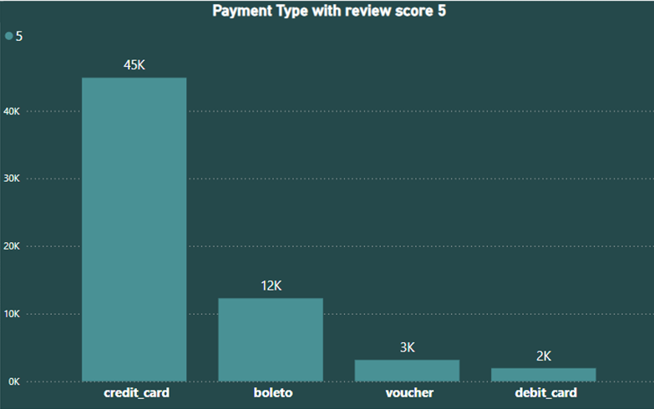
Payment Type with review score 5
OBSERVATION
We observe that there are total 45k orders with review score 5 and payment type as credit card.
We can clearly see that for the higher number of orders the payment is made using credit card.
Customers who use credit cards may have a better shopping experience or find it more convenient and secure, leading to higher satisfaction and positive reviews.
CONCLUSION
Preference for credit card payments
Effective customer Engagement
Replicate successful Strategies
Popular payment method

Slide 11
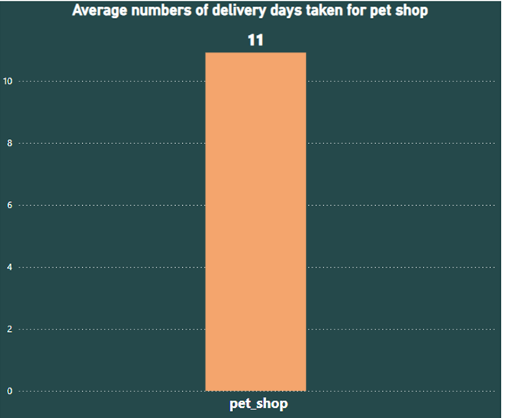
Average numbers of delivery days taken for pet shop
OBSERVATION
The average number of days taken for pet Shop is
11 days.
This provides insight on the speed at which the order is processed right from punching the order to delivering to the customer.
Evaluate with the seller if the number of days can be reduced further resulting in enhancement of customer experience.
CONCLUSION
Current Efficiency: 11 days
Collaborate to Reduce Time
Enhance Logistics

Slide 12
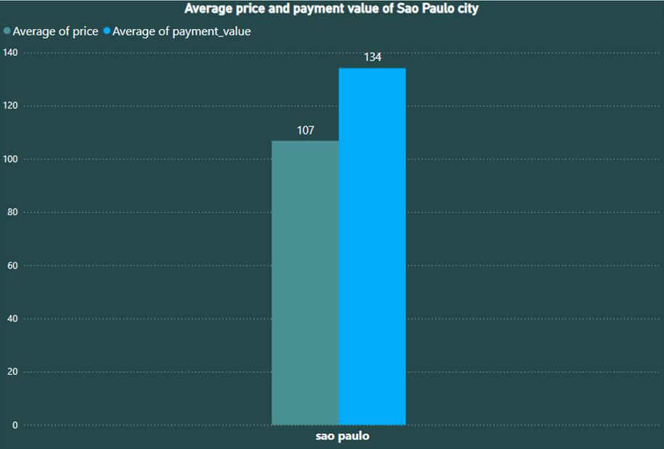
Average price and payment value of Sao Paulo city
OBSERVATION
The average price is $107 and the average payment value is $134
On study it is observed that both price & payment values are higher for Sao Paulo city compared to the other cities
Despite of high values the customers of Sao Paulo have placed maximum orders i.e. 15428 indicating they are high income groups and have high purchasing capacity
CONCLUSION
Premium Market Potential
Quality Assurance & Pricing
Strategic Marketing

Slide 13
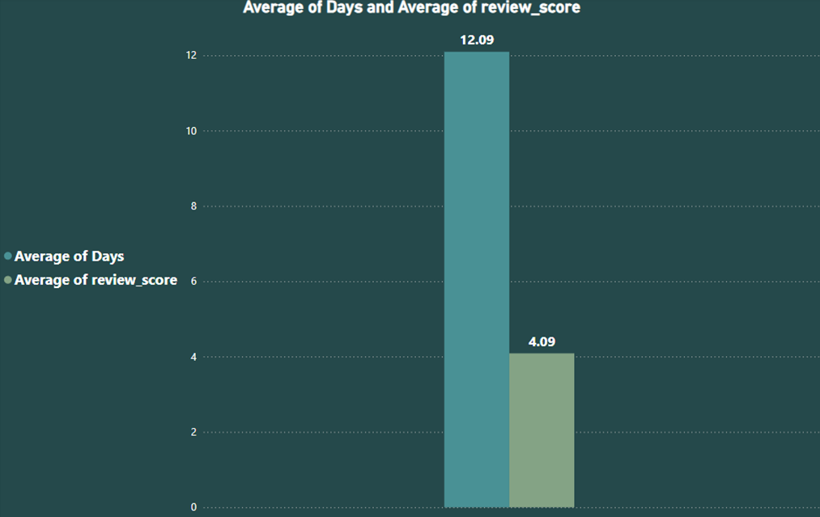
Average shipping days vs review scores
OBSERVATION
There is negative correlation between number of shipping days and the review score given by customers
Longer the shipping days results in customer dissatisfaction which is evident in the customer review score
Olist should review the operational efficiencies to reduce the shipping days Eg. Olist can give guidelines with regard to shipment dispatch, maintaining inventory for fast moving products, onboard fastest delivery partners etc.
CONCLUSION
Shipping Efficiency Improvement
Guidelines, Optimization, Partnerships Faster Delivery
Satisfaction Boost
Enhanced Reputation

Slide 14
Insights
Insights :
According to the data, Olist E-commerce has about 99,440 orders. With about 89,940 orders being delivered, the company has a 90% delivery success rate.
Their average product rating is 4.09 stars, with product categories going as high as 4.67 stars and as low as 2.5 stars.
1 Star reviews are on third place in the review score distribution ranking which likely indicates that there could be problems with product quality in some product categories.
Delivery performance could also influence review scores and success rate could certainly be improved.
Insights from this analysis can help in making business decisions, such as focusing on products that customers are interested in, improving product and service quality, and optimizing marketing in provinces with high total sales.
In addition, this analysis also provides an overview of customer consumption trends and patterns that can be used to direct further business strategies

Slide 15
Recommendations
RECOMMENDATIONS:
Regularly monitor and analyze customer reviews to gain insights in product quality and identify areas for improvement.
Dashboards can be used to identify patterns in customer reviews. This will provide a data-driven approach to enhance customer experience.
Investigate delivery delays and undelivered orders.Analyzing geographic locations could bring insights about certain challenges with demographics, accessibility, and possible route optimization.
Tracking fleet performance with the use of telematics can help identify issues before they become a problem.
Providing a proper shipment tracking system aids in having clear and concise communication between customers, sellers and couriers.
Regular updates can set proper expectations among customers and specific delivery instructions of customers can be properly accommodated.
By establishing trust and communication, both parties can work together to resolve any issues that may arise.

Slide 16
Summary
SUMMARY:
Marketplace Integration: Simplifies the process for sellers to list and manage their products across multiple e-commerce sites.
Comprehensive Support: Offers assistance with logistics, customer service, and returns, ensuring a seamless experience for both sellers and buyers.
Data Analytics: Provides insights and analytics to help retailers optimize their sales strategies and improve performance.
Technology and Innovation: Utilizes advanced technology to streamline operations and improve the efficiency of e-commerce processes.
Olist's business model focuses on empowering smaller retailers by giving them access to a broader audience and the tools necessary to compete with larger e-commerce players.

Slide 17
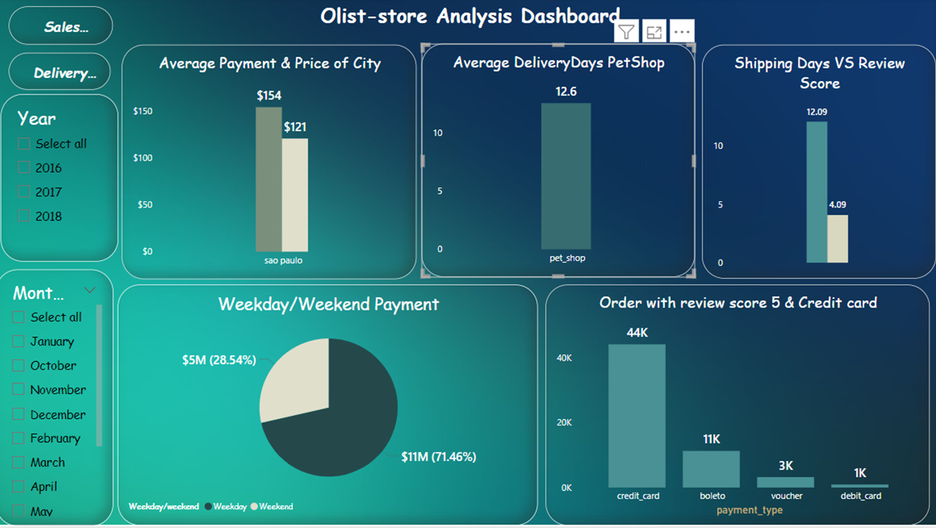
Dashboard

Slide 18
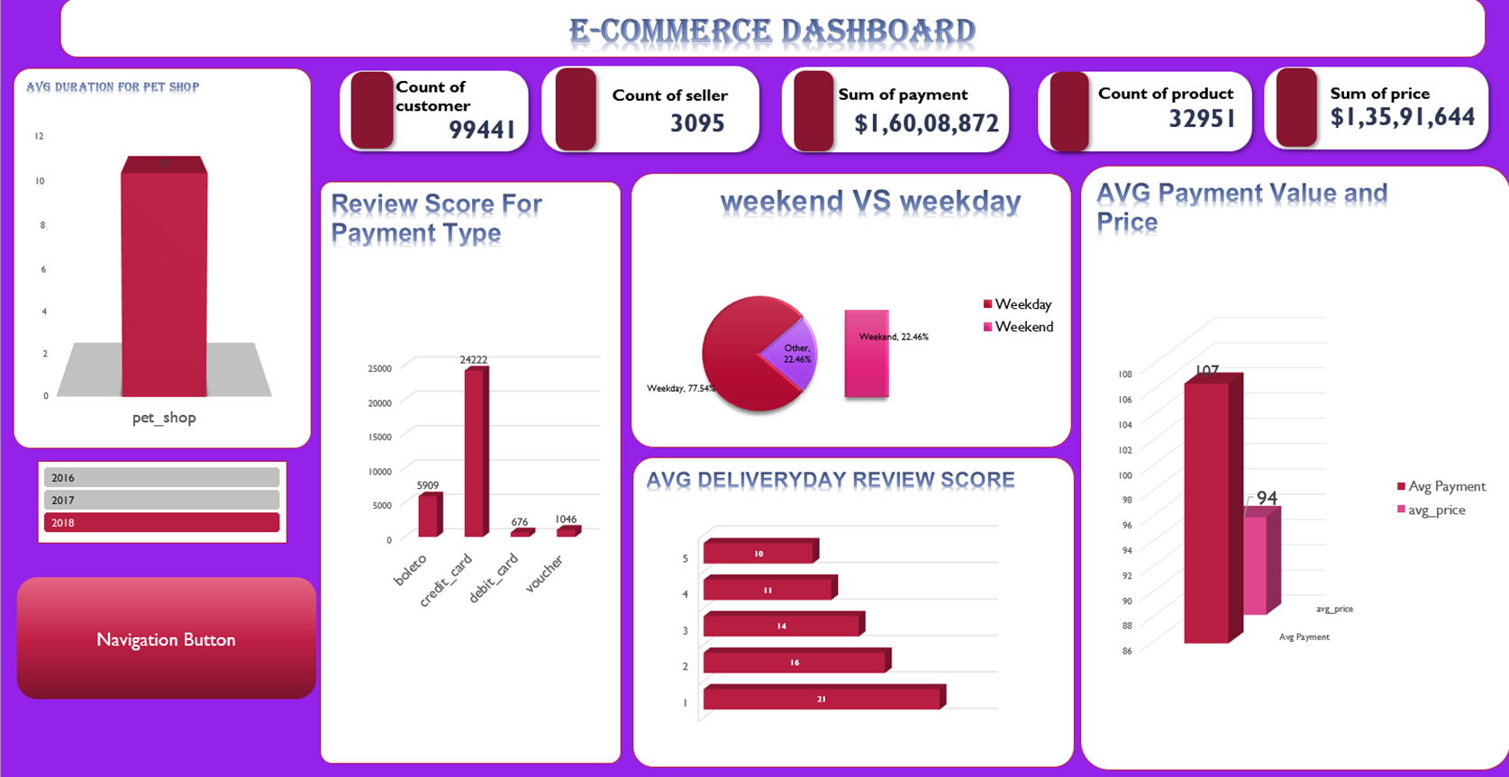

Slide 19


