Slide 1
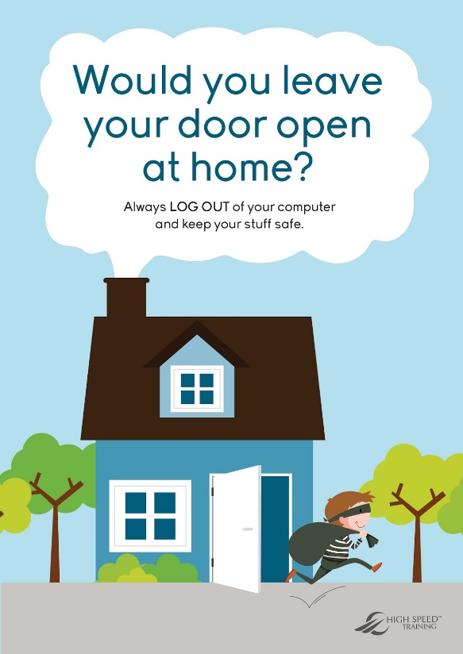
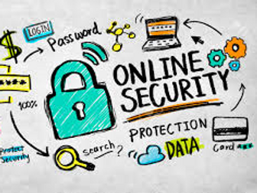
Scouts Social Media and Internet Safety

Slide 2
What is internet safety?
Internet safety is protecting your online activity from things such as:
Malicious software: Malware designed to get into your computer, phone or tablet to cause damage and gain access to its contents.
Would be hackers: Hackers try to gain access to your computer, phone or tablet by using a method called online dictionary attack. This will start automatically going through words in attempt to guess your password.
Data leaks: This will give hackers access to the likes personal information which can allow them to commit identity fraud, get bank details and contact people you know with malware to gain access to their computers.

Slide 3


How can we protect ourself while online?
Protecting against malicious software
Personal Vigilance: Its up to you to ensure that you are being carful while clicking links online or via emails. This is an easy way for malware to access your computer by disguising itself through video clips and downloadable content.
Anti virus: This will identify and warn you of any harmful websites or viruses that have managed to slip through its protection. Anti viruses are a very good thing to have and would be highly recommended.
This Photo by Unknown Author is licensed under CC BY-SA-NC

Slide 4
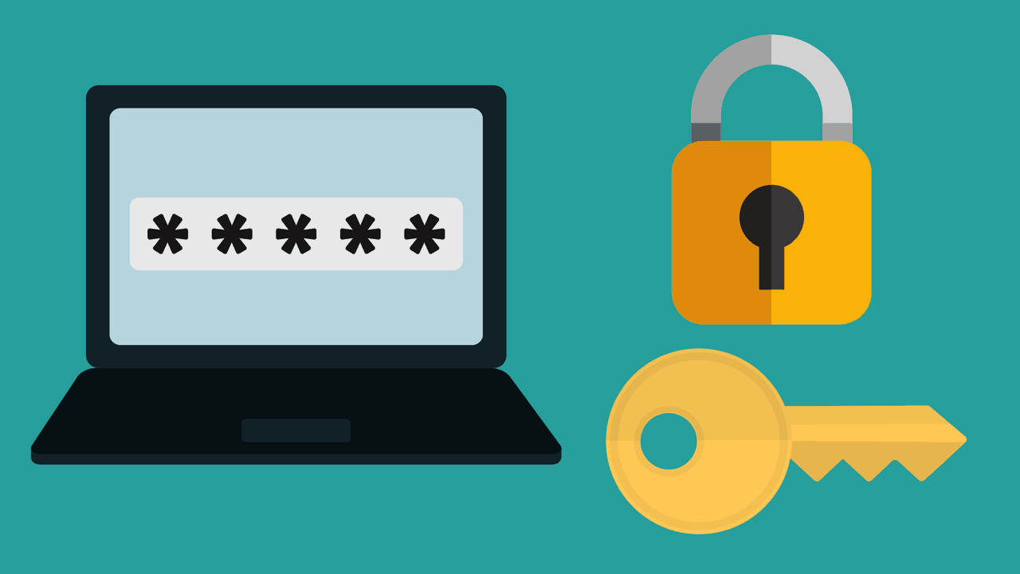
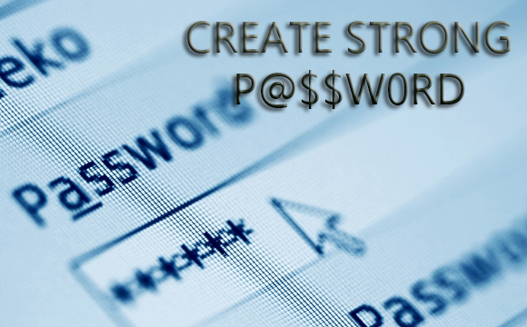
How to help prevent anyone getting your password
Pick a password that isn’t easily guessed, maybe something that relates to you so its easy to remember aka
Whitewall47
happydogs247
backwardspassword1!
You could even mix it up with numbers or symbols to be even harder to guess like H@ppyd0g$247

Slide 5
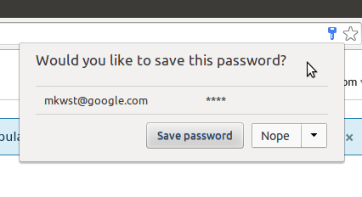
Saving your password
Save your Password in your browser
Saving your password in your browser means letting your web browser (such as Chrome, Safari or Edge) remember your password for you.
This can help:
Make sure you do not lose or forget your password
Protect you against some cybercrime, such as fake websites
It is safer than using weak passwords, or using the same password in more than one place.

Slide 6
Back up your data
Backing up data means creating a copy of your information and saving it to another device or to cloud storage (online)
Backing up regularly means you will always have a recent version of your information saved. This will help you recover your data in the event of your computer being hacked meaning you keep your data.
You can also turn on automatic backups

Slide 7
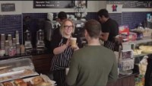
What people can find out about you
https://www.youtube.com/watch?v=yrjT8m0hcKU

Slide 8








How many of these do you know?
Notes:
1 facebook 2 Instagram 3 snapchat 4 youtube 5 twitter 6 twitch 7 whatsapp 8 pintrest

Slide 9
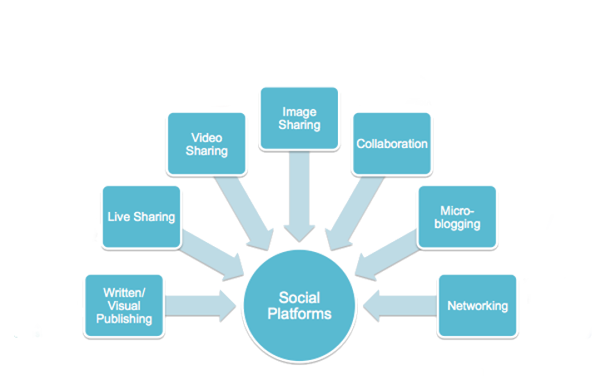












How do they fit in this diagram?

Slide 10
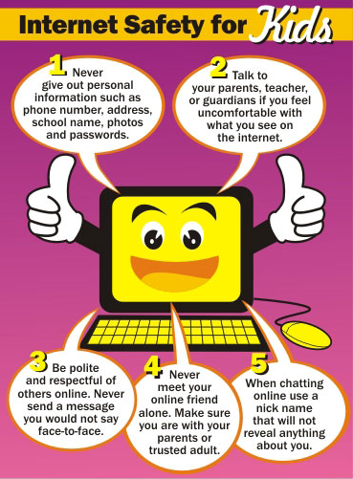

Slide 11

Do you add too much to the internet
https://www.youtube.com/watch?v=yiKeLOKc1tw

Slide 12
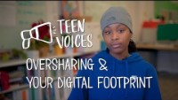
Something to think about Oversharing and your Digital Footprint
https://www.youtube.com/watch?v=ottnH427Fr8

Slide 13
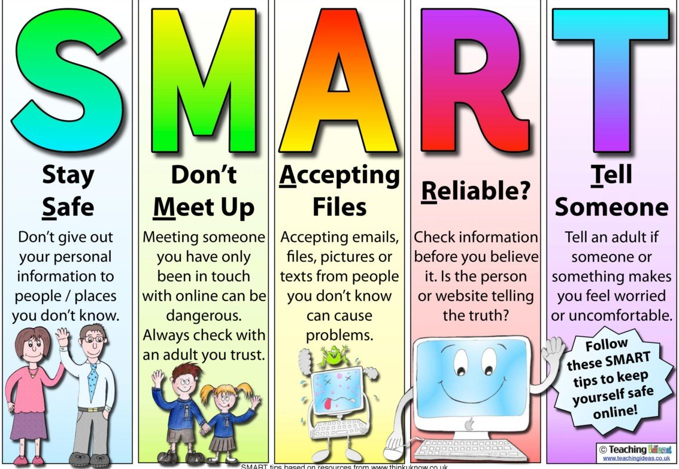
Do you know who you’re talking to?
Links if you feel you need help:
https://www.ceop.police.uk/safety-centre/
Online safety | NSPCC
Staying safe online | Childline

Slide 14
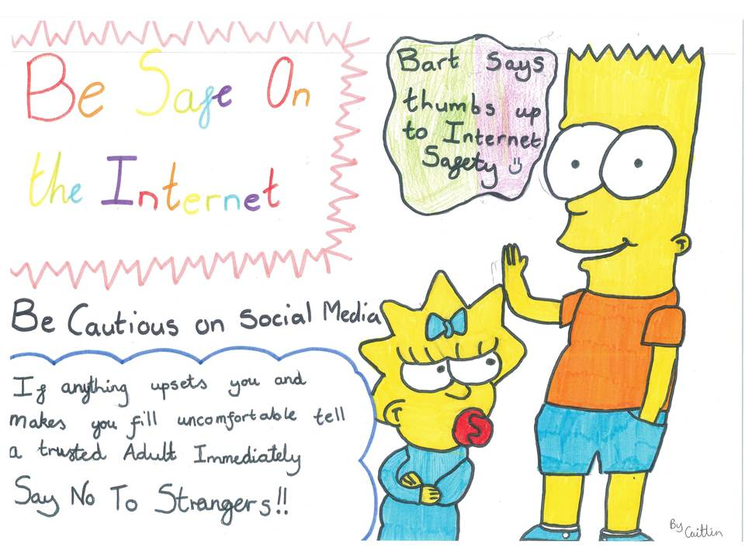

Slide 15

Thanks for joining in.
Remember to come back to our next meeting for more ideas and badge work

