Slide 1
Alexa Skill Description
Perform symbolic differentiation of mathematical expressions
The objective is used to help students to learn differentiation problems. It can also be used by teachers to teach their students and checking answers. Sometimes it can also be used to lookup solutions to complicated expressions reducing the need to solve them manually. Sometimes researches also may need to do quick differentiation while reading/developing research papers. The future objective is to extend this to more complication functions like doing limit problems, integration, solving equations/optimization problems, solving differential equation etc.
Creating a mathematical expression through voice is a major challenge especially if we are trying to build a complicated mathematical expression. This skill takes a dynamic programming approach to build complicated expressions from simple expressions. This ensures that Alexa is correctly able to identify the expressions through speech as well as allowing us to create some very complicated expressions involving these simple building blocks!!!

Slide 2
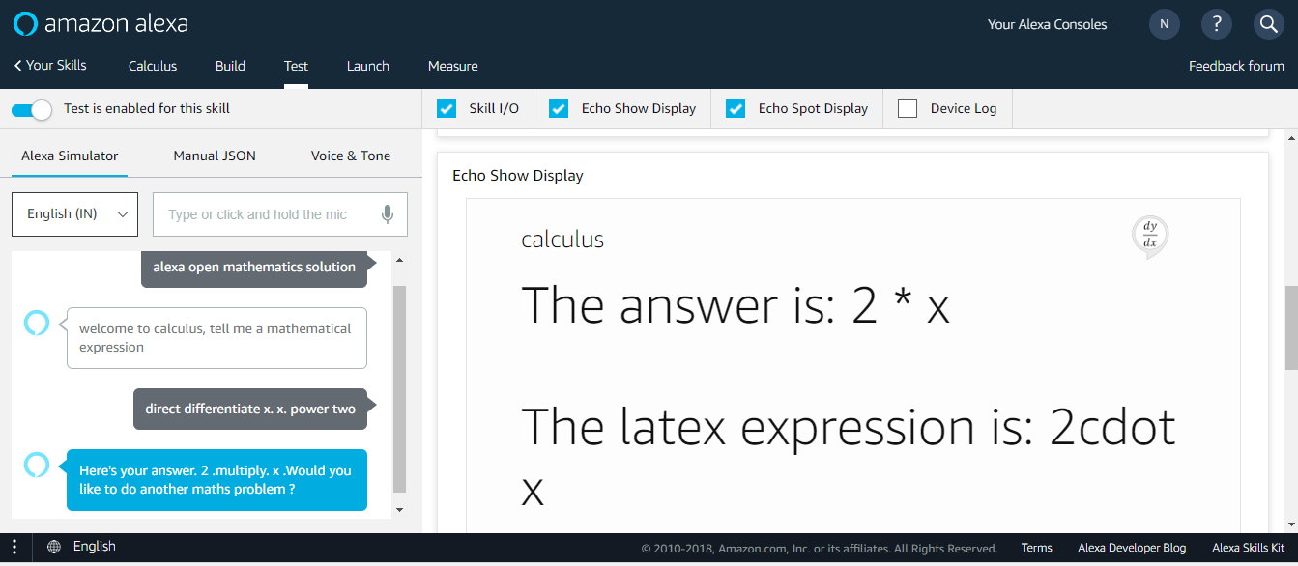
Simple Differentiation

Slide 3
Simple Differentiation Syntax
Direct differentiate x x power two
Number. This is not necessary for all operations like logarithm,exponential. For trigonometric functions it is optional and allows for selecting inverse/hyperbolic functions. This is explained in detail later.
To let Alexa know that we are differentiating a simple expression. We will see how to differentiate complicated expression in the subsequent slides
symbol to differentiate with respect to
Operation type
Variable name
Type of function to perform. Currently only differentiate is supported. In future this will be extended to include integration etc.

Slide 4
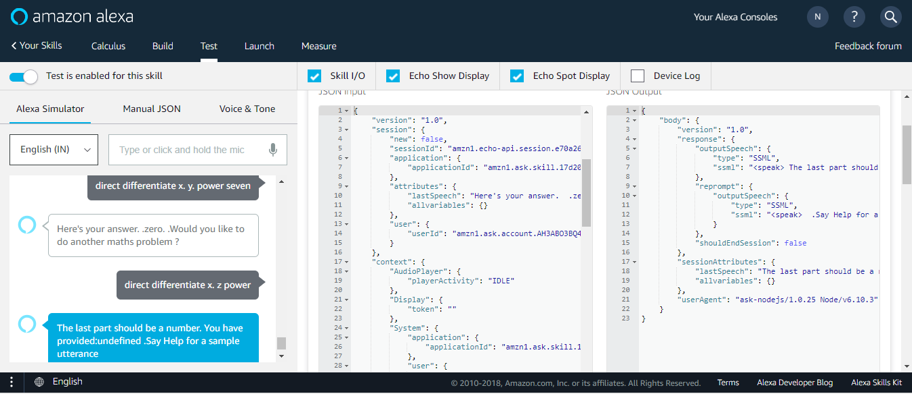
Simple Differentiation
Appropriate Error Handling to ensure user is able to correct himself

Slide 5
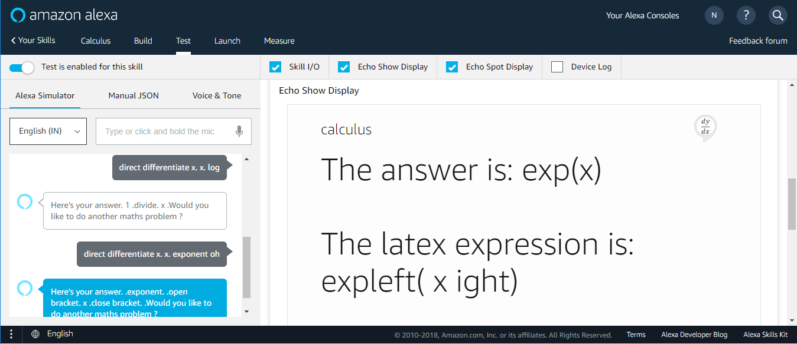
Simple Differentiation – logarithm and exponential Functions
First step is to create

Slide 6
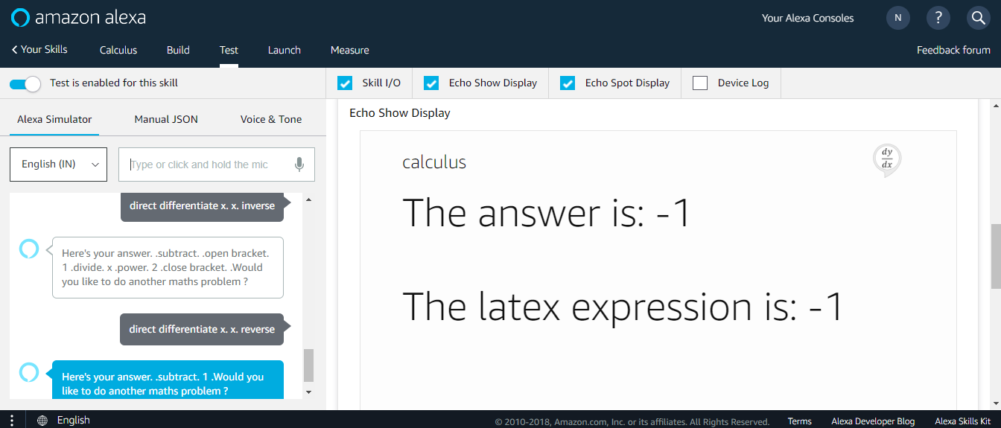


Simple Differentiation – Inverse and Reverse Functions
First step is to create
$$1/x$$
$$−x$$

Slide 7
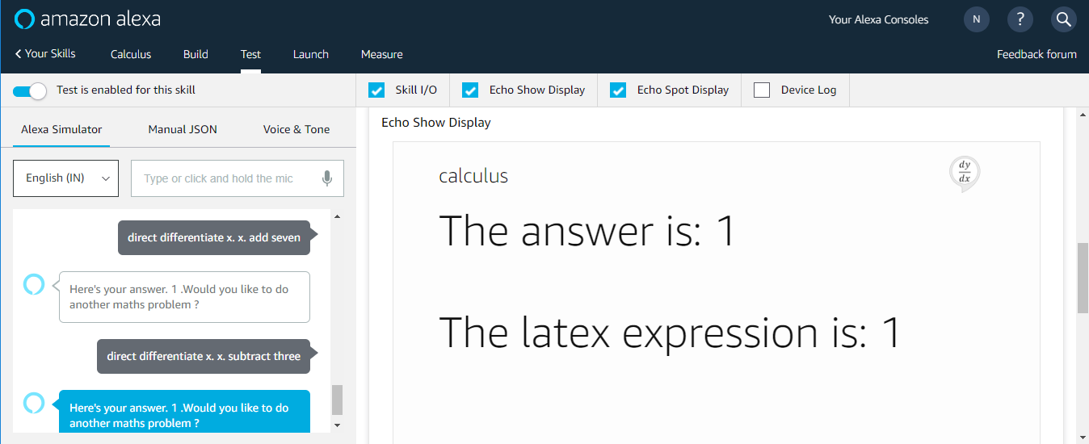
Simple Differentiation – Arithmetic Functions
First step is to create

Slide 8
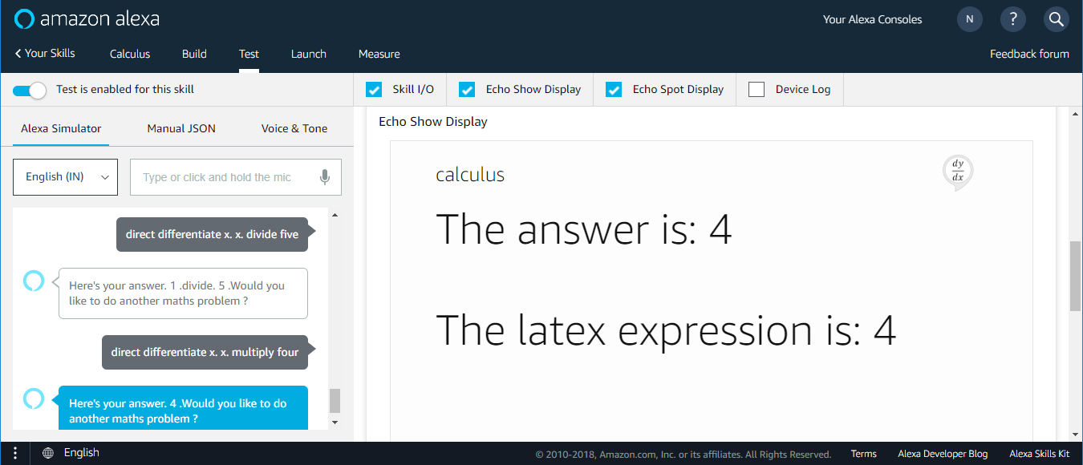
Simple Differentiation – Arithmetic Functions
First step is to create

Slide 9
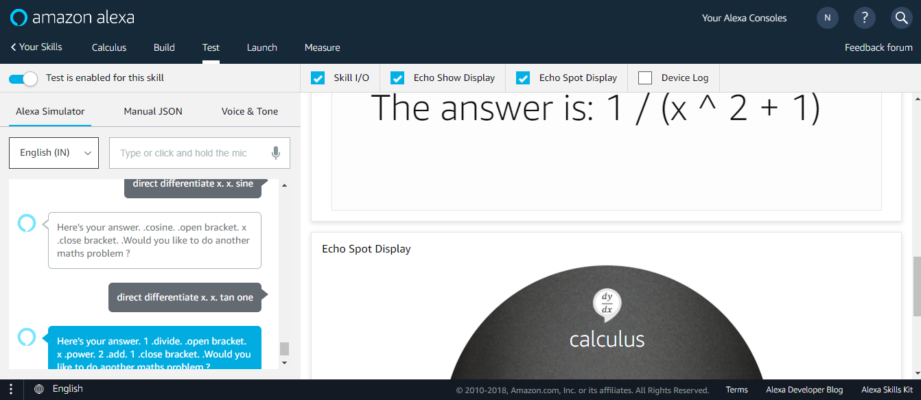
Simple Differentiation – Trigonometric Functions
First step is to create
For trigonometric functions. If we do not provide anything after the operation sine, it takes a simple sine function or sin(x).
IF the number is 1, then it does a inverse function or atan(x) (or arcsine of x)
If number is 2, then it does an hyperbolic function, for sine it would be sinh(x)
If number is 3, then it does an inverse hyperbolic function, for sine it would be asinh(x)

Slide 10
Differentiation of complicated expressions
First create a simple expression in a similar manner as shown in previous functions
Then assign different variables to each of these simple expressions
Next combine these individual expressions using the variables to create a complicated expressions
Finally differentiate this complicated expression
An example is shown in the next few slides

Slide 11
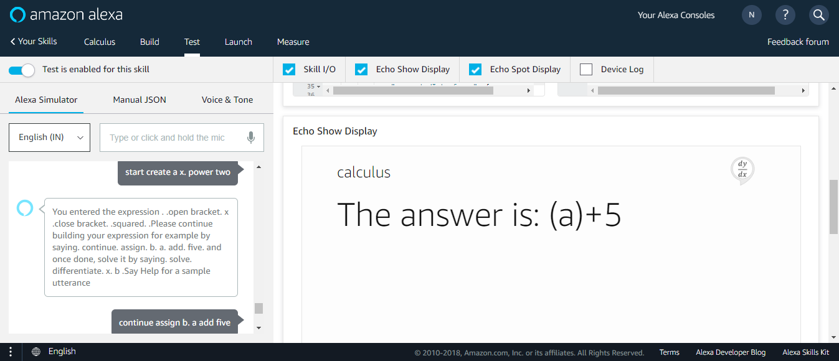
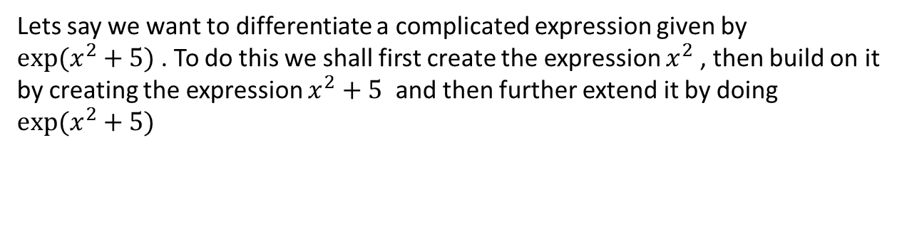


Differentiation of complicated expressions
Lets say we want to differentiate a complicated expression given by
$exp⁡(x^{2}+5)$ . To do this we shall first create the expression $x^{2}$, then build on it by creating the expression $x^{2}+5$ and then further extend it by doing $exp⁡(x^{2}+5)$
$$x^{2}$$
$$x^{2}+5$$

Slide 12
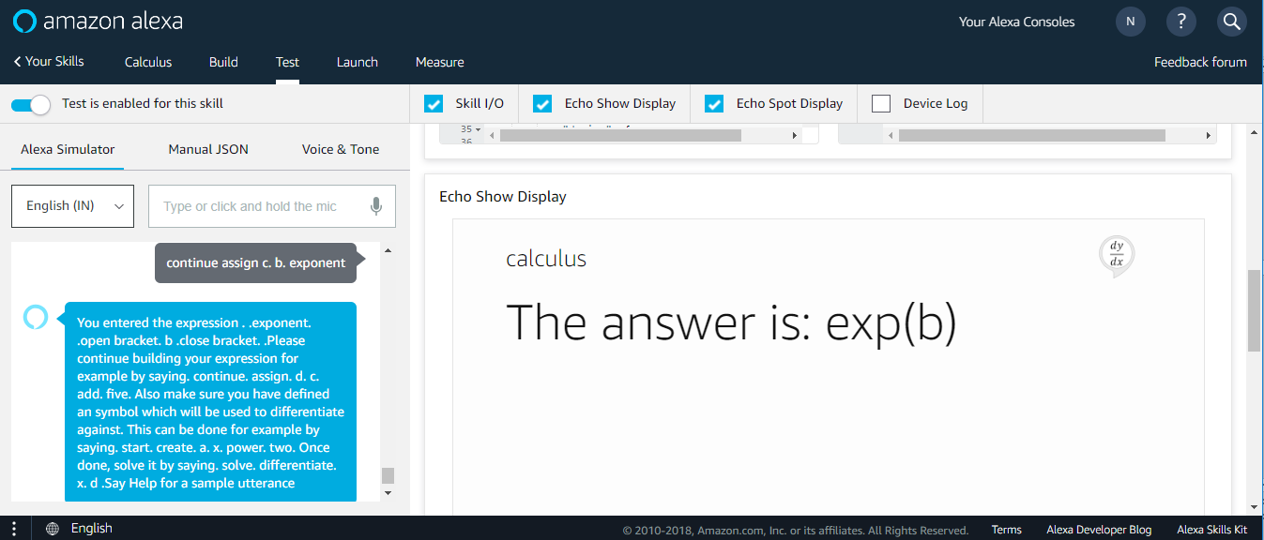

Differentiation of complicated expressions
$$exp⁡(x^{2}+5)$$
The skill provide guidance to the user along the way helping him to build the expression

Slide 13
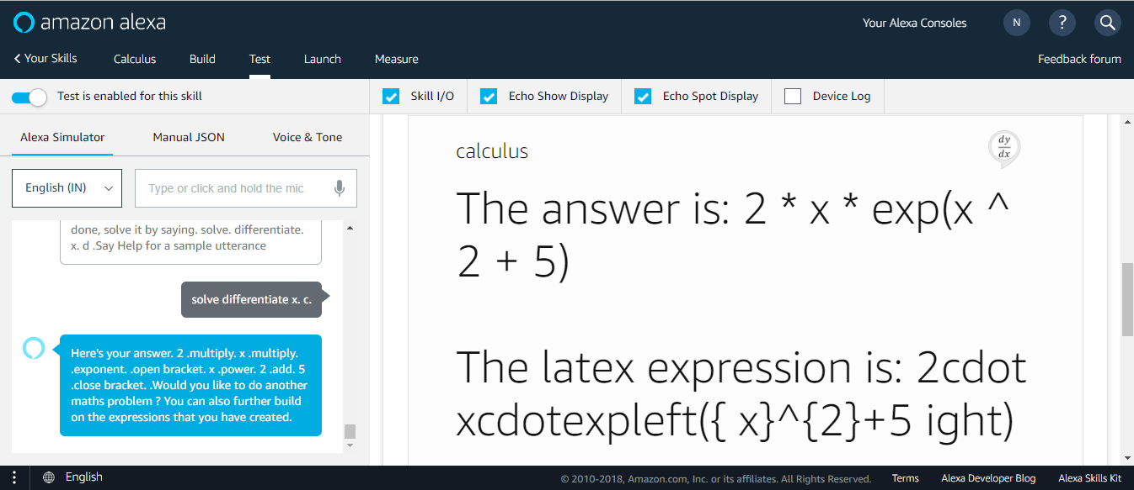
Differentiation of complicated expressions – Finally solving

Slide 14
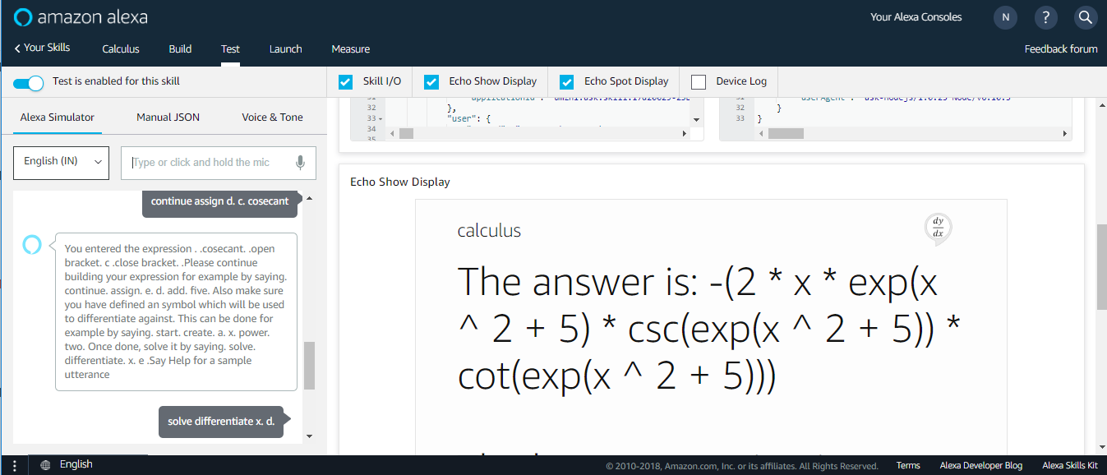

Differentiation of complicated expressions – Continuing
Lets say, we want to further build on this and we want to differentiate the expression $cosec(exp⁡(x^{2}+5)$
$csc(exp⁡(x^{2}+5)$)
$$Finally differentiate with respect to x$$

Slide 15
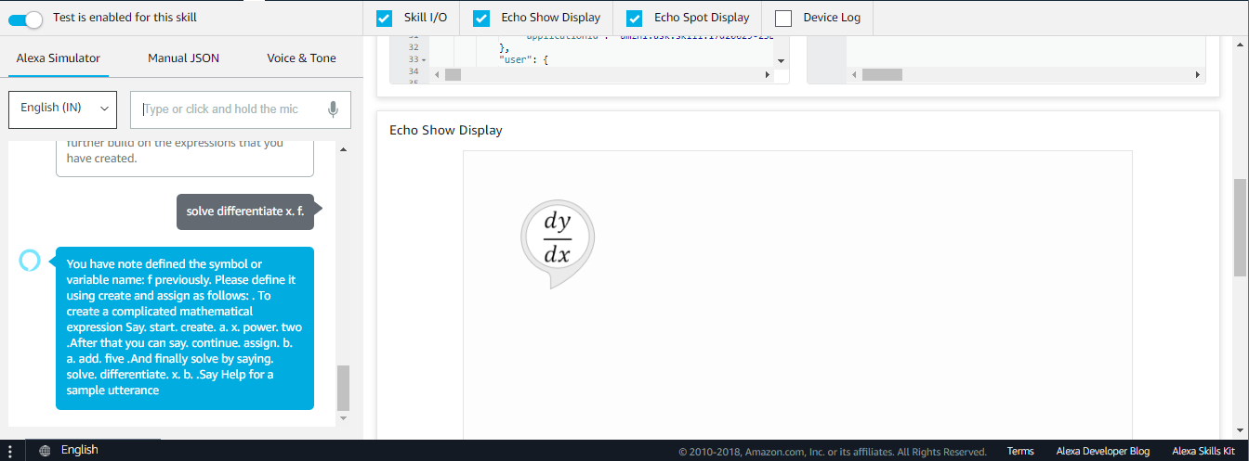
Conclusion
So we can see how easy it is to create some complicated expressions and differentiate
The skill provides help at every way and provides error messages explaining why something is not correct
For example, if we try to differentiate with respect to an variable which we have not defined, we get the following message

Slide 16
THANK YOU

