Slide 1
Battle of the Neighborhood
Nilabja Haldar
Date: 26.11.2019

Slide 2
Analyse count of Indian Restaurant and Popular Venue location wise
The intended audience of this project is usually the tourists who are first time visiting the neighbourhood of Toronto or New York City and don’t have an idea of the top venues around a place.
So they are sometime lost and didn’t get chance to visit the top places. Using this analysis we can help the tourists to self-guide to where to visit according to their choice.
Target audience of the 2nd use case is upcoming entrepreneurs who want to establish some business in these neighbourhoods.
The issue is most of the times the less experience budding entrepreneurs have less or no idea about the top running business in certain localities, which cuisine is most popular in which area, which shop is most trending in which area, and which area has what popular venues. So lack of this data often misguides them to enter in wrong business and can be a trouble to them.

Slide 3
DATA acquisition
The dataset for this project is collected from various sources.
New York City Data:
New York City data is collected from the below link:
https://cocl.us/new_york_dataset
The dataframe has 5 boroughs and 306 neighborhoods.
Foursquare location data used along with this data to find out the venues, popularity, location etc.
Toronto Data:
Toronto data is collected from the below link:
https://en.wikipedia.org/wiki/List_of_postal_codes_of_Canada:_M
The dataframe has 287 records

Slide 4
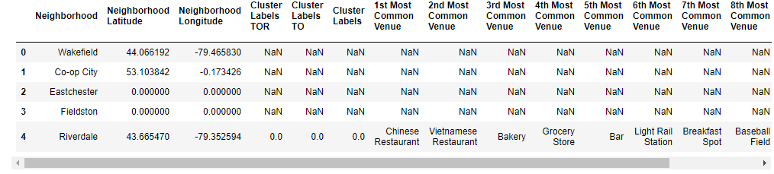
Data Pre-processing and Data Cleaning
Data cleaned in different phases of the project.
There are many rows which does not have any latitude and longitude. So if we continue with the missing data then it can cause error in further analysis. So we removed these rows.
The New York data set before missing data was 306 rows and 3 columns and Toronto was 287 rows and 3 columns. Data set size after data cleaning is for New York 135 Rows and for Toronto 199 rows.
In k-means clustering cleaned the merged data with NaN values.

Slide 5
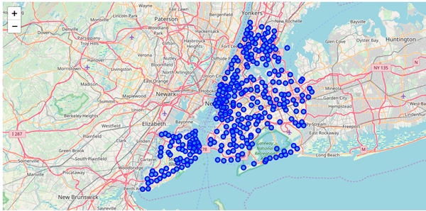
visualize geographic details of New York and Toronto

Slide 6
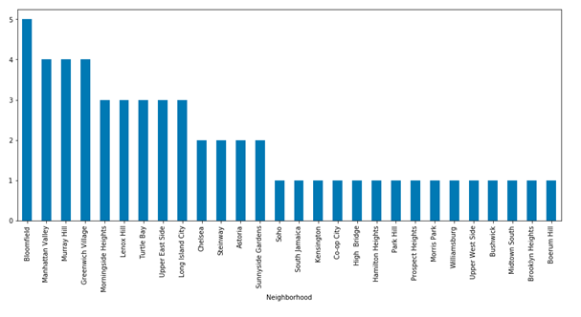
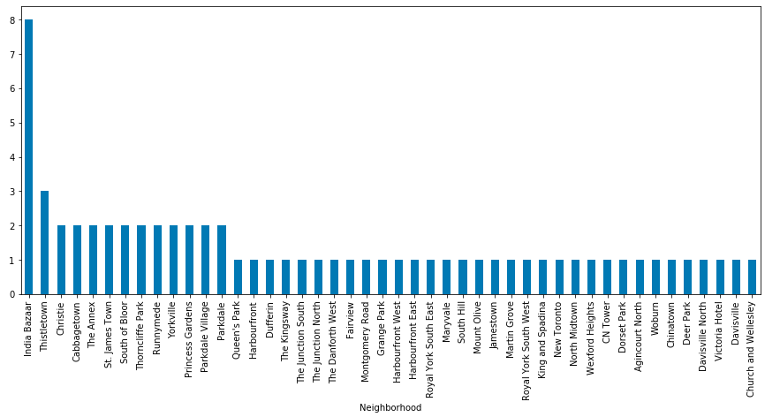
Statistical Analysis

Slide 7
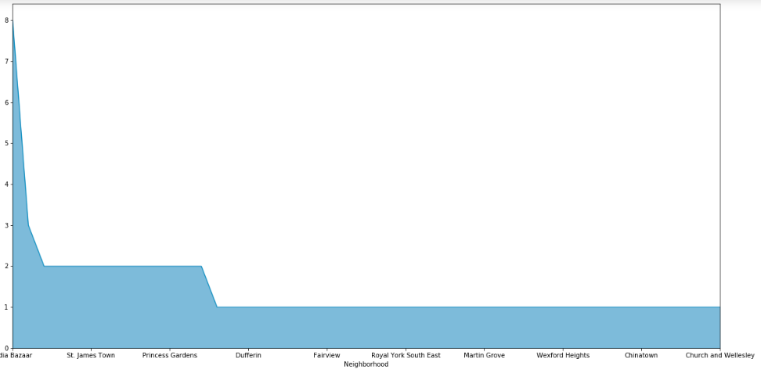
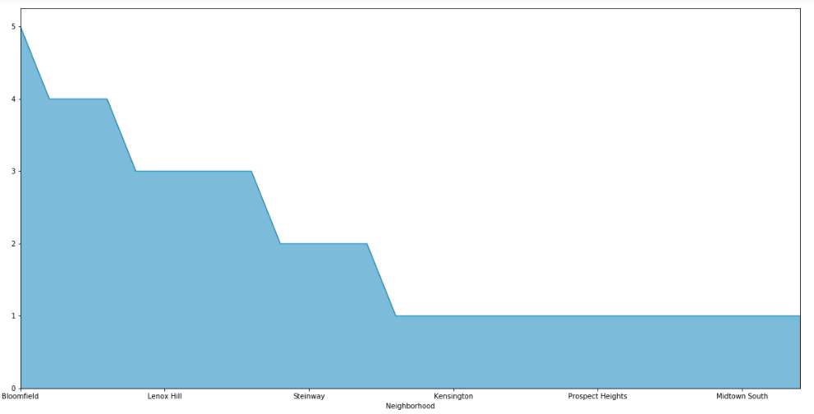

Slide 8
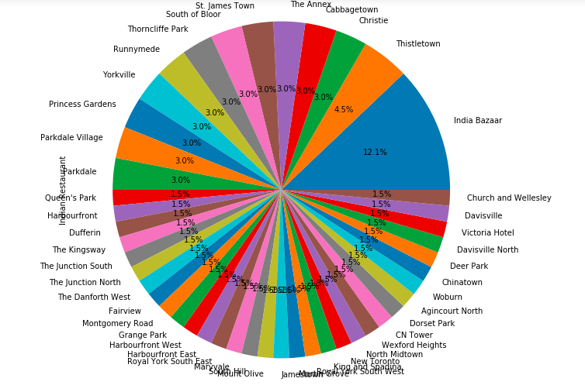

Slide 9
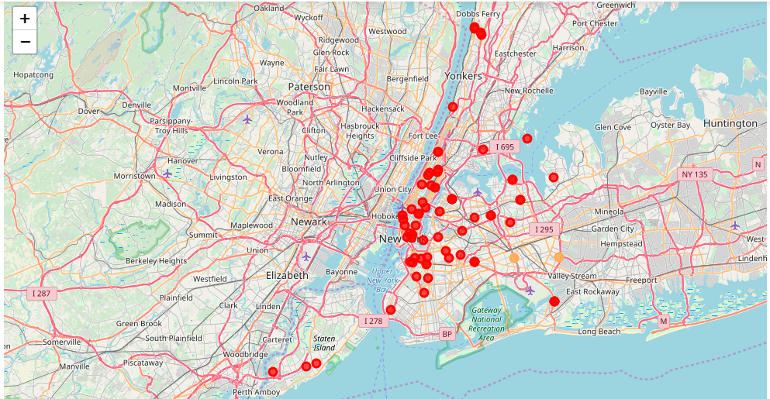
New York City K-mean clustering

