Slide 1


SCM, Branching and Release Management

Slide 2

Topics
Few Release Engineering Concepts
Branching and Merging
Current Release Process
Proposed Release Process
Release Versioning
Nightly build Setup
Continuous Integration
Proprietary & Confidential | 2

Slide 3
Software Development Life Cycle (SDLC)
Proprietary & Confidential | 3

Slide 4
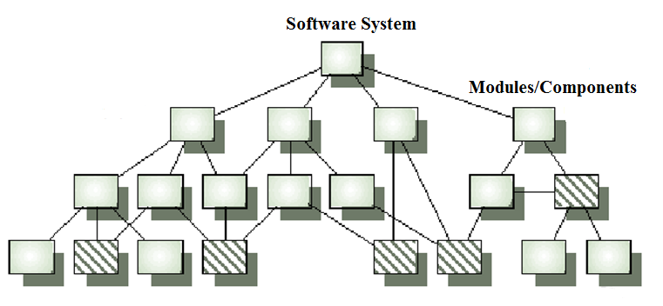
Modular Design Architecture
Proprietary & Confidential | 4

Slide 5
Modular Design Architecture
( i-admin )
epayroll
hris
reports
Proprietary & Confidential | 5

Slide 6
Modular Design Architecture
( i-admin 5.2 )
epayroll
(Version 3.5.8)
hris
reports
(Version 4.6)
(Version 7.1)
Proprietary & Confidential | 6

Slide 7
Sample Branching Model
/main
/ epayroll
/reports
/hris
1.0
Proprietary & Confidential | 7

Slide 8
Sample Branching Model
Bugfixes
/main
/ epayroll (1.0.5)
/reports (1.0.2)
/hris (1.0.1)
Rel ease/ Maintenance
branch
/main
/ epayroll
/reports
/hris
1.0
Proprietary & Confidential | 8

Slide 9
Sample Branching Model
Bugfixes
/main
/ epayroll (1.0.5)
/reports (1.0.2)
/hris (1.0.1)
Rel ease/ Maintenance
branch
Merge back to main
/main
/ epayroll
/reports
/hris
1.0
Proprietary & Confidential | 9

Slide 10
Sample Branching Model
Bugfixes
/main
/ epayroll (1.0.5)
/reports (1.0.2)
/hris (1.0.1)
Rel ease/ Maintenance
branch
Merge back to main
/main
/ epayroll
/reports
/hris
1.0
Tax Calculations
/ epayroll (1.1)
/reports (1.1)
/hris
Feature / Development
branch
Proprietary & Confidential | 10

Slide 11
Sample Branching Model
Bugfixes
/main
/ epayroll (1.0.5)
/reports (1.0.2)
/hris (1.0.1)
Rel ease/ Maintenance
branch
Merge back to main
/main
/ epayroll
/reports
/hris
1.0
2.0
Tax Calculations
/ epayroll (1.1)
/reports (1.1)
/hris
Feature / Development
branch
Merge back to main
Proprietary & Confidential | 11

Slide 12


PROD
6
UAT
9
5
TEST
Fetch and Merge
4
Build on
local machine
8
3
SVN
2
7
1

Slide 13
Proposed Release Process
PROD
UAT
CI integrated Test Environment
Smoke/Regression Passed
Smoke/ Regression Fails
Smoke/Regression
Build/ UT Success
Build/ UT Failed
CI Builds
SVN
Proprietary & Confidential | 13

Slide 14

Thank You

