Slide 1
Software Configuration Management

Slide 2
Software Configuration Management ?
Problem:
Multiple people have to work on software that is changing
More than one version of the software has to be supported:
Released systems
Custom configured systems (different functionality)
System(s) under development
Software on different machines & operating systems
Need for coordination
Software Configuration Management
Manage and support evolving software systems
Support and facilitate parallel development.
Control the risks and costs involved in making changes to a system i.e Change Management.

Slide 3
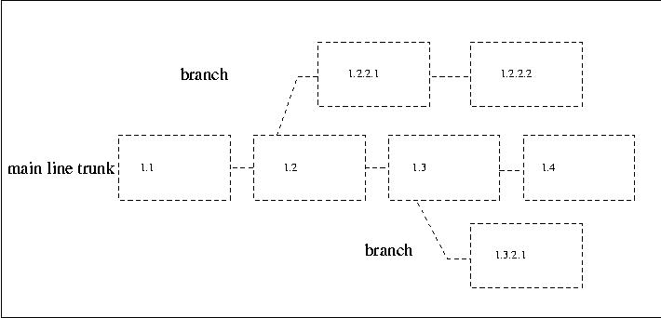
Product Codeines and Releases

Slide 4
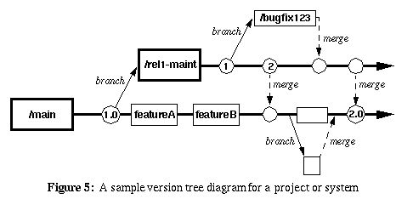
Source Code Management

Slide 5
Hot Fix / Bug Fix / Patch Release
Hot fix branch will be Created from main branch.
Developer checks out and develops on this Hot Fix branch.
Code Review.
Unit Testing.
Code check in to the Hot fix branch.
Build and Smoke Testing.
Hot fix to Main / Release branch merge.

Slide 6
Nightly Build SetUp
The Nightly Build is a process in which the software is built every night.
The purpose of these nightly builds is to identify and eliminate several common and time-consuming risks, like unsuccessful integration, low product quality and poor progress visibility.
This nightly build environment will be owned and maintained by the Build Team

Slide 7


PRD
UAT
TST
Fetch and Merge
Build on
local machine
SVN

Slide 8
Proposed Release Pipeline
Deployment
Deployment to Production
Instance passes all acceptance criteria
Predefined Acceptance Criteria
CI integrated Test Environment
Performance, Scalability and Failover tests
Smoke/ Regression Fails
Continuous
Integration
Smoke/Regression
Build/ UT Success
Build/ UT Failed
CI Builds
Source Code Repo - SVN
Development

Slide 9
Thank You !

