Slide 1
Capstone Project - The Battle of Neighborhoods

Slide 2
Problem Statement:
Prospects of finding an Indian Restaurant in Toronto, Canada.
Toronto, the capital of the province of Ontario, is the most populous Canadian city. Its diversity is reflected in Toronto’s ethnic neighborhoods such as Chinatown, Corso Italia, Greektown, Kensington Market, Koreatown, Little India, Little Italy, Little Jamaica, Little Portugal & Roncesvalles. One of the most immigrant-friendly cities in North America with more than half of the entire Indian Canadian population residing in Toronto it is one of the best places to find a good rated Indian restaurant.
In this project we will go through step-by-step process to make a decision where to find a good Indian restaurant.

Slide 3
Problems:
List and visualize all major parts of Toronto City that has great Indian restaurants.
what is best location in Toronto City for Indian Cuisine?
which areas have potential Indian Restaurant Market?
which all areas lack Indian Restaurants?
which is the best place to stay if you prefer Indian Cuisine?

Slide 4
Target Audience:
Who will be more interested in this project? What type of clients or a group of people would be benefitted?
Business personnel who wants to invest on an Indian restaurant in Toronto. This analysis will be a comprehensive guide to start or expand restaurants targeting the Indian crowd.
2. This analysis will give an idea, how beneficial it is to open a restaurant and what are the pros and cons of this business.
3. Indian crowd who wants to find neighborhoods with lots of option for Indian restaurants.
4. Business Analyst or Data Scientists, who wish to analyze the neighborhoods of Toronto using Exploratory Data Analysis and other statistical & machine learning techniques to obtain all the necessary data, perform some operations on it and, finally be able to tell a story out of it.

Slide 5
Data Sources:
Used “List of Postal code of Canada: M” (https://en.wikipedia.org/wiki/List_of_postal_codes_of_Canada:_M) wiki page to get all the information about the neighborhoods present in Toronto. This page has the postal code, borough & the name of all the neighborhoods present in Toronto.
Used “https://cocl.us/Geospatial_data” csv file to get all the geographical coordinates of the neighborhoods.
P.T.O

Slide 6
Data Sources (Cont.):
3. To get location and other information about various venues in Toronto Foursquare’s explore API has been used. Using the Foursquare’s explore API (which gives venues recommendations), all details about the venues up present in Toronto and collected their names, categories and locations (latitude and longitude) have been fetched.
4. From Foursquare API (https://developer.foursquare.com/docs), I retrieved the following for each venue:
Name: The name of the venue.
Category: The category type as defined by the API.
Latitude: The latitude value of the venue.
Longitude: The longitude value of the venue

Slide 7
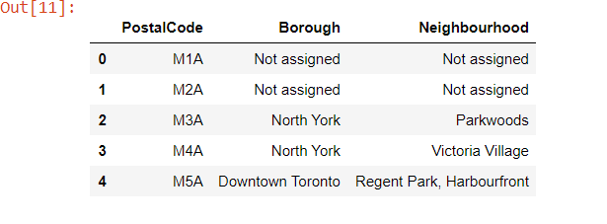
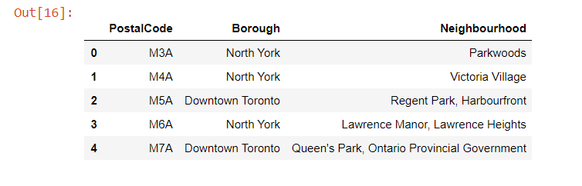
Methodology:
1. Started the task by collecting the data about Canada from the Wikipedia page link "https://en.wikipedia.org/wiki/List_of_postal_codes_of_Canada:_M"
2. Removed all the cells having a Not Assigned Borough

Slide 8
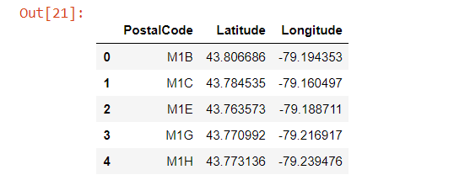
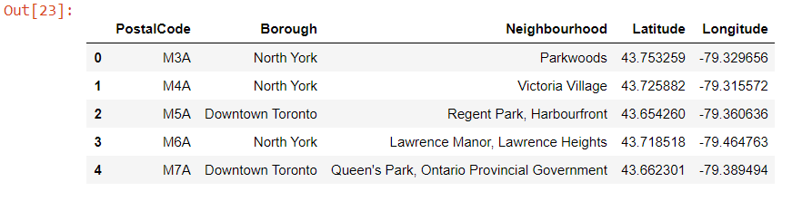
3. Used “https://cocl.us/Geospatial_data” csv file to get all the geographical coordinates of the neighborhoods.
4.Got the actual data frame containing all the latitude and longitude values of all the neighborhoods of Canada.

Slide 9
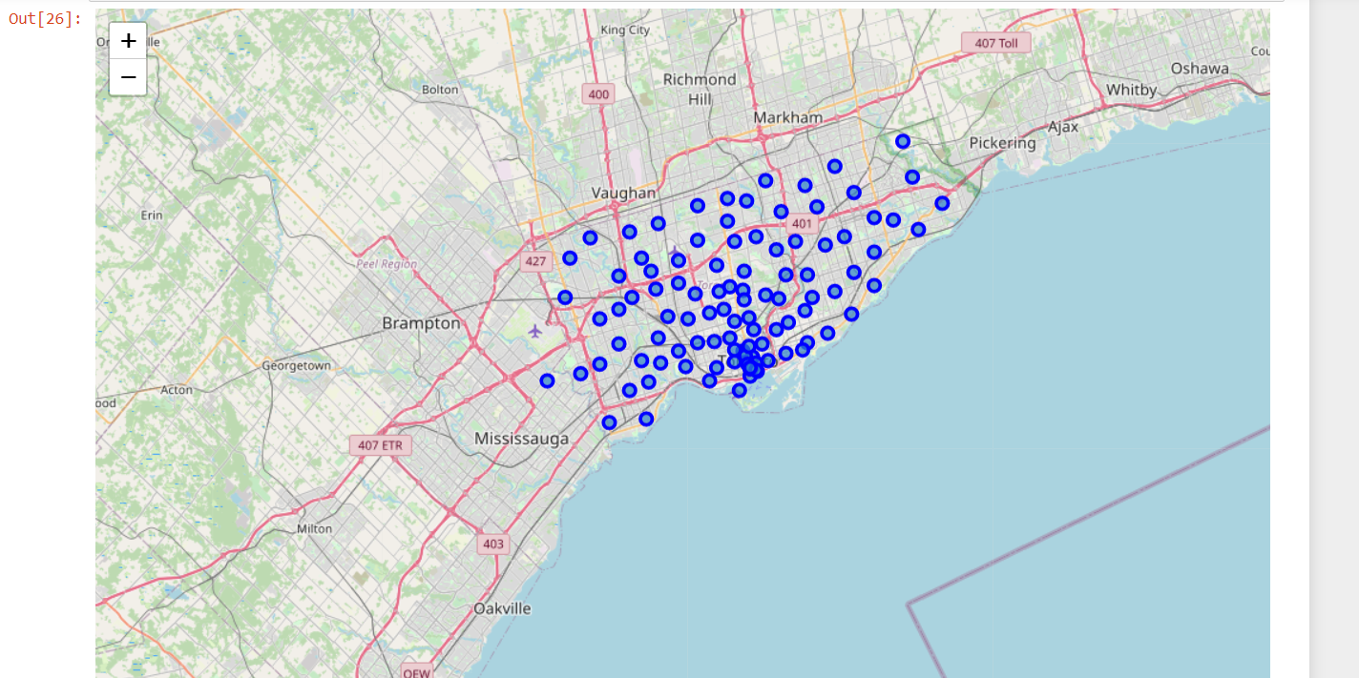
5. Created a Map of Toronto with neighborhoods superimposed on top

Slide 10
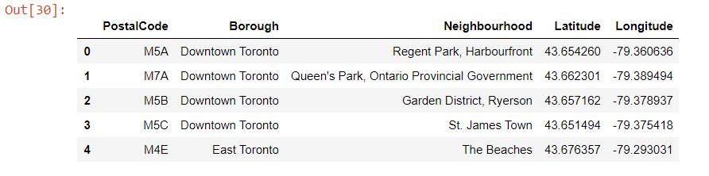
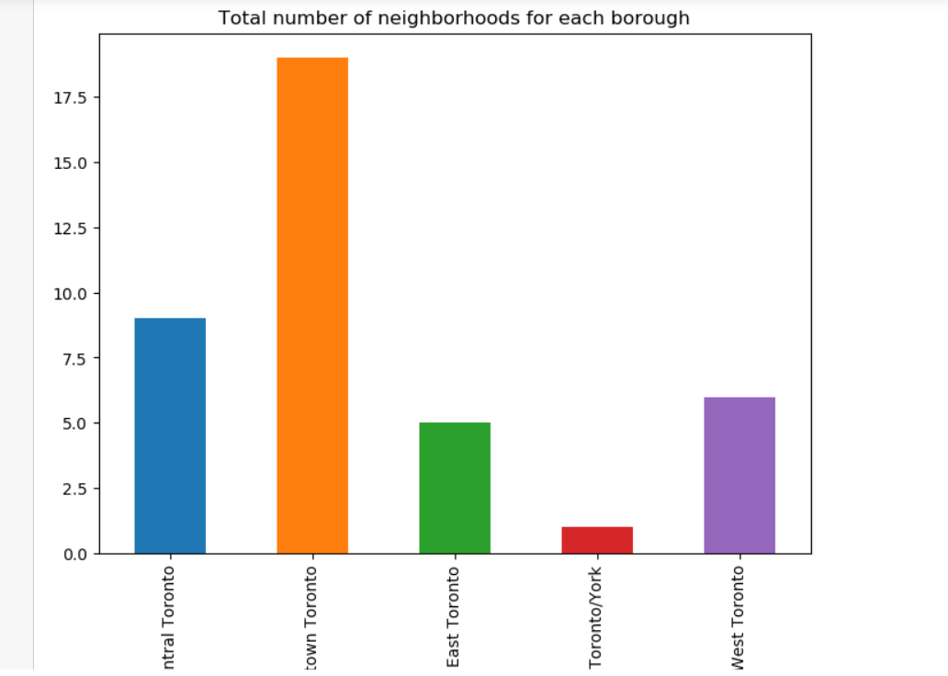
6. Got the list of all the neighborhoods of Toronto
7. Created a bar graph to visualize the total number of neighborhoods for each borough

Slide 11
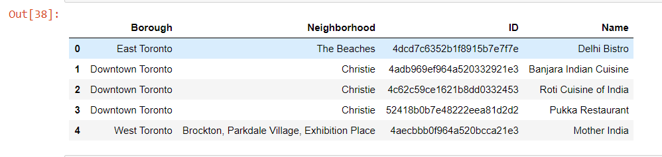
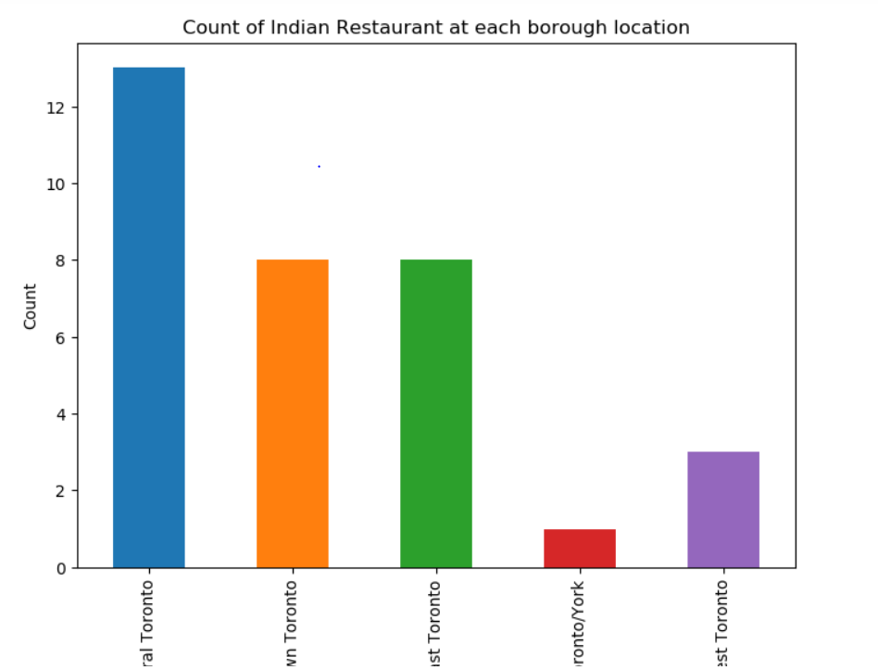
8. Got the list of all the Indian restaurants in Toronto city
9. Created a bar graph to visualize the total number of Indian Restaurants for each borough

Slide 12
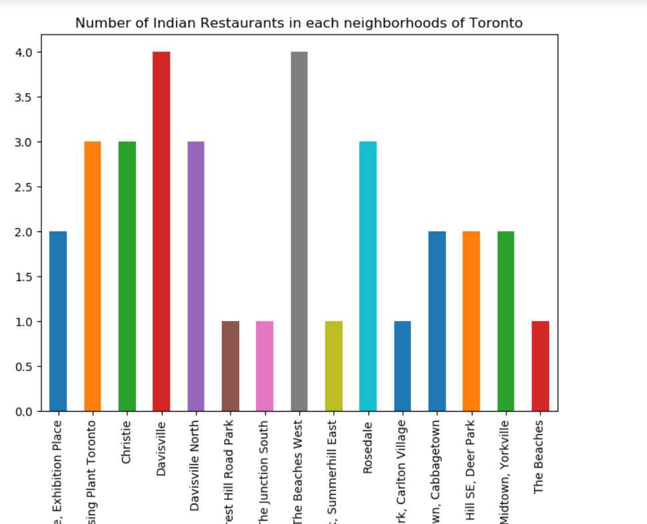
10. Created a bar graph to visualize the total number of Indian Restaurants for each neighborhood

Slide 13
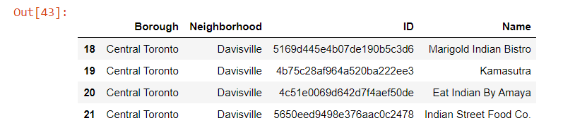
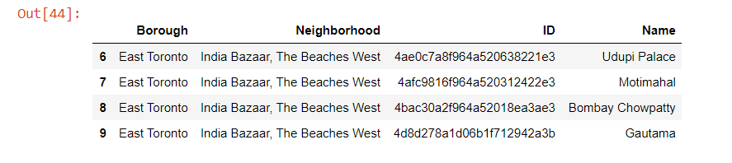
11.Got the list of all the Indian Restaurant in Davisville neighborhood in Toronto
12. Got the list of all the Indian Restaurant in India Bazar, The Beaches West neighborhood in Toronto

Slide 14
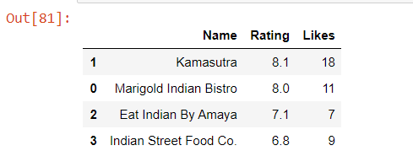
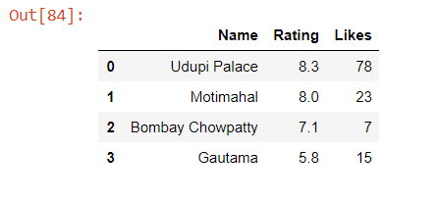
13. List of all the Indian Restaurants in Davisville neighborhood with their corresponding likes , rating and tips
14. List of all the Indian Restaurants in India bazar, The Beaches West neighborhood with their corresponding likes , rating and tips

Slide 15
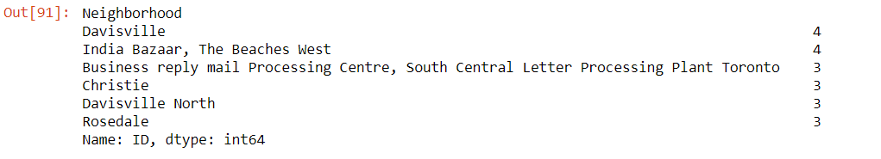
Result:
1.List of all the major parts of Toronto City that has great Indian restaurants:
2. Davisville and India Bazaar are the best locations in Toronto City for Indian Cuisine.

Slide 16
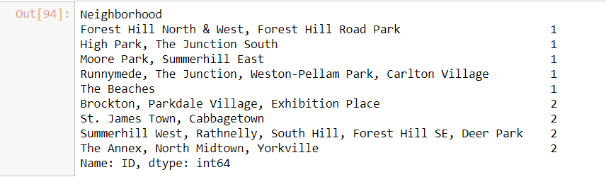
3. Davisville, India Bazaar, Business reply mail processing centre, Christie, Davisville North these are some areas having potential Indian Restaurant markets.
4. List of areas having lack Indian Restaurants:
5. India Bazaar, The Beaches West is the best place to stay in Toronto if someone loves Indian Cousins because the highest rated Indian Restaurant in Toronto “Udupi Palace” is situated here.

