Slide 1

Image Authentication based on Histogram shifting Method using Arnold’s Cat Map
presented by-
Niladri Ghosh
Arnab Bera
Ramakrishna Mission Residential College (Autonomous)

Slide 2
Contents
Abstract
Steganography Basics
Integer wavelet Transform
Arnold’s Cat Map
Histogram Shifting
Image Embedding Process
Image Extraction Process
Performance Evaluation Technique
Results
Conclusion
References

Slide 3
Abstract

Slide 4
Abstract:
Digital watermarking is a crucial technique for embedding and extracting hidden information in digital media, including medical images. Image authentication plays a critical role in ensuring the integrity and authenticity of digital medical images, which are essential for accurate diagnosis, treatment planning, and research. The project focuses on the development of a robust watermarking algorithm for images authentication using methods, including techniques like Haar Transform, Histogram Shifting, Arnold’s Cat Map. The methods aim to embed an imperceptible watermark into images, which can later be extracted to verify the authenticity and integrity of the images.

Slide 5
Steganography

Slide 6
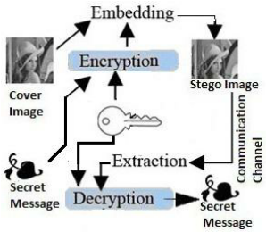
Steganography: Steganography is the art and science of
writing hidden or stealth messages in such a way that no one apart
from the receiver the existance of the message. This can be done by
concealing the secret message into cover medium like text , audio ,
image ,videos.
1
Cover Image
2
Stego Image
The original, unsuspicious image into which secret data (e.g., text, another image, or any form of digital data) is embedded using steganographic techniques. The cover image should appear unchanged or minimally altered to avoid arousing suspicion.
The image that contains hidden data (e.g., text, another image, or any form of digital information) embedded within it using steganographic techniques. The stego image is designed to appear as normal and unchanged as possible to prevent detection of the hidden data.
Key Points
3
Embedding
The embedding process in image steganography involves integrating secret data into a cover image to produce a stego image. This process is designed to be imperceptible to the human eye, ensuring that the hidden data remains undetected.
Image Steganography diagram

Slide 7
Integer Wavelet Transform (Haar Transform)

Slide 8
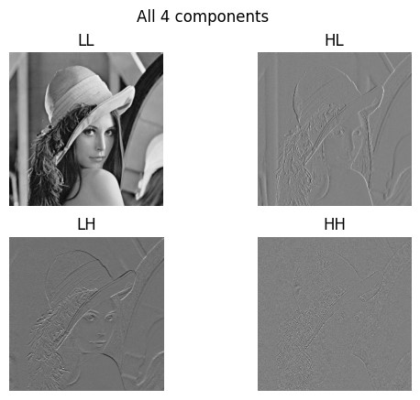
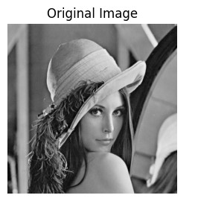
Integer wavelet Transform (Haar Transform):
The Integer Wavelet Transform (IWT) is a variant of the discrete wavelet
transform (DWT) that maps integers to integers. It is particularly useful
in applications where lossless data compression or reversible transforms
are essential , such as image compression and digital signal processing. In our experiment We use the haar integer wavelet transform .
Apply haar transform
.
Equation for haar transform:
a[n]= x[2n]+x[2n+1]
d[n]=x[2n]-x[2n+1]

Slide 9
Example of haar transform:
Let consider 4x4 matrix on which we will apply Haar wavelet transform
After Haar Transform The Matrix is:
100 | 50 | 60 | 150
20 | 60 | 40 | 30
50 | 90 | 70 | 82
75 | 66 | 90 | 58
57.5 | 70 | 25 | -45
70 | 75 | -20 | 5
17.5 | 35 | -20 | -6
0 | 1 | 4 | 10
75 | 105 | 60 | -45
40 | 35 | -20 | 5
70 | 76 | -20 | 6
70 | 74 | 4 | 16
Transform all rows
Transform all columns
Forward Transformation:
75
40
70
70
57.5
70
17.5
0
1st row:
Original-
1st Column:
Original-
100 | 50 | 60 | 150
After Transform-
a1=(100+50)/2=50 d1=(100-50)/2=25
a2=(60+150)/2=105 d2=(60-150)/2=-45
After Transform-
75 | 105 | 25 | -45
a1=(75+40)/2=57.5 d1=(75-40)/2=17.5
a2=(70+70)/2=70 d2=(70-70)/2=0

Slide 10
Arnold’s Cat Map

Slide 11
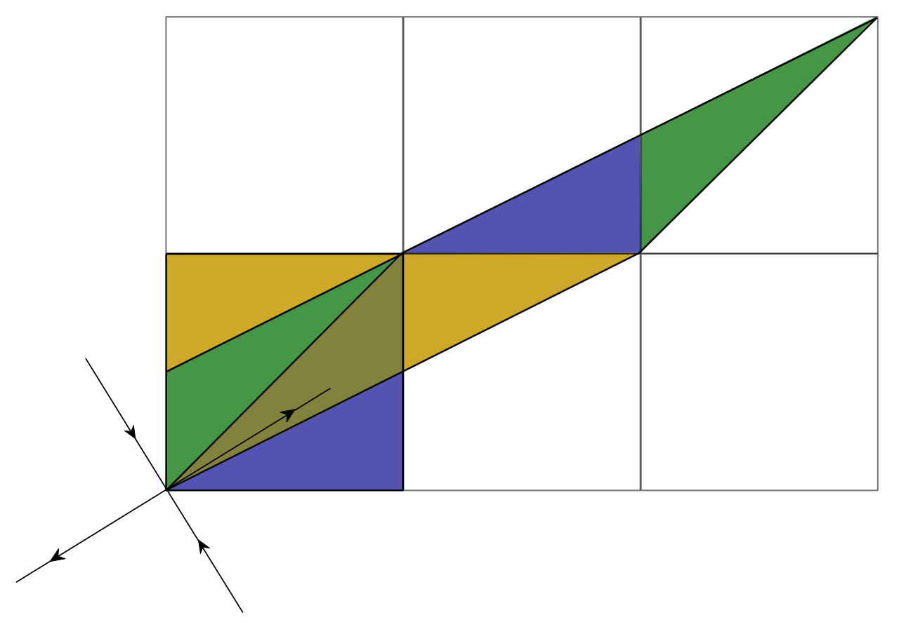
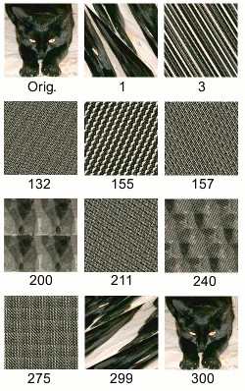
Arnold’s cat map :
1
What is Arnold’s cat map?
Arnold's Cat Map is a transformation that can be applied to an image. The pixels of the image appear to be randomly rearranged, but when the transformation is repeated enough times, the original image will reappear!
2
Mathematical intuition of Arnold’s cat map
Arnold's cat map is the transformation Γ:𝑇2→𝑇2 given by the formula
Γ(𝑥,𝑦)=(2𝑥+𝑦,𝑥+𝑦)mod1. Equivalently, in matrix notation, this is
Γ([𝑥𝑦])= [2111][𝑥𝑦]mod1=[1101][1011][𝑥𝑦]mod1.
3
Apply on Image - Sample mapping on a picture of 150x150 pixels The number shows the iteration step; after 300iterations,
the original image returns.

Slide 12
Histogram Shifting

Slide 13
Histogram Shifting for data hiding:
Histogram shifting is a technique used in image processing, particularly in the context of data hiding and image watermarking. This method manipulates the histogram of pixel values in an image to embed hidden information while ensuring that the visual quality of the image is preserved.

Slide 14
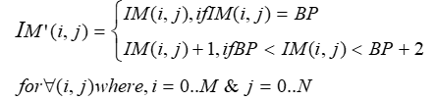
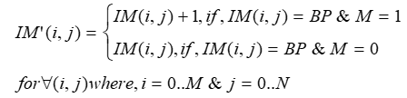
Coefficient Histogram Shifting : Encryption
Let, the matrix is given below and payload : “101”
Histogram Shifting
1 | 1 | 3 | 4 | 3 | 4
-97 | 151 | 150 | -3 | 195 | 244
244 | -97 | -3 | -3
244 | 151 | -3 | -3
244 | 150 | 150 | 195
244 | 195 | 150 | 195
Histogram Shifting
1 | 4 | 3 | 1 | 3 | 4
-97 | -3 | 150 | 151 | 195 | 244
Here, 150 pixel is the BP(best point), where H(BP) >= length(MSG) and best fits at (BP+1) with minimum shifting
Histogram Shifting
244 | -97 | -3 | -3
244 | 152 | -3 | -3
244 | 151 | 150 | 195
244 | 195 | 151 | 195
244 | -97 | -3 | -3
244 | 152 | -3 | -3
244 | 150 | 150 | 195
244 | 195 | 150 | 195
Embedded : ‘101”

Slide 15
Hash Code (SHA-256)

Slide 16

Algorithm For Generating Hash Code:
Input: Watermark image. Output: Binary 256 SHA code
Steps
Step-1: Convert watermark image W into vector PIX using row major form.
Step-2: Concatenate all values in PIX into binary bit string MSG with 8-bit encoding.
Step-3: Apply UTF-8 encoding to MSG.
Step-4: Compute SHA-256 on MSG to generate hash code H in hexadecimal.
Step-5: Finally generate 256 bit binary form HW of from H.
6c366e65f14b71d63360840f4eeec15bcbf03738ca54004cdd75e15bb46a553c
SHA-256 Code for lena.jpeg

Slide 17
Image Embedding

Slide 18
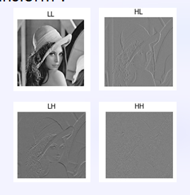
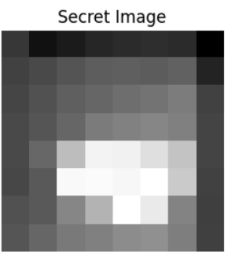
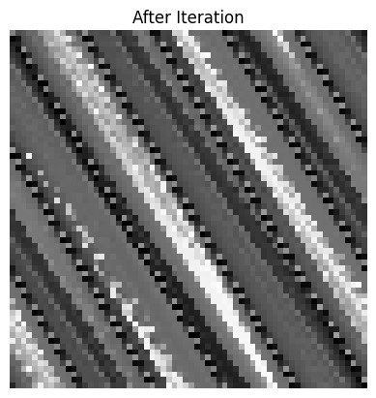
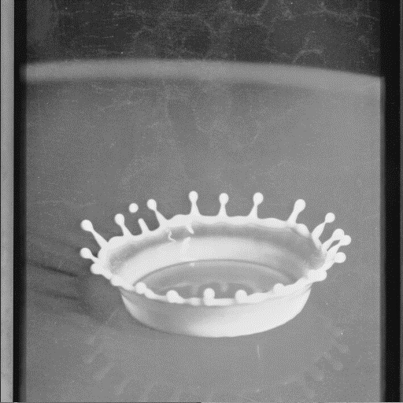
Image Embedding Process Example :
Stego Image
After Apply IWT
After Data Hiding the Image
SHA-256
embeding
Arnold’s Cat
map iteration-2
Hiding by
Histogram Shifting
Resize into 16x16
Secret Image

Slide 19
Algorithm:
Algorithm: Embedding (COVER, WI)
Step1: Divide the image into 4parts by forward IWT on COVER image and return components LL, HL, HH
Step2: Apply Arnold’s cat map with a specified iteration on WI
Step3: Code WI to SHA-256
Step4: Apply Histogram Shifting technique to hide the secret image in the HH block and SHA256 code to the LL block
Step5: if find a base point then go to
step 6 otherwise stop execution Step6: Apply the Inverse IWT to the image that results STEGO image

Slide 20
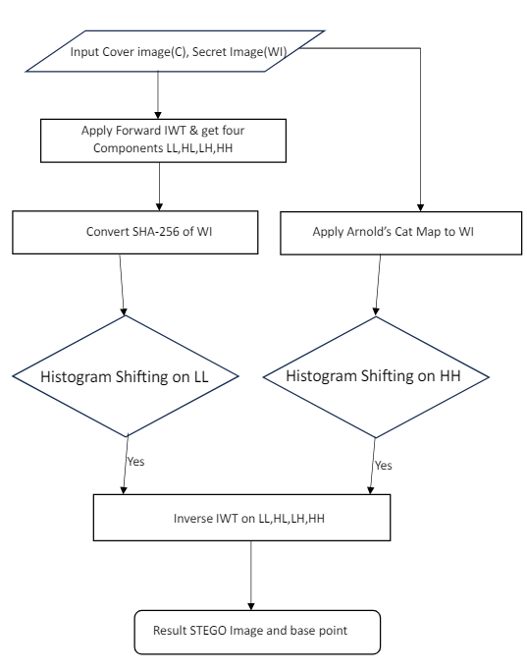
Flowchart:

Slide 21
Image Extraction

Slide 22
Secret Image Extraction diagram :
Stego Image
After Apply IWT
SHA-256
Arnold’s Cat
map
iteration-2
Image Extraction Using Basepoint
Resizing to 32x32
Secret Image

Slide 23
Algorithm:
Algorithm2: Extraction (STEGO, basepoints)
Step1: First, divide the given watermarked image into 4 sub-bands LL, HL, LH & HH using forward IWT
Step2: Take the HH part and apply histogram extraction technique with the basepoint
Step3: extract the secret image
Step4: Apply the Arnold’s Cat Map on secret image with remaining iterations to get actual secret image
Step5: Take the LL part and apply histogram extraction technique with the basepoint
Step6: Extract the SHA-256 value

Slide 24
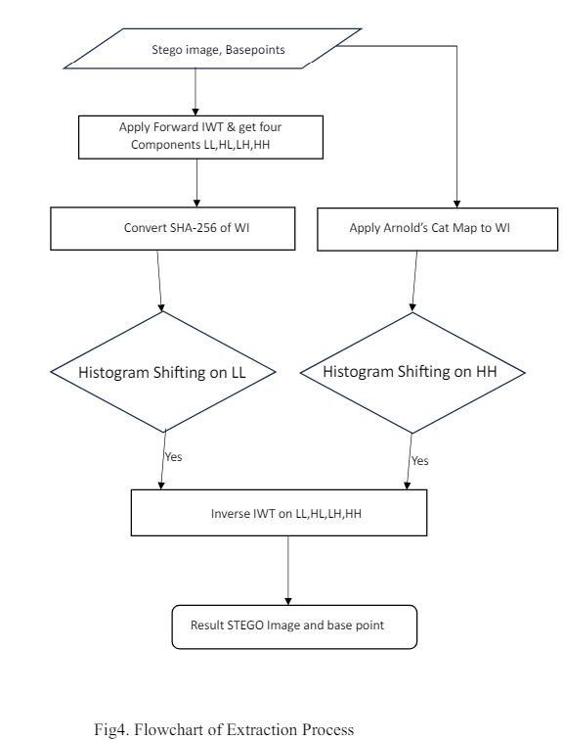
Flowchart:

Slide 25
Performance Analysis

Slide 26
Performance Evaluation Techniques
For evaluate various aspects of image watermarking, several metrics are commonly used. Among the most popular are Peak Signal to Noise Ratio (PSNR), and Normalized Cross-Correlation (NCC).
The following sections define these metrics in detail next:

Slide 27


Peak signal to noise ratio (PSNR)
PSNR is a widely used and highly regarded metric for assessing the quality of a watermarked image by analyzing the mean squared error (MSE) between the cover image and the watermarked image. For 8-bit images,
PSNR is calculated as follows:
And MSE is calculated as:
N is the number of cover image pixels, C_{i} is the intensity of i^{th} pixel in the watermarked-image and C_{i}’ is the intensity of i^{th} pixel in the cover image.

Slide 28
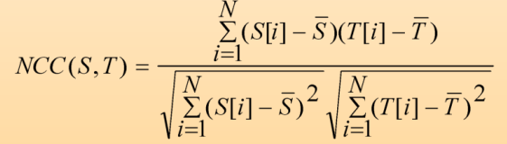
Normalized Cross Correlation(NCC)
Normalized Cross-Correlation (NCC) is a metric used to measure the level of correlation or similarity between two signals. When the signals are highly correlated, the NCC value approaches 1, reaching exactly 1 if the signals are identical. Conversely, an NCC value of -1 indicates no similarity between the signals. For two discrete one-dimensional signals, 𝑆S and 𝑇T, each with 𝑁N elements, NCC is calculated as follows:

Slide 29
Without attack we get the result:
Apply the hiding process in the images from USC SIPI dataset
Cover Image | Secret Image | PSNR | MSE | NCC | SHA
airplane.tiff | splash.tiff | 59.53416 | 0.072388 | 1 | TRUE
Barbara.tif | splash.tiff | 61.20761 | 0.04924 | 1 | TRUE
elaine.tiff | splash.tiff | 61.14979 | 0.0499 | 1 | TRUE
fishingboat.tiff | splash.tiff | 60.74799 | 0.054737 | 1 | TRUE
Goldhill.tif | splash.tiff | 61.51282 | 0.045898 | 1 | TRUE
house.tiff | splash.tiff | 60.31865 | 0.060425 | 1 | TRUE
lena.tiff | splash.tiff | 60.40253 | 0.059269 | 1 | TRUE
peeper.tiff | splash.tiff | 61.3544 | 0.047604 | 1 | TRUE
sailboat.tiff | splash.tiff | 61.06172 | 0.050922 | 1 | TRUE
tank.tiff | splash.tiff | 61.37709 | 0.047356 | 1 | TRUE

Slide 30
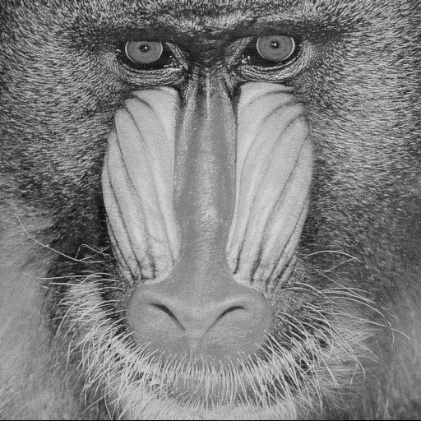
Without attack we get the result:
Cover Image Stego Image Secret Image Extract Image
a)Lena.tiff
a) On Lena.tiff
b) Baboon.tiff
b) On Baboon.tiff

Slide 31
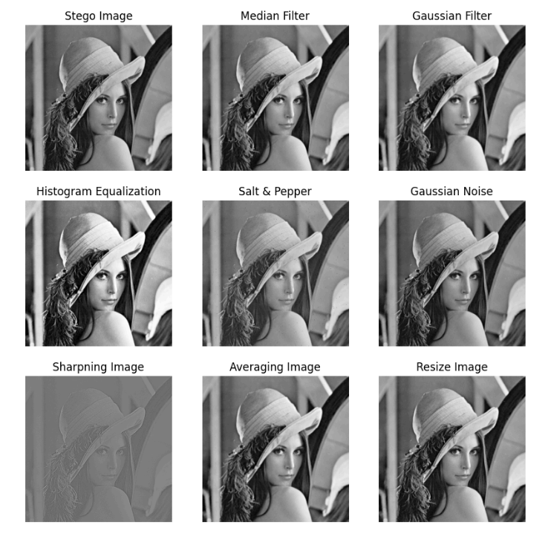
With attack we get the result:
Results after embedding with attack of on samples images from USC SIPI database. We performed attacks-
Histogram Equalization,
Median Filtering, kernel size=3x3,
Gaussian filter with sigma (standard deviation) = 1, Salt & Pepper noise with density=0.001,
Gaussian Noise with variance=0.005,
Apply Image Sharpening,
Average Filtering,
Image Resizing with scale=0.5,
JPEG Compression with 90%.

Slide 32
With attack on lena.tiff we get the result:
Get the PSNR (db) values :
Histogram Equalization- 19.449,
Median Filtering, kernel size=3x3,- 34.08
Gaussian filter -30.25,
Salt & Pepper noise with density=0.001,- 36.98
Gaussian Noise with variance=0.005,- 45.14
Apply Image Sharpening,- 30.28
Average Filtering,- 44.67
Image Resizing with scale=0.5, - 37.89
JPEG Compression with 90% - 32.45
Get the NCC values :
Histogram Equalization- 0.79 ,
Median Filtering, kernel size=3x3,- 0.81
Gaussian filter – 0.80,
Salt & Pepper noise with density=0.001,- 0.84
Gaussian Noise with variance=0.005,- 0.75
Apply Image Sharpening,- 0.78
Average Filtering,- 0.84
Image Resizing with scale=0.5, - 0.76
JPEG Compression with 90% - 0.34

Slide 33
Conclusions

Slide 34




Limitations and Challenges
Robustness
Security
Capacity
Complexity
The stego image may be vulnerable to image processing operations, limiting its robustness.
The hidden message can still be detected by advanced steganalysis techniques, requiring stronger security measures.
The embedding capacity may be limited by the image size and complexity, requiring optimization techniques.
The implementation of the histogram shifting algorithm can be computationally complex, impacting performance.

Slide 35
Conclusion and Future Work
Conclusion
The histogram shifting technique offers a promising approach to image steganography, providing high capacity, reversibility, and imperceptibility. However, further research is needed to address its limitations and enhance the overall security and robustness of the method.
Future Work
Potential areas for future research include developing more secure and resilient embedding algorithms, exploring machine learning-based techniques, and investigating the integration of histogram shifting with other steganographic methods for improved performance.

Slide 36
References

Slide 37
Reference :
R. A. Ghazy, N. A. El-Fishawy, M. M. Hadhoud, M. I. Dessouky and F. E. A. El-Samie, "An Efficient Block-by-Block SVD-Based Image Watermarking Scheme," 2007 National Radio Science Conference, Cairo, Egypt, pp. 1-9, doi: 10.1109/NRSC.2007.371376. (2007)
F. N. Thakkar, V. K. Srivastava, “A blind medical image watermarking: DWT-SVD based robust and secure approach for telemedicine applications.” Multimed Tools Appl 76, 3669–3697 (2017). https://doi.org/10.1007/s11042-016-3928-7
R. K. Singh, D. K. Shaw & J. Sahoo “A secure and robust block-based DWT-SVD image watermarking approach.” Journal of Information and Optimization Sciences, pp. 911-925, DOI: 10.1080/02522667.2017.1372137
Sunesh, V. Malik, N. Sangwan, S. Sangwan “Digital Watermarking using DWT-SVD Algorithm” Advances in Computational Sciences and Technology ISSN 0973-6107 Volume 10, Number 7, pp. 2161-2171 © Research India Publications. (2017)
5. A. Anand, A. K. Singh, “An improved DWT-SVD domain watermarking for medical information security”, Computer Communications Vol.152 pp.72–80, ISSN 0140-3664, (2020)
6. Hemdan, E.ED. An efficient and robust watermarking approach based on single value decompression, multi-level DWT, and wavelet fusion with scrambled medical images. Multimed Tools Appl 80, 1749–1777 (2021). https://doi.org/10.1007/s11042-020-09769-7
7. Yasmeen, F., Uddin, M.S., “An Efficient Watermarking Approach Based on LL and HH Edges of DWT–SVD.” SN COMPUT. SCI. 2, 82 (2021). https://doi.org/10.1007/s42979-021-00478-y
8. N. Zermia, A. Khaldib, R. Kafib, F. Kahlessenaneb, S. Euschi “A DWT-SVD based robust digital watermarking for medical image security.”, Forensic Science International, Volume 320, 110691, ISSN 0379-0738. (2021)
More……..

Slide 38
Thank You

