Slide 1

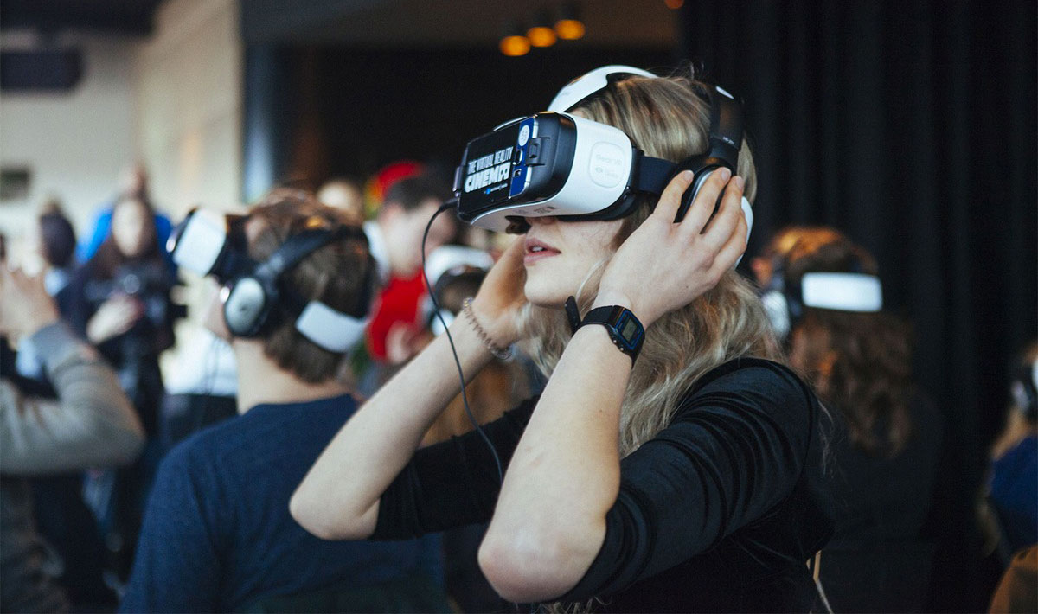
Deep Dive into the VR Dataset
By: Anastasia Sidorova and Paola Cancino
ThePhoto by PhotoAuthor is licensed under CCYYSA.

Slide 2
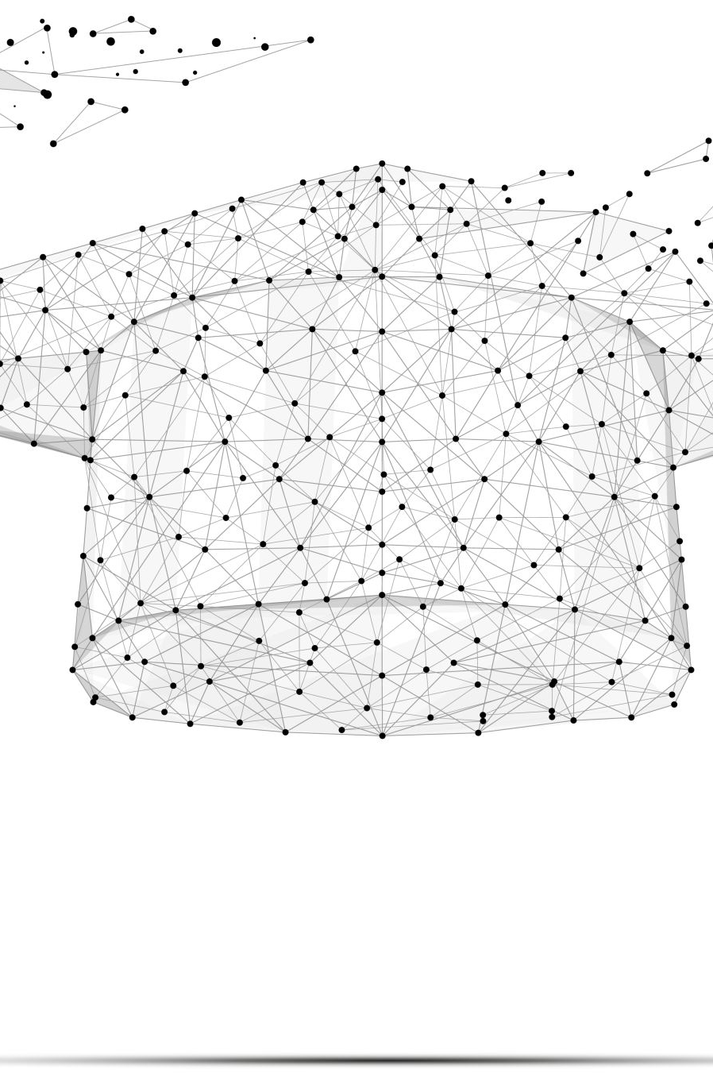
Introduction into the Impact of Virtual Reality in Education Dataset
The dataset we selected for analysis is sourced from Kaggle and explores the impact of incorporating virtual reality in education, featuring data from 5,000 students.
We will examine the relationship between age, hours of VR usage, effects on learning outcomes, impact on creativity, stress levels, willingness to continue using VR, and perceived effectiveness.
Hypothesis: The usage of VR in education will enhance learning outcomes and creativity; however, it may also lead to increased stress levels and lower interest in continuing usage.

Slide 3
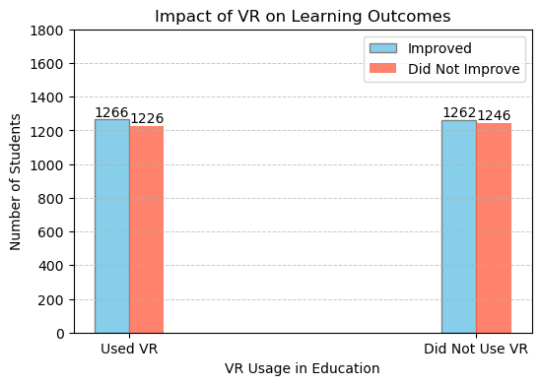
1. Does Usage and Non-usage of VR in Education impact Learning Outcomes?
VR proved to be slightly more effective in improving education compared to not using it at all, although the numbers are fairly similar.
While the differences in effectiveness are modest, VR may lead to positive outcomes, such as improved engagement, knowledge retention, and comprehension.
Incorporating VR into education can promote a more inviting and interactive environment, helping prepare students for a bright future.

Slide 4
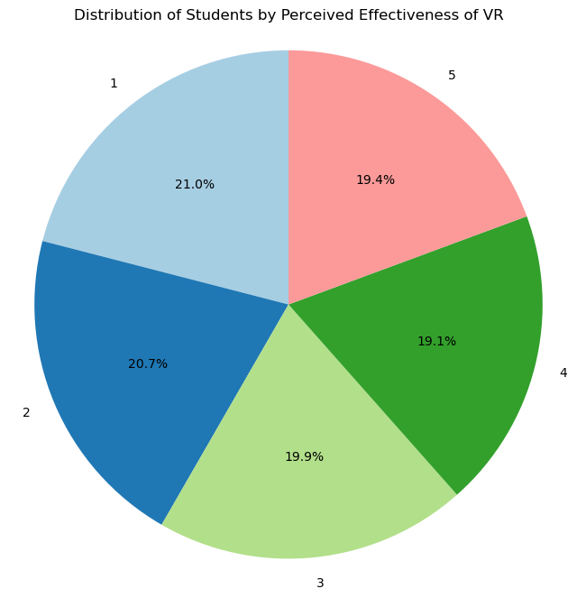
2. What is the distribution of students by perceived effectiveness of VR?
The majority of the ranking from 1-5 of perceived effectiveness of VR falls in the 1–2 rating.
Surprisingly, the average of the 3-5 ranking is lower then the 1-2 ranking. But overall, all the rankings are ultimately very similar to one another.
Understanding how students perceive the effectiveness of VR can help educators identify which VR applications or tools contribute most to learning outcomes.
Feedback can guide the incorporation of VR into schooling methods, ensuring that it complements traditional teaching methods effectively.

Slide 5
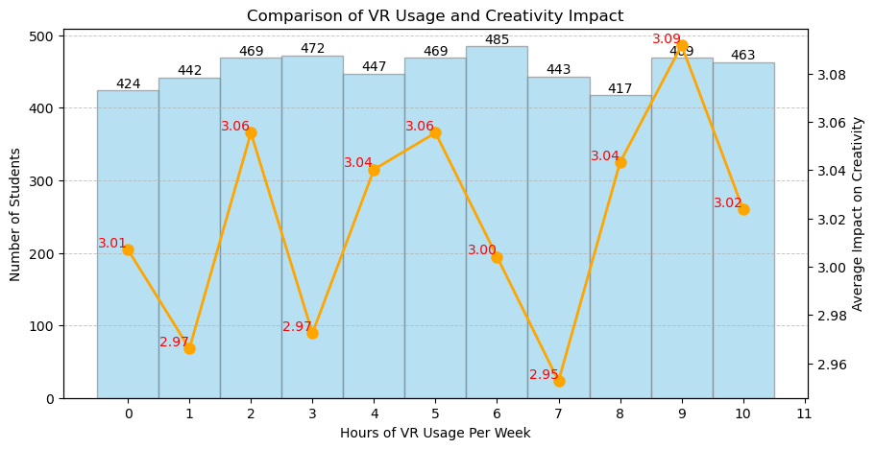
3. Does hourly usage influence creativity?
The highest number of students use around 6 hours of VR per week.
Hourly usage can also contribute to the development of practical skills.
While more usage can yield benefits, there may also be diminishing returns if students become fatigued or overwhelmed.
The highest average impact on creativity is observed at 9 hours of usage, with a score of 3.09, while the lowest is 2.95 at 7 hours.
Although the differences in averages are not substantial, this suggests that extended exposure might contribute to a slight boost in creativity levels.
Regular VR usage can stimulate creativity by allowing students to experiment and explore without real-world consequences.
Hours of VR Usage Per Week | Number of Students
0 | 424
1 | 442
2 | 469
3 | 472
4 | 447
5 | 469
6 | 485
7 | 443
8 | 417
9 | 469
10 | 463

Slide 6
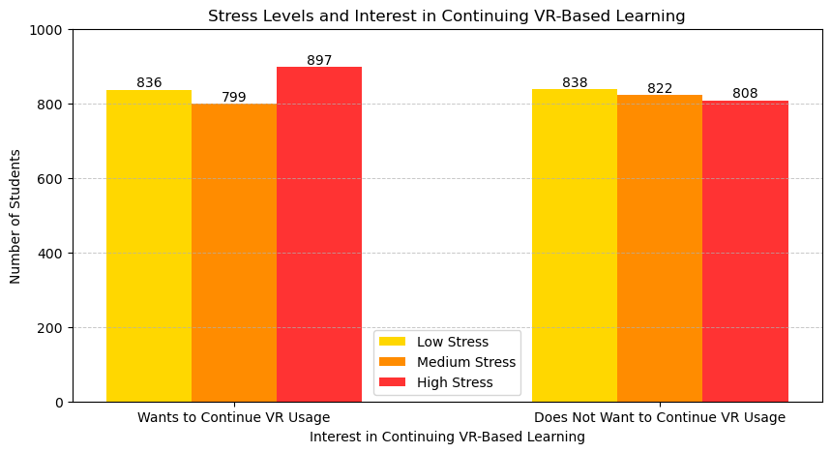
4. How does stress level influence the interest in continuing VR based learning?
There is a higher level of stress in the number of students who want to continue VR usage compared to those who do not want to continue.
There is 2,532 students who want to continue the usage of VR and 2,468 students who do not want to continue.

Slide 7
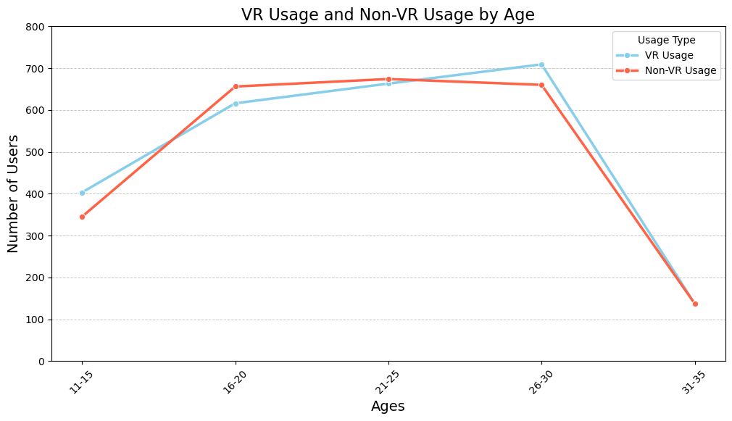
5. What correlation does age have with usage of VR?
709, the majority, of the students that do use VR fall in the age range of 26-30.
137, the minority, of both that use VR and that don’t fall in the age range of 31-35.
This information can help create products, marketing strategies, or educational content specifically for those age groups.
The analysis can help allocate resources effectively, focusing on the age groups that show the most promise for growth in VR usage.

Slide 8
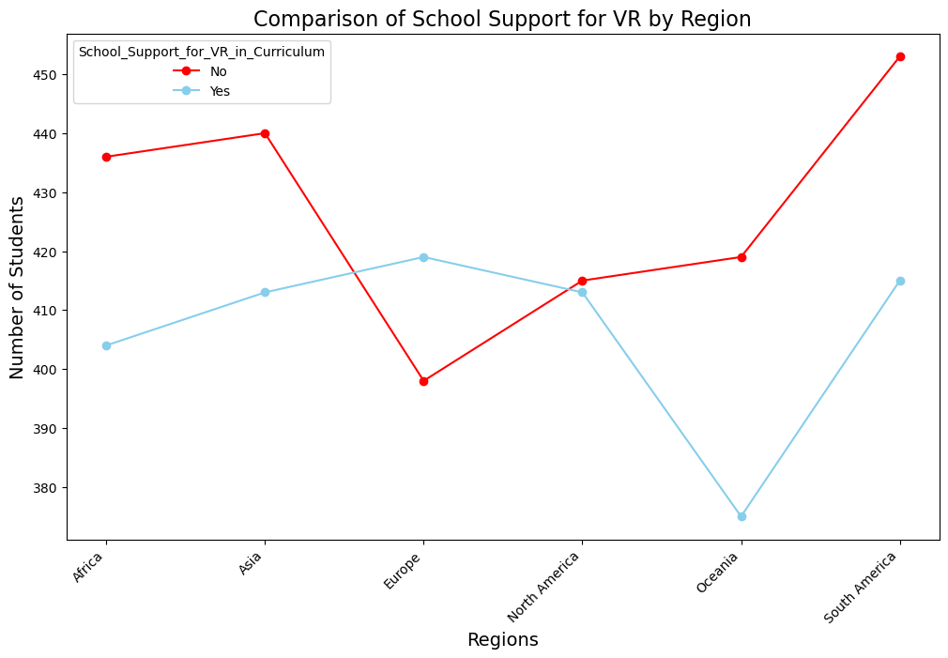
6. How does North America compare to other regions in terms of support for VR?
North America shows a relatively balanced distribution between students with and without school support for VR, making it the most evenly distributed region in terms of support.
In contrast, the Oceania region appears to have the lowest level of school support for VR.
Countries | Yes | No
Africa | 436 | 404
Asia | 440 | 413
Europe | 398 | 419
North America | 415 | 413
Oceania | 419 | 375
South America | 453 | 415

Slide 9
Conclusion
Our findings indicate that while the use of virtual reality can significantly enhance learning outcomes and foster creativity among students, there may be considerable opposition to its implementation.
Some notable concerns we found are increased stress levels and student reluctance to engage with VR for learning.
It is essential for educators to receive proper training and develop a thorough understanding of VR before integrating it into their classrooms.
As technology advances, we should use it to our best advantage to maximize educational benefits.
Based on this data, we believe further research is necessary to gain a clearer understanding into the effectiveness of implementing VR in a classroom and what challenges it may present.

Slide 10
Sources used
https://www.kaggle.com/datasets/waqi786/impact-of-virtual-reality-on-education

