Slide 1

Deep Dive into the Data Analyst and Data Engineer datasets
By: Anastasia Sidorova and Paola Cancino

Slide 2

Introduction
Datasets Used:
Data Analyst – Kaggle
Data Engineer – Kaggle
Both datasets were derived from LinkedIn Job Postings
Both include Salaries, Location, Job Description, Company Size, Easy Apply, Rating, Type of Ownership, and Industry.
Purpose:
We selected these datasets because they provide valuable insights into two career paths related to our degree, allowing us to make informed decisions about future career directions.
Hypothesis:
Data engineers tend to earn higher salaries but require more training and carry greater responsibility. Data analyst roles are easier to apply for and have a higher number of job openings.

Slide 3
Data Analyst vs. Data Engineer What Are They?
Data Engineer:
Design and manage data systems to control data flow.
Develop and optimize data pipelines and storage solutions.
Ensure secure and efficient data access.
Specialize in data collection, organization, and storage.
Proficient in technologies such as SQL, Java, Python, Shell, Azure, and more.
Data Analyst:
Conduct basic analyses to describe and interpret data.
Develop reports and dashboards to present data insights.
Clean and prepare data for analysis.
Focus on data preparation, exploration, and visualization with minimal programming and statistical work.
Skilled in tools such as SQL, Excel, Tableau, Power BI, Python, and R.

Slide 4
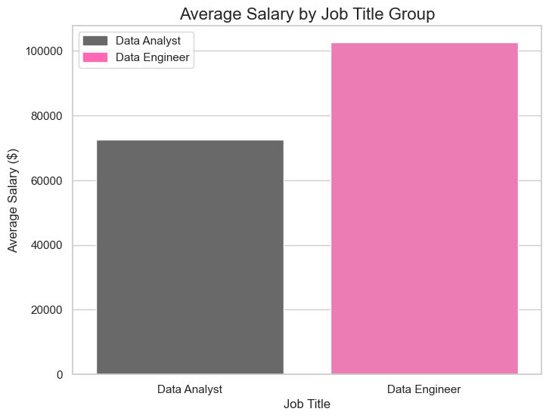
Difference in Average Salary
Data Engineers have a higher average salary of $102,604.51.
Data Analysts have a lower salary with an average of $72,679.12.
Data engineers typically earn higher salaries due to advanced technical skills and responsibilities.
Data analyst roles offer a competitive salary with more entry-level opportunities.
The salary gap reflects the specialized expertise required in data engineering.
Choosing a path depends on desired income potential, skills, and training level.

Slide 5
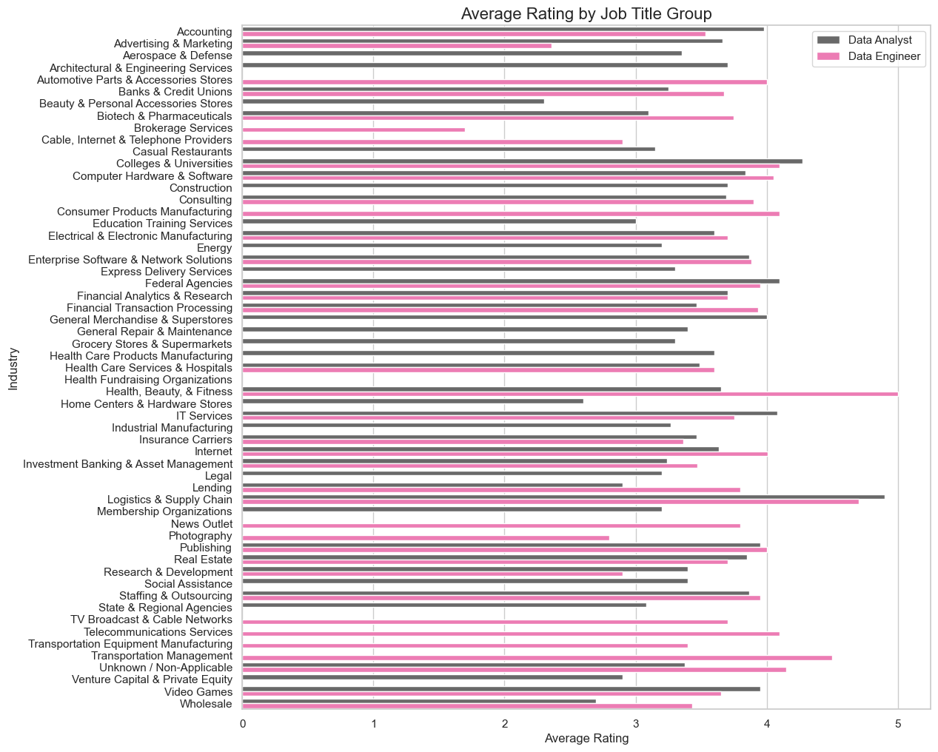
Difference in Average Rating

Slide 6
Best and Worst Ratings for Data Analyst
Industry | Rating
Logistics & Supply Chain | 4.9
Colleges & Universities | 4.3
Federal Agencies | 4.1
IT Services | 4.1
Lending | 2.9
Wholesale | 2.7
Home Centers & Hardware Stores | 2.6
Beauty & Personal Accessories Stores | 2.3
Logistics & Supply Chain reflects a strong job satisfaction or performance perceptions in this industry.
Federal Agencies and IT Services ratings suggest a stable, respected career option, and they provide favorable conditions for data-related roles.
Beauty & Personal Accessories has the lowest rating amongst the Data Analysts because of challenges within a specific sector and lack of advancement.

Slide 7
Best and Worst Ratings for Data Engineers
Industry | Rating
Health, Beauty, & Fitness | 5.0
Logistics & Supply Chain | 4.7
Transportation Management | 4.5
Colleges & Universities | 4.1
Cable, Internet & Telephone Providers | 2.9
Photography | 2.8
Advertising & Marketing | 2.4
Brokerage Services | 1.7
Health, Beauty & Fitness has a perfect 5-star rating due high job satisfaction and opportunities in this field.
Logistics & Supply Chain and College & Universities have a very similar rating to Data Analysts.
Brokerage Service has the lowest rating, because of high pressure and fast-paced environments. There is also significantly more workload when it comes to entry-level jobs.

Slide 8
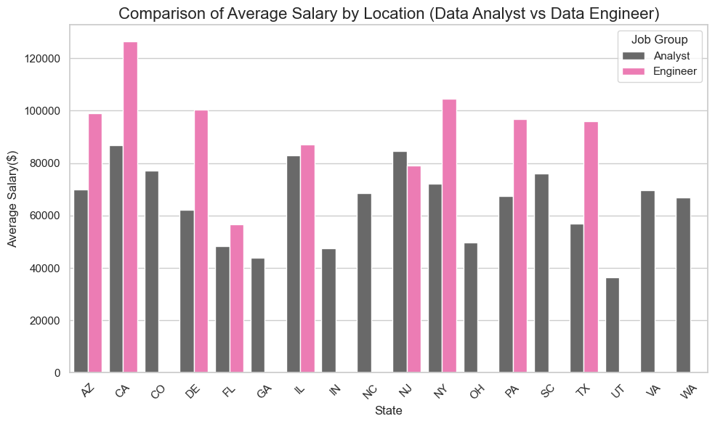
Salary based on Location
California (CA) and New York (NY) show the highest average salaries for both roles. This makes sense given the higher cost of living and demand for tech roles in these states.
In states like Texas (TX) and Delaware (DE), data engineers earn noticeably more than data analysts, indicating that these states may have a higher demand for data engineering skills.
Data Engineer jobs are not as widespread as Data analyst and their average salary is clearly more impacted by location.

Slide 9
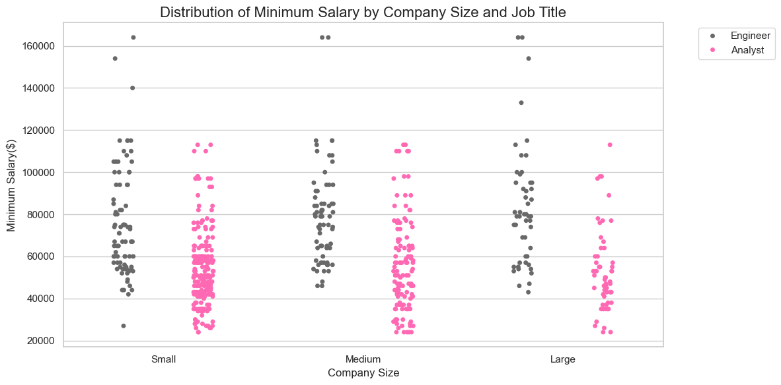
Size of Company
Data engineers more frequently have minimum salaries above $60k.
For data analysts, the minimum salary clusters between $40k and $80k.
There are outliers for data engineers where the minimum salary exceeds $140k.
Large companies show a greater variation in minimum salary for both roles.

Slide 10
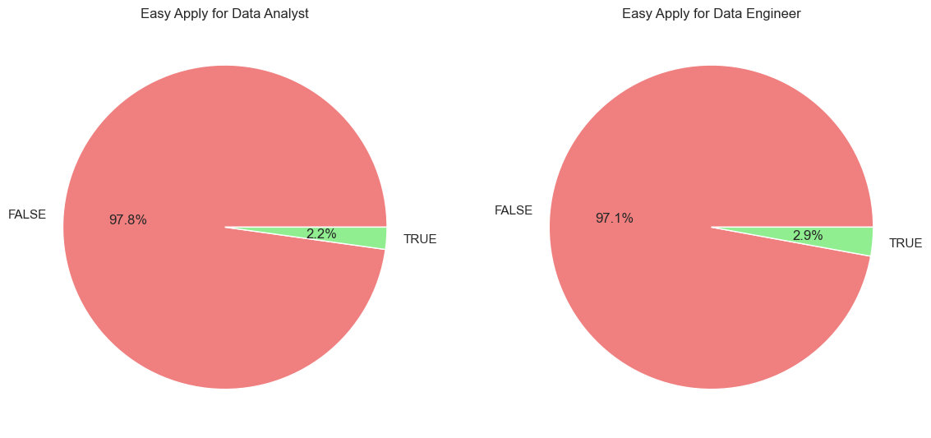
Application Difficulty
Both career paths have a higher amount of job postings that are considered difficult to attain.
For Data Analysts you are required to submit a resume and cover letter which is then followed by a series of interviews that often involve technical skills assessments, data analysis case studies, and questions about your experience with data manipulation, visualization tools, and statistical methods.
For Data Engineers a resume and a cover letter is also required which is followed by the initial interview process, a technical assessments, and multiple rounds of interviews focused on data engineering concepts, coding skills, and system design.

Slide 11
Takeaway
Opportunities for each job role is limited but attainable with targeted skills and certifications.
Market demand for these roles remains strong despite the competition.
Pursue certifications or training in in-demand skills like cloud computing (for engineers) or advanced analytics tools like Tableau and Power BI (for analysts).
While the path to these careers is competitive, preparation and persistence can lead to success.

Slide 12

Thank you

