Slide 1







Department of Computer Science and Engineering (Cyber Security)
CS23533 - Foundations of Artificial Intelligence
2026-2027
AI-POWERED INCIDENT RESPONSE SYSTEM
Rule-based expert system that classifies, prioritizes and recommends responses for cybersecurity incidents
Rule-based reasoning
Forward chaining
Heuristic prioritization
Constraint-based response
Dr. P. Tamilselvi, Ph.D.
Professor & Head of the Department
Dept. of CSE (Cyber Security)
Team members
NILA ELA (241901074)
SREEDHARSHINI M (241901110)

Slide 2







Problem Statement and Motivation
INCOMING ALERT SOURCES
Brute force
Repeated login attempts against user and admin accounts
Port scanning
Probing hosts to discover open ports and exposed services
Denial-of-service
Flooding a service until it can no longer answer real users
WHY MANUAL HANDLING BREAKS DOWN
01
02
03
Alert overload
Every alert needs an analyst to read, classify and rank it before anyone acts.
Slow, inconsistent triage
Critical incidents wait in the same queue as low-risk noise; ranking depends on who is on shift.
Fragmented tooling
Detection, incident records and response guidance live in separate tools and workflows.
Problem: existing systems detect or record incidents but give limited prioritization and no explainable response guidance.
Motivation: one system that analyzes every incident, ranks it, and recommends a response with the rules that justify it.

Slide 3


Objectives
1
2
3
4
5
Centralize
Classify
Prioritize
Recommend
Monitor
Collect, store and manage cybersecurity incident records in one backend
Classify each incident from its facts using rule-based AI reasoning
Determine severity and priority with heuristic evaluation
Select response actions that satisfy the incident's conditions
Show incidents, priorities and AI recommendations on a web dashboard
Spring Boot + MySQL
Rules + forward chaining
Heuristic scoring
Constraint satisfaction
Web dashboard
TARGET WORKFLOW (REPORT 2.3.1)
Incident data
AI analysis
Threat classification
Priority
Response recommendation

Slide 4
Abstract
Context. Brute-force, port-scan and denial-of-service attacks generate more security alerts than analysts can triage by hand. Manual prioritization is slow, error-prone and tied to individual expertise.
Approach. The AI-Powered Incident Response System combines a rule-based expert system, forward-chaining inference, heuristic evaluation and constraint-based response selection to classify each incident, assign a priority and recommend a response.
Architecture. Incident input, preprocessing, AI analysis, incident evaluation and response output, served by a Spring Boot backend with MySQL and a planned web dashboard.
Status. Database, incident entity, repository, service and controller layers and CRUD REST APIs are built and tested in Postman. The AI rule engine, prioritization, recommendation and dashboard come next.
4
3
AI techniques
Attack classes
rules, forward chaining, heuristics, constraints
brute force, port scan, DoS
4
6/11
System modules
Milestones done
backend, analysis, prioritization, dashboard
backend complete, AI layer next

Slide 5


Scope, Security and SDG Alignment
Project scope
Security requirements
9
SDG 9
Industry, Innovation and Infrastructure
1
Incident collection
Secure incident data management
Controlled access to incident information
Secure database integration
Reliable incident classification
No unauthorized modification of incident records
Secure communication between components
Accurate prioritization of critical incidents
2
Preprocessing
Target 9.1 Reliable, sustainable and resilient infrastructure
Target 9.5 Scientific research and technological capability
3
Classification
4
Prioritization
5
Response recommendation
Contribution
Moves organizations from manual incident handling to intelligent, prioritized, AI-assisted response, strengthening digital infrastructure against evolving threats.
6
Database management
7
Dashboard monitoring

Slide 6
Literature Survey
S.No | Author(s) & Year | Paper title & venue | Methodology | Limitation | Takeaway for this project
1 | Buczak & Guven (2016) | A Survey of Data Mining and Machine Learning Methods for Cyber Security Intrusion Detection IEEE Commun. Surveys & Tutorials | Survey of data-mining and ML methods for misuse and anomaly detection | Performance depends on the data, features and attack context | Favor transparent, attack-specific rules for triage
2 | Sommer & Paxson (2010) | Outside the Closed World: On Using Machine Learning for Network Intrusion Detection IEEE Symp. Security & Privacy | Analysis of why ML anomaly detection struggles in operational networks | High cost of errors, diverse traffic and a semantic gap between alerts and meaning | Every decision must be explainable to the analyst
3 | Khraisat et al. (2019) | Survey of Intrusion Detection Systems: Techniques, Datasets and Challenges Cybersecurity (Springer) | Review of signature-based and anomaly-based IDS and benchmark datasets | No single technique suits every attack; dataset choice affects evaluation | Per-attack rules feeding one shared priority layer

Slide 7
Literature Survey
S.No | Author(s) & Year | Book & publisher | Methodology | Limitation | Takeaway for this project
4 | Russell & Norvig | Artificial Intelligence: A Modern Approach Pearson | Knowledge representation, forward chaining, heuristic search, constraint satisfaction | General methods; cybersecurity rules must be written for the domain | Source of the four AI techniques used here
COVERAGE MATRIX: WHERE THIS PROJECT FITS
Work | Attack detection | ML-based analysis | Rule-based reasoning | Incident prioritization | Response recommendation
[1] Buczak & Guven | ● | ● | – | – | –
[2] Sommer & Paxson | ● | ● | – | – | –
[3] Khraisat et al. | ● | ● | ● | – | –
[4] Russell & Norvig | – | – | ● | – | –
Proposed system | input | – | ● | ● | ●
● covered – not addressed | [3] covers rule-based reasoning through signature-based IDS

Slide 8
Research Gap/Existing System
Existing system
Research gap
How this project responds
Manual investigation, rule/signature-based IDS, security monitoring, and separate detection, analysis and response tools.
ML is hard to apply reliably to real network security
Rule-based expert system with explicit, auditable rules
Advantages
ML needs labelled datasets and feature engineering
Rules run on incident attributes; no training set required
Simple to implement
Detects known attack patterns
Useful for basic monitoring; established techniques
Real network data is hard to model accurately
Reason over incident-level facts: type, source, target, counts
Limitations
Alert volume overwhelms security teams
Manual analysis is time-consuming
Limited intelligent prioritization
Response depends on human expertise
Detection and response sit in separate systems
No single technique suits every attack type
Per-attack rule sets feeding one shared priority score
Weak prioritization and response support
Heuristic priority plus constraint-based response selection

Slide 9


Proposed System
Presentation
Security analyst
Submits and reviews incidents
Web dashboard
Incidents, priority, recommended actions
Application
(Spring Boot REST)
Controller
REST endpoints
Service
Business logic
Repository
Data access
Entity
Incident model
AI analysis engine
Rule base
IF-THEN knowledge
Inference engine
Forward chaining
Heuristic evaluator
Severity & priority
Constraint solver
Response selection
Data
Incident
Core record
IncidentAnalysis
Class, score, response
ResponseAction
Action catalogue
SystemLog / User
Audit and access
IMPLEMENTED
PLANNED

Slide 10
DFD Diagram
LEVEL 0 (CONTEXT)
Data flows
Security logs / external sources
Incident information
logs and alerts from external sources
1
1
2
Incident data
query or request from the analyst
2
AI-Powered Incident Response System
3
MySQL
database
User
(Security analyst)
3
Store / retrieve
incident records to and from MySQL
6
4
Processed data
sent to the AI engine
4
5
5
Classification, priority, response
returned by the AI engine
AI analysis engine
6
Analysis results
response recommendation to analyst

Slide 11
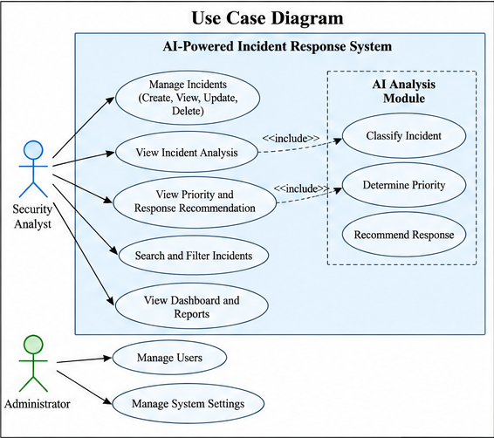
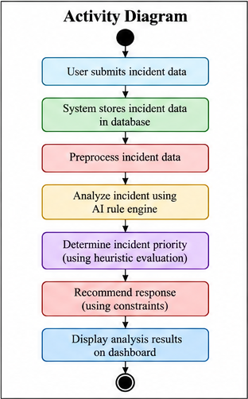
UML Diagrams: Use Case and Activity
Actors
Security analyst: manages incidents (CRUD), views analysis, priority and recommendation, searches and filters, opens dashboard reports
Administrator: manages users and system settings
AI analysis module
Classify incident, determine priority and recommend response, included in the analyst's analysis use cases
Activity flow
Submit, store, preprocess, analyze with rule engine, prioritize heuristically, recommend under constraints, display
Fig. 3.2 Use case diagram
Fig. 3.3 Activity diagram

Slide 12
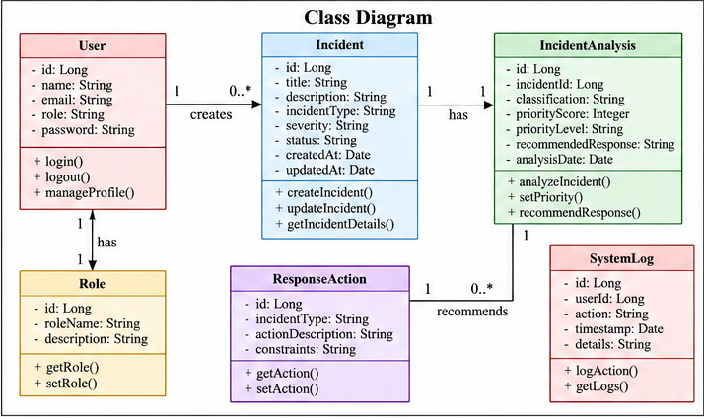
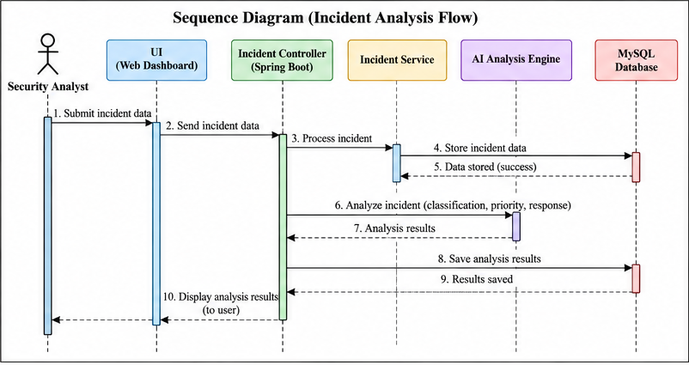
UML Diagrams: Class and Sequence
Fig. 3.4 Class diagram
Fig. 3.5 Sequence diagram (incident analysis flow)
6 classes: User, Role, Incident, IncidentAnalysis, ResponseAction, SystemLog. One user creates many incidents; each incident has one analysis that recommends many response actions.
10 messages: analyst to UI to Spring Boot controller; the service stores the incident in MySQL, calls the AI engine for classification, priority and response, saves results and returns them to the dashboard.

Slide 13
Methodology/Work Flow Diagram
1
Incident input
2
Validate & preprocess
3
Rule matching
4
Forward chaining
Attack type, source, target and details arrive through the REST API
Check required fields and convert values into facts
Compare facts with IF-THEN rules for each attack class
Fire matched rules and add new facts until none apply
IMPLEMENTED
PLANNED
PLANNED
PLANNED
Red outline = AI core (steps 3 to 6): rule-based reasoning, forward chaining, heuristic evaluation, constraint satisfaction
8
Dashboard & evaluation
7
Store / return result
6
Select response
5
Heuristic priority
Display results and test with attack scenarios
Persist in MySQL and return through the API
Pick actions that satisfy every incident constraint
Score severity from incident characteristics
PLANNED
PARTIAL
PLANNED
PLANNED

Slide 14
AI Reasoning Techniques
Rule-based reasoning
Forward chaining
Knowledge stored as IF condition THEN conclusion rules written from security domain knowledge.
Data-driven inference: start from known facts, fire every rule whose conditions hold, add conclusions, repeat until nothing new.
Role: Maps incident facts to an attack class: brute force, port scan or DoS.
Role: Derives classification and severity step by step, so every result has a rule trace.
Heuristic evaluation
Constraint satisfaction
Scores an incident from its characteristics instead of exhaustive analysis. Candidate factors: attack type, target criticality, frequency, rule confidence.
Treats response actions as choices that must satisfy incident conditions, e.g. never auto-block a whitelisted internal host.
Role: Orders incidents into Critical, High, Medium and Low priority.
Role: Returns only response actions that are valid for this incident.

Slide 15
Sample Rule Base and Inference Trace
Rule | IF (conditions) | THEN (conclusion)
R1 | failed logins > N within T, single source IP | type = Brute force
R2 | distinct ports probed > P from one source within T | type = Port scan
R3 | request rate > k × baseline AND service degraded | type = DoS
R4 | type = Brute force AND target = privileged account | severity = High
R5 | type = DoS AND service = critical | severity = Critical
R6 | severity ∈ {High, Critical} | notify analyst immediately
Facts
many failed logins in a short window, one source IP, target = admin account
R1 fires
type = Brute force
R4 fires
severity = High
Heuristic
priority = High (privileged target, repeated attempts)
Constraints
source not whitelisted ✓ production login service ✓
Illustrative design rules. N, P, T and k are thresholds to be fixed and tested during implementation.
Response
block source IP, lock and reset account, alert analyst (R6)

Slide 16




Tools and Technologies
Java
Spring Boot
MySQL
LANGUAGE
BACKEND FRAMEWORK
DATABASE
Core language for backend services and the AI engine
REST API with entity, repository, service and controller layers
Persistent store for incident records and analysis results
Postman
REST / JSON
Web dashboard
API TESTING
INTEGRATION
USER INTERFACE
Create, read, update and delete endpoints tested
Contract between dashboard, backend and AI engine
Monitoring view for incidents, priorities and actions
No training dataset or ML model needed: the AI layer is knowledge-based (rules, inference, heuristics, constraints) and runs on incident attributes.

Slide 17




List of Modules
M1
M2
M3
M4
Incident Management & Backend
AI-Based Incident Analysis
Intelligent Prioritization & Response
Dashboard & Integration
CRUD for incident records
Spring Boot layers + MySQL
APIs tested in Postman
Rule base per attack class
Forward-chaining inference
Classification with rule trace
Heuristic severity and priority
Constraint-based action selection
Recommended response output
Incident list and status
Priority and AI recommendations
Connected to REST APIs
Progress
Progress
Progress
Progress
IMPLEMENTED
PLANNED
PLANNED
PLANNED
Current milestone: M1 backend foundation complete; M2 to M4 build the end-to-end AI-assisted response workflow on top of it.

Slide 18
Module Description(For each Module separately)
MODULE 1 | INCIDENT MANAGEMENT & BACKEND
IMPLEMENTED
Purpose: create, read, update and delete incident records.
Controller
Exposes REST endpoints, maps HTTP to service calls
CRUD operations
Incident (entity)
POST
Create
createIncident()
id
Long
Service
Business logic and validation hooks
title
String
GET
Read
getIncidentDetails()
description
String
Repository
Data access for incident entities
incidentType
String
PUT
Update
updateIncident()
severity
String
Entity
Incident object mapped to a table
status
String
DELETE
Delete
remove record
createdAt
Date
MySQL
Persistent incident records
✓ All four verified in Postman
updatedAt
Date

Slide 19
Module Description(For each Module separately)
MODULES 2 TO 4 | AI LAYER AND DASHBOARD
PLANNED
M2 AI-Based Incident Analysis
M3 Prioritization & Response
M4 Dashboard & Integration
INPUT
INPUT
INPUT
Validated incident facts: type, source, target, counts
Classification and incident characteristics
Incidents and analysis results via REST API
PROCESS
PROCESS
PROCESS
Match rules, run forward chaining until no new facts
Heuristic severity score; constraint check on candidate actions
List, search and filter; show priority and actions
OUTPUT
OUTPUT
OUTPUT
Attack classification plus fired-rule trace
Priority level and recommended response
Monitoring view and reports for analysts

Slide 20
Threat Model and Security Controls
ATTACK SURFACES
Web dashboard
REST APIs
AI analysis module
Authentication
MySQL database
Threat | Target surface | Security control
Unauthorized access | Dashboard, authentication | Authentication and role-based authorization (User, Role)
SQL injection | MySQL via REST APIs | Input validation and parameterized database queries
API abuse | REST APIs | API security: reject unauthorized requests, request controls
Data manipulation | Incident records | Data integrity checks; activity recorded in SystemLog
Credential theft | Authentication system | Restricted access, logging and monitoring of user actions
Denial-of-service | APIs, dashboard | Availability: error handling, backups, request controls
Rule tampering / bad input | AI analysis module | AI security: controlled rule set and validated inputs

Slide 21
Results & Discussion
Milestone completion
Milestones by module
Implementation status
Spring Boot project configured
MySQL database created
Incident entity integrated
Repository, service, controller
CRUD REST APIs developed
APIs tested in Postman
55%
AI rule-based analysis
Heuristic prioritization
Response recommendation
Dashboard
Final testing
■ Completed 6 ■ Pending 5
EVALUATION PLAN FOR THE AI LAYER (NO ACCURACY FIGURES YET: ENGINE NOT BUILT)
Metric | How it will be measured | Test scenarios
Classification correctness | Rule output vs expected attack label per scenario | Brute force, port scan, DoS
Priority consistency | Same incident facts always yield the same priority | Repeated and edge-case inputs
API success rate / latency | 2xx responses per request; time per analysis call | CRUD + analysis endpoints

Slide 22



User Interface/ Screenshots
Screenshot 1: Postman | CREATE / READ API response
Screenshot 2: MySQL | Incident table with stored records
Paste screenshot here
Paste screenshot here
Screenshot 3: Spring Boot | Startup and DB connection
Screenshot 4: Postman | UPDATE / DELETE verification
Paste screenshot here
Paste screenshot here

Slide 23



Conclusion
Built
Centralized incident backend: Spring Boot, MySQL, entity, repository, service and controller layers, CRUD REST APIs tested in Postman.
A rule-based AI layer on a working Spring Boot and MySQL backend turns raw incident records into classified, prioritized, actionable responses, with the rule trace that explains each decision.
Designed
AI workflow of rule-based reasoning, forward chaining, heuristic prioritization and constraint-based response; DFD and UML models complete.
Next
Implement the AI engine, integrate the dashboard and evaluate the full workflow on brute-force, port-scan and DoS scenarios.

Slide 24

Future Work
PHASE 1
PHASE 2
PHASE 3
PHASE 4
AI engine
Priority & response
Dashboard & hardening
Evaluation
Rule base for brute force, port scan, DoS
Forward-chaining inference with rule trace
Transparent heuristic criteria for severity
Constraint-based response recommendations
Dashboard connected to REST APIs
Input validation, authentication, authorization, security tests
Scenario-based testing with measured results
Capture real implementation screenshots

Slide 25
References
A. L. Buczak and E. Guven, "A Survey of Data Mining and Machine Learning Methods for Cyber Security Intrusion Detection," IEEE Communications Surveys & Tutorials, vol. 18, no. 2, pp. 1153-1176, 2016.
1
R. Sommer and V. Paxson, "Outside the Closed World: On Using Machine Learning for Network Intrusion Detection," in Proc. IEEE Symposium on Security and Privacy, 2010, pp. 305-316.
2
A. Khraisat, I. Gondal, P. Vamplew and J. Kamruzzaman, "Survey of Intrusion Detection Systems: Techniques, Datasets and Challenges," Cybersecurity, vol. 2, art. 20, 2019.
3
S. J. Russell and P. Norvig, Artificial Intelligence: A Modern Approach, 4th ed. Pearson, 2020.
4

Slide 26
Thank You
Questions and discussion
NILA ELA (241901074) | SREEDHARSHINI M (241901110)

