Slide 1







Department of Computer Science and Engineering (Cyber Security)
CS23533 - Foundations of Artificial Intelligence
2026-2027 | Review 2
AI-POWERED INCIDENT RESPONSE SYSTEM
Rule-based expert system that classifies, prioritizes and recommends responses for cybersecurity incidents
Rule-based reasoning
Forward chaining
Heuristic prioritization
Constraint-based response
Dr. P. Tamilselvi, Ph.D.
Professor & Head of the Department
Dept. of CSE (Cyber Security)
Team members
NILA ELA (241901074)
SREEDHARSHINI M (241901110)

Slide 2







Problem Statement and Motivation
INCOMING ALERT SOURCES
Brute force
Repeated login attempts against user and admin accounts
Port scanning
Probing hosts to discover open ports and exposed services
Denial-of-service
Flooding a service until it can no longer answer real users
WHY MANUAL HANDLING BREAKS DOWN
01
02
03
Alert overload
Every alert needs an analyst to read, classify and rank it before anyone acts.
Slow, inconsistent triage
Critical incidents wait in the same queue as low-risk noise; ranking depends on who is on shift.
Fragmented tooling
Detection, incident records and response guidance live in separate tools and workflows.
Problem: existing systems detect or record incidents but give limited prioritization and no explainable response guidance.
Motivation: one system that analyzes every incident, ranks it, and recommends a response with the rules that justify it.

Slide 3


Objectives
1
COMPLETED
2
PENDING
3
PENDING
4
PENDING
5
PENDING
Centralize
Classify
Prioritize
Recommend
Monitor
Collect, store and manage cybersecurity incident records in one backend
Classify each incident from its facts using rule-based AI reasoning
Determine severity and priority with heuristic evaluation
Select response actions that satisfy the incident's conditions
Show incidents, priorities and AI recommendations on a web dashboard
Spring Boot + MySQL
Rules + forward chaining
Heuristic scoring
Constraint satisfaction
Web dashboard
Expected outcomes: every incident receives a class, a priority level and a valid response with its rule trace; identical facts always give the same priority; analysts see all incidents in one place.
Completed so far: objective 1 (centralized backend, CRUD APIs tested in Postman).

Slide 4
Project Progress Since Review 1
REVIEW 1
SINCE REVIEW 1
Current status
Concept and design
Design completed
Problem statement and objectives
Literature survey of 4 sources
Proposed system architecture
Methodology: rules, forward chaining, heuristics, constraints
Sample incident priority chart
DFD Level 0, use case, activity, class and sequence diagrams
Threat model, attack surfaces and security controls
6/11
Implementation completed
Spring Boot project configured
MySQL database created
Incident entity and database integration
Repository, service and controller layers
CRUD REST APIs developed
APIs tested successfully in Postman
milestones complete (55%)
Next: AI rule engine, heuristic prioritization, response recommendation, dashboard, final testing

Slide 5
Literature Survey
S.No | Author(s) & Year | Paper title & venue | Methodology | Limitation | Takeaway for this project
1 | Buczak & Guven (2016) | A Survey of Data Mining and Machine Learning Methods for Cyber Security Intrusion Detection IEEE Commun. Surveys & Tutorials | Survey of data-mining and ML methods for misuse and anomaly detection | Performance depends on the data, features and attack context | Favor transparent, attack-specific rules for triage
2 | Sommer & Paxson (2010) | Outside the Closed World: On Using Machine Learning for Network Intrusion Detection IEEE Symp. Security & Privacy | Analysis of why ML anomaly detection struggles in operational networks | High cost of errors, diverse traffic and a semantic gap between alerts and meaning | Every decision must be explainable to the analyst
3 | Khraisat et al. (2019) | Survey of Intrusion Detection Systems: Techniques, Datasets and Challenges Cybersecurity (Springer) | Review of signature-based and anomaly-based IDS and benchmark datasets | No single technique suits every attack; dataset choice affects evaluation | Per-attack rules feeding one shared priority layer

Slide 6
Literature Survey
S.No | Author(s) & Year | Book & publisher | Methodology | Limitation | Takeaway for this project
4 | Russell & Norvig | Artificial Intelligence: A Modern Approach Pearson | Knowledge representation, forward chaining, heuristic search, constraint satisfaction | General methods; cybersecurity rules must be written for the domain | Source of the four AI techniques used here
COVERAGE MATRIX: WHERE THIS PROJECT FITS
Work | Attack detection | ML-based analysis | Rule-based reasoning | Incident prioritization | Response recommendation
[1] Buczak & Guven | ● | ● | – | – | –
[2] Sommer & Paxson | ● | ● | – | – | –
[3] Khraisat et al. | ● | ● | ● | – | –
[4] Russell & Norvig | – | – | ● | – | –
Proposed system | input | – | ● | ● | ●
● covered – not addressed | [3] covers rule-based reasoning through signature-based IDS

Slide 7




Research Gap and Project Response
1
2
3
4
Literature findings
Limitations
Refined research gap
Progress toward solution
Data-mining and ML methods dominate intrusion detection [1]
ML faces error cost, traffic diversity and a semantic gap in practice [2]
IDS rely on signature or anomaly methods tested on benchmark datasets [3]
Results depend on data, features and attack context
No single technique suits every attack type
Output stops at detection, with little prioritization or response guidance
No lightweight, explainable layer that turns a recorded incident into class, priority and a valid response with a rule trace
Centralized Spring Boot + MySQL incident backend built
CRUD REST APIs tested in Postman
AI workflow designed: rules, forward chaining, heuristics, constraints
RESPONSE PATH: BUILT VS NEXT
Spring Boot + MySQL backend
Rules + forward chaining
Heuristic priority
Constraint-based response
Dashboard

Slide 8


System Architecture / Proposed System
Presentation
Security analyst
Submits and reviews incidents
Web dashboard
Incidents, priority, recommended actions
Application
(Spring Boot REST)
Controller
REST endpoints
Service
Business logic
Repository
Data access
Entity
Incident model
AI analysis engine
Rule base
IF-THEN knowledge
Inference engine
Forward chaining
Heuristic evaluator
Severity & priority
Constraint solver
Response selection
Data
Incident
Core record
IncidentAnalysis
Class, score, response
ResponseAction
Action catalogue
SystemLog / User
Audit and access
COMPLETED
PENDING

Slide 9
DFD Diagram (Level 0)
LEVEL 0 (CONTEXT)
Data flows
Security logs / external sources
Incident information
logs and alerts from external sources
1
1
2
Incident data
query or request from the analyst
2
AI-Powered Incident Response System
3
MySQL
database
User
(Security analyst)
3
Store / retrieve
incident records to and from MySQL
6
4
Processed data
sent to the AI engine
4
5
5
Classification, priority, response
returned by the AI engine
AI analysis engine
6
Analysis results
response recommendation to analyst

Slide 10
DFD Diagram (Level 1)
Security logs / sources
alerts
store / retrieve
Legend
1.0
Submit & validate incident
validated incident
2.0
Manage incident records
D1 Incidents
External entity
Security analyst
Process (built)
incident details
incident facts
Process (planned)
5.0
Recommend response
priority level
4.0
Prioritize (heuristic)
attack class + trace
3.0
Classify incident
D3 Response actions
candidate actions
Data store
class, priority, response
Data flow
analysis results
6.0
Display on dashboard
dashboard view
Security analyst
Expands process 0 of the Level 0 diagram into six sub-processes.
D2 Incident analysis

Slide 11
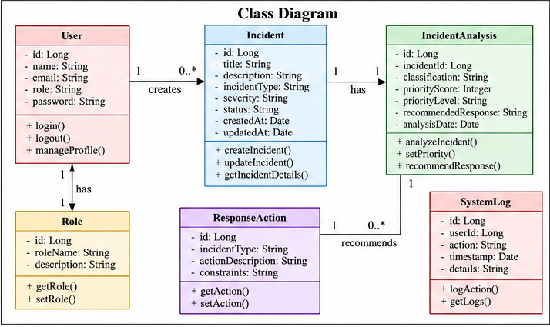
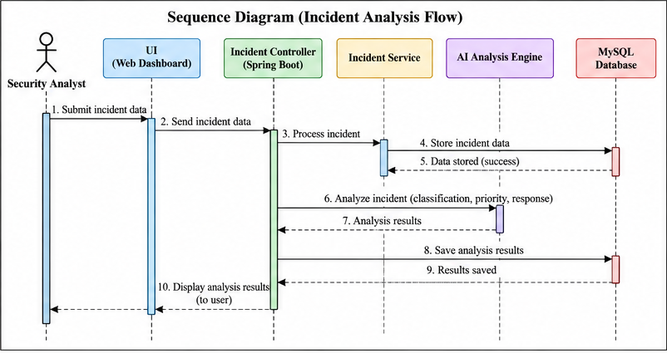
UML Diagrams: Class and Sequence
Fig. 3.4 Class diagram
Fig. 3.5 Sequence diagram (incident analysis flow)
6 classes: User, Role, Incident, IncidentAnalysis, ResponseAction, SystemLog. One user creates many incidents; each incident has one analysis that recommends many response actions.
10 messages: analyst to UI to Spring Boot controller; the service stores the incident in MySQL, calls the AI engine for classification, priority and response, saves results and returns them to the dashboard.

Slide 12
Methodology / Workflow Diagram
1
Incident input
2
Validate & preprocess
3
Rule matching
4
Forward chaining
Attack type, source, target and details arrive through the REST API
Check required fields and convert values into facts
Compare facts with IF-THEN rules for each attack class
Fire matched rules and add new facts until none apply
COMPLETED
PENDING
PENDING
PENDING
Red outline = AI core (steps 3 to 6): rule-based reasoning, forward chaining, heuristic evaluation, constraint satisfaction
8
Dashboard & evaluation
7
Store / return result
6
Select response
5
Heuristic priority
Display results and test with attack scenarios
Persist in MySQL and return through the API
Pick actions that satisfy every incident constraint
Score severity from incident characteristics
PENDING
IN PROGRESS
PENDING
PENDING

Slide 13




Tools and Technologies
Java
Spring Boot
MySQL
PROGRAMMING LANGUAGE
FRAMEWORK
DATABASE SOFTWARE
Typed, mature ecosystem; one language for backend and rule engine
Auto-configuration and layered REST structure cut setup time
Relational schema fits structured incident and analysis records
Postman
REST / JSON
Web dashboard
API TESTING TOOL
INTERFACE
USER INTERFACE (PLANNED)
Quick, repeatable checks of every CRUD endpoint
Language-neutral contract, so dashboard and AI engine plug in later
One monitoring view for incidents, priority and actions
Dataset: no training data needed; the rule-based AI layer works on incident attributes. Scenario incidents (brute force, port scan, DoS) will be prepared for testing.

Slide 14




List of Modules
M1
M2
M3
M4
Incident Management & Backend
AI-Based Incident Analysis
Intelligent Prioritization & Response
Dashboard & Integration
CRUD for incident records
Spring Boot layers + MySQL
APIs tested in Postman
Rule base per attack class
Forward-chaining inference
Classification with rule trace
Heuristic severity and priority
Constraint-based action selection
Recommended response output
Incident list and status
Priority and AI recommendations
Connected to REST APIs
Progress
Progress
Progress
Progress
COMPLETED
PENDING
PENDING
PENDING
Current milestone: M1 backend foundation complete; M2 to M4 build the end-to-end AI-assisted response workflow on top of it.

Slide 15
Module Implementation – Part 1
MODULE 1 | INCIDENT MANAGEMENT & BACKEND
COMPLETED
Input: incident JSON via REST Output: stored record / JSON
Controller
Exposes REST endpoints, maps HTTP to service calls
CRUD operations
Incident (entity)
POST
Create
createIncident()
id
Long
Service
Business logic and validation hooks
title
String
GET
Read
getIncidentDetails()
description
String
Repository
Data access for incident entities
incidentType
String
PUT
Update
updateIncident()
severity
String
Entity
Incident object mapped to a table
status
String
DELETE
Delete
remove record
createdAt
Date
MySQL
Persistent incident records
✓ All four verified in Postman
updatedAt
Date

Slide 16
Module Implementation – Part 2
MODULE 2 | AI-BASED INCIDENT ANALYSIS
PENDING
Input: incident facts from M1 Output: class, rule trace
Forward-chaining algorithm (pseudocode)
Interaction with other modules
FORWARD_CHAIN(F: facts, R: rules)
trace ← [ ]
repeat
new ← ∅
for each rule r in R
if r.IF ⊆ F and r.THEN ∉ F
new ← new ∪ {r.THEN}
trace.append(r.id)
F ← F ∪ new
until new = ∅
return F, trace // F holds type, severity
PRIORITY ← HEURISTIC(F) // M3
RESPONSE ← SELECT(actions | constraints(F))
M1
Incident record (type, source, target, counts)
M2
Matches rules, runs forward chaining
M3
Uses class to score priority and pick response
M4
Displays class, trace, priority and actions
Planned test: brute-force, port-scan and DoS incidents; fired rules must match the expected class.

Slide 17
Preliminary Results and Discussion
Milestone completion
Milestones by module
Implementation status
Spring Boot project configured
MySQL database created
Incident entity integrated
Repository, service, controller
CRUD REST APIs developed
APIs tested in Postman
55%
AI rule-based analysis
Heuristic prioritization
Response recommendation
Dashboard
Final testing
■ Completed 6 ■ Pending 5
API TEST CASES EXECUTED (POSTMAN)
BASELINE COMPARISON
Test | Endpoint | Expected outcome | Result
TC1 | Create (POST) | Incident saved in MySQL | PASS
TC2 | Read (GET) | Stored incident returned | PASS
TC3 | Update (PUT) | Incident fields updated | PASS
TC4 | Delete (DELETE) | Incident removed | PASS
Aspect | Manual / existing | Current system
Incident storage | Scattered across tools | One MySQL store
Record access | Tool-specific | REST CRUD API
Prioritization | Analyst judgement | Heuristic (next)
Response advice | Expertise-dependent | Constraint-based (next)

Slide 18


User Interface / Implementation Screenshots
Screenshot 1: Postman | CREATE / READ API response
Screenshot 2: MySQL | Incident table with stored records
Paste screenshot here
Paste screenshot here
Shows: new incident created and fetched as JSON
Shows: incident rows persisted in the database
Screenshot 3: Spring Boot | Startup and DB connection
Screenshot 4: Postman | UPDATE / DELETE verification
Paste screenshot here
Paste screenshot here
Shows: application starts and connects to MySQL
Shows: record edited, then deleted successfully

Slide 19


Challenges Faced and Solutions
Challenge
Solution adopted
Remaining issues
No labelled incident dataset to train a model
Knowledge-based AI (rules, heuristics, constraints) that works on incident attributes
Heuristic criteria and rule thresholds still to be fixed
Dashboard not yet built
No measured AI results yet
Authentication and input validation to be added
Analysts must trust and verify each decision
Forward chaining records every rule fired, giving a readable trace
Incident data spread across separate tools
One Spring Boot + MySQL backend with tested CRUD REST APIs
The incident store is itself an attack target
Threat model with validation, authentication, API security and logging controls

Slide 20
Work Plan Until Final Review
Task
W1
W2
W3
W4
W5
W6
W7
W8
1
Rule base + forward-chaining engine
2
Heuristic priority + constraint-based response
3
Dashboard + REST API integration
4
Security hardening: validation, auth, API security
5
Scenario testing: brute force, port scan, DoS
6
Documentation, screenshots, final report, presentation
End of W4: M2 + M3 ready
End of W5: Dashboard live
End of W8: Final review

Slide 21
References
A. L. Buczak and E. Guven, "A Survey of Data Mining and Machine Learning Methods for Cyber Security Intrusion Detection," IEEE Communications Surveys & Tutorials, vol. 18, no. 2, pp. 1153-1176, 2016.
1
R. Sommer and V. Paxson, "Outside the Closed World: On Using Machine Learning for Network Intrusion Detection," in Proc. IEEE Symposium on Security and Privacy, 2010, pp. 305-316.
2
A. Khraisat, I. Gondal, P. Vamplew and J. Kamruzzaman, "Survey of Intrusion Detection Systems: Techniques, Datasets and Challenges," Cybersecurity, vol. 2, art. 20, 2019.
3
S. J. Russell and P. Norvig, Artificial Intelligence: A Modern Approach, 4th ed. Pearson, 2020.
4

Slide 22
Thank You
Questions and discussion
NILA ELA (241901074) | SREEDHARSHINI M (241901110)

