Slide 1
HATe speech detectıon on turkısh tweets
Nil Akay
150210737
Notes:
© Copyright PresentationGO.com – The free PowerPoint template library

Slide 2


People have a free platform to openly express their emotions thanks to social media. Twitter is one of the most popular of them.
Go to the page
Notes:
<a href="https://www.freepik.com/free-photos-vectors/business">Business vector created by pikisuperstar - www.freepik.com</a>

Slide 3


Whats happening?
Nil
The enormous size of the data influence of Turkish social media contains a lot of harmful content that causes major content filtering issues, such as hate speech, cyberbullying, and insulting material.
The rise of these online insults directed towards other countries, ethnicities, faiths, and other groups has an effect and disturbs social peace. Due to its irony and sarcasm, Turkish hate speech is hard to detect.
Tweets
38
Following
38
Followers
38
There are some hate speech to detect!
Trends For You
Take a look
#DataMining
#HateSpeech
#IstanbulTechnicalUniversity
#AI
Who to follow
Refresh
Deniz
Alin
Notes:
A man bike
<a href="https://www.freepik.com/free-photos-vectors/business">Business vector created by pikisuperstar - www.freepik.com</a>
A man sitting
<a href="https://www.freepik.com/free-photos-vectors/menu">Menu vector created by freepik - www.freepik.com</a>

Slide 4


Issues About Related Work
Imbalanced
Biased
Mislabeled
Towards some entities and religions
Simple mention of the entities in question, model can label that instance offensive.
Can train the model wrongly
Subjective
Generalizability problems
Tend to favor the majority class for accuracy

Slide 5
Datasets
“The
OffensEval-20"
“HATC”
“5k Turkish
tweets
with incivil
content”
Homophobic-Abusive Turkish Comments
Was collected from Instagram
List of 201 words that would cause high morphological uncertainty was created and removed from this dataset
A collection of Turkish tweets from twitter.
2,073 of the 5,054 total samples are offensive
Constructed and often used for offensive language categorization,
Manually classified
Notes:
<a href="https://www.freepik.com/free-photos-vectors/business">Business vector created by pikisuperstar - www.freepik.com</a>

Slide 6

HATC
The
OffensEval-2020
5k Turkish tweets w/ incivil content
50% toxic
Dataset
50%
non toxic
4000
(2000/2000)
4000
(2000/2000)
2000
(1000/1000)
10,000 instances (5000/5000)
Notes:
Girl point on chart
<a href="https://www.freepik.com/free-photos-vectors/menu">Menu vector created by pikisuperstar - www.freepik.com</a>
Clouds
<a href="https://www.freepik.com/free-photos-vectors/background">Background vector created by rawpixel.com - www.freepik.com</a>

Slide 7
The Model
The Model includes:
Refresh
Combination of
BERT – transformed based ML technique
CNN-BiLSTM – a deep learning pipeline
outperforms most of the other models
#BERTurk
A Turkish BERT model with 128k uncased vocabulary
Extracts Turkish language features
#1D CNN
Since they can extract as many features from the text as possible
#BiLSTM
It efficiently expands the network’s information pool, enhancing the context that the algorithm has access to.
Uses the extracted features to learn bidirectional long-term dependencies between words
BERT-CNN-BiLSTM
Notes:
A man bike
<a href="https://www.freepik.com/free-photos-vectors/business">Business vector created by pikisuperstar - www.freepik.com</a>
A man sitting
<a href="https://www.freepik.com/free-photos-vectors/menu">Menu vector created by freepik - www.freepik.com</a>

Slide 8
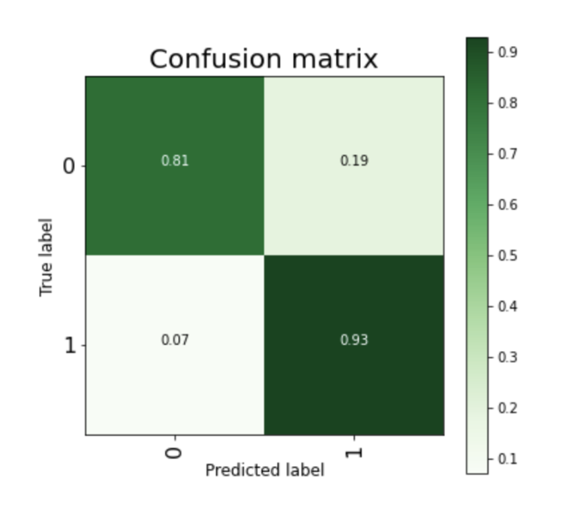
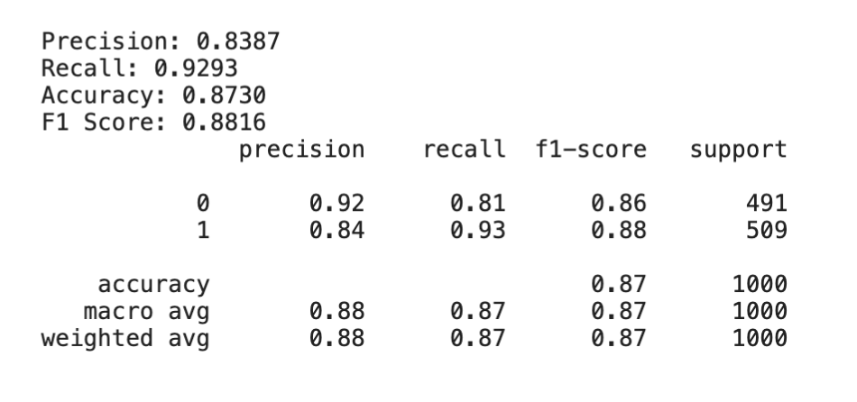
Results
0.07
Notes:
<a href="https://www.freepik.com/free-photos-vectors/background">Background vector created by freepik - www.freepik.com</a>

Slide 9
Conclusion & Future Work
Different instances were gathered from different datasets to have more various samples in the set. The samples were arranged to be the same number per class to get rid of the imbalanced data problem.
The dataset’s size can be increased by adding more positive instances about specific races, religions, entities, etc. In this way, the bias toward those entities can be reduced, and the generalizability can be improved. Also, we can reduce the harm that mislabeled data can give to the model by customizing the loss function.
Notes:
<a href="https://www.freepik.com/free-photos-vectors/background">Background vector created by freepik - www.freepik.com</a>

