Slide 1
Microwave Network Analysis

Slide 2
it is usually much easier to apply the simple and intuitive ideas of circuit analysis to a microwave problem
field analysis gives us much more information about the particular problem under consideration than we really want or need
usually we are only interested in the voltage or current at a set of terminals, the power flow through a device, or some other type of terminal quantity,

Slide 3
it is then very easy to modify the original problem, or combine several elements together and find the response, without having to reanalyze in detail the behavior of each element in combination with its neighbors

Slide 4
The basic procedure for microwave network analysis
defined and determined a voltage, current, and characteristic impedance
apply the circuit theory for transmission lines to characterize this line as a circuit element.
use the impedance and/or admittance matrices of circuit theory to relate these terminal or port quantities to each other,
arrive at a matrix description of the network.

Slide 5
IMPEDANCE AND EQUIVALENT VOLTAGES AND CURRENTS

Slide 6
Equivalent Voltages and Currents
At microwave frequencies the measurement of voltage or current is difficult unless a clearly defined terminal pair is available
Such a terminal pair may be present in the case of TEM-type lines (such as coaxial cable, microstrip line, or stripline), but does not strictly exist for non-TEM lines

Slide 7
Equivalent Voltages and Currents
Ability to define unique voltage and current
Voltage: integral of electric field
Current: integral of magnetic field

Slide 8
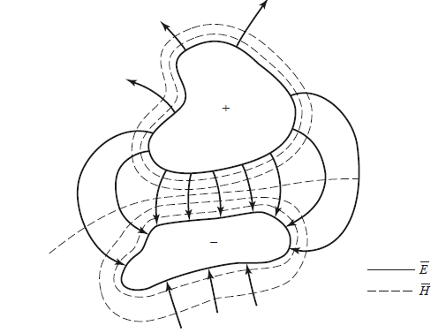
Figure shows the electric and magnetic field lines for an arbitrary two-conductor TEM transmission line

Slide 9

the voltage, V, of the + conductor relative to the − conductor can be found as
where the integration path begins on the + conductor and ends on the − conductor

Slide 10
because of the electrostatic nature of the transverse fields between the two conductors, the voltage defined in eqn. is unique and does not depend on the shape of the integration path.

Slide 11

The total current flowing on the + conductor can be determined from an application of Ampere’s law as
where the integration contour is any closed path enclosing the + conductor
(but not the − conductor)

Slide 12

A characteristic impedance Z0 can then be defined for traveling waves as

Slide 13
Defining Voltages and Currents
Voltage and current are defined only for a particular waveguide mode, and are defined so that
the voltage is proportional to the transverse electric field and the current is proportional to the transverse magnetic field.
their product gives the power flow of the waveguide mode.
The ratio of the voltage to the current for a single traveling wave should be equal to the characteristic impedance of the line.

Slide 14
Concept of Impedance
The term impedance was first used to describe the complex ratio V/I in AC circuits consisting of resistors, inductors, and capacitors
The various types of Impedances we use:
intrinsic impedance of the medium.
This impedance is dependent only on the
material parameters of the medium, and is
equal to the wave impedance for plane waves.

Slide 15

wave impedance
This impedance is a characteristic of the
particular type of wave.
3. characteristic impedance.
Characteristic impedance is the ratio of voltage to current for a traveling wave on a transmission line

Slide 16
IMPEDANCE AND ADMITTANCE MATRICES

Slide 17
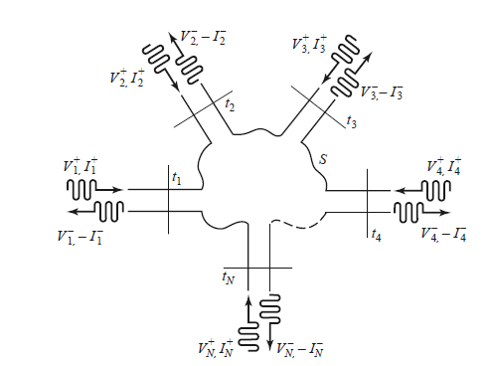
Consider and N-port microwave network

Slide 18
The ports in Figure may be any type of transmission line or transmission line equivalent of a single propagating waveguide mode.
At a specific point on the nth port, a
terminal plane, tn, is defined along with
equivalent voltages and currents for the
incident and reflected waves.

Slide 19

The terminal planes are important in providing a phase reference for the voltage and current phasor.
at the nth terminal plane, the total voltage and current are given by
when z=0

Slide 20
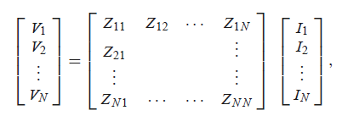

The impedance matrix [Z] of the microwave network then relates these voltages and currents:
Or in matrix form as:

Slide 21
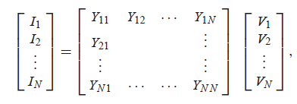

Similarly, we can define an admittance matrix [Y] as
Or in matrix form as

Slide 22

the [Z] and [Y ] matrices are the inverses of each other:
both the [Z] and [Y ] matrices relate the total port voltages and currents

Slide 23

we see that Zi j can be found as
Zi j can be found by driving port j with the current I j , open circuiting
all other ports (so Ik = 0 for k = j ), and measuring the open-circuit voltage at
port i .
Thus, Zii is the input impedance seen looking into port i when all other ports are
open-circuited, and Zi j is the transfer impedance between ports i and j when all other ports are open-circuited.

Slide 24

Yi j can be found as
which states that Yi j can be determined by driving port j with the voltage Vj , short circuiting all other ports (so Vk = 0 for k = j ), and measuring the short-circuit current at port i .

Slide 25
In general, each Zi j or Yi j element may be complex. For an arbitrary N-port network, the impedance and admittance matrices are N × N in size, so there are 2N2 independent quantities or degrees of freedom.

Slide 26
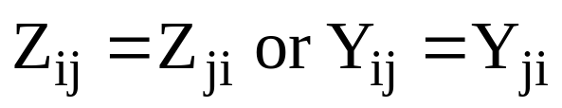
Reciprocal and Lossless Networks
Reciprocal networks usually contain nonreciprocal media such as ferrites or plasma, or active devices. We can show that the impedance and admittance matrices are symmetrical, so that.
Lossless networks can be shown that Z_{ij} or Y_{ij} are imaginary
Refer to text book Pozar pg193-195

Slide 27
An Introduction To
Two – Port Networks
wlg
Notes:
These notes were first prepared during the Spring Semester of
2002 in support of the ECE 202 course which will be changed
to ECE 300 in the Fall Semester of 2002. The material on two
Ports will be the same.

Slide 28
Two Port Networks
Generalities:
The standard configuration of a two port:
I₁
I₂
The Network
+
Input
Port
+
Output
Port
V₁
V₂
_
_
Notes:
The two port network configuration shown with
this slide is practically used universally in all text
books. The same goes for the voltage and current
assumed polarity and direction at the input and
output ports. I think this is done because of how
we define parameters with respect the voltages
and currents at the input and out ports.
With respect to the network, it may be configured
with passive R, L, C, op-amps, transformers, dependent sources but not independent sources.

Slide 29
Two Port Networks
Network Equations:
V₁ = z₁₁I₁ + z₁₂I₂
V₂ = z₂₁I₁ + z₂₂I₂
Impedance
Z parameters
I₁ = y₁₁V₁ + y₁₂V₂
I₂ = y₂₁V₁ + y₂₂V₂
V₁ = h₁₁I₁ + h₁₂V₂
I₂ = h₂₁I₁ + h₂₂V₂
Admittance
Y parameters
Hybrid
H parameters
Transmission
A, B, C, D
parameters
V₁ = AV₂ - BI₂
I₁ = CV₂ - DI₂
* notes
Notes:
The equations in light orange are the ones we will consider here. The other equations are also presented and consider in Nilsson & Riedel, 6th ed.
The parameters are defined in terms of open and short circuit conditions of the two ports.
This will be illustrated and some examples presented.

Slide 30
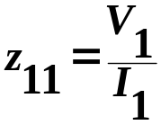

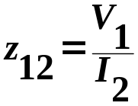

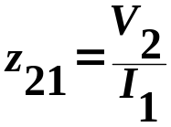
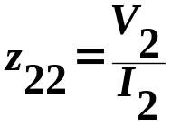
Two Port Networks
Z parameters:
z₁₁ is the impedance seen looking into port 1
when port 2 is open.
z₁₂ is a transfer impedance. It is the ratio of the
voltage at port 1 to the current at port 2 when
port 1 is open.
z₂₁ is a transfer impedance. It is the ratio of the
voltage at port 2 to the current at port 1 when
port 2 is open.
z₂₂ is the impedance seen looking into port 2
when port 1 is open.
* notes
Notes:
Z₁₁ and z₂₂ are easy to remember. We look into
the input port and calculate the impedance with
the output terminals open, if the circuit is
contains only R, L. C elements.
We do the same at the output port to find z₂₂.
However, if the network contains dependent
Sources, transformers, or op-amps, we must
find V₁/I₁ with I₂ = 0. Similarly for z₂₂
For z₁₂ and z₂₁ we still find ratios of port voltage
To port current with the opposite port open.
If you have only R, L, and C then z₁₂ = z₂₁.

Slide 31
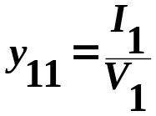

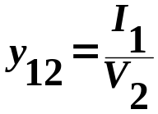

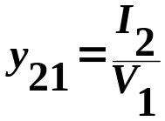
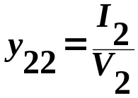
Two Port Networks
Y parameters:
y₁₁ is the admittance seen looking into port 1
when port 2 is shorted.
y₁₂ is a transfer admittance. It is the ratio of the
current at port 1 to the voltage at port 2 when
port 1 is shorted.
y₂₁ is a transfer impedance. It is the ratio of the
current at port 2 to the voltage at port 1 when
port 2 is shorted.
y₂₂ is the admittance seen looking into port 2
when port 1 is shorted.
* notes
Notes:
Similar to input and output impedance, y₁₁ and y₂₂ are determined by looking into the input and output ports with the opposite ports short circuited.
When we look for y₁₂ and y₂₁ we adhere to the above equations with respect to shorting the
output terminals.
If the circuit is not passive, we need to be careful
and do exactly as the equations tell us to do.

Slide 32
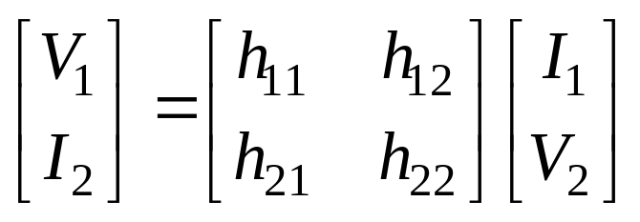
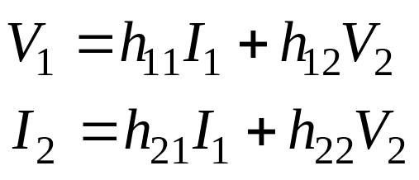
The h-parameter (Hybrid parameter)
H-parameter is the combination of Z and Y parameter defined by
or in scalar form
H-parameter is commonly used in transistor modeling.

Slide 33
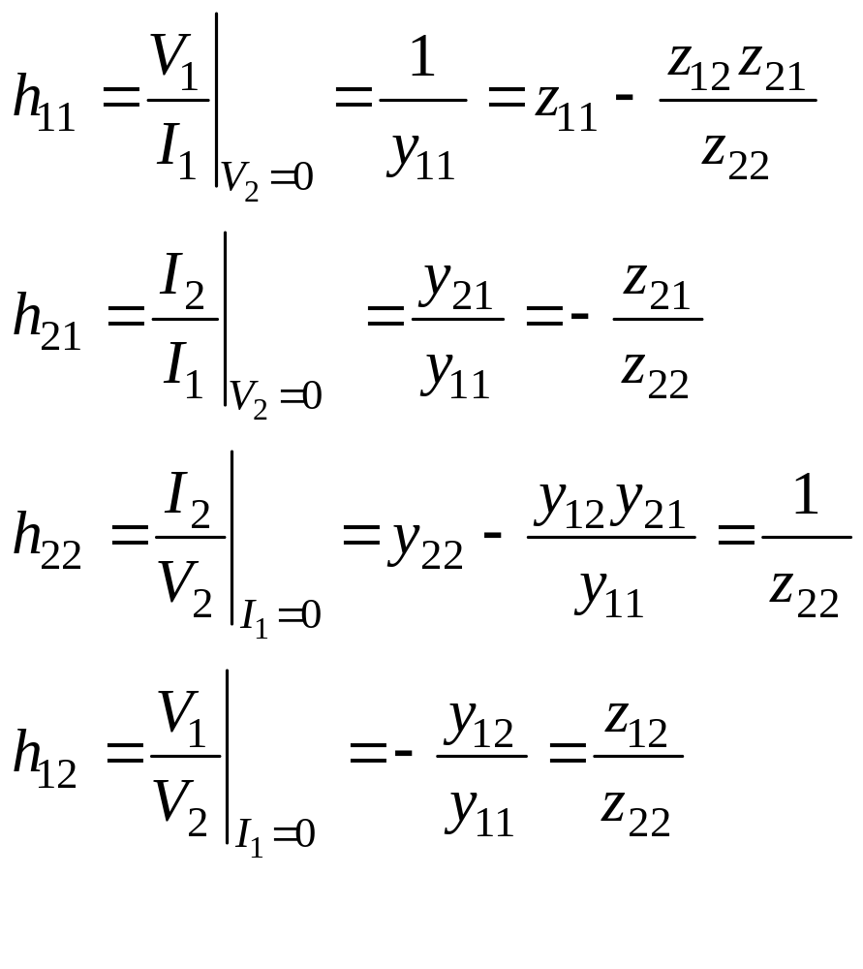
The h-parameter
The h parameters can found from

Slide 34
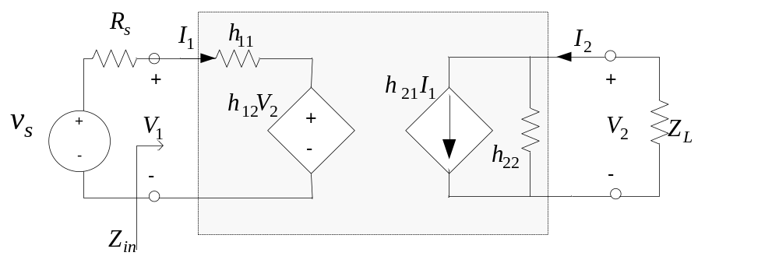
The h-parameter
Fig 17 Hybrid parameter model

Slide 35
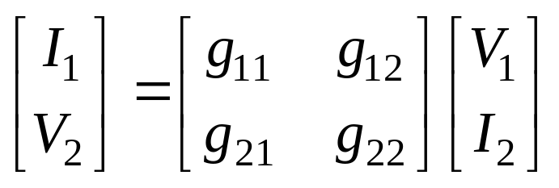
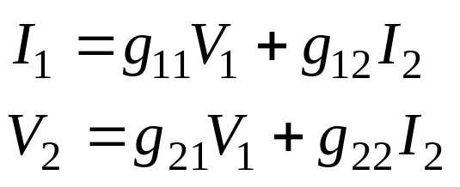
The inverse hybrid parameter
(g- parameter)
g-parameter is defined by
or in scalar form
g-parameter is an alternative form of hybrid representation.

Slide 36
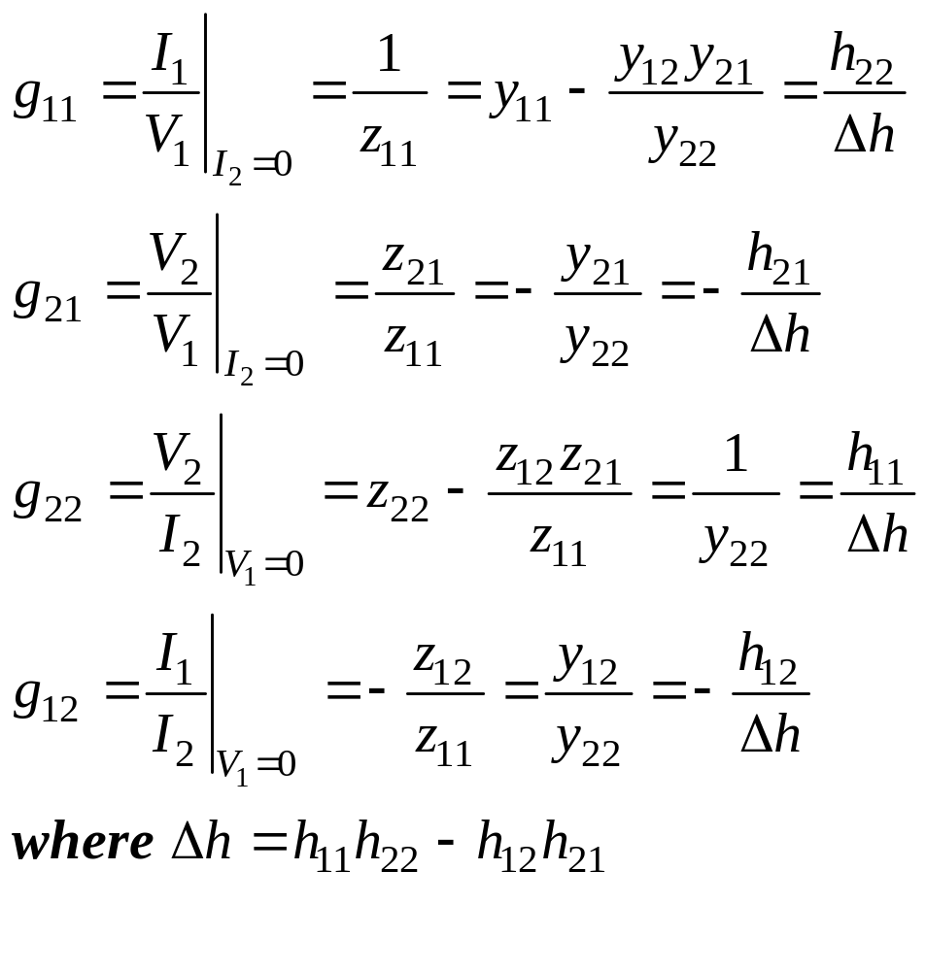
The g parameters can found from

Slide 37
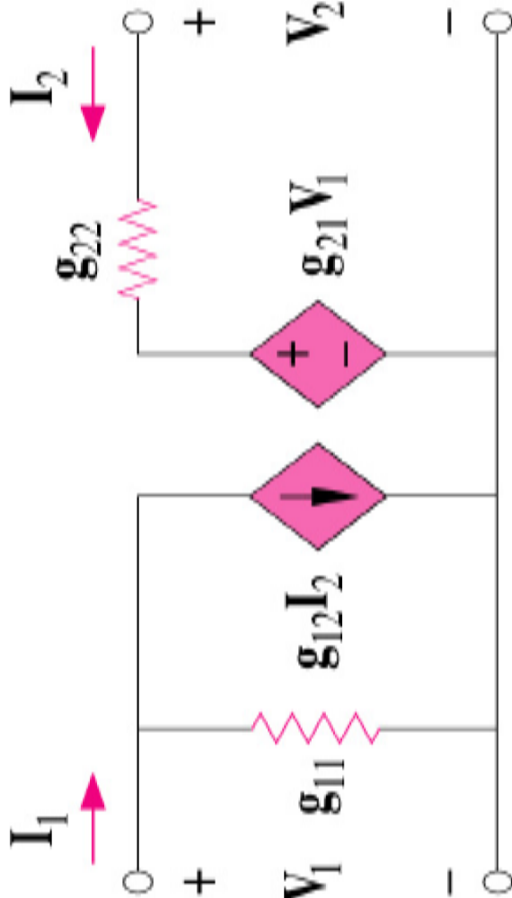
Inverse hybrid parameter model

Slide 38
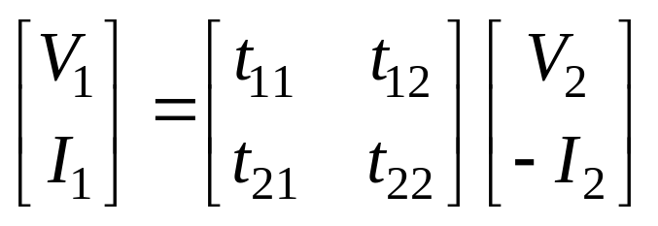
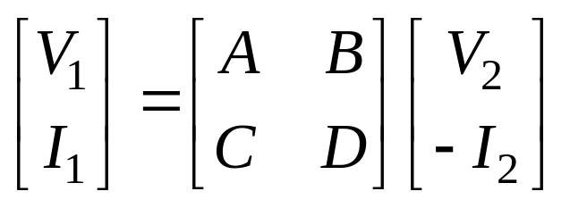
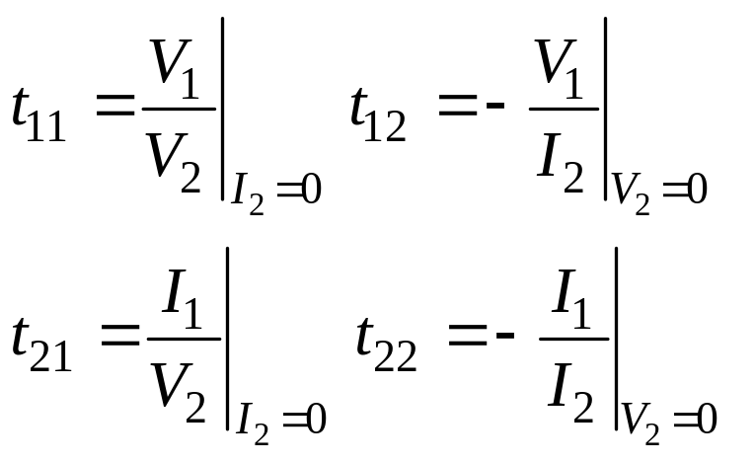
Transmission parameter
The t-parameter or transmission parameters are used in power system
and it is called ABCD parameter. The transmission parameter is defined by
or
This means that the power flows into the input port and flow out to the
load from the output port.
t-parameter can be calculated from
Open or short circuit at
the output port

Slide 39

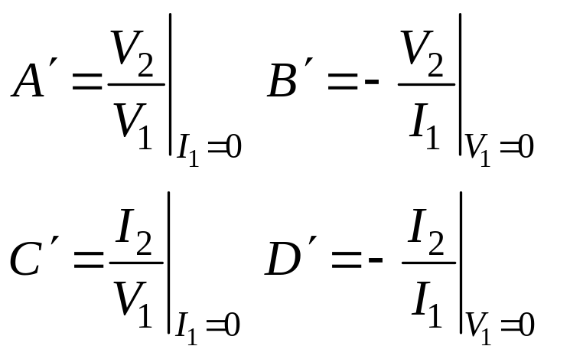
Inverse Transmission parameter

