Slide 1


FULL ADDER USING TWO HALF ADDER AND 1-BIT COMPARATOR(Xnor using Nor)
Prepared By:-
Student 1 Name: TIRTH MISTRY
Roll no: 10
Enrollment No: 22002170220019
Batch: F1 Branch: IT
Student 2 Name: NILAKSH PIMPALE
Roll no: 11
Enrollment No: 22002170220029
Batch: F1 Branch: IT
Student 3 Name: HEET SHAH
Roll no: 18
Enrollment No: 22002170220012
Batch: F1 Branch: IT

Slide 2
Project Outline
Idea that lead to the concept:
The idea behind using two half adders to create a full adder is to combine two smaller, simpler circuits to perform a more complex task. A full adder is a combinational logic circuit that is used to perform addition of three single-bit binary numbers: two operands and a carry-in bit. A half adder is a digital circuit that takes two binary inputs (A and B) and produces two binary outputs: the sum (S) and the carry (C). However, when adding three binary inputs (A, B, and C_in) to produce a sum (S) and a carry (C_out), a full adder is needed.
Using two half adders to construct a full adder allows for a simpler, modular design that can be easily expanded to handle larger inputs. It also reduces the complexity of the individual circuits, making them easier to design and test.
The idea behind the project of implementing a 1-bit magnitude comparator is to create a digital circuit that can compare the relative magnitudes of two binary numbers. The circuit takes two binary numbers, each consisting of one bit, and determines whether one number is greater than, less than, or equal to the other number.
Overall, the project of implementing a 1-bit magnitude comparator is an important step towards creating more complex digital circuits and systems that can perform advanced mathematical operations on binary numbers.
Components:
Following are the Components:
1) EX-OR GATE IC
2) AND GATE IC
3) OR GATE IC
4) NOR GATE IC
Functionality:
The user can have the following functionality:
1) FULL ADDER USING 2 HALF ADDER

Slide 3
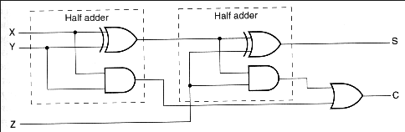
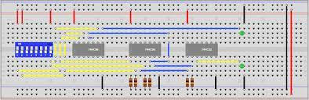
Circuit diagram/Block diagram:-
Circuit diagram of full adder using two half adder
Full adder on breadboard

Slide 4
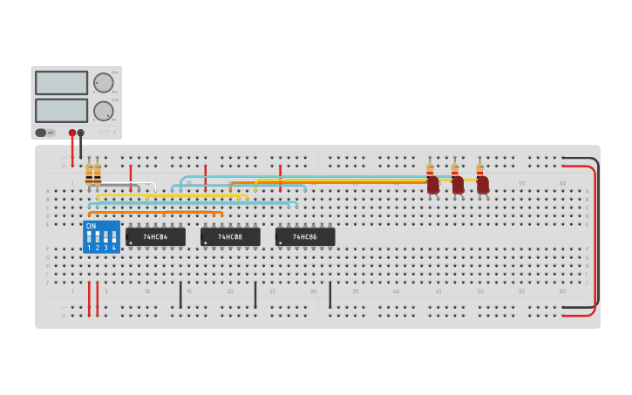
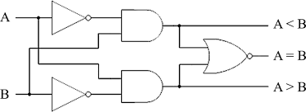
Circuit diagram/Block diagram:-
1 bit comparator
Full adder on breadboard

Slide 5
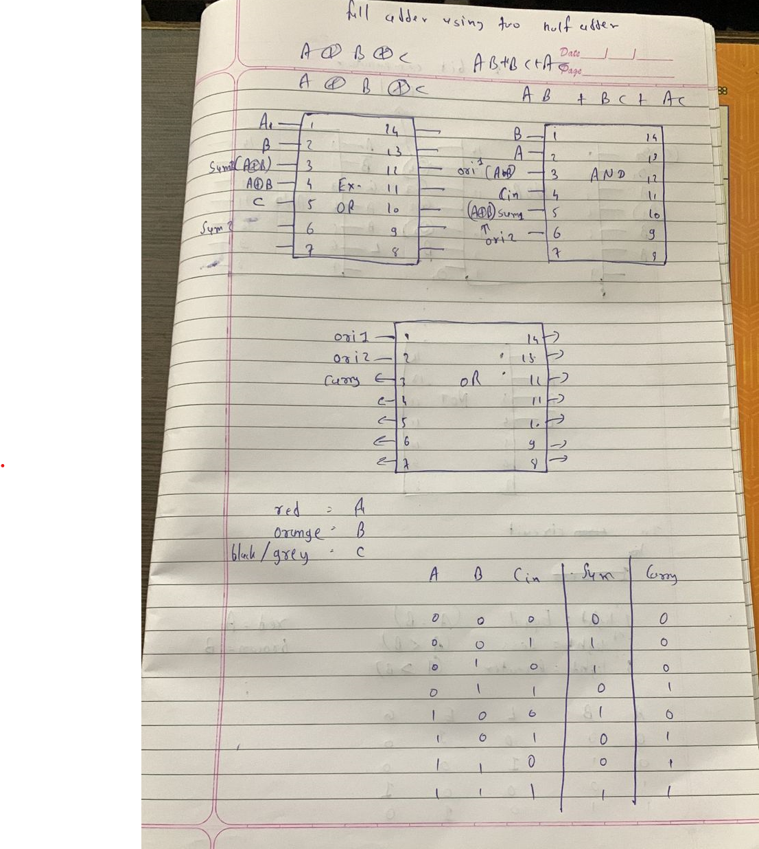
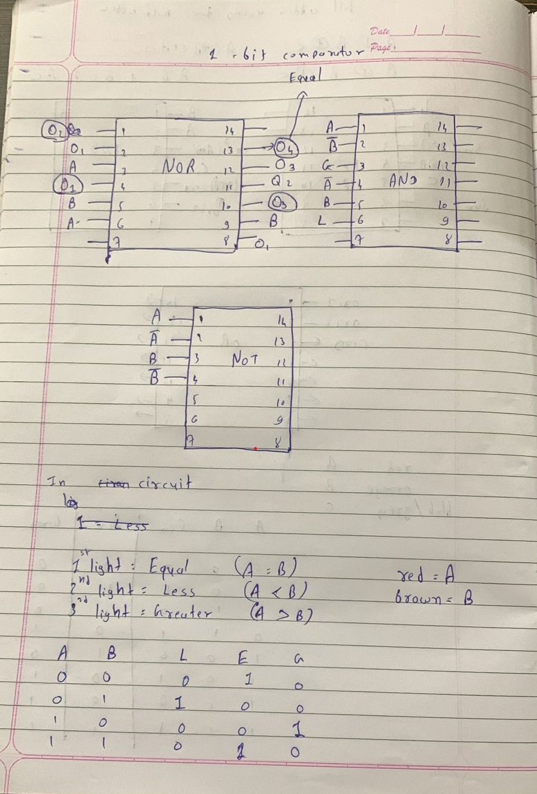
On IC Representation

Slide 6
Merits ,Demerits and Future scope
Merits:
Versatility: A full adder can be used to perform addition of two single-bit binary numbers as well as addition of multiple-bit binary numbers by cascading multiple full adders.
Accuracy: The full adder circuit is designed to accurately add binary numbers, ensuring that the output is correct.
Speed: Full adders can perform additions in a very short amount of time, making them ideal for use in high-speed arithmetic circuits.
Simplicity: The 1-bit comparator is a very simple circuit, requiring only a few logic gates to implement.
Speed: The 1-bit comparator can perform comparisons in a very short amount of time, making it ideal for use in high-speed digital systems.
Accuracy: The 1-bit comparator circuit is designed to accurately compare binary values, ensuring that the output is correct.
Demerits:
Additional components: Using two half adders instead of a single full adder requires additional components, which can increase the cost and physical size of the circuit.
Slower operation: The use of an additional OR gate to combine the carry outputs from the two half adders can slow down the overall operation of the circuit.
Reduced efficiency: The use of two half adders can be less efficient than using a single full adder, as it requires additional circuitry and can consume more power.
Limited functionality: A 1-bit magnitude comparator can only compare two 1-bit binary numbers, making it suitable for only small-scale applications. For larger applications, multi-bit comparators must be used.
References:
Deldsim
Future scope:
Integration with other circuits: The full adder circuit can be integrated with other circuits, such as memory and storage circuits, to build more complex digital systems.
Add more bit to compare in comparator.
Optimization for speed and power consumption: The circuit can be optimized for speed and power consumption by using different circuit designs, technologies, and fabrication processes.

Slide 7
THANK YOU….

