Slide 1
Medicare-for-Py
Kimra Castleton
Nilam Roy
Vasudha Gangireddy
Jazmin Hicks

Slide 2

What is Medicare?
Federal health insurance program for:
≥ 65 years
Certain disabilities in adults
Advanced kidney diseases
Medicare can cover:
Hospital
Nursing facilities and home health care
Medical Supplies
Prescriptions
Preventative Care

Slide 3

Why does it matter?
Medicare leads to better care for EVERYONE
Pays providers for quality of care not quantity.
Quality measures translate across all patient populations.
Medicare helps fight poverty
Before Medicare, seniors were most impoverished age group.
10 years of Medicare, senior poverty rates cut in half
2 examples…

Slide 4

Why we are interested?
2020 presidential election
Healthcare top issue for debate
“Medicare-for-all”
aligns U.S. with how the rest of the world provides health care to residents
arguably shown to be successful
>40 million Medicare beneficiaries
regardless of election outcomes, any change impacts large population

Slide 5

What we want to know…
How have hospital charges for Medicare-covered services changed over time?
Is there a difference in what each state charges Medicare beneficiaries to treat the same diagnosis?
How much is not covered by Medicare?
What diagnoses are Medicare beneficiaries treated for the most? Least?

Slide 6

Centers for Medicare & Medicaid Services
Data Source
Centers for Medicare & Medicaid Services
(Dept of Health and Human Services)
cms.gov
Medicare, Medicaid, Affordable Care Act, healthcare regulations, etc.

Slide 7
Data Cleanup and Exploration
cms.gov
Medicare provider information
2011-2016 flat files
2016 sufficient
limitations of government datasets
Data did not match from year to year
2014-2016 contained more information

Slide 8
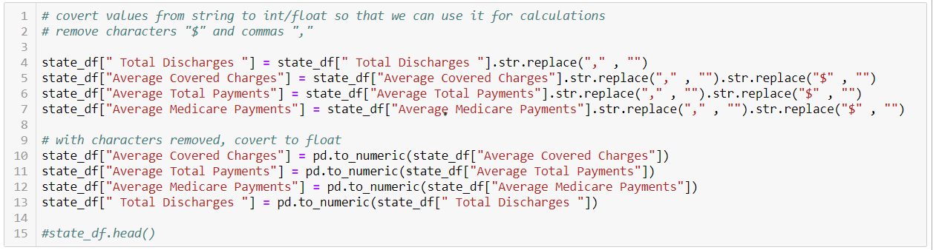
Data Cleanup & Exploration
Multiple columns contained strings.
Removed special characters
Ensured values read as floats
Discovered spaces to include in name

Slide 9
Data Analysis
*Note : some graphs compare all diagnoses while others reference a select few

Slide 10
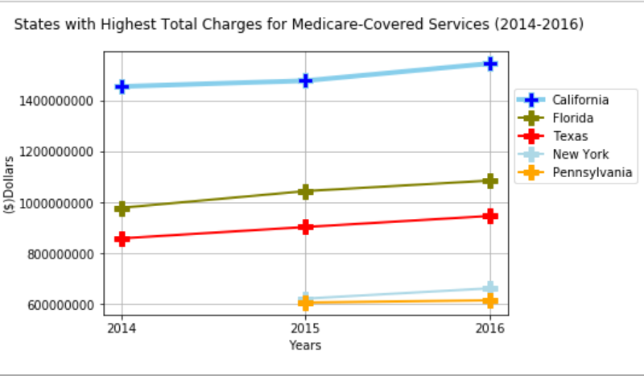
How have Medicare provider charges changed overtime?
California, Florida, Texas, New York and Pennsylvania charge the highest totals.
Correlates with highest-populated states.

Slide 11
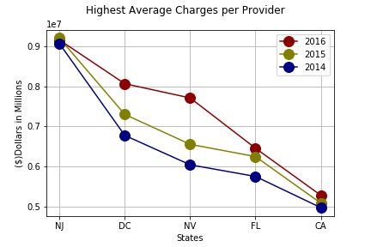
Charges overtime per provider
Average charges per provider in each state.
New Jersey ranks 11th in total discharges.
D.C. not in top 20.
Yearly increase in charges

Slide 12
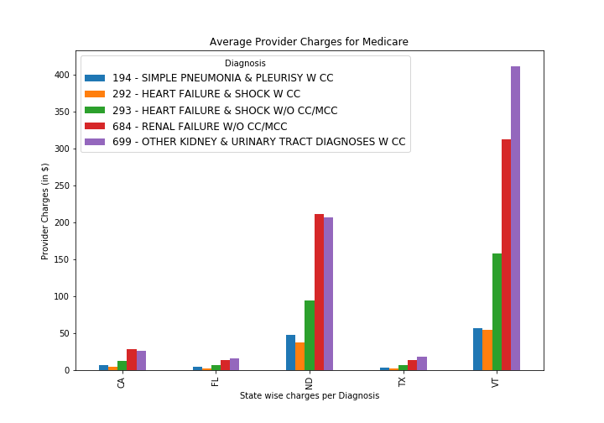
Is there a difference in what each state charges Medicare beneficiaries to treat the same diagnosis?
Comparing 5 diagnoses across 5 states:
California, Florida, and Texas providers charge similar rates for heart and renal failure diagnoses
States charge different rates to treat the same diagnosis

Slide 13
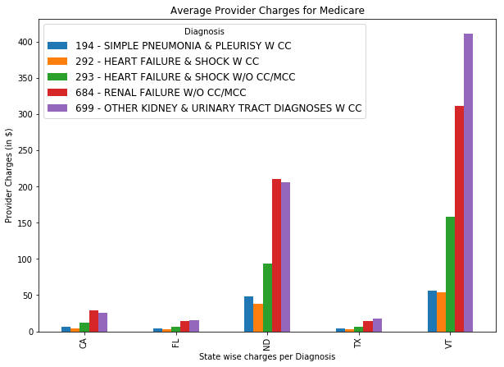
Texas Medicare Provider Charges
Charges vary for same diagnosis within same state
Hospitals individually choose what they charge patients.

Slide 14
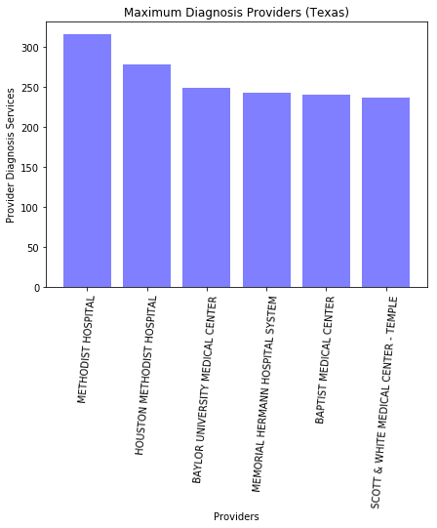
Medicare Provider Charges in Texas CONT.
Texas providers that treat the most patients
among highest frequency diagnoses
Methodist
Houston Methodist
Baylor Medical Center

Slide 15
How much is not getting covered by Medicare?
After reimbursements, how much still needs
to be paid to provider?
Only 10% of the total charges remains in Alaska (among highest frequency diagnoses)

Slide 16
Comparing 5 states >40% of total balance remains in Florida and North Dakota ~80% of the cost covered in other states

Slide 17
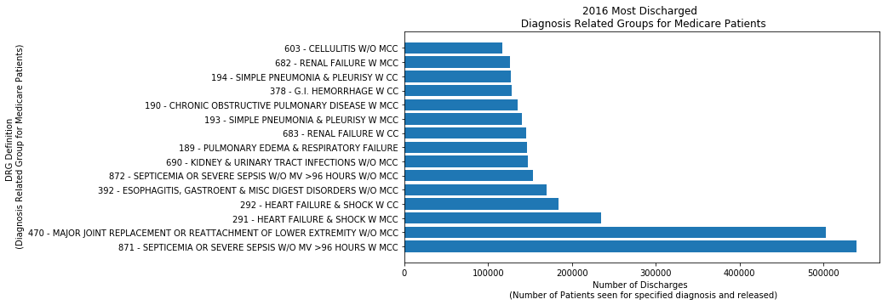
What diagnosis is being treated the most among Medicare beneficiaries?
Most common diagnoses: sepsis, joint replacement, heart failure.
Least common diagnosis: labor and delivery.
*Considering recipients are largely adults 65+ , observations expected.

Slide 18
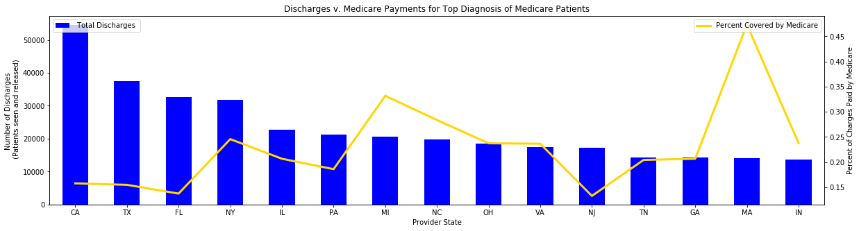
Entry Points: Most frequent diagnosis (sepsis) across different states
Most populated states = highest discharges
Results: Some reimbursements cover small fraction of total charges
Massachusetts appears to lead health care reform in reducing extra charges

Slide 19
Barriers
Data for years 2011-2013 had significantly less diagnosis information than 2014-2016.
Our team unknowingly referenced different data sources
Formatting the dataset
strings to floats
titles

Slide 20
?Additional questions?
1. What amount are patients paying?
2. What are states like Massachusetts doing differently?
3. How do public, private, and faith-based hospitals compare in cost?
4. How do charges differ by county or smaller regions (e.g. zip codes)?

Slide 21

Final Medicare Observations
Coverage varies between states and providers.
≈ 15 – 20% of total payment remains after reimbursement.
Most common diagnoses
sepsis (infection)
joint replacement
heart failure
renal failure.
Cost increased over years.

Slide 22
Questions?
U.S. Healthcare has significant room for improvement!

