Slide 1
MANAGERIAL FINANCE | CASE STUDY & FINTECH STRATEGY
Revamping SME Operations
Through Embedded Fintech
Financial Discipline, Working Capital Acceleration & Market Advantage for Sri Lankan Workshops
CASE SME: Performance Automotive Engineering (Pvt) Ltd, Piliyandala • SOLUTION: AutoPulse Platform
PRESENTERS: Group B15 • DURATION: 12 Minutes (4 Speakers + Live Demonstration Video)

Slide 2
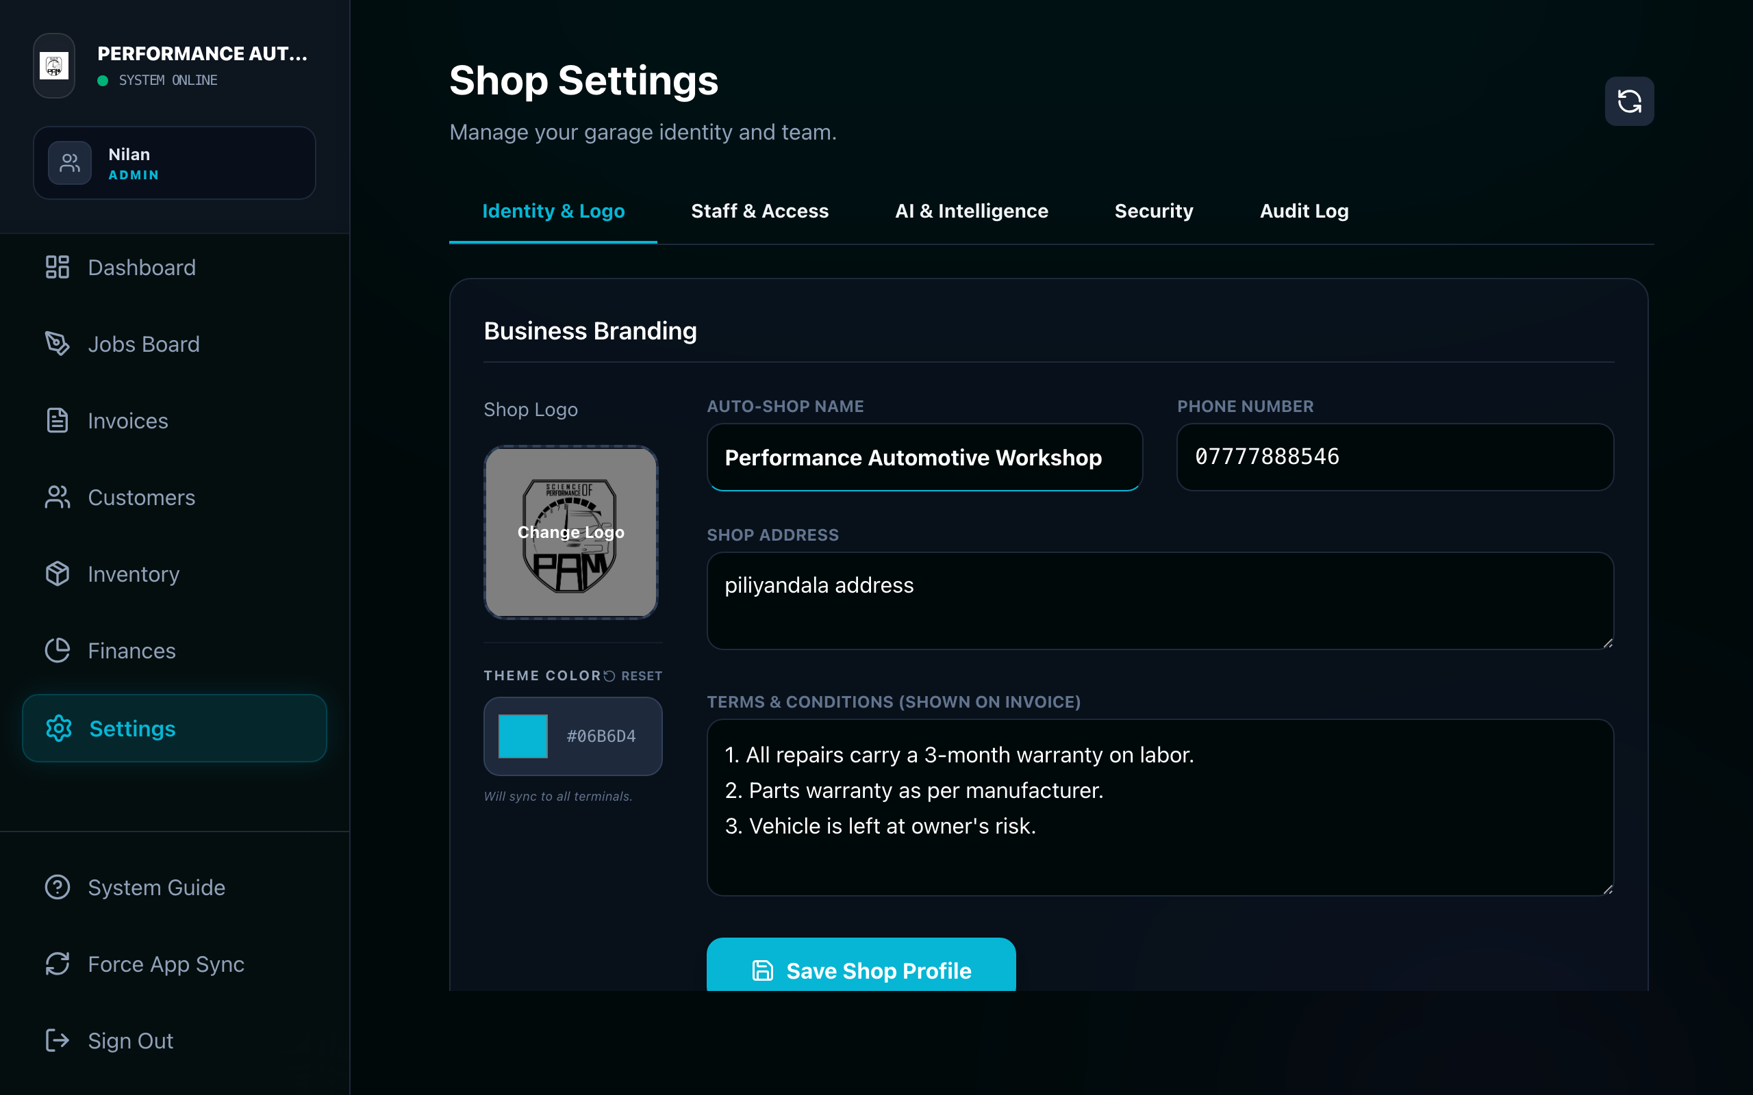
SPEAKER 1 | 0:30 - 1:15
The SME Profile: Performance Automotive Engineering
A high-value precision automotive workshop in Piliyandala, Western Province, Sri Lanka
• Specialized Niche: Not a basic lube-bay or generic service shop; focuses on advanced performance tuning, ECU remapping, engine reliability & diagnostics.
• Scale & Capacity: Services 40+ vehicles per month with a tight team of 5 skilled technicians and engineers.
• Governance Structure: Co-ownership model; owners actively work on vehicle builds while managing day-to-day administrative tasks.
• Customer Retention: High client trust, enthusiast loyalty, and strong word-of-mouth reputation in the local automotive community.
• Financial Dilemma: High technical value created on the shop floor, but captured inefficiently due to manual, paper-based administration.

Slide 3
SPEAKER 1 | 1:15 - 2:00
The Sri Lankan SME Context: Macro Volatility & Capital Strain
Why traditional informal management is no longer sustainable in Sri Lanka's current economic climate
Import Restrictions & Parts Inflation
Severe currency fluctuation and import barriers in Sri Lanka mean spare parts costs fluctuate wildly. Carrying dead stock or mispricing parts leads directly to unrecoverable margin losses.
Prohibitive Cost of Debt (>18-24%)
With commercial borrowing rates historically high in Sri Lanka, SME workshops cannot rely on bank overdrafts. Working capital must be self-generated from rapid receivables and lean inventory.
The 'Informal Management' Trap
Most Sri Lankan auto workshops rely on memory, pocket notebooks, and delayed verbal billing. Over 30% of unbilled minor parts and labour hours are quietly lost each month.
TRANSITION: Chathura will now examine the operational bottlenecks and the Fintech solution.

Slide 4
SPEAKER 2 (CHATHURA) | 2:00 - 2:45
The Operational Reality: Paper-Based Administrative Blindspots
The disconnect between high technical skill on the floor and zero visibility in the back-office
THE 4 MAJOR ADMINISTRATIVE BREAKDOWNS• Manual Paper Job Cards: Work instructions scribbled on paper grease-sheets; prone to being misplaced, torn, or incomplete.
• Telephone Call Tracking: Customers constantly call for updates, interrupting technicians and halting billable hours.
• Delayed End-of-Job Billing: Invoices manually hand-written at collection; parts prices guessed from memory, discounts unrecorded.
• Total Financial Blindness: The owner cannot tell at any given moment: What is unbilled WIP? Who owes money? Are we profitable?
MANAGERIAL FINANCE CONSEQUENCES
⚠ Revenue Leakage: 5% to 8% of consumables (fluids, clips, seals) never make it onto the invoice.
⚠ Delayed Cash Conversion: Customers take days or weeks to settle hand-written bills without digital payment links.
⚠ Distorted Unit Economics: Management cannot distinguish whether profit came from high-margin labour or low-margin parts.
⚠ Tax & Audit Vulnerability: Zero audit trail for Sri Lankan tax authorities; annual accounts assembled in chaos at year-end.

Slide 5
SPEAKER 2 (CHATHURA) | 2:45 - 3:30
The Fintech Paradox for Sri Lankan SMEs
Why off-the-shelf banking and enterprise fintech often fails small automotive workshops
TRADITIONAL FINTECH / ERP BARRIERS• POS Hardware Costs: POS terminal rentals (LKR 3,000–5,000/mo) + merchant transaction fees (2.5% to 3.5%) eat into slim parts margins.
• Complex Bank Onboarding: Lengthy KYC, corporate guarantees, and merchant approval cycles from commercial banks.
• Rigid Accounting Software: QuickBooks/Xero require accounting knowledge, separate manual data entry, and lack garage workflow.
• Capex Friction: Upfront software licenses ($500–$2,000/yr) are prohibitive for a 5-person workshop in Sri Lanka.
WHAT AUTO-WORKSHOPS ACTUALLY NEED• Zero Capex Architecture: Cloud-native web app running on existing smartphones and workshop laptops — zero new hardware.
• Embedded in Daily Workflow: Fintech must happen automatically as a byproduct of mechanics logging parts and completing jobs.
• LankaQR & Direct Settlement: Bypasses expensive card interchange fees; utilizes Sri Lanka's low-cost national LankaQR rails.
• Statutory Native (1 Apr – 31 Mar): Calculations must automatically map to Sri Lanka's Inland Revenue fiscal requirements.

Slide 6
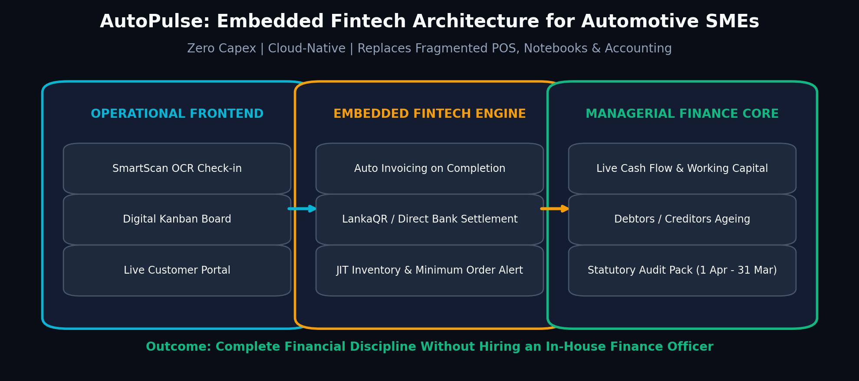
SPEAKER 2 (CHATHURA) | 3:30 - 4:30
The Solution: AutoPulse Connected Fintech Platform
Unifying shop-floor vehicle workflows, real-time inventory, and embedded managerial finance
THE UNIFIED WORKFLOW• SmartScan Check-In: On-device OCR recognizes license plate instantly; retrieves vehicle service history in seconds.
• Digital Kanban Board: Tracks status: Pending -> In Progress -> Waiting Parts -> Completed.
• Automated Invoicing: Job card automatically compiles parts and labor into a compliant digital invoice on completion.
• Omnichannel Settlement: One-click invoice dispatch via WhatsApp and SMS with payment links.
• Live Financial Dashboard: Real-time P&L, debtors, creditors, and bank balances without manual bookkeeping.

Slide 7
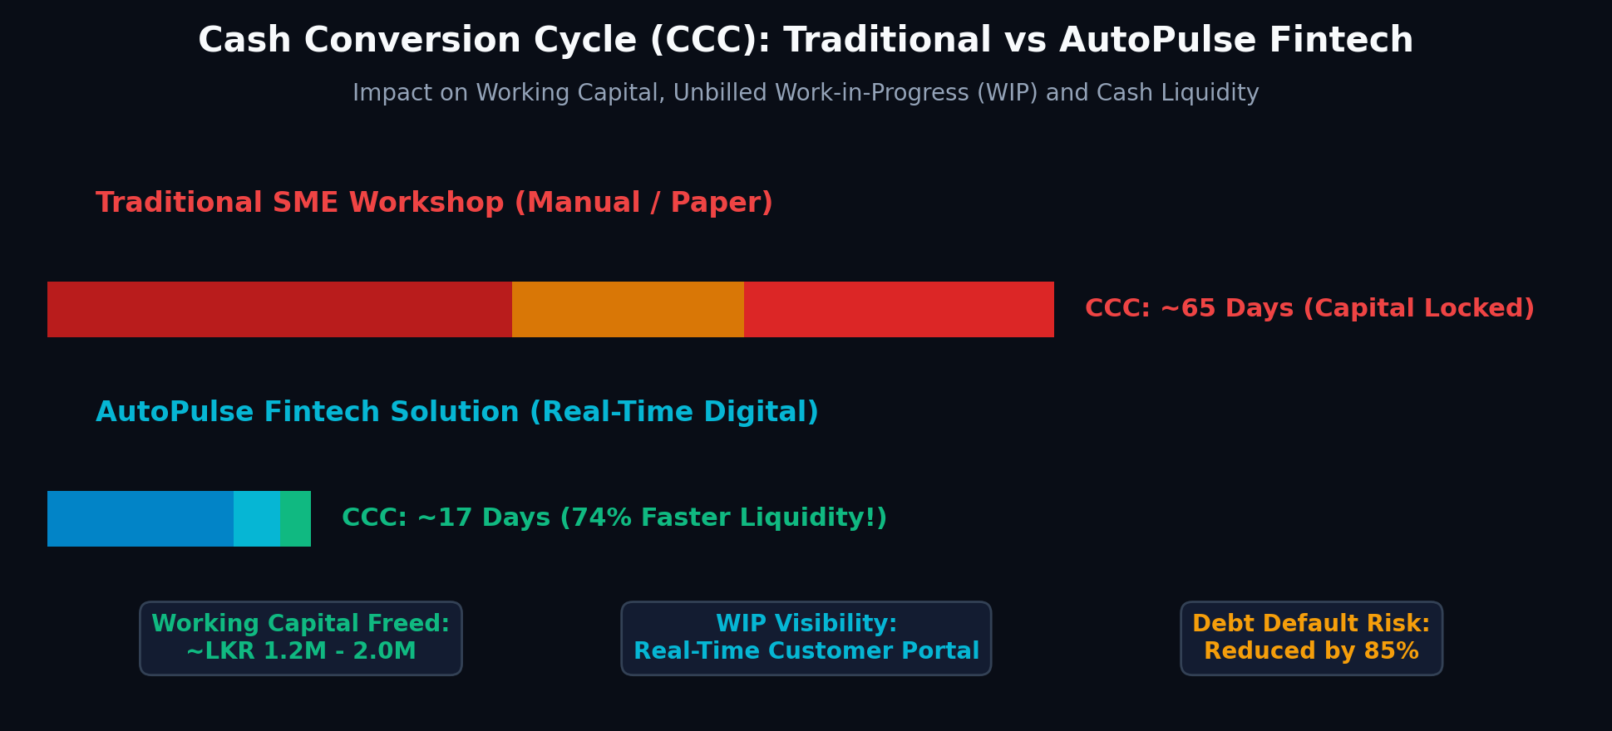
SPEAKER 3 | 4:30 - 5:15
Managerial Finance: Compressing the Cash Conversion Cycle (CCC)
Mathematical framework: Accelerating cash flow from 65 days down to 17 days
THE CCC FORMULA: Cash Conversion Cycle = Days Inventory Outstanding (DIO) + Days Sales Outstanding (DSO) − Days Payables Outstanding (DPO)
Traditional Workshop: DIO (30d) + DSO (20d) + WIP (15d) = ~65 Days vs AutoPulse Fintech: DIO (12d) + DSO (2d) + WIP (3d) = ~17 Days
WORKING CAPITAL IMPACT• Trapped Cash Released: Accelerating receivables and WIP frees ~LKR 1.5M to 2.0M in liquid operating cash.
• Zero Overdraft Need: Self-funded cash flow eliminates reliance on high-interest (20%+) emergency loans.
• Eliminated Unbilled WIP: Mechanics cannot deliver a vehicle without the system registering every fitted part.
• Debtors Ageing Alert: Real-time aging buckets identify overdue customer balances before they turn into bad debts.

Slide 8
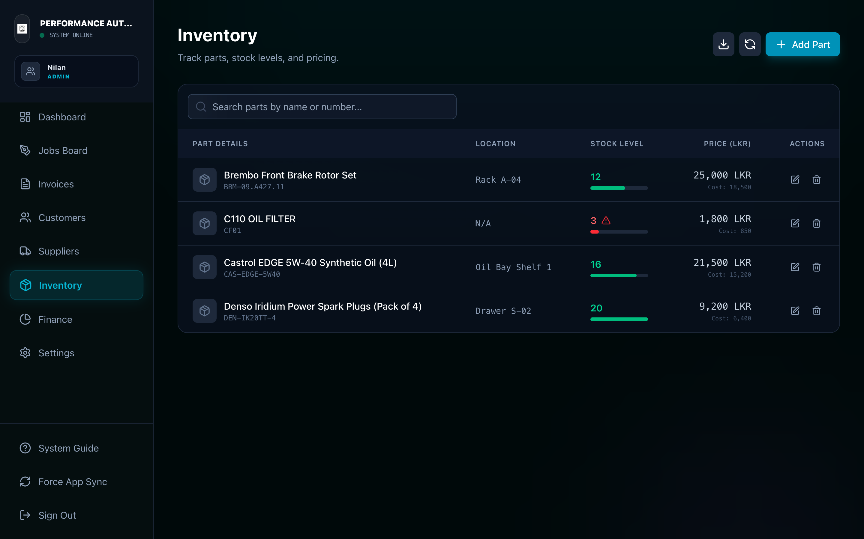
SPEAKER 3 | 5:15 - 6:00
Inventory Optimization: Stopping Working Capital Leaks
Treating parts as invested working capital, not unmonitored physical metal on a shelf
INVENTORY FINANCE PRINCIPLES• Parts Are Not Expenses: Purchasing parts swaps Cash for Stock asset; cost is recognized only when fitted to a customer's job card.
• Minimum Stock Levels (MOL): Automated threshold alerts prevent stockouts of critical consumables (filters, brake pads, synthetic oil).
• Stopping Silent Cash Bleed: Workshops restock without recording cash outflows; AutoPulse auto-reconciles stock count to ledger balance.
• Zero Negative Stock: Strict database constraints (stock >= 0) ensure no mechanic can fit a part that was never checked into inventory.
• Holding Cost Reduction: Reduces dead capital lockup by 40%, directly lowering carrying and obsolescence costs.

Slide 9
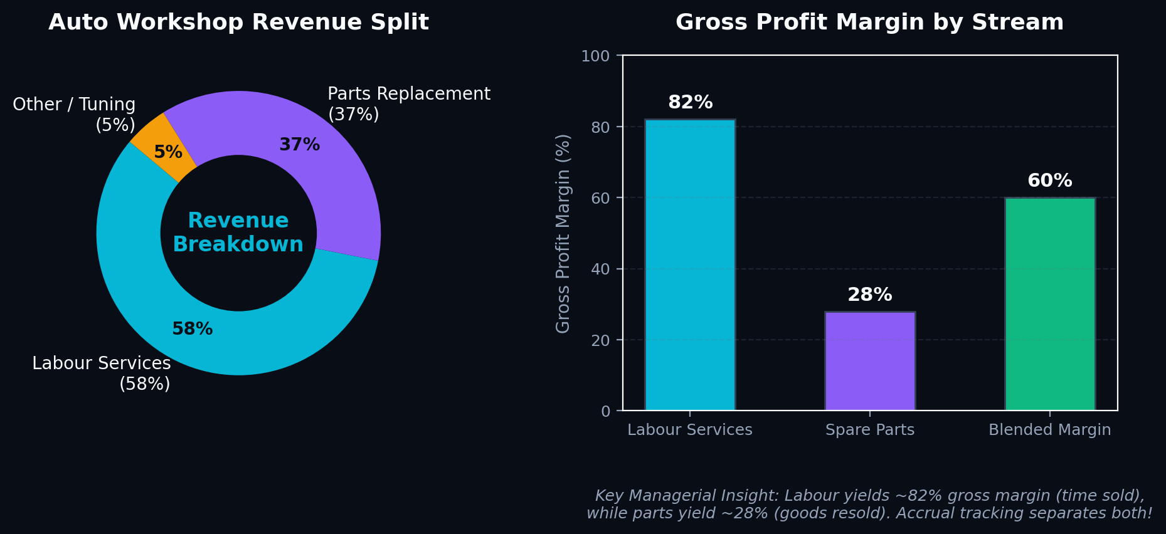
SPEAKER 3 | 6:00 - 6:45
Revenue Composition: Labour vs Parts Margin Decomposition
Why revenue must come from authoritative invoices, and why margin separation matters
STRATEGIC MARGIN INSIGHTS• Labour Is Pure Time Sold: Yields ~82% gross margin; this is the core profit driver of engineering expertise.
• Parts Are Pass-Through Goods: Yields ~28% gross margin; carries carrying risk, warranty risk, and supplier price volatility.
• The 'Free Labour' Trap Broken: Workshops often discount labour to justify costly parts; AutoPulse separates both on the invoice.
• Accrual Principle Enforced: Revenue is recognized upon job completion, while cash settlement is a separate event on its own date.
• Zero Discrepancy Books: Double-entry rules ensure debits equal credits at all times across all ledger accounts.

Slide 10
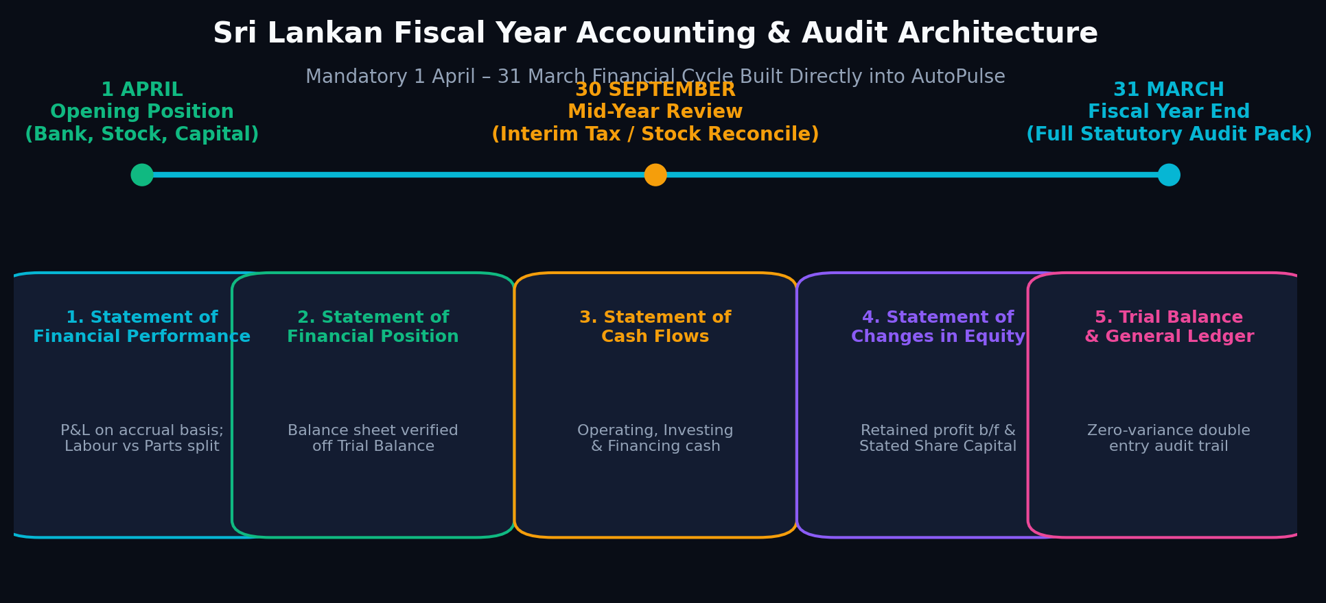
SPEAKER 3 | 6:45 - 8:00
Statutory Compliance: Sri Lankan Fiscal Year Audit Pack
Automating statutory compliance (1 April – 31 March) without hiring an expensive accountant
THE STATUTORY PACK• Financial Performance: P&L on accrual basis; separate labour & parts.
• Financial Position: Balance sheet verified off Trial Balance.
• Statement of Cash Flows: Operating, investing, and financing flows.
• Changes in Equity: Retained earnings b/f and stated capital.
• Trial Balance & Ledger: Zero-variance audit trail for tax authorities.
"In most SMEs, profit, cash, receivables, payables, and inventory live in someone's head or scattered across notebooks. AutoPulse enforces real financial discipline. It manages cash on purpose, not by accident, and makes decisions on facts, not feelings."
— Group B15 Core Managerial Finance Thesis • Enterprise control without the overhead of an in-house finance team.

Slide 11
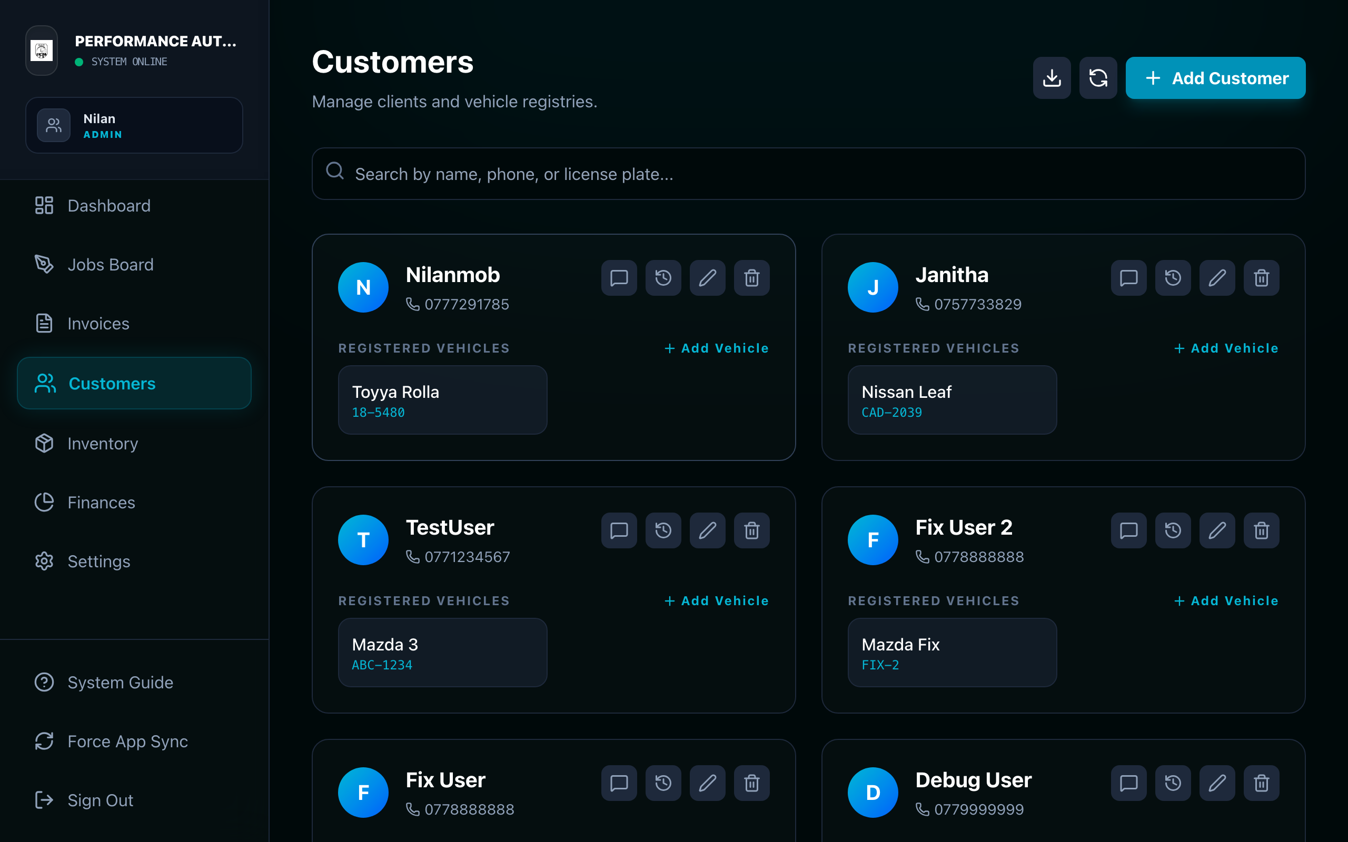
SPEAKER 4 | 8:00 - 8:45
Strategic Advantage: Customer Retention & Communication Moat
How fintech touchpoints and transparent customer tracking build high switching costs
THE 4 STRATEGIC MOATS• Radical Transparency: Live customer job status portal eliminates owner anxiety; clients see work in progress in real time.
• Frictionless WhatsApp Billing: Direct WhatsApp invoice delivery with LankaQR payment details leads to 85% same-day settlements.
• The Customer Data Asset: Complete vehicle service history, mileage logs, and past repair registries create unbeatable switching barriers.
• Supplier Credit Negotiation: Transparent payables tracking gives the workshop bargaining power for favorable credit terms.

Slide 12
SPEAKER 4 | 8:45 - 9:30
Business Resilience, ROI & Long-Term Scalability
Quantifying the financial return on investment and organizational peace of mind
Administrative Cost Savings
Saves 15+ hours per week of manual paperwork, phone coordination, and billing reconciliations.
LKR 100,000+ / mo
Equivalent to a full-time accountant saved
Working Capital Acceleration
Compressing CCC from 65 to 17 days frees up trapped capital from unbilled WIP and parts holding.
LKR 1.5M - 2.0M
Self-funded liquidity for workshop expansion
Disaster-Proof Cloud Asset
Eliminates risk of lost physical invoices or notebook destruction. Bank-grade encrypted multi-tenant cloud.
100% Redundant
Multi-device access from phone or PC

Slide 13
SPEAKER 4 | 9:30 - 10:00
Summary & Transition to Practical Demonstration
Turning passionate technicians into disciplined, data-driven business leaders
EXECUTIVE SUMMARY FOR MANAGERIAL FINANCE• Embedded, Not Imposed: Fintech succeeds in SMEs when it is invisible—built into grease-monkey workflows, not added as extra bureaucracy.
• Liquidity Over Paper Profit: Compressing the Cash Conversion Cycle guarantees real bank liquidity to withstand Sri Lanka's economic shocks.
• Statutory Peace of Mind: Automatic alignment with the 1 April – 31 March fiscal year ensures audit readiness at zero marginal cost.
• Scalable Market Advantage: Data assets, customer transparency, and digital speed transform an SME workshop into a modern market leader.
UP NEXT: 2-MINUTE DEMONSTRATION VIDEO
▶ Owner Perspective:
Hear directly from the co-owner on how real-time visibility transformed operational peace of mind.
▶ Customer Onboarding Drama:
Observe a real vehicle intake, live status tracking, and the delight of transparent digital billing.
▶ Fintech in Action:
Watch instant WhatsApp invoice generation and seamless customer collection.

Slide 14
VIDEO SHOWCASE | 10:00 - 12:00
Practical Demonstration: AutoPulse in Action
Featuring owner testimony, customer onboarding drama, and customer satisfaction
▶ VIDEO DEMONSTRATION
AutoPulse Demo: Owner Interview & Customer Onboarding Journey
Duration: 2 Minutes • Media: walkthrough/autopulse-demo.mp4
GROUP B15 • THANK YOU • QUESTIONS & MANAGERIAL FINANCE DISCUSSION

