Slide 1
AI POWERED PLACEMENT PREPARATION PLATFORM
BATCH:C22
GUIDE:Mrs.S.LINCY JEMINA
NILANI S(211422104317)
NIVETHA D(211422104328)

Slide 2
OUTLINE
The AI-powered placement preparation platform aims to improve student learning and assessment by offering personalized quizzes generated from a dynamic question pool. It integrates anti-cheating mechanisms like tab restriction and behavior monitoring, ensuring secure assessments. The platform also provides real-time feedback through an AI chatbot, enhancing user engagement. Educators can easily create and manage quizzes, track student progress, and analyze performance. The system’s architecture includes AI-driven quiz generation, secure backend processes, and user-friendly interfaces. Future enhancements may include multi-language support and machine learning for even more personalized learning experiences.

Slide 3
ABSTRACT
This AI-powered placement preparation platform is designed to transform the way students prepare for placement exams by offering personalized quizzes that adapt to individual performance using a large pool of questions covering technical and aptitude topics. The platform features advanced anti-cheating measures, such as tab-switching prevention, and includes an AI chatbot for instant feedback and real-time query resolution during quizzes. Built using the MERN stack (MongoDB, Express, React, Node.js), the platform provides faculty with secure quiz management, performance monitoring, and detailed result analysis. This system aims to streamline exam preparation, offering students an efficient, focused approach while equipping educators with valuable insights into student progress.

Slide 4
OBJECTIVE
The objective of the AI-powered placement preparation platform is to enhance the efficiency and effectiveness of placement exam preparation by offering personalized, dynamically generated quizzes. The platform aims to provide real-time feedback, advanced anti-cheating mechanisms, and interactive AI support, while also empowering educators with tools to manage and analyze student progress. By leveraging AI technology, the platform seeks to create a secure, engaging, and adaptive learning environment that caters to individual student needs and optimizes their preparation for placement exams.

Slide 5
LITERATURE SURVEY
S.NO | TITLE | YEAR | TECHNIQUES | RESULT | CHALLENGES
1. | Personalized Learning with Big Data | 2018 | Adaptive Learning | Improved student engagement and performance through personalized learning paths | Effectiveness depends on real-time feedback and content relevance.
2. | AI Applications in Education | 2019 | AI-powered content customization and feedback automation | Enhanced learning outcomes and efficient, tailored learning experiences | Difficulty in maintaining consistent content quality and personalization across large datasets

Slide 6
3. | AI-Powered Cheating Detection for Online Exams | 2020 | Machine learning algorithms for proctoring and behavior monitoring) | Improved cheating detection through AI-driven tracking systems (e.g., tab-switching, eye movement) | Integration with adaptive learning systems remains an ongoing research area
4. | AI for Personalized Education and Assessment | 2021 | AI-driven data analytics for student assessment | Identifies knowledge gaps and provides targeted interventions, improving learning outcomes | Ensuring accurate predictions for student performance in diverse learning environments
5. | AI-Driven Analytics for Student Performance | 2020 | AI algorithms for analyzing quiz results and tracking progress | Real-time tracking and personalized adjustments boost student performance | Scalability and real-time performance issues with larger datasets

Slide 7
EXISTING SYSTEM
Current placement preparation platforms, like Testbook and PrepInsta, provide static quizzes from large question banks but lack adaptability to individual performance. Adaptive learning platforms such as Khan Academy use basic AI for general education, but they are not placement-specific. Proctoring tools like ProctorU ensure exam integrity but operate separately from quiz platforms, limiting their integration with personalized learning.
DISADVANTAGES
No Personalization: Static quizzes that don't adapt to individual student needs.
Minimal AI Use: Limited AI integration for real-time feedback and dynamic quizzes.
Weak Anti-Cheating: Inadequate anti-cheating measures, relying on separate proctoring solutions.

Slide 8
PROPOSED SYSTEM
The AI-powered placement platform provides personalized, adaptive quizzes that adjust based on student performance. It uses AI for real-time feedback via chatbots and advanced anti-cheating measures like tab-switching detection. Built on the MERN stack, it ensures scalability, performance, and security.
ADVANTAGES
Personalized Quizzes: Tailored to each student’s strengths and weaknesses.
Instant Feedback: AI chatbots provide real-time assistance during quizzes.
Anti-Cheating: Integrated measures like tab-switching prevention ensure integrity.
Scalability: MERN stack ensures secure, scalable operation.

Slide 9
DEVELOPMENT ENVIRONMENT
SOFTWARE REQUIREMENT:
Operating System: Windows 10 or higher, macOS, or Linux (compatible for development) using MEARN stack.
Frontend Framework: React.js for building user interfaces.
Backend Framework: Node.js with Express.js for server-side development.
Database: MongoDB for storing and managing data.
Browser: Google Chrome or Mozilla Firefox for testing the web app.
HARDWARE REQUIREMENTS:
Processor: Intel i5 or equivalent (for smooth development and testing).
RAM: 8 GB or higher (for handling development tasks efficiently).
Storage: 100 GB SSD (for faster read/write speeds and storing necessary files).

Slide 10
MODULE DESCRIPTION
They are
User Authentication Module
Quiz Management Module
AI-Driven Content Generation Module
Real-Time Feedback Module
Performance Analytics Module
Admin Management Module

Slide 11
User Authentication Module:
Allows users to create accounts and log in securely.
Users can reset their passwords if forgotten.
Supports authentication via email verification for added security.
Manages user sessions to ensure secure access to the platform.
Quiz Management Module:
Facilitates the creation and customization of quizzes by faculty.
Enables dynamic question generation from a pool of questions.
Allows users to select quizzes based on topics and difficulty levels.
Provides options for timed and untimed quizzes.

Slide 12
Admin Management Module
Allows administrators to manage user accounts and access levels.
Provides tools for overseeing quiz submissions and tracking user engagement.
Facilitates communication with users through announcements and updates.
Supports data backup and security measures to protect user information.

Slide 13
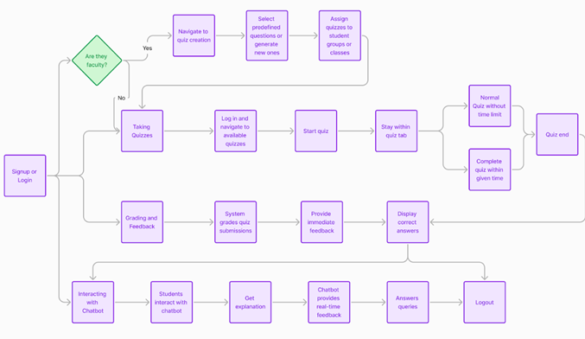
ARCHITECTURE DIAGRAM

Slide 14
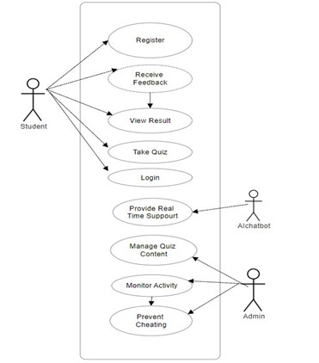
UML DIAGRAMS: USE CASE DIAGRAM

Slide 15
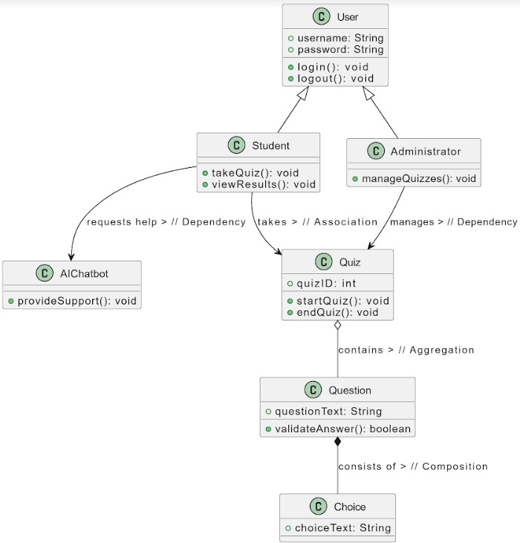
CLASS DIAGRAM

Slide 16
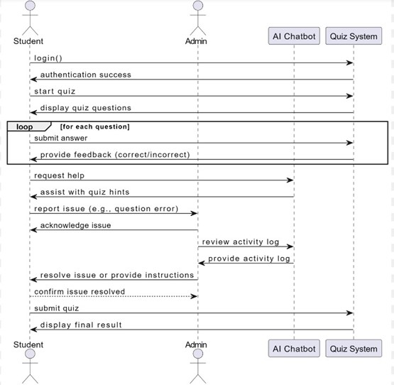
SEQUENCE DIAGRAM

Slide 17
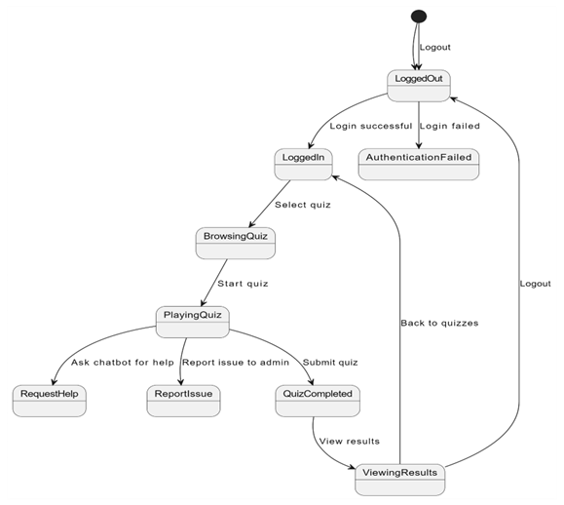
ACTIVITY DIAGRAM

Slide 18
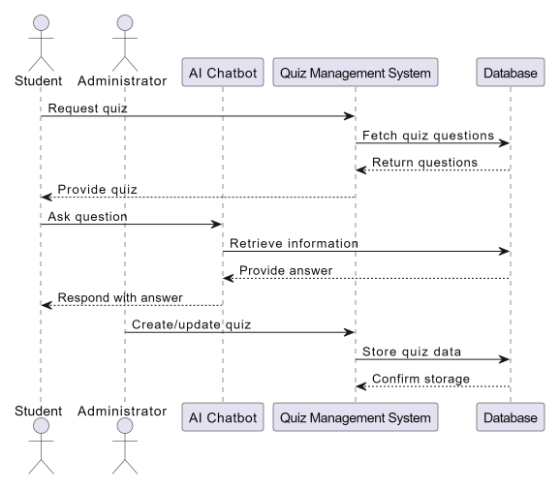
COLLABORATION DIAGRAM

Slide 19
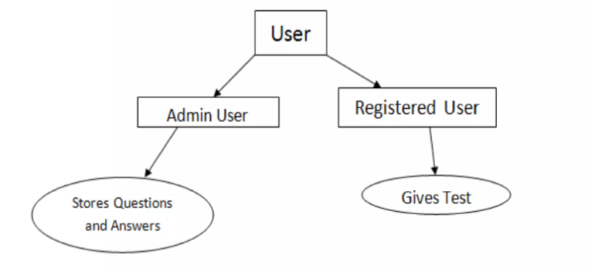
DFD DIAGRAM

Slide 20
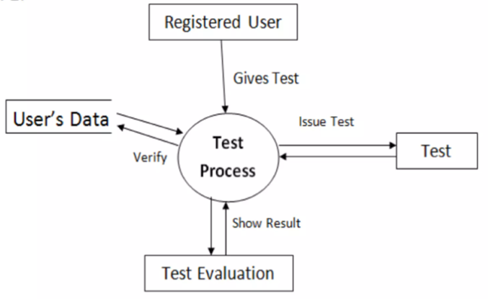
DFD DIAGRAM LEVEL 1 DFD

Slide 21
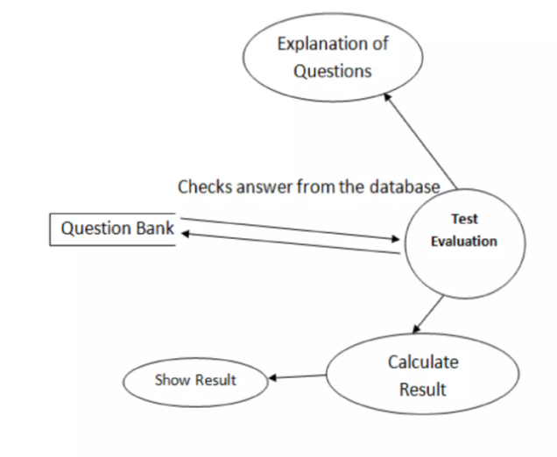
LEVEL 2 DFD DIAGRAM
1

Slide 22

HOME PAGE:

Slide 23
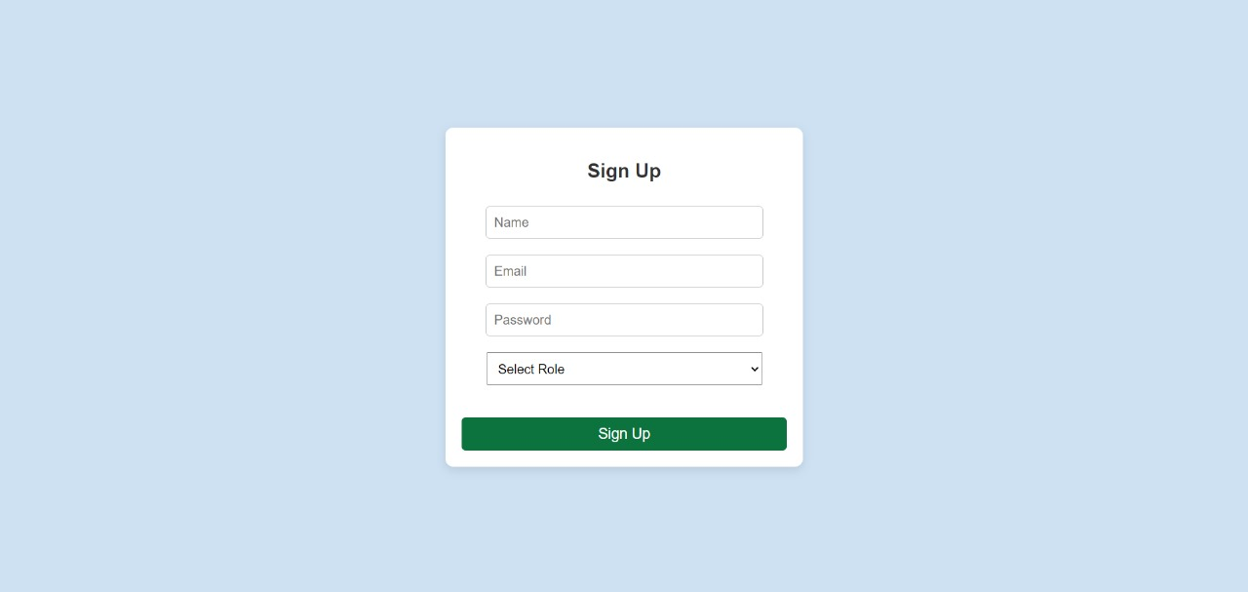
SIGNUP PAGE:

Slide 24
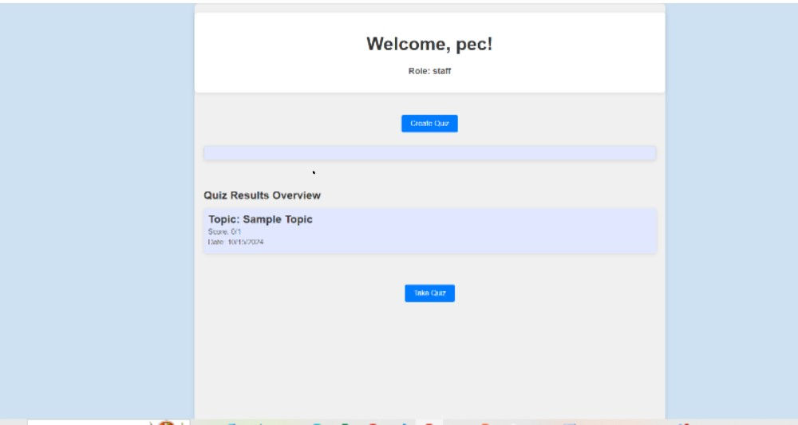
STAFF DASHBOARD:

Slide 25
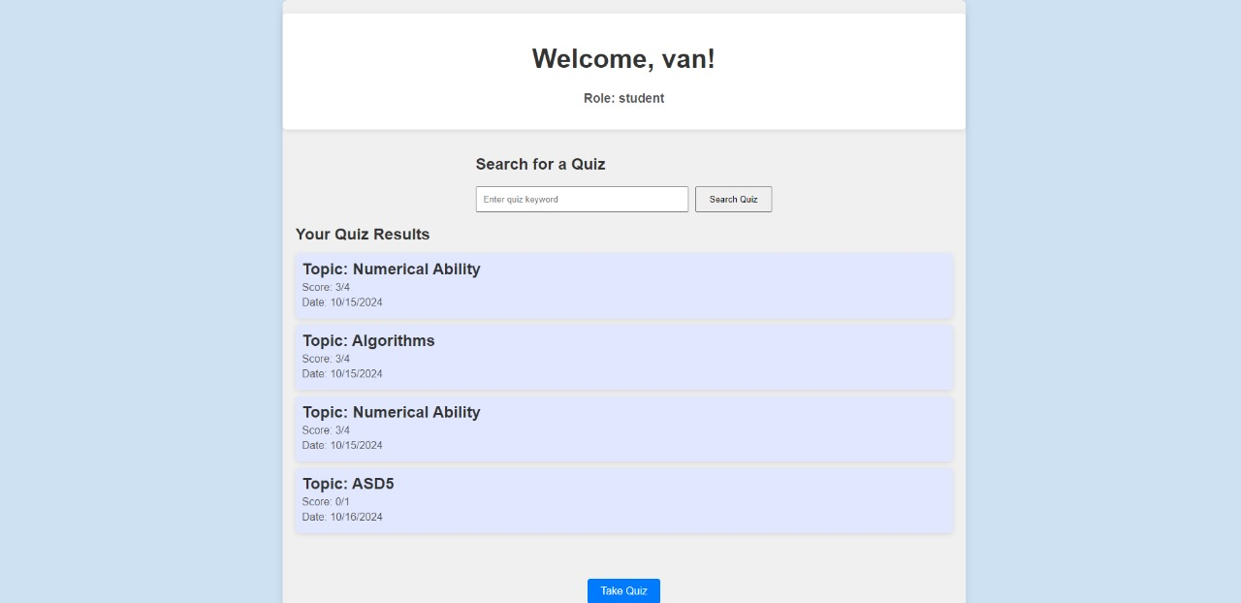
STUDENT DASHBOARD:

Slide 26
CONCLUSION
The AI-powered placement preparation platform significantly enhances student preparation for placement exams through tailored question generation and improved user experience. It outperforms competitors in key metrics, offering faster response times and personalized content.
As students navigate competitive job markets, this platform equips them with essential tools for success and fosters confidence in their preparation. Future enhancements, like adaptive learning and mobile access, will further establish it as a crucial resource for aspiring professionals, transforming the placement preparation process into a more effective experience.
FUTURE ENHANCEMENTS
Adaptive Learning: Utilize machine learning to personalize learning paths based on user performance..
Real-Time Feedback: Provide immediate performance insights to encourage continuous improvement.
Expanded Question Pool: Update the question database regularly to include the latest placement exam trends.

Slide 27
REFERENCES
Zhou, Y., & Zhang, L. (2022). Intelligent Placement Preparation System Based on Machine Learning. Journal of Educational Technology & Society, 25(4), 1-12.
Patel, D., & Desai, A. (2021). Enhancing Student Engagement in Online Placement Preparation through AI. International Journal of Computer Applications, 174(7), 17-22.
Mehta, A., & Joshi, P. (2022). AI-Driven Personalized Learning for Job Placement: A Review. Journal of Intelligent Learning Systems and Applications, 14(2), 67-75.
Srinivasan, S., & Kumari, S. (2020). A Framework for AI-Based Assessment and Placement Solutions. International Journal of dvanced Research in Computer Science, 11(4), 34-39.
Ali, S., & Khurshid, H. (2023). A Smart System for Placement Preparation Using Artificial Intelligence Techniques. Journal of C omputer Science and Technology, 38(1), 25-33.

Slide 28
THANK YOU

