Slide 1
Machine Learning Regression Model Using Spark Pipeline
Objective: Develop a regression machine learning model to predict Big Mart sales, optimizing inventory management, and enhancing decision-making for increased profitability and customer satisfaction.
Approach: Data understanding, Data preprocessing, pipeline implementation, model implementation and model evaluation.
Submitted by : Nilanjan Das
Roll No. : 28

Slide 2
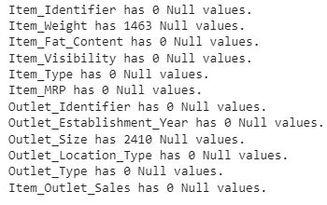
DATA DESCRIPTION
The Dataset has 8523 rows and 12 columns
2410 null values in Outlet_Size and 1463 null values in Item_Weight.
Categorical Variables:
'Item_Identifier',
'Item_Fat_Content',
'Item_Type',
'Outlet_Identifier',
'Outlet_Size',
'Outlet_Location_Type',
'Outlet_Type'
Numerical Variable :
'Item_Weight',
'Item_Visibility',
'Item_MRP',
'Outlet_Establishment_Year',
Target variable :
'Item_Outlet_Sales'

Slide 3
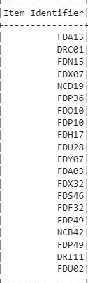
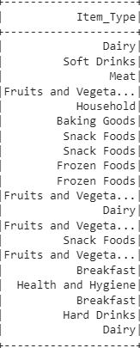
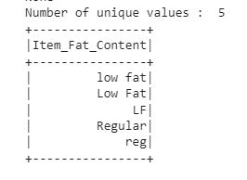
FEATURE ENGINEERING
Item_identifier ID has first two charachters defining the item type, these are FD, DR, NC means 'Food', 'Drinks', 'Non-Consumables'. Converting Item_Type into these 3 categories Food, Drinks, Non-Consumable. And repeated values in 'Item_Fat_Content' are replaced. Outlet_size and Item_Identifier are dropped as Outlet_size consists 28% null values and Item_Identifier is considered insignificant. And null values of Item_Weight has been replaced by its mean.

Slide 4
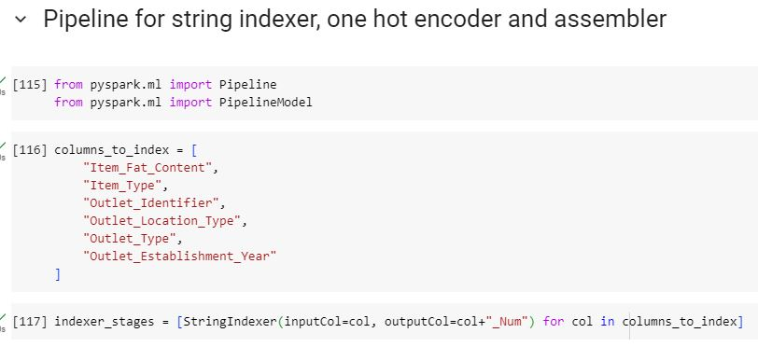
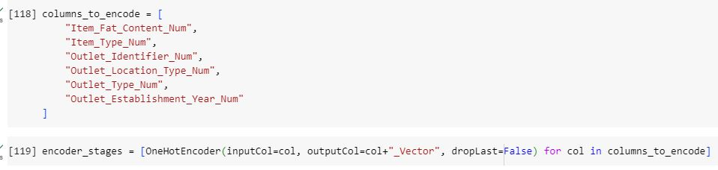
Contd.

Slide 5
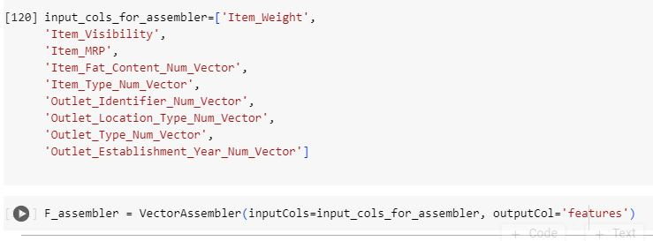
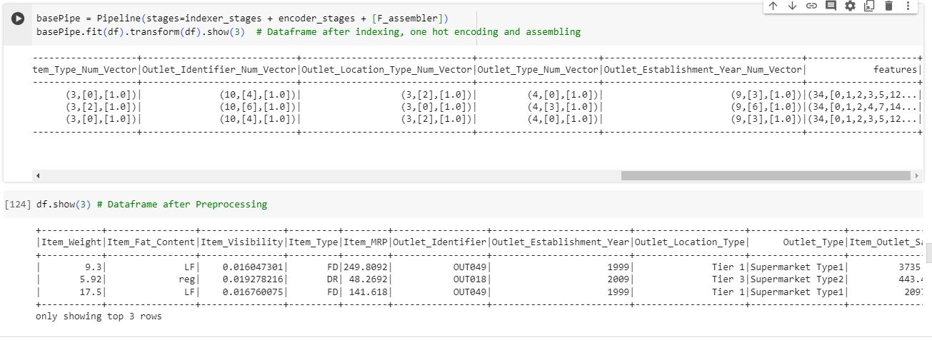

Slide 6
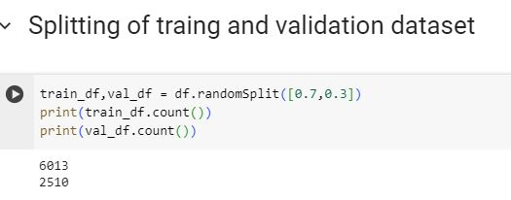
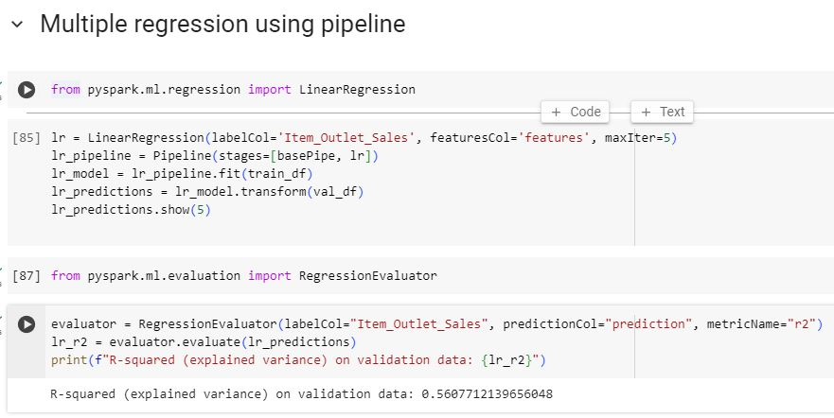

Slide 7
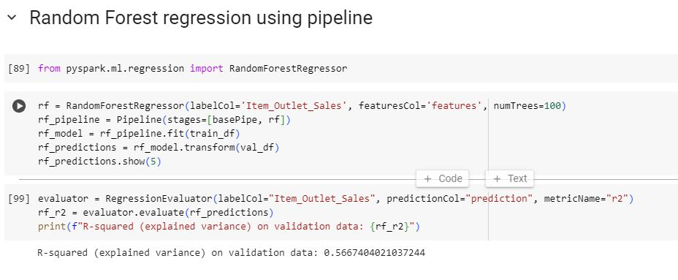

Slide 8
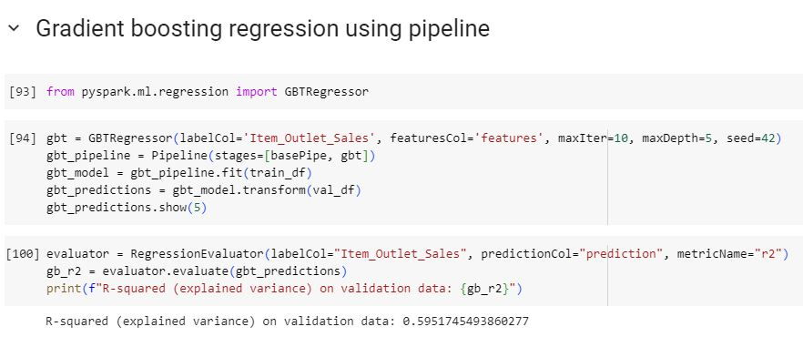

Slide 9
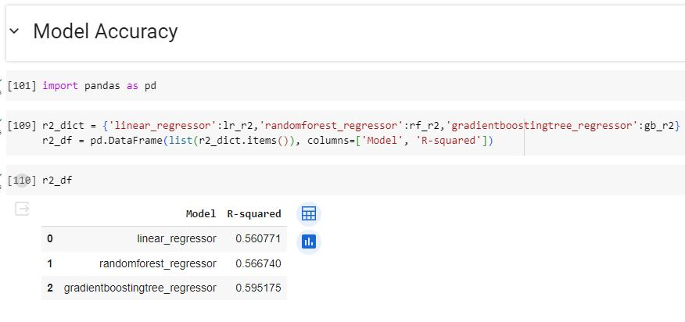
The gradient boosting regression tree gives better accuracy (R-square) result than others. Also the accuracy level can be improved by better data preprocessing with domain knowledge.
The implementation of the regression machine learning model for predicting Big Mart sales holds the potential to revolutionize inventory management strategies, leading to enhanced decision-making. This approach not only contributes to increased profitability through optimized stock levels but also fosters improved customer satisfaction by ensuring product availability and efficient supply chain operations.

Slide 10
Thank You

