Slide 1

Heart Disease Prediction system
COER UNIVERSITY
Title :-
SUPERVISER :- Ms. SANDHYA SAMANT
Submitted By:
NILANSH KUMAR

Slide 2
Table of contents
01
04
02
05
03
06
Introduction
Data cleaning
Problem statement
Technology used
Data Selection
Conclusions

Slide 3
Introduction
Heart disease predictor is an offline platform designed and developed to explore the path of machine learning. The goal is to predict the health of a patient from collective data, so as to be able to detect configurations at risk for the patient, and therefore, in cases requiring emergency medical assistance, alert the appropriate medical staff of the situation of the latter.
We initially have a dataset collecting information of many patients with which we are able to conclude the results into a complete form and can predict data precisely. The results of the predictions, derived from the predictive models generated by machine learning, will be presented through several distinct graphical interfaces according to the datasets considered. We will then bring criticism as to the scope of our results.

Slide 4
Problem Statement
Machine learning allows building models to quickly analyze data and deliver results, leveraging the historical and real-time data, with machine learning that will help healthcare service providers to make better decisions on patient's disease diagnosis.
By analyzing the data we can predict the occurrence of the disease in our project. This intelligent system for disease prediction plays a major role in controlling the disease and maintaining the good health status of people by predicting accurate disease risk.
Machine learning algorithms can also be helpful in providing vital statistics, real-time data and advanced analytics in terms of the patient's disease, lab test results, blood pressure, family history, clinical trial data, etc., to doctors.

Slide 5
Data Collection
Data has been collected from Kaggle.
Data collection is the process of gathering and measuring information from countless different sources. In order to use the data we collect to develop practical artificial intelligence (AI) and machine learning solutions, it must be collected and stored in a way that makes sense for the business problem at hand.
What is Kaggle?
KAGGLE is an online community of data scientists and machine learners, owned by Google LLC. Kaggle allows users to find and publish data sets, explore and build models in a web-based data-science environment, work with other data scientists and machine learning engineers, and enter competitions to solve data science challenges.

Slide 6
Data Cleaning
Data Cleaning is essentially the task of removing errors and anomalies or replacing observed values with the true values from data to get more values in analytics.
Methods
Get rid of extra space
Select and treat all blanks cells
Remove Duplicates
Highlight errors
Spell check
Delete all formating

Slide 7
Attributes used
Age
(Restecg)
Gender
Angina(Exang)
Chest Pain(cp)
Blood pressure
Cholestrol
Fasting Blood sugar
Heart Rate
Resting Electrocardiographic
Thalassemia

Slide 8
Technology Used
Python Libraries :-
Pandas
Numpy
Sklearn
Models :-
Logistic Regression
Support vector machine
Knearest neigbours

Slide 9
Testing Technologies
Anaconda(Python) –
Anaconda is a free and open-source distribution of the Python and R programming languages for scientific computing, that aims to simplify package management and deployment.
Jupyter Notebook –
The Jupyter Notebook is an open-source web application that allows you to create and share documents that contain live code, equations, visualizations and narrative text. Uses include: data cleaning and transformation, numerical simulation, statistical modeling, data visualization, machine learning, and much more.

Slide 10




Data Flow Diagram
USER LOGIN
UPLOAD INPUT DATA
UPLOAD FILES
PREDICT HEART DISEASE
USER LOGIN
STORE IN DATABASE
PRE-PROCESSING DATA
DATABASE
ADMIN CAN PREPARE THE DATA FOR ANALYSIS
UPLOAD TRAINING DATA
ADMIN

Slide 11
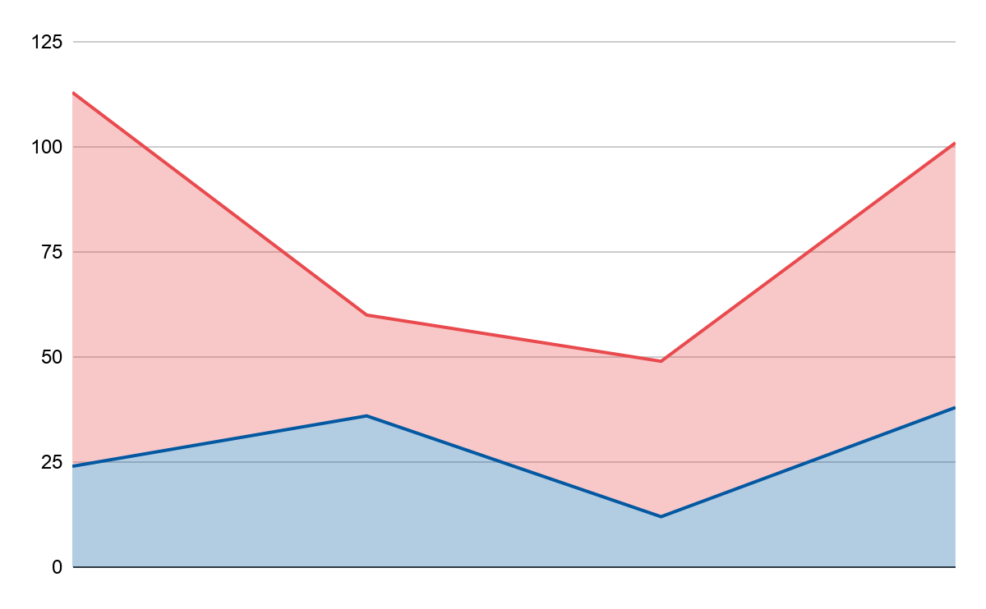
Risk Factors
Evolution
Prevalence
Male
70%
Female
30%
Male
Female

Slide 12
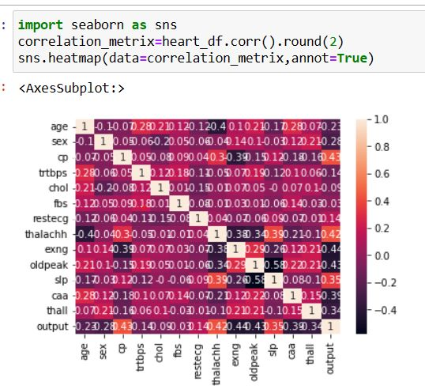
Graphical Representation :-

Slide 13
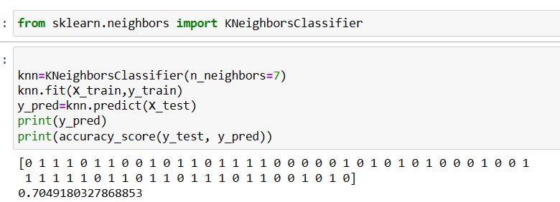
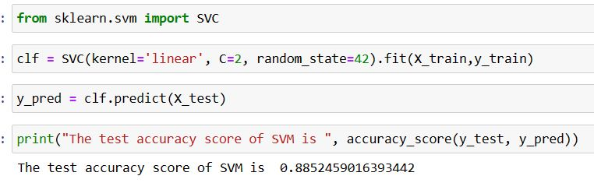

Slide 14
Thank you

