Slide 1
ATDRPS
Advanced Threat Detection and Reinforcement Protocol System
A world model for network attack forecasting
Every IDS asks
ATDRPS asks
"Is this flow malicious?"
"Where is this network heading?"
It learns P(S t+1 | S ≤t) over network state and rolls it forward K steps — so a scan that is still only a scan can be read as a trajectory toward compromise.
Recon
>
Initial
Access
>
Lateral
Movement
>
Command
& Control
>
Exfiltration
Smart India Hackathon 2026 · PS 26153 · NTRO · Team Bell Labs, Lloyd Institute of Engineering & Technology
Notes:
A conventional IDS classifies one flow at a time and throws away time. Infiltration is a process, not a packet. ATDRPS models how network state evolves and forecasts forward.

Slide 2
From packets to a network state
Dual-level features, because flow records erase exactly the evidence the hard cases need
1
PCAP / CSV
2
Flows
3
Features
4
State Sₜ
→
→
→
in-tree pcap + pcapng
parser — no scapy
5-tuple assembly,
idle + active timeouts
NetFlow aggregates
+ packet statistics
30 s window →
103-dim vector
What one window contains
Measured separation
Volume and shape (22) — rates, distinct hosts and ports, direction, concentration
Distributional aggregates (60) — mean, spread and peak of 20 per-flow features. Spread is the signal: beacons have near-zero timing variance
Behavioural detectors (21) — ports swept per pair, beacon regularity, worm fan-out, half-open ratio, DNS query size, TTL inconsistency
feature
benign
attack
max ports per pair
1.3
22.8
port scan
same-port fan-out
0.79
1.89
worm
half-open ratio
0.00
0.80
SYN flood
beacon regularity
0.66
0.92
C2 beacon
DNS query size
4.29
5.39
DNS tunnel
TTL inconsistency
0.001
0.104
MitM
Of the 18 attacks in our taxonomy, 9 are modelled as stages with generated training data, 6 are caught through their consequences, and 3 need a different sensor — and we say which.
Notes:
The problem statement asks for flow and packet features combined. This is where they are combined, and the table shows the separation each level buys.

Slide 3
The world model
One encoder, three heads, and a forward simulation
Temporal transformer
K-step forward simulation
L = 16 context windows · d_model 128 · 4 heads · 3 pre-norm blocks
predict → append → re-predict. Errors compound, and they should — a model equally confident at step 5 as step 1 is lying about what it knows.
next-state Δ
how the state changes — the dynamics target
S t+1
S t+2
stage head
S t+3
S t+4
MITRE ATT&CK stage of the next window
S t+5
infiltration head
confidence decays with distance
probability infiltration is underway next
Predicted states are clamped to the range training data covered, so a simulation cannot wander into states no network has ever produced.
Training all three together is the point. The stage head alone is a classifier with extra steps; making one representation also reconstruct the next state is what forces it to learn dynamics.
The fix that made it work: predict the change, not the state
Regressing the absolute next state looked fine in unit tests. Rendering the first live forecast exposed it: five steps read 1.00, 0.00, 0.00, 0.99, 1.00. Ridge shrinks toward zero, so a regularised model predicts the mean state — and feeding mean states back into the context made the heads swing between extremes. Predicting S t+1 − S t makes shrinkage mean "nothing changes", which is the right prior for network state. False-positive rate fell from 0.134 to 0.071.
Notes:
Residual dynamics. Found by building the dashboard and looking at a real forecast, not by a unit test. Halved the false positive rate.

Slide 4
Results
Held-out captures — train and test share no window, no flow, no campaign. Thresholds chosen on validation.
False-positive rate
0.071
vs 0.166
snapshot classifier
Is it really a world model?
Next-state error against the persistence floor. A model that wins on F1 but cannot beat "assume nothing changes" has learned a classifier, not dynamics.
0.611 world model
1.006 persistence
It leads at every horizon step, and halves the false-positive rate
The world model leads at every step, and it more than halves the false-positive rate of the snapshot classifier the problem statement criticises — 0.071 against 0.166. A static classifier has nothing to extrapolate from; a learned transition model does. The weakest class is Impact, F1 0.500 on 32 test windows: too rare in this corpus to learn well, and reported rather than hidden.
Notes:
Every model sees identical sequences, splits and features. Thresholds chosen on validation and applied unchanged to test.

Slide 5
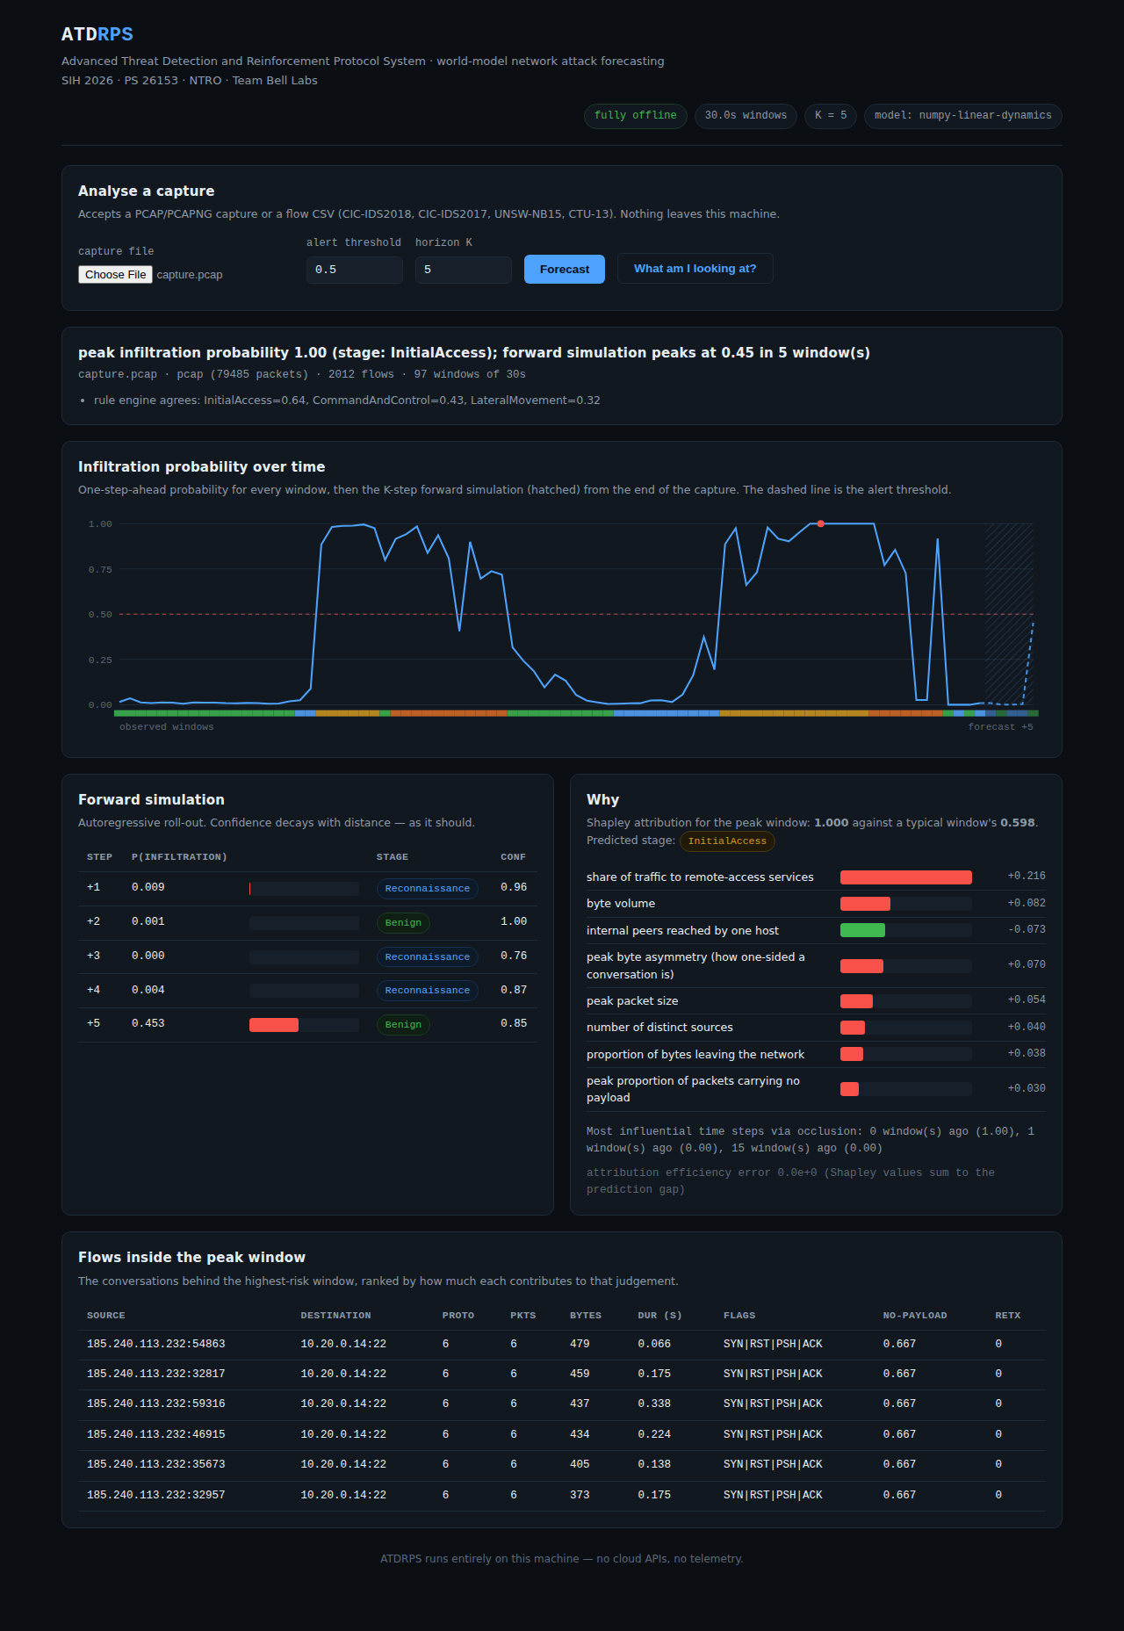
Explainable, and it runs in an air-gapped network
Both are requirements, not features — and both shaped what we were willing to depend on
What drove it
Grouped KernelSHAP over the 96 features — written in-tree, verified against closed-form Shapley values to 1.2e-05. Reported in plain language: "share of traffic to remote-access services +0.216".
When it came from
Attention across the 16 context windows, with model-agnostic occlusion as a cross-check — so every backend is explainable, not just the transformer.
Why no scapy, no shap
CII networks are air-gapped. ATDRPS ships its own pcap/pcapng parser and its own KernelSHAP, so there is one less supply chain to vet and patch. No cloud API, no telemetry, no runtime download.
The offline dashboard: risk timeline, forward simulation, Shapley drivers and the flows behind the peak window. 79,485 packets to rendered result in 3.9 seconds.
215 tests · standard library only · MIT licensed · reproducible from (config, dataset, seed)
Notes:
Explainability is mandatory in the problem statement. The offline constraint is what drove us to implement the pcap parser and KernelSHAP ourselves.

