Slide 1


Project ‚BRFC‘ Behavior Risk Factors & Cancer
nilapalin
Agnes Thanbichler

Slide 2
Setting the context

Slide 3
Setting the context
Get the idea
Cancer among leading causes of deaths
Behavioral risk factors for cancers rising: obesity, physical inactivity, diet
at least 13 types of cancer related to overweight or obesity
Lets combine cancer and behavioral risk factor datasets
and show a connection!
https://www.cancer.gov/about-cancer/causes-prevention/risk/obesity/obesity-fact-sheet

Slide 4
Hypotheses

Slide 5
Hyoptheses
Get the idea - be more precise
Behavioral risk factors
are influencing the chance to develop cancer
are influencing the chance of mutation(s) in genes which are related to obesity (and cancer)

Slide 6
What data?

Slide 7
BRFSS | GDC
Open data from the U.S.
BRFSS - Behavioral Risk Factor Surveillance System
Health surveys collecting data about United States residents, run by the Centers for Disease Control and Prevention.
BRFSS FAQ
Comma separated values file for download
Percent of adults aged 18 years and older who have an overweight classification
Percent of adults aged 18 years and older who have obesity
Percent of adults who engage in muscle-strengthening activities on 2 or more days a week
Percent of adults who engage in no leisure-time physical activity
GDC - Genomic Data Commons
Research program of the National Cancer Institute (NCI) in the United States. GDCs mission is to provide a unified repository to the cancer research community to support research to help all people to live longer, healthier lives.
GDC - About the GDC
REST and GraphQL WebAPI
Used GraphQL to only load data which is used in that report.
year of diagnosis, age at diagnosis, primary site, disease type, mutation in specific genes
Genes: SIM1, POMC, LEPR, MRAP2, ADCY3, NTRK2, MC4R, KSR2, LEP, PCSK1, BDNF, SH2B1
Genes contributing to obesity The genetics of obesity: from discovery to biology Loos RJF, Yeo GSH. The genetics of obesity: from discovery to biology. Nat Rev Genet. 2022 Feb;23(2):120-133. doi: 10.1038/s41576-021-00414-z. Epub 2021 Sep 23. PMID: 34556834; PMCID: PMC8459824.

Slide 8
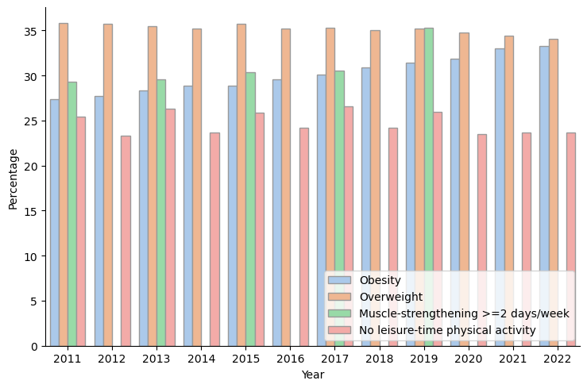
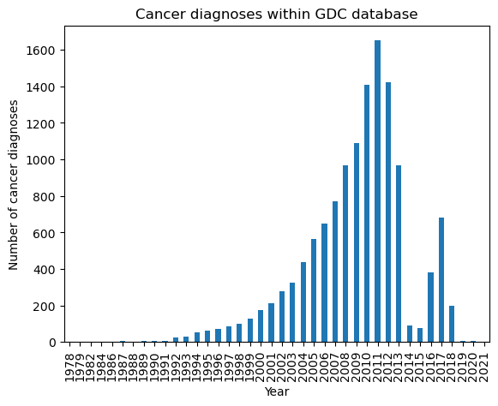
BRFSS | GDC
Data structure and Limitations
BRFSS - Behavioral Risk Factor Surveillance System
Data for aged 18 and older
Data for years 2011 to 2022
GDC - Genomic Data Commons
Submissions are on a free basis. Features may not be submitted (age, residence).
Diagnoses with residence (at enrollment) in U.S. have
max age = 29
number diagnoses for aged 18 and older within U.S. = 3
Drop of submissions
in year
2012/2013/2014
Limitations
Diagnoses in GDC are not restricted by residence (at enrollment) = U.S.
Only data from year 2011 is considered (present in BRFSS and GDC)

Slide 9
Results?

Slide 10
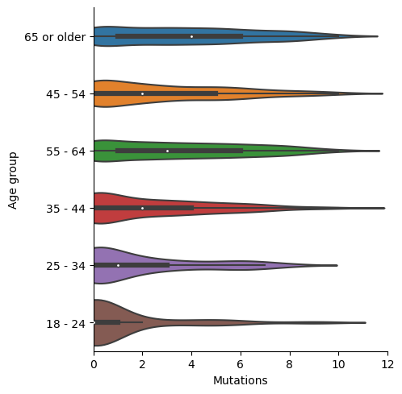
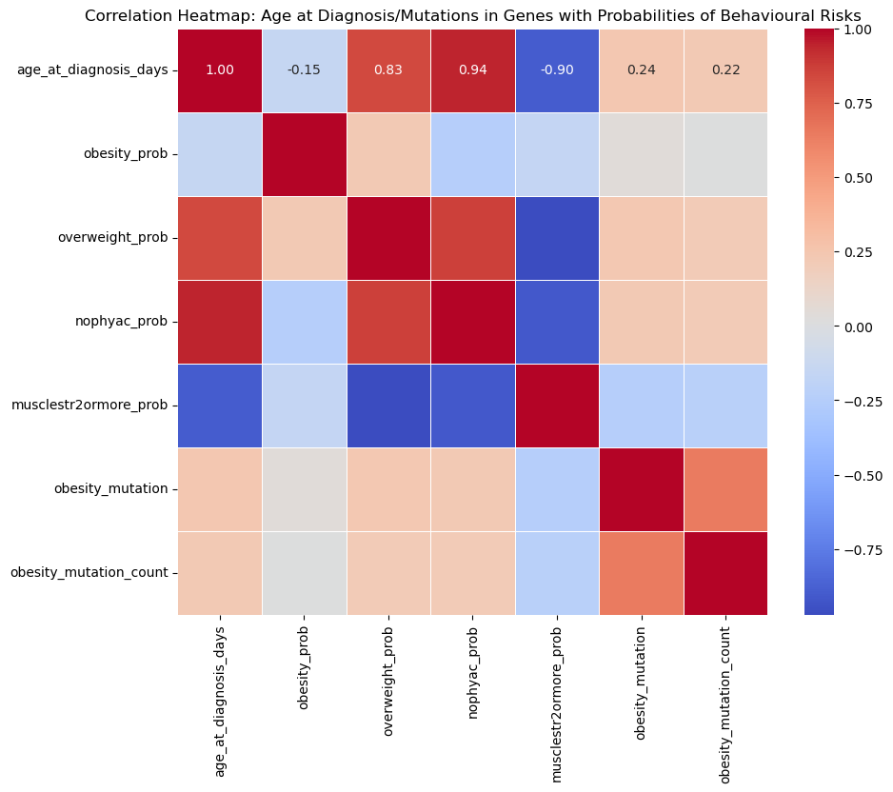
Correlation of BRFSS and Cancer
Based on age at diagnosis
age groups
BRFSS data is aggregating to age groups, therefore GDC data is also aggregated to those age groups with feature age at diagnosis.
Correlation BRFSS and Age at diagnosis
The correlation matrix shows correlation between:
Age at diagnosis and
Probability of muscle strengthening 2 or more days a week (-0.90)
Probability of no physical activity (0.94)
Probability of overweight (0.83)
Other combination do
not show significant correlation.
Patients with higher age most likely have also more mutated genes (related to obesity).

Slide 11
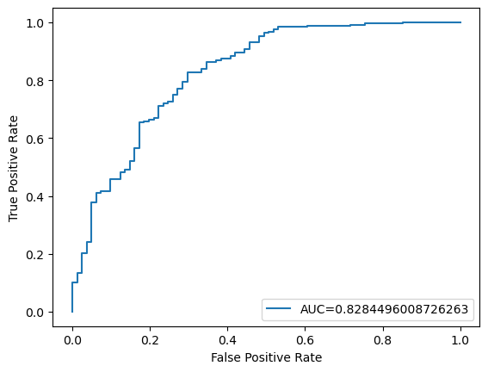
Classification
Binary classification - Logistic Regression
Is there a mutation in one or more genes given behavioral risk factors, age, primary site and disease type?
Logistic Regression classification report | Precision | Recall | F1-Score | Support
0 | 0.90 | 0.47 | 0.62 | 81
1 | 0.85 | 0.98 | 0.91 | 249
accuracy |  |  | 0.86 | 330
macro avg | 0.88 | 0.73 | 0.77 | 330
weighted avg | 0.86 | 0.86 | 0.84 | 330
Good precision for both classes (0: no mutation, 1: mutation), small number in False Positives
Drop in Recall and F1-Score for class 0 (no mutation): Some are classified as class 1 (mutated) but are class 0 (not mutated)
Tend to classify more towards class 1 (mutated).
ROC (Receiver Operator Curve) and AUC (Area under Curve) ok.

Slide 12
Conclusion
The report shows that mutations in genes related to obesity for patients with cancer diagnosis could potentially be linked to the behavioural risk factors.
Further investigations needed and more (complete) data would be beneficial!

Slide 13
Thank you for your attention!

