Slide 2
Don Bosco’s tips
Use time well
Eat and drink moderately
Do what pleases God
Do good to others
Make studious friends
When it’s time to play, play
Concentrate on your work
Above all, pray

Slide 3
Algorithmic Thinking

Slide 4
It’s a mindset
A disciplined way of solving problems
Break into small parts
Solve them all systematically
Combine them
Putting a structure to complex problems, hence simplifying them

Slide 5
But why is this essential?

Slide 6
Why?
To find a solution, start with the MAIN ESSENCE / DEFINITION
What is it? Break down into simple parts, solve each part, combine.
Break how?
Solve how?
Combine how?
‘How’ comes after ‘why’. What do you want to achieve by solving the problem?
Typically the answer looks like “I want the best possible …..”.
Eg: most profitable investment, most time-saving way of doing 5 of my HWs due tomorrow, optimize my schedule for productivity, coding project, doctors prescribing medication.
The answer to ‘how’ usually just comes from what you want to achieve. Requires a lot of thought, but possible.

Slide 7
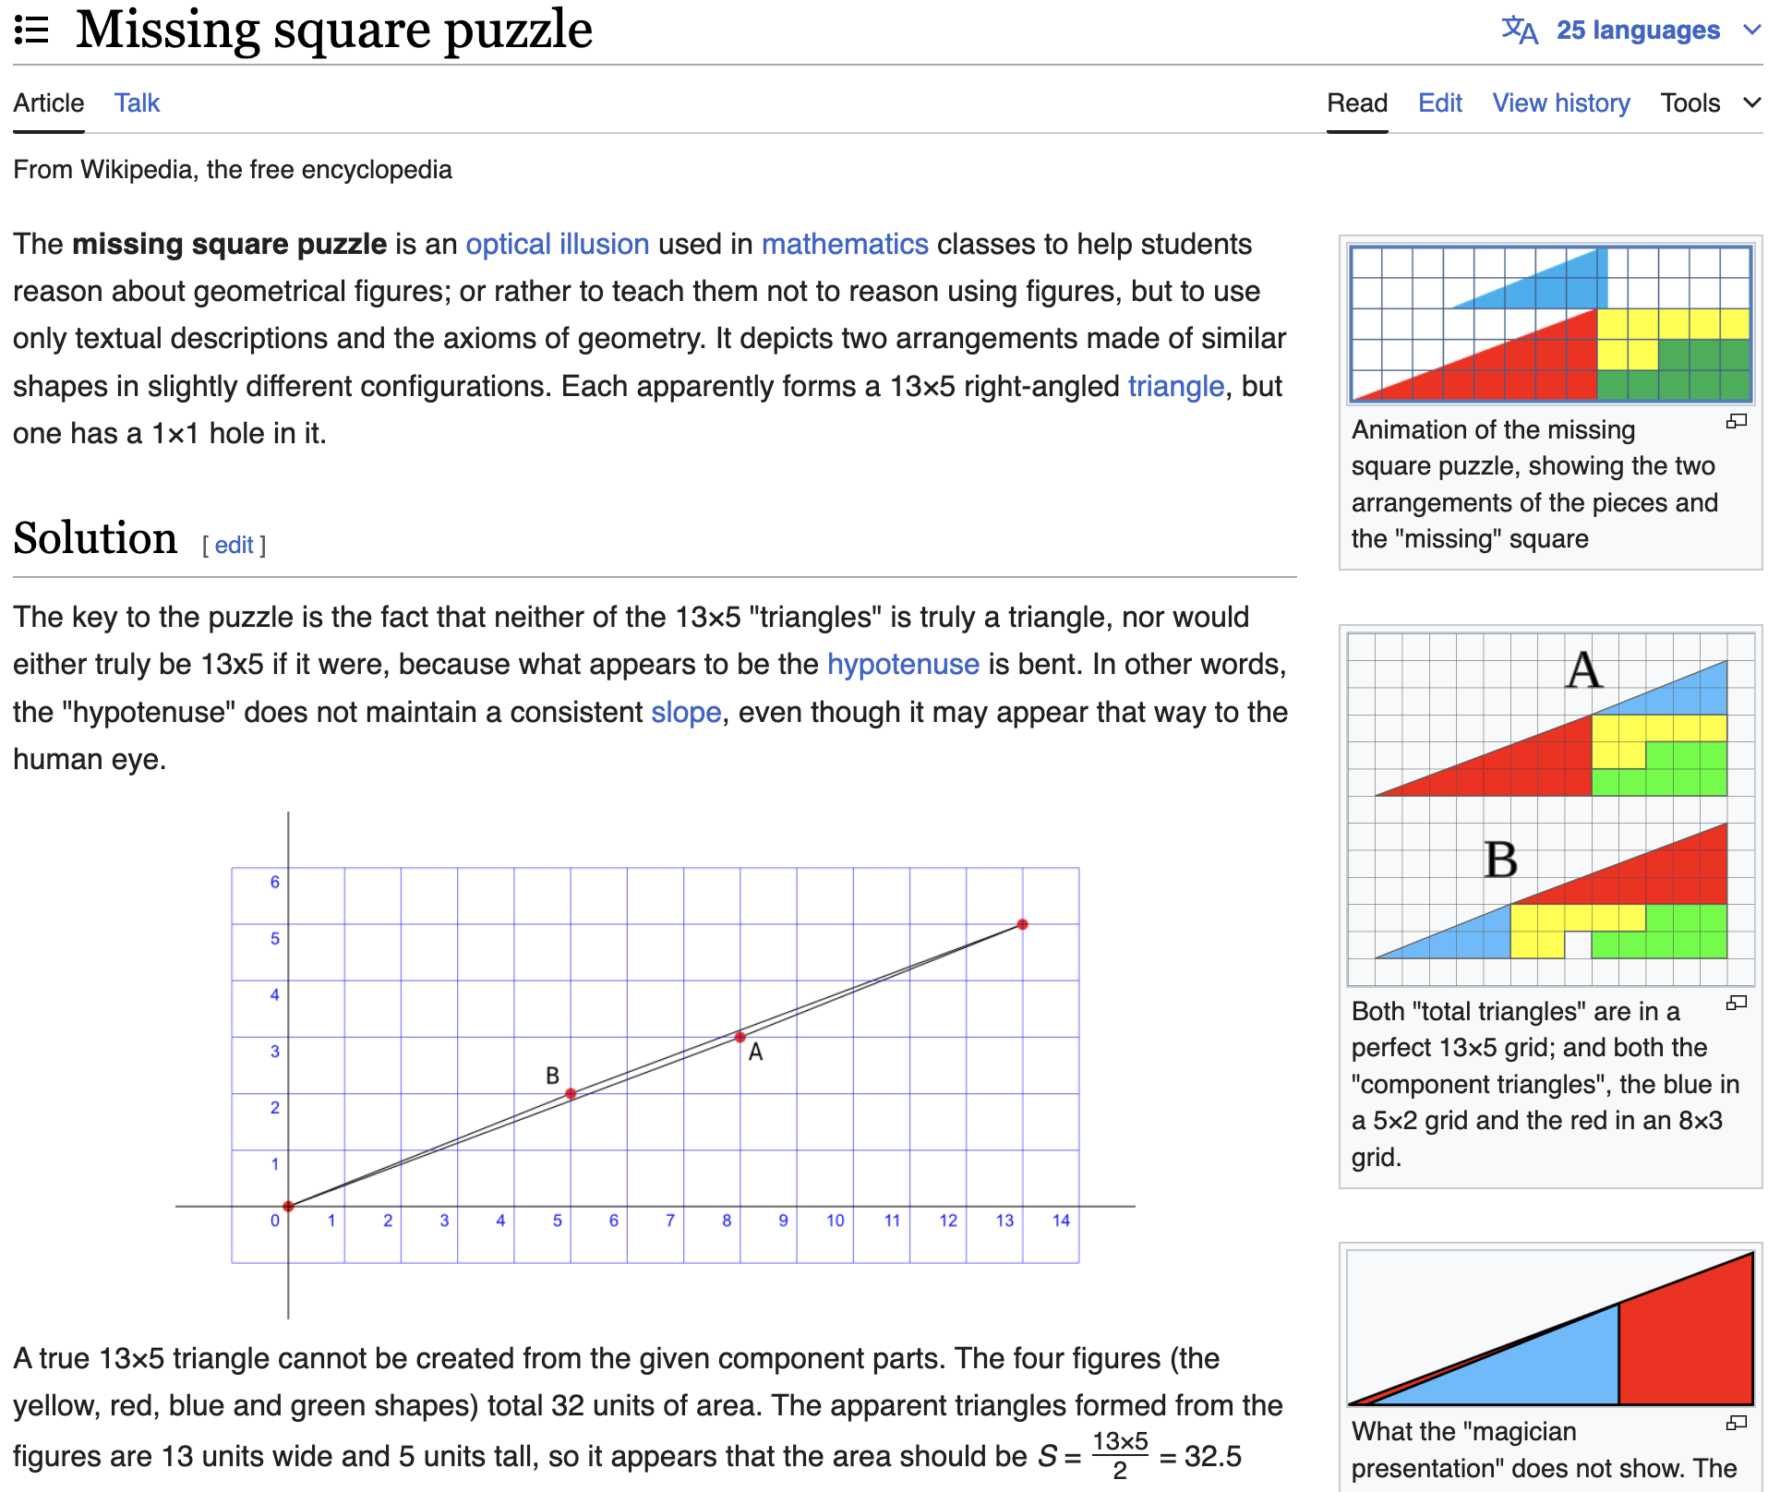
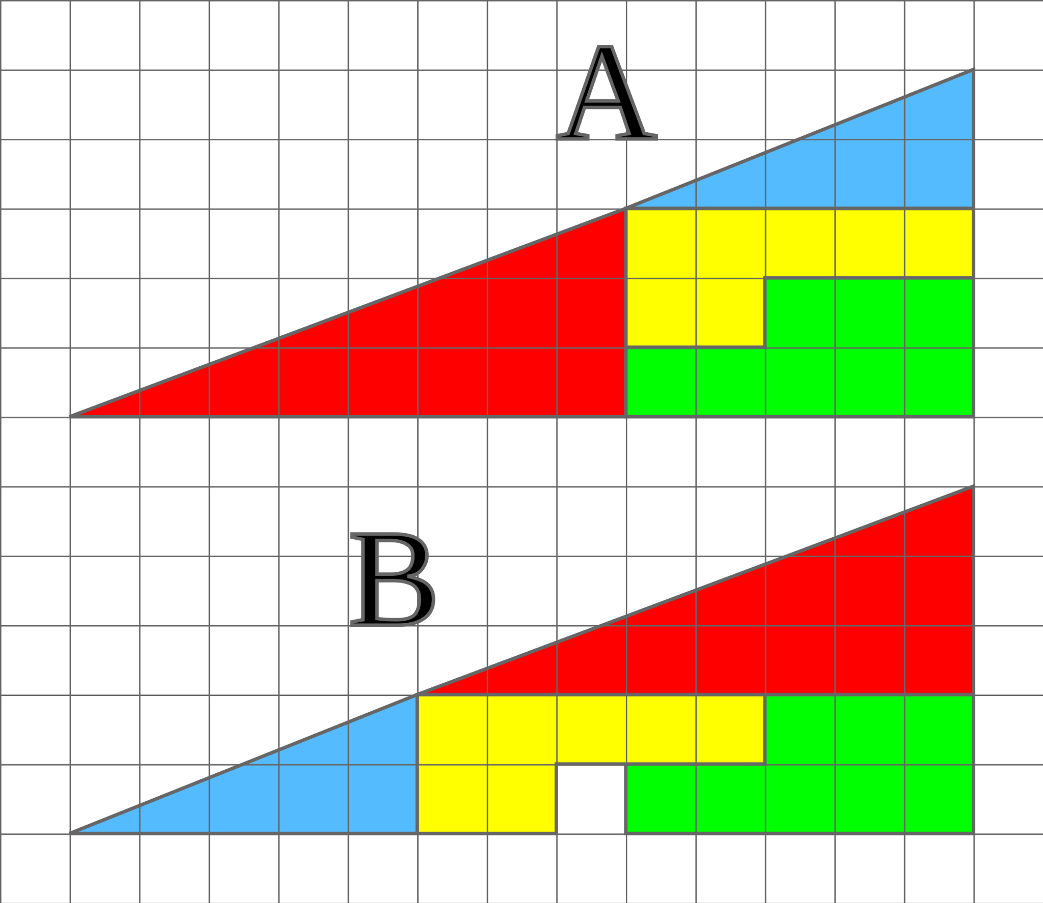
Famous example:
Missing square puzzle

Slide 8
Example: doctors prescribing medication
(Subject to the doctor’s judgement of the situation).
Doc removed some medicines and kept the last medicine to same dosage
Dad asked why not reduce dosage of that as well
Doc’s reply - It’s sticky fat and unless it is zero, can’t risk lowering the dose. But can risk removing the other three meds. Minimum risk.
What if he had lowered - maybe the effect of that med would be reversed.

Slide 9
Example: what people say during filling an important form
“Do you want to take another 30 mins to revise your input OR do you want to risk spending 3 more hours on a fresh form when the current one is rejected?”
Brings me to an important tip during your exams: if you have time, revise your answers.

Slide 10
Why?
Drives Creativity
If you don’t have to think about the same situational problem again and again (i.e., make it a robotic task for yourself), you free up your brain space that processes creativity.
Creativity doesn’t mean just creative writing. It includes coming up with new ways to tackle problems and express yourself. In the exam, in life …
When you do something robotically, you already know the solution along that path. This lets you find/explore new paths. Makes you stand out.
Robert Frost: “Two roads diverged in a wood, and I – I took the one less traveled by, And that has made all the difference.”

Slide 11
Why?
Empowers decision making
Structured thinking lets you abstractify a problem, and solve it within your comfort zone. Being within your comfort zone means that you can draw more meaningful conclusions.
Gives clarity. Hence better decisions.
More information. Hence well-informed decisions.
Very important in technology, social policy designing, business, healthcare…

Slide 12
Why?
Cultivates collaboration
Maybe different people solve different problems.
Eg: some days your dad cooks when your mom’s late from office, and on other days, the mom cooks when your dad is late.
Eg: you divide the tasks of kitchen cleaning, vegetable cutting, cooking, floor cleaning among your hostel mates.
Eg: different teams working on different themes to make Bosco’tsav work as one functioning school fest.

Slide 13
Keywords
Divide-and-conquer
Optimize
Experience (from failure)
Risk/cost minimization
Practise (and hence free up brain space)
Try a different path
Decision-making
Collaboration

Slide 14
A math example of optimization
Ram has a wood for a rectangular fence of perimeter 100m. He wants to build it around his sheep so that it doesn't run away. But Ram also wants to ensure that he gives his sheep the maximum possible grazing area.
What do you do?
2(l+b) = 100
Maximize lb subject to the above and that l,b >= 0.
Could apply various solving techniques - calculus or AM-GM inequality.
Answer is 625 sq m when l = b = 25m.

Slide 15
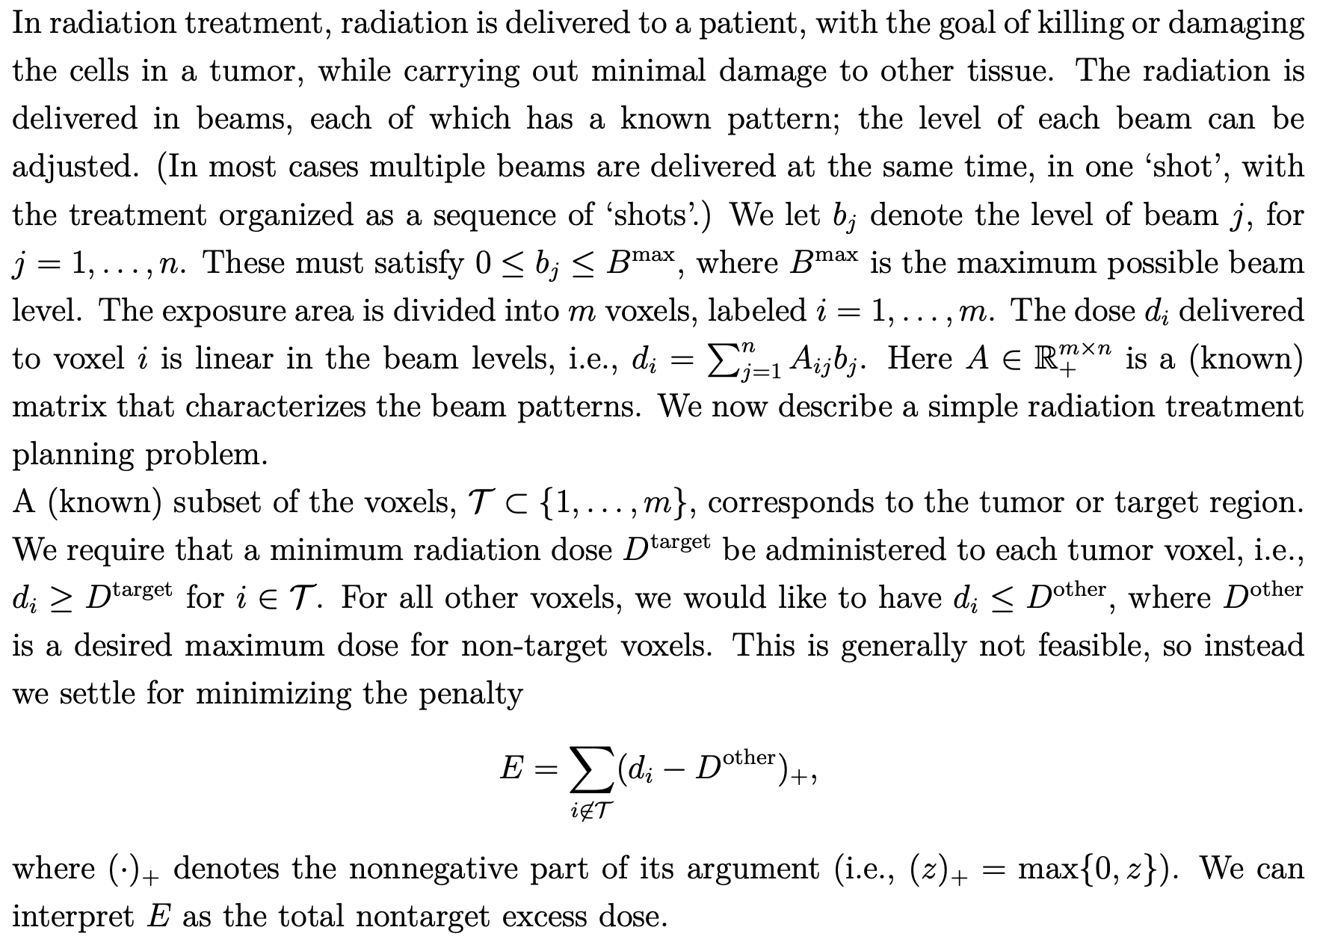
Radiation
Treatment
Planning

Slide 16
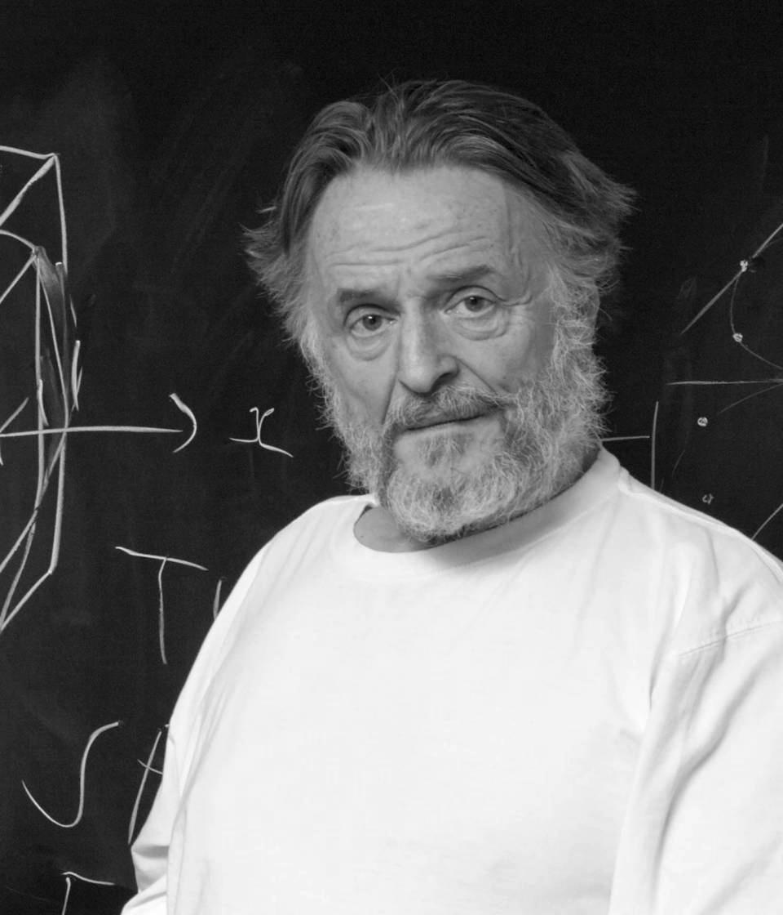

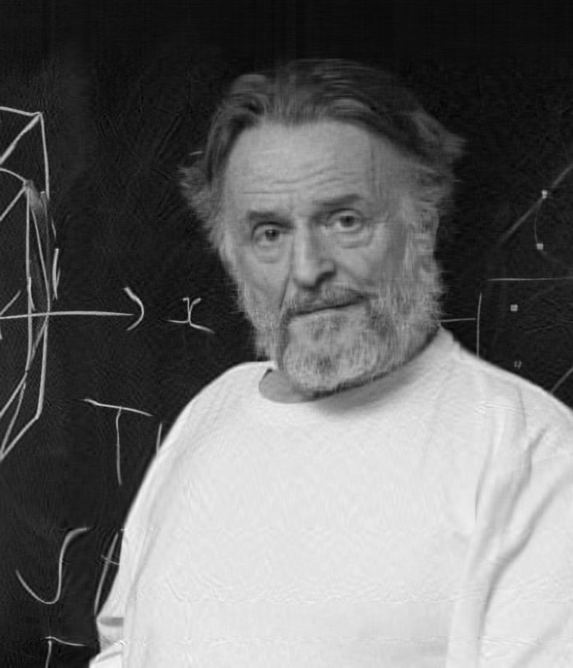


Image Compression
1075200 numbers
742240 less numbers
Less than ⅓ pixels
83240 numbers
166480 numbers
249720 numbers
332960 numbers

Slide 17
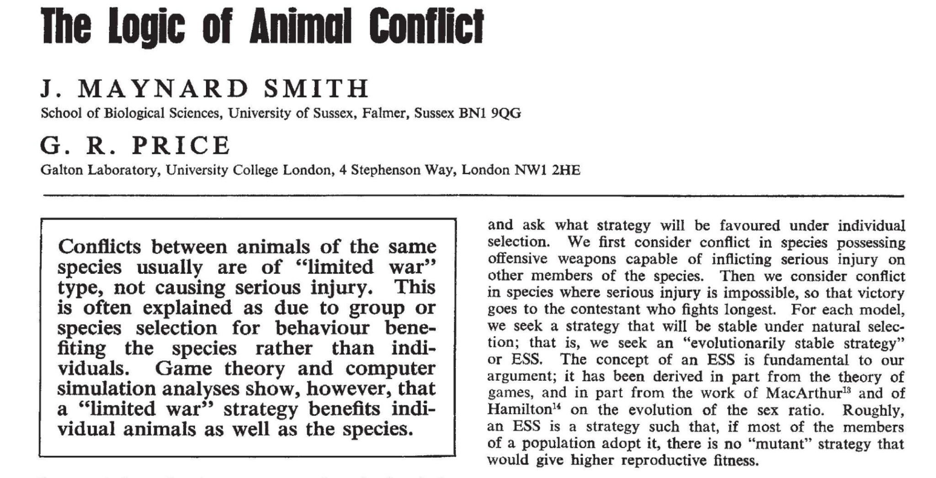
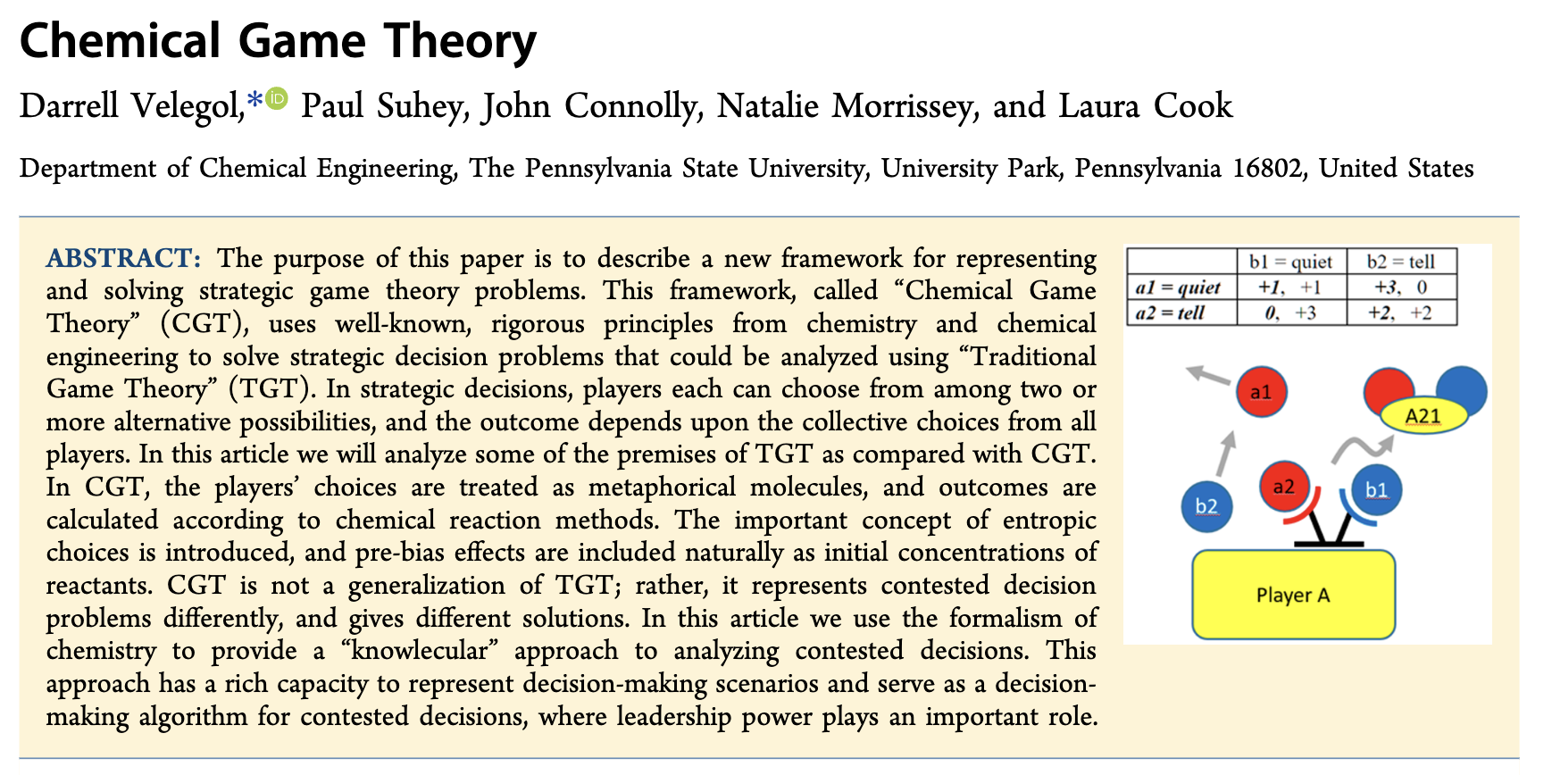
Some more “buzzword” applications
Machine Learning
Market design
Stock prediction
Fair division
Auctions
Analyze fighting behaviour
Evolutionary stable strategy
Chemical Game Theory

Slide 18
The most important takeaway
Discipline and Structure

Slide 19
Some practical qualities/skills to have to survive out there
Whatever you do, do it well.
Practise over and over again even if you know how to do something. Don’t stop until you’re the fastest in the world to solve a given kind of problems.
Get yourself a goal to wake up to everyday. But set a goal you believe you can achieve - it doesn’t matter what others think.
Be open to suggestions from experienced people. Weigh the risks.
Backtrack from that goal, and decide what you need to do next.
Never give up hope if that goals seems too far. Or try something adjacent.
Solve problems daily. Whatever sort of problems. I do CodeForces.
Spend time with yourself.
Never be dishonest. Always help your fellow neighbors.
Never fear to try something out-of-the-box. You never know where the less-taken-path could take you.

Slide 20
Thankyou

