Slide 1
Technical Analysis of EUR/INR Exchange Rate
Pozhil nilavan G
November 7, 2023

Slide 2
Agenda
01. Introduction
02. Data Collection
Explanation about the analysis.
Where we get the Data values from?
03. Analysis
04. Results
05. Conclusion
Analyzing with indicators -Moving Average -Bollinger Bands -CCI (Commodity Channel Index)
Decisions or Results based upon the Analyzing.
Summarize the key findings of our analysis

Slide 3

Introduction
Welcome to our the "Technical Analysis of EUR/INR exchange rate. In this presentation, we will explore the application of various technical analysis techniques to the EUR/INR exchange rate, with the goal of understanding and predicting its price movements. Implementation of key technical indicators, including moving averages, Bollinger Bands, and the Commodity Channel Index (CCI).

Slide 4
Data Collection
In this Analyzing, we collected historical data for the EUR/INR exchange rate to perform our technical analysis. The data was sourced from Yahoo Finance, a trusted and widely used platform for financial data.
The date range selected for our analysis spans from january 1, 2023, to november 2, 2023. This time frame provides a substantial dataset that allows us to apply various technical analysis techniques to gain insights into the price movements of the EUR/INR exchange rate.
Using Yahoo Finance as our data source allows us to access real-time market data and historical price information for the EUR/INR exchange rate, which is essential for our study.

Slide 5
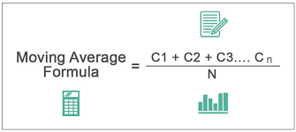
Analysis - Moving Average
Moving averages are fundamental tools in technical analysis, used to analyze and identify trends in the price of financial assets.
These indicators smooth out price data by calculating the average of a set of historical prices over a specific time period. we calculated two essential moving averages for the EUR/INR exchange rate:
1-Day Moving Average (1-Day MA):
This moving average is calculated based on the average closing price of the EUR/INR exchange rate over a single trading day.
1-Week Moving Average (1-Week MA):
The 1-Week MA is calculated based on the average closing price of the EUR/INR exchange rate over the past five trading days (assuming a 5-day trading week).

Slide 6
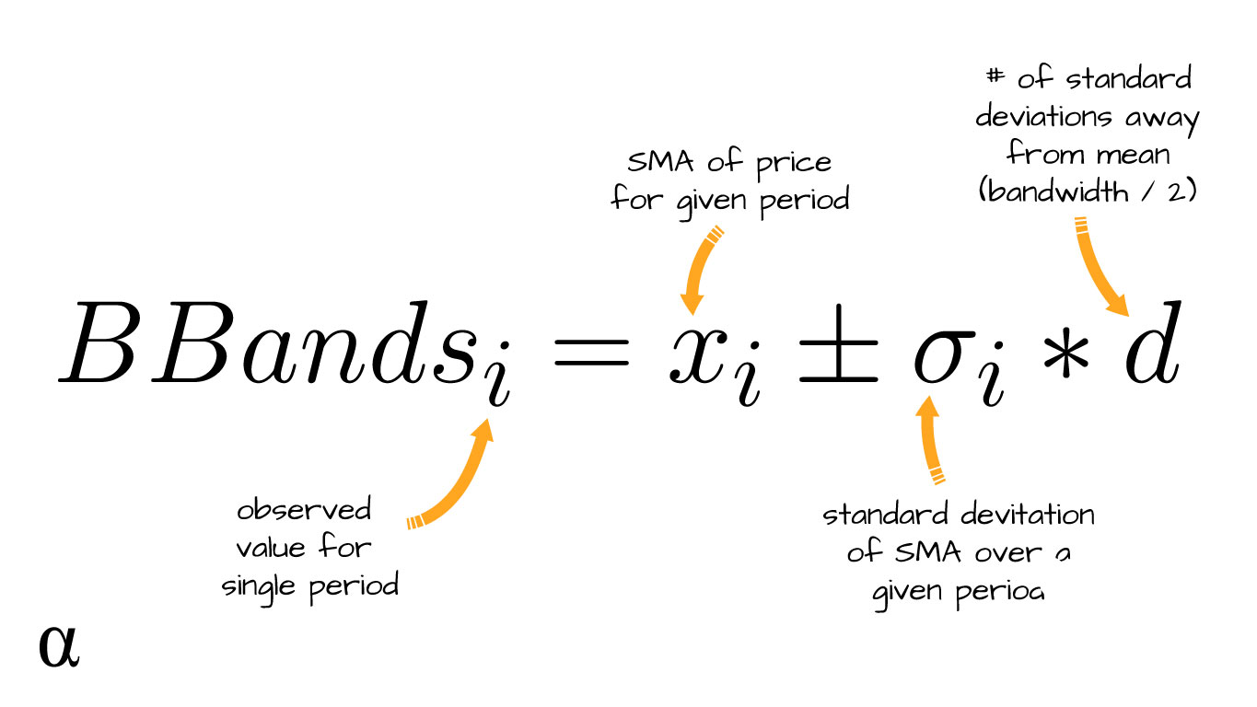
Analysis - Bollinger Bands
Bollinger Bands are a popular technical indicator developed by John Bollinger. They consist of three lines on a price chart: a middle band, an upper band, and a lower band.
These bands are used to understand the price volatility and potential trading opportunities These indicators smooth out price data by calculating the average of a set of historical prices over a specific time period. we calculated two essential moving averages for the EUR/INR exchange rate:
Middle Band: The middle band is typically a 20-day simple moving average (SMA) of the asset's price. It represents the average price over the selected time period.
Upper Band: The upper band is calculated by adding two times the 20-day standard deviation to the middle band. It shows the potential upper resistance level.
Lower Band: The lower band is calculated by subtracting two times the 20-day standard deviation to the middle band.

Slide 7
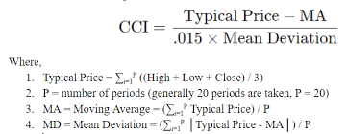
Analysis - CCI (Commodity Channel Index)
The purpose of CCI is to provide insights into an asset's price cycles. It does so by comparing the current price to its historical average, considering the price's deviation from that average.
CCI helps traders spot overbought and oversold conditions and potential shifts in the market's direction.
In our analysis we,
Calculate the typical price for each data point. The typical price is the average of the high, low, and closing prices.
Compute the mean deviation, which measures the average deviation of the typical price from its simple moving average (SMA).
Calculate CCI using the formula: CCI = (Typical Price - 20-day SMA of Typical Price) / (0.015 * Mean Deviation)

Slide 8
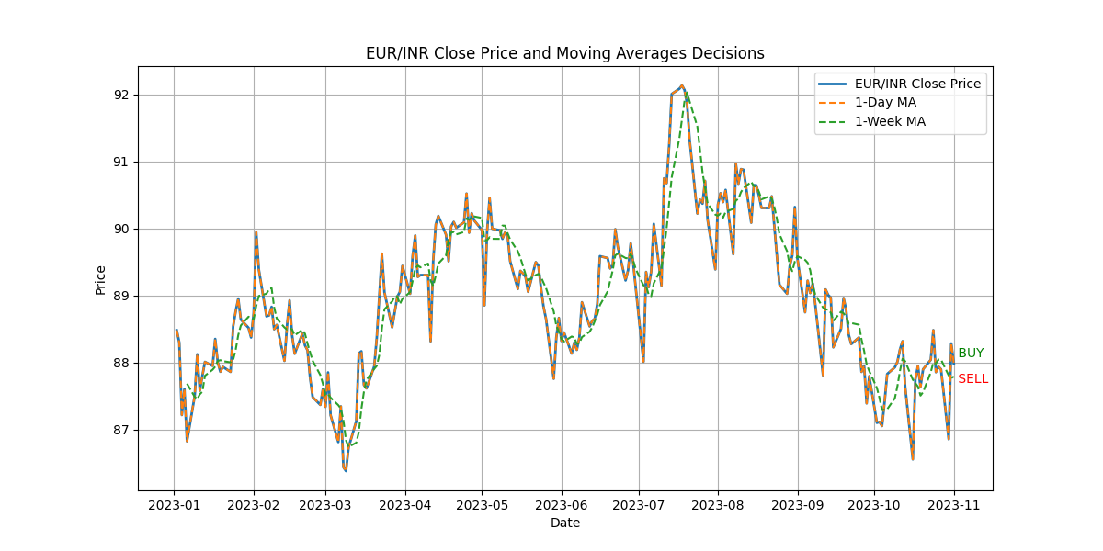
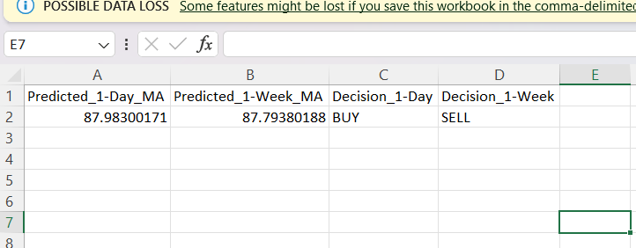
Results - Buy/Sell Decisions Based on Moving Averages:
Buy Signal:
When the 1-Day MA crosses above the 1-Week MA, a "Golden Cross" occurs, signaling a potential buy opportunity.
Sell Signal:
When the 1-Day MA crosses below the 1-Week MA, a "Death Cross" is generated, indicating a potential sell opportunity.
Neutral:
If the two moving averages are very close or nearly equal, it indicates no clear crossover.

Slide 9
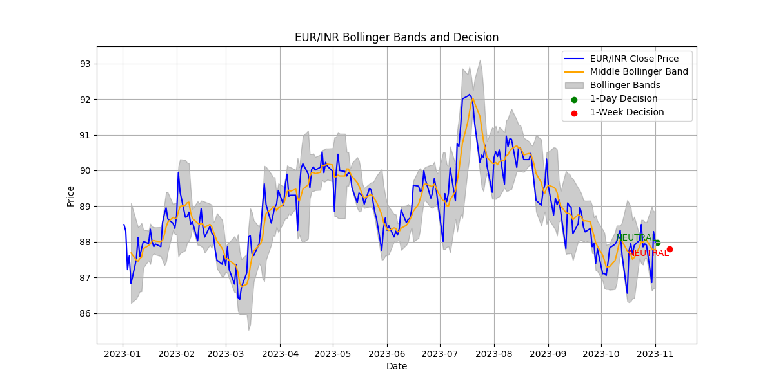
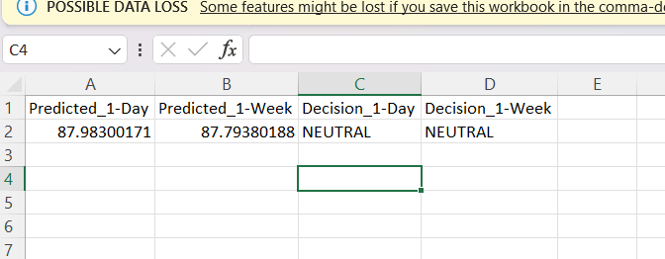
Results - Buy/Sell Decisions Based on Bollinger Bands :
Bollinger Band Squeeze: When the bands squeeze close together, it suggests low volatility. A potential breakout is anticipated. Traders may prepare for a buy/sell signal when the price breaks out of the bands.
Touching or Crossing Bands: When the price touches or crosses the upper band, it may be overbought, indicating a potential sell opportunity. Conversely, when the price touches or crosses the lower band, it may be oversold, signaling a potential buy opportunity.
Price Inside Bands: If the price stays within the bands, it suggests a ranging market with no clear trend. In this case, traders may opt for a "NEUTRAL" position, as there is no immediate buy/sell signal

Slide 10
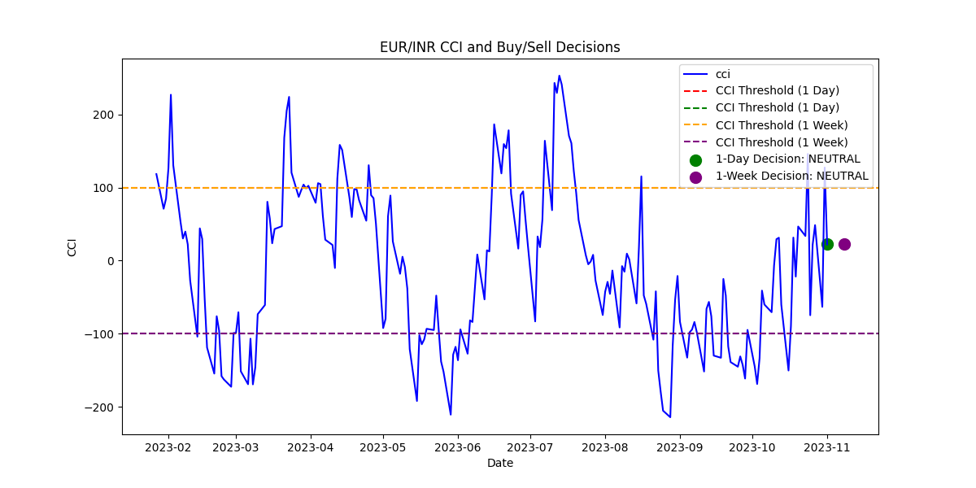
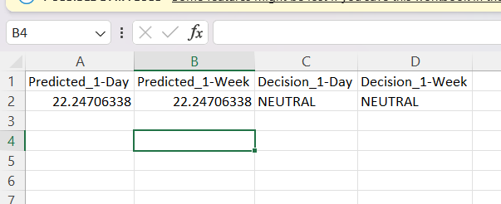
Results - Buy/Sell Decisions Based on CCI:
CCI Above Threshold (e.g., +100): When CCI values rise above a predefined threshold, such as +100, it suggests overbought conditions, indicating a potential sell opportunity.
CCI Below Threshold (e.g., -100): When CCI values drop below a specified threshold, like -100, it suggests oversold conditions, signaling a potential buy opportunity.
CCI Between Thresholds: When CCI values remain between the established thresholds, it indicates a ranging market with no clear trend. In such cases, traders may choose a "NEUTRAL" position as there is no immediate buy/sell signal

Slide 11
Conclusion
In conclusion, our analysis has showcased the practical application of technical analysis in the market of currency exchange rates.
The insights and methodologies explored here are valuable assets for traders and investors looking to navigate the complexities of financial markets.
each technical analysis method has its unique way of interpreting market data and generating buy/sell decisions. The differences in decisions are a result of the distinct criteria and parameters used by each method.
Traders often use a combination of these methods and additional analysis to make well-informed trading decisions.

Slide 12

Thank you
.
Pozhilnilavan G
nilavanpoz123@gmail.com

